Slide 1

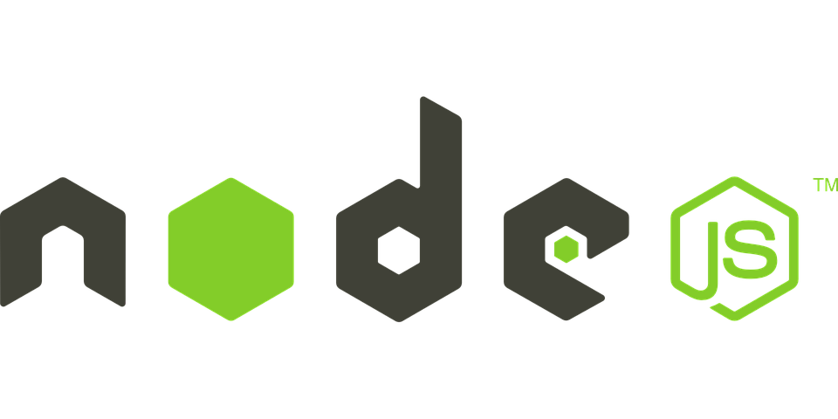

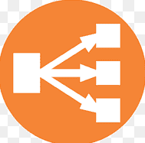










vpc 10.0.0.0/16
eu-central-1c
subnet-public 10.0.160.0/20
subnet-private 10.0.208.0/21
eu-central-1b
subnet-public 10.0.144.0/20
subnet-private 10.0.200.0/21
eu-central-1a
subnet-public 10.0.128.0/20
subnet-private 10.0.192.0/21
NOT WORKING
security-group-ec2
security-group-db
ElasticIP
NLB
EC2 istance
VPC endpoint
RDS istance
Internet gateway
IAM Role
Let EC2 istance to read secret
SecretsManager
User /Password
db domain

Slide 2

vpc 10.0.0.0/16
eu-central-1c
subnet-public 10.0.160.0/20
subnet-private 10.0.208.0/21
eu-central-1b
subnet-public 10.0.144.0/20
subnet-private 10.0.200.0/21
eu-central-1a
subnet-public 10.0.128.0/20
subnet-private 10.0.192.0/21
NOT WORKING
security-group-ec2
security-group-db
ElasticIP
NLB
EC2 istance
RDS istance
Route53
Private hosted zone
Internet gateway
IAM Role
Let EC2 istance to read secret
SecretsManager
User /Password
db domain

Slide 3
vpc 10.0.0.0/16
vpc default
Test
Route53 on vpc default
Le connessioni Rosse funzionano se si punta direttamente all’endpoint RDS e non al DNS
Per le gialle funziona la risoluzione DNS ma non sembra funzionare l’accesso da applicazione node.js
eu-central-1c
subnet-public 10.0.160.0/20
subnet-private 10.0.208.0/21
subnet-public 172.31.0.0/20
eu-central-1b
subnet-public 10.0.144.0/20
subnet-private 10.0.200.0/21
subnet-public 172.31.32.0/20
eu-central-1a
subnet-public 10.0.128.0/20
subnet-public 10.0.176.0/21
Subnet default 172.31.16.0/20
security-group-ec2
security-group-db
security-group-ec2
security-group-db
security-group-ec2
security-group-db
EC2 istance
RDS istance
EC2 istance
RDS istance
EC2 istance
RDS istance
Route53
Private hosted zone
Internet gateway
IAM Role
Let EC2 istance to read secret
SecretsManager
User /Password
db domain

Slide 4
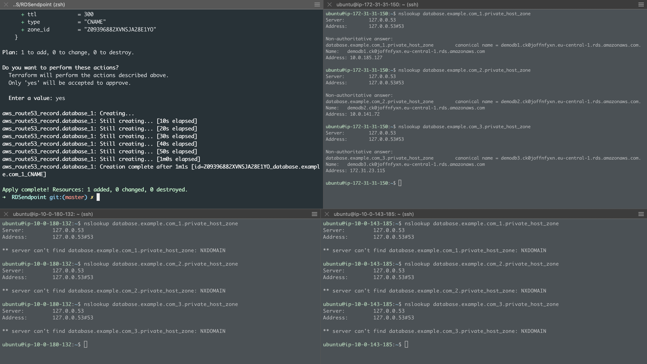
public on default VPC
Public on custom VPC
private on custom VPC

Slide 5
vpc 10.0.0.0/16
vpc default
Test
Route53 on vpc custom
Red connections work only if you use the original RDS endpoint (Route53 doesn’t resolve the domain name)
For Yellow connections DNS resoluiton works but the node.js app doesn’t render the DB. Probably a VPC peering must be activated
eu-central-1c
subnet-public 10.0.160.0/20
subnet-private 10.0.208.0/21
subnet-public 172.31.0.0/20
eu-central-1b
subnet-public 10.0.144.0/20
subnet-private 10.0.200.0/21
subnet-public 172.31.32.0/20
eu-central-1a
subnet-public 10.0.128.0/20
subnet-public 10.0.176.0/21
Subnet default 172.31.16.0/20
security-group-ec2
security-group-db
security-group-ec2
security-group-db
security-group-ec2
security-group-db
EC2 istance
RDS istance
EC2 istance
RDS istance
EC2 istance
RDS istance
Route53
Private hosted zone
Internet gateway
IAM Role
Let EC2 istance to read secret
SecretsManager
User /Password
db domain

