Slide 1

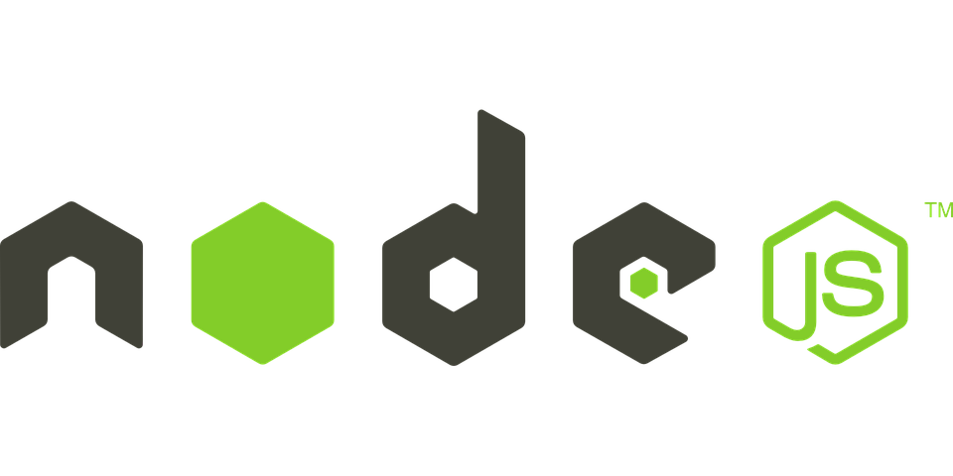


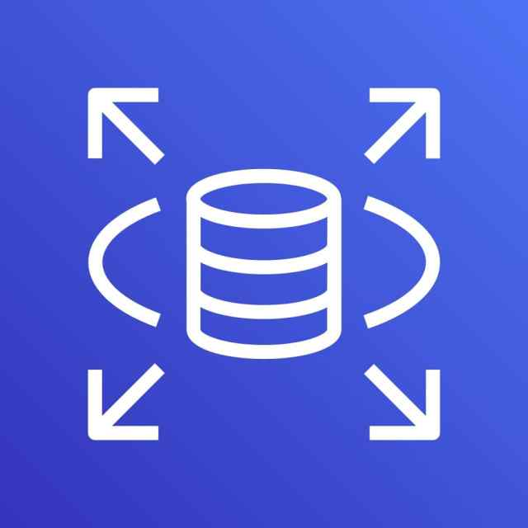







vpc-default
subnet-default
security-group-ec2
security-group-db
EC2 istance
RDS istance
ElasticIP
IAM Role
Let EC2 istance to read secret
Route53
Private hosted zone
SecretsManager
User
Password
db domain

