Slide 1

Can Capacity Markets foster Investment? Evidence from US-American Independent System Operators
Máté Borvendég, Susanne Hantke
Technische Universität München
TUM School of Management
Center of Energy Markets
Munich, 26th May 2023

Slide 2
Contents
Introduction
Capacity Markets
2.1. Basic Functionality
2.2 New York Installed Capacity Market
Analysis
3.1 Data
3.2 Methodology
Hypothesis
Current Difficulties

Slide 3
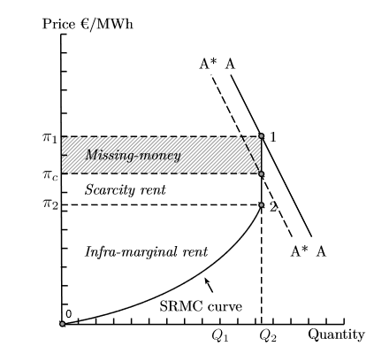
1. Introduction
Missing Money Problem in Energy-only Markets
Price for electricity derived by operating costs (merit order)
Idea: Recover fixed costs during times when demand > supply (scarcity price)
Problem:
Scarcity price too low due to price cap or
Times with demand > supply do not occur sufficiently often/do not last long enough
Price cap: A*
From: See, P. C., Fosso, O. B., Wong, K. Y., & Molinas, M. (2015). Flow-based forward capacity mechanism: an alternative to the regulated capacity remuneration mechanisms in electricity market with high RES penetration. IEEE Transactions on Sustainable Energy, 7(2), 830-840.

Slide 4
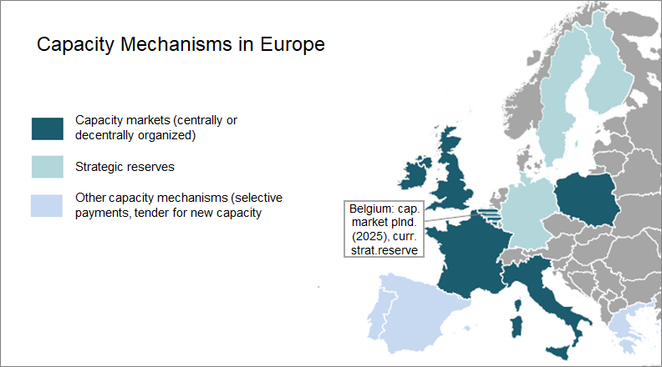
1. Introduction
Possible Solutions to the Missing Money Problem
Some capacity markets, but quite new
Few data points due to annual auctions
Adapted from: Kapazitätsmechanismen in Europa – Umsetzung der grenzüberschreitenden Beteiligung aus Sicht der Übertragungsnetzbetreiber, Schleich S, TransnetBW GmbH, 2020

Slide 5
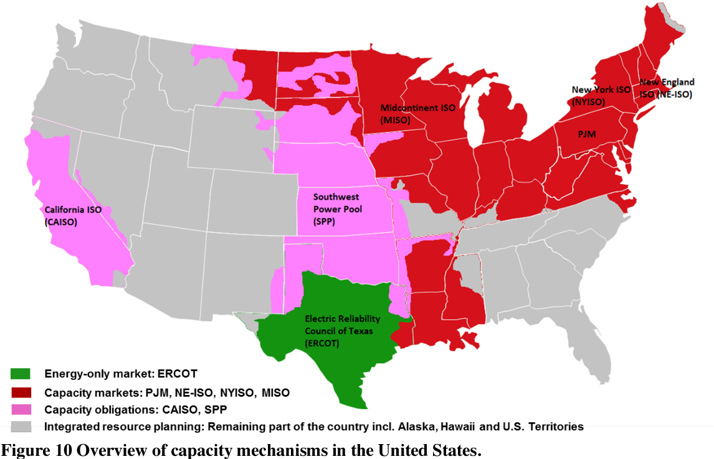
1. Introduction
Research Question
Can Capacity Markets foster Investment?
Evidence from US-American Independent System Operators
à Focus on NY ISO
From: Botterud, A., & Auer, H. (2020). Resource Adequacy with Increasing Shares of Wind and Solar Power: A Comparison of European and U.S. Electricity Market Designs. Economics of Energy and Environmental Policy, 9.

Slide 6
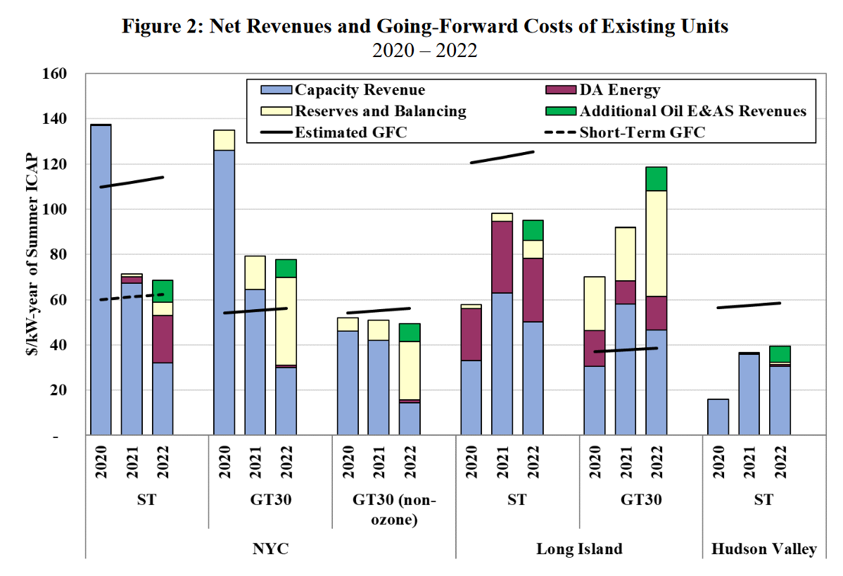
2. Capacity Markets
2.1 Basic Functionality
In addition to electricity market
Expansion of the energy-only market by a market for capacity
Revenue stream to recover fixed costs
Auctions:
Bids for capacity [MW] instead of bids for electricity [MWh]
Selling availablility of generation capacity in the long term
Source: NY Control Area Installed Capacity Requirement Technical Report for May14-Apr15, New York State Reliability Council, LLC, Installed Capacity Subcommittee, 2013
From: Potomac Economics (2023). 2022 State of the Market Report for the New York ISO Markets, Market Monitoring Unit for the NY ISO

Slide 7
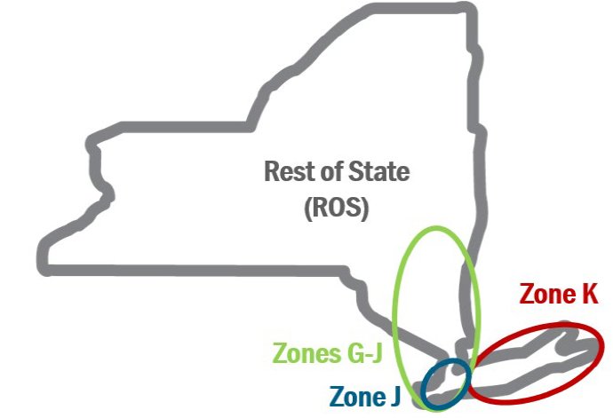
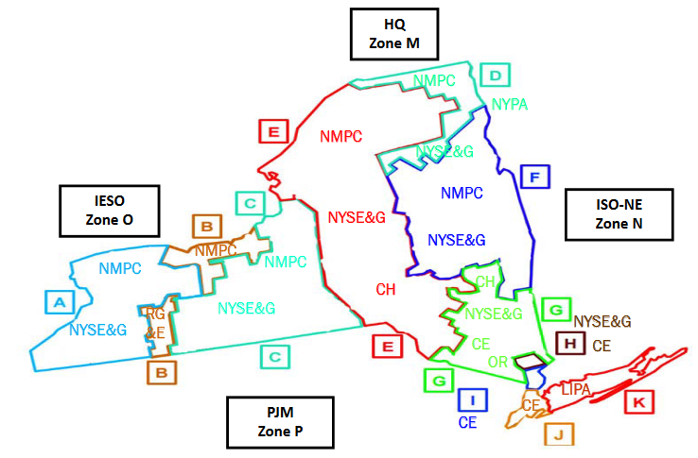
2. Capacity Markets
NYCA
2.2. New York Installed Capacity Market (ICAP)
Long Island
Since the formation of the NY ISO in 1999
11 balancing zones → 4 localities
2 capability periods: summer, winter
3 different kinds of auctions:
Compulsory (spot)
Optional (monthly, strip)
Installed capacity requirement derived from load forecast, adjusted by safety margin (IRM) and tailored to localities
G-J
NYC
Island
From: NYISO Training Documents: Installed Capacity (ICAP) Market, LSEs Capacity Obligations (https://www.nyiso.com/documents)

Slide 8
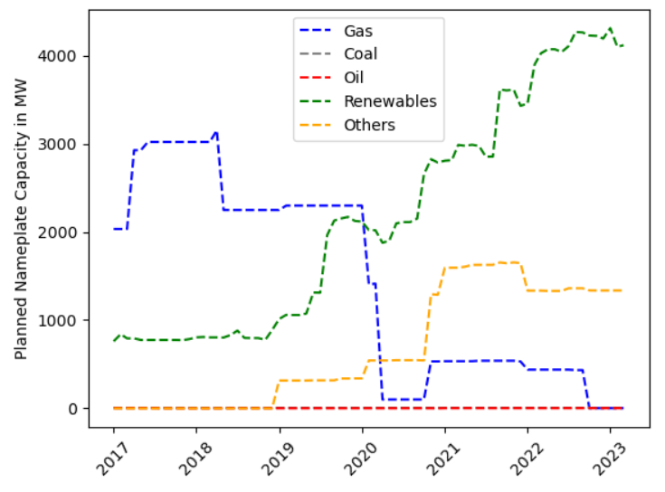
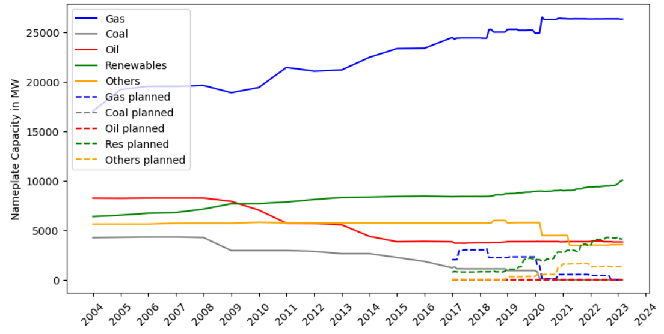
3. Analysis
3.1 Data – Generation Capacity
Installed Capacity Resources 2023: ca. 40 GW
Source: NPCC 2022 Interim New York Area Review of Resource Adequacy, NYISO, 2022
Preliminary Monthly Electric Generator Inventory (https://www.eia.gov/electricity/data/eia860M/)
Planned Capacity
Installed Capacity

Slide 9
3. Analysis
3.1 Data – ICAP capacity prices
From: NYISO Market Prices, Custom Report for Day-Ahead Electricity Prices, NYISO, 2023 (https://www.nyiso.com)

Slide 10
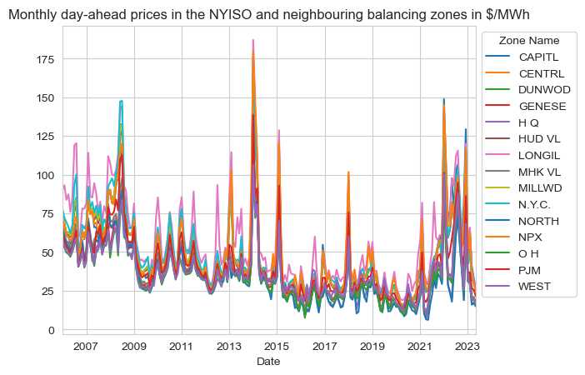
3. Analysis
3.1 Data – Wholesale Electricity and Fuel Prices
From: NYISO Market Prices, Custom Report for Day-Ahead Electricity Prices, NYISO, 2023 (https://www.nyiso.com)

Slide 11
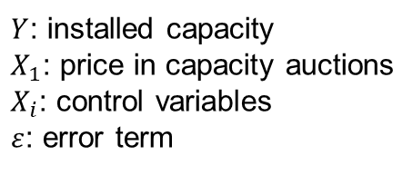
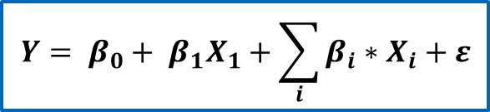
3. Analysis
3.2 Methodology – Regression Analysis
Research question: Can capacity markets foster investment?
Capturing it via an econometric model:
Dependent variable:
Available/planned generation capacity OR
Change in available generation capacity
Independent variables:
Capacity market prices
Revenue/cost drivers
Wholesale electricity and reserve prices
Wholesale fuel prices
Installed Reserve Margin (IRM), demand, UCAP
$$Y= β_{0}+ β_{1}X_{1}+\sum_{i}{β_{i}∗X_{i}}+ε$$
$Y$: installed capacity
$X_{1}$: price in capacity auctions
$X_{i}$: control variables
$ε$: error term

Slide 12
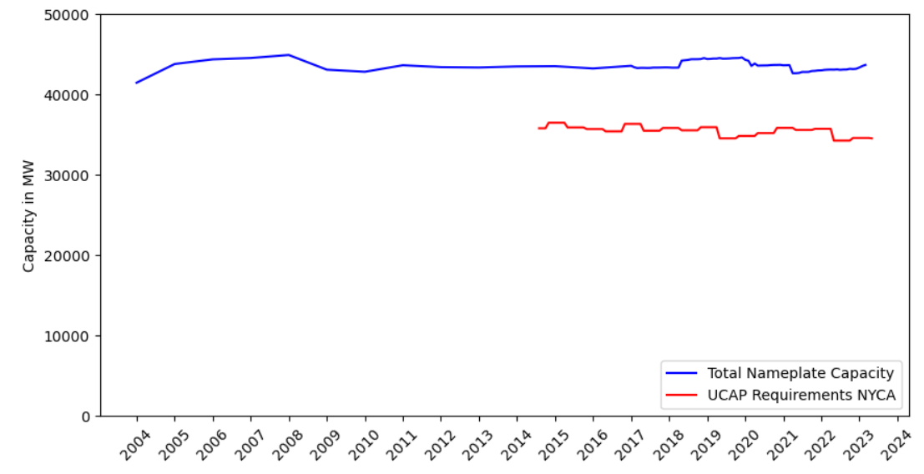
4. Hypothesis
Can Capacity Markets foster Investment?
Adequacy achieved
More capacity installed than required
Hypothesis: Yes, but inefficiently

Slide 13
5. Current Difficulties
Complex market structure
Using zonal and locational prices
Analysing multiple technologies
Assignment of plants to zones and localities unclear
Potential time lag between auction and induced investment
Including lagged variables
Time-series regression, co-integration analysis
High number of factors potentially influencing investment
Control variables, statistical significance
Co-integration, multicollinearity test

Slide 14
Thank you for your attention!

Slide 15
Back-up slides

Slide 16
Capacity Markets
Capacity markets are an answer to the missing money problem, they provide revenues for availability of generators
NYISO operates monthly capacity auctions in 4 localities to reflect transmission system constraints
The goal of the NYISO power markets is to provide efficient signals for investment, mainenance and retirement decisions
Analysis
The main drivers of capacity prices are available generation, peak demand, and transmission constraints
Annual and monthly electricity generation capacities show high variance in gas and renewable capacity
Fuel costs, capacity prices, power and reserve prices and other control variables are collected to analyse their impact on available and planned power plant capacities

Slide 17
5. Current Difficulties
Complex market structure
Capturing congestion via zonal and locational prices
Including the structure of the generation fleet
Controlling for fuel prices, reflecting for political signals
Potential time lag between auction and induced investment
Including lagged variables to capture construction time
Choosing the right model for time-series regression, co-integration analysis to check for long-term, VEC model for non-stationary time-series data
High number of factors potentially influencing investment
Include different control variables, and check their statistical significance
Keep the model consistent via co-integration and multicollinearity test

Slide 18
Back-up slides
Definitions: A
Capacity = "The rated continuous load-carrying ability, expressed in megawatts (“MW”) or megavolt-amperes (“MVA”) of generation, transmission or other electrical equipment." A
Availability = "A measure of time a generating unit, transmission line, or other facility is capable of providing service, whether or not it actually is in service. Typically, this measure is expressed as a percent available for the period under consideration."

Slide 19
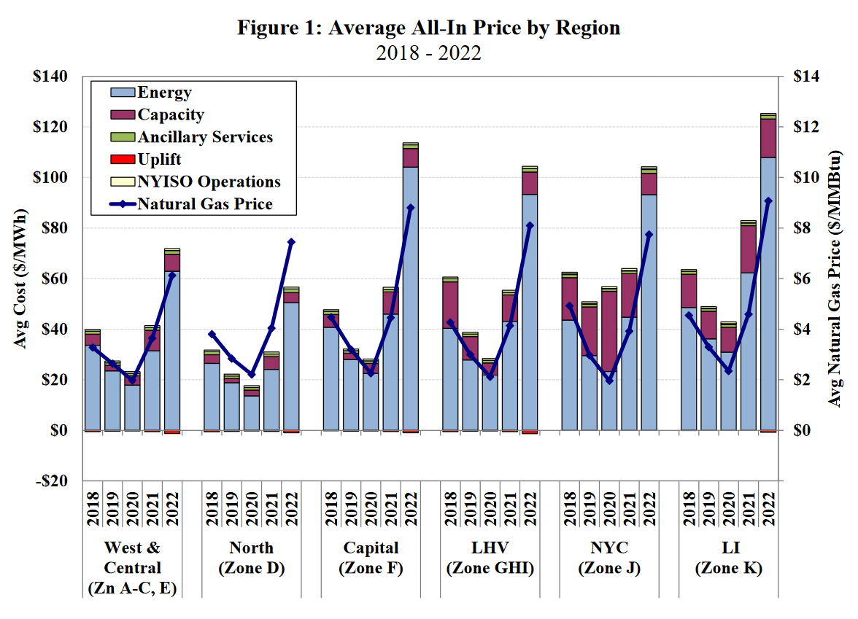

Slide 21
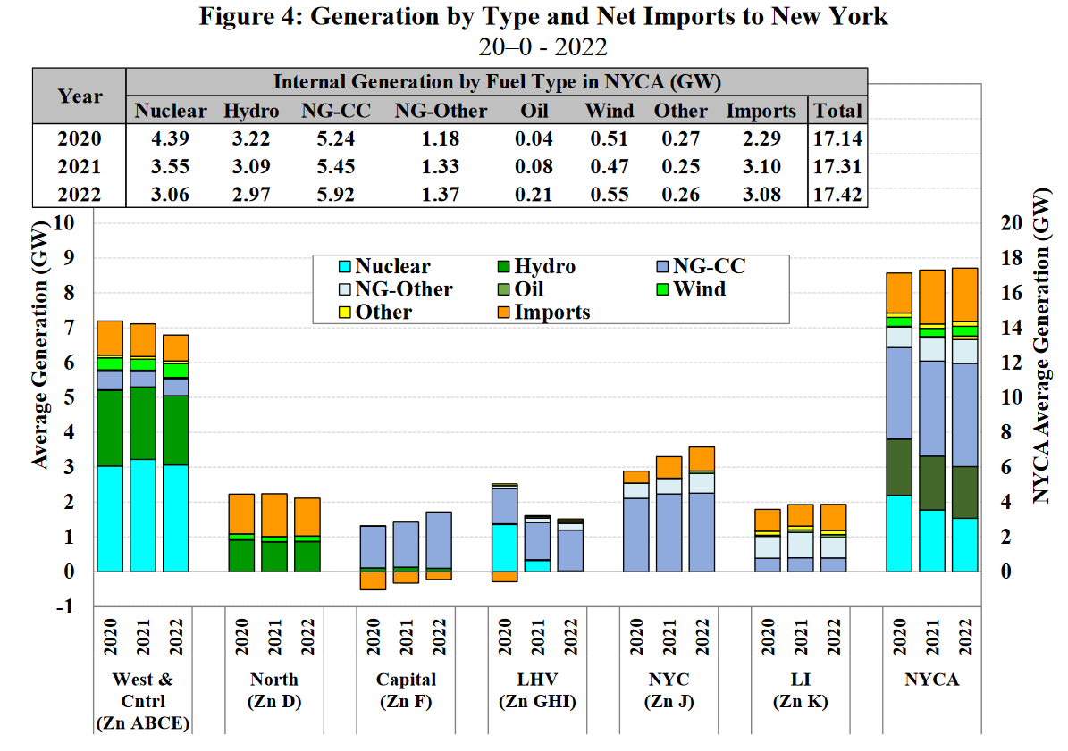

Slide 22
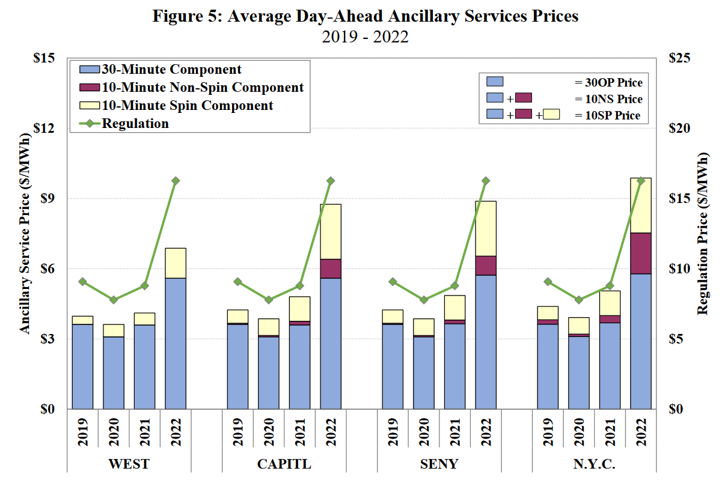

Slide 23
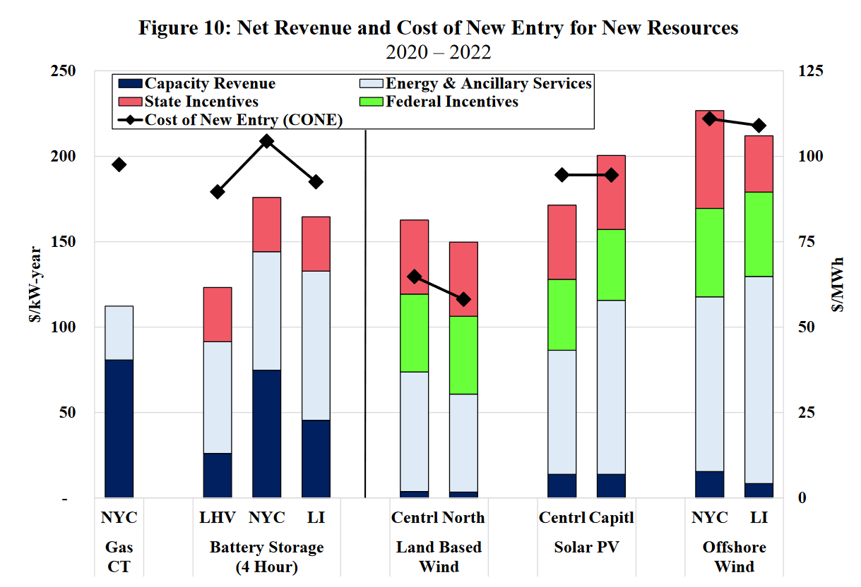

Slide 24
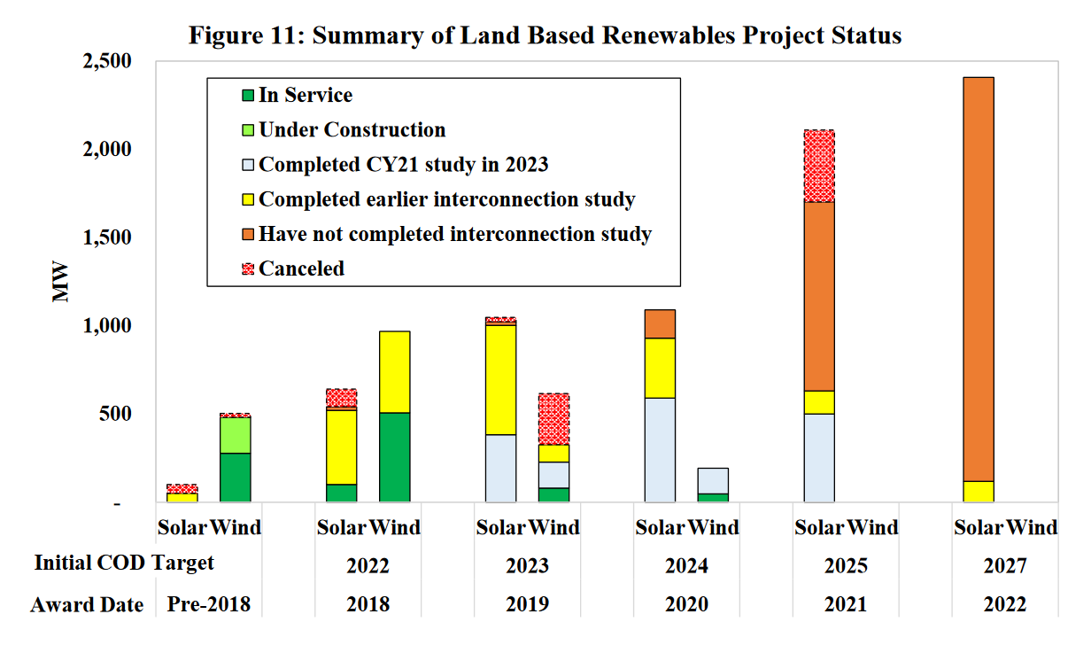

Slide 25
References
https://www.nysrc.org/pdf/Reports/2014%20IRM%20Report%20Appendicies%20%20Final%2012-6-13.pdf

