Slide 1

Can Capacity Markets ensure sufficient Investment in Power Generation? Evidence from US-American Independent System Operators
Máté Borvendég, Susanne Hantke
Technische Universität München
TUM School of Management
Center of Energy Markets
Munich, 22st June 2023

Slide 2
Contents
Introduction
1.1 Relevance for the Topic
1.2 Research Question
1.3 Methodology
Context and Data
Empirical Strategy
Results
Discussion
Conclusion
References

Slide 3
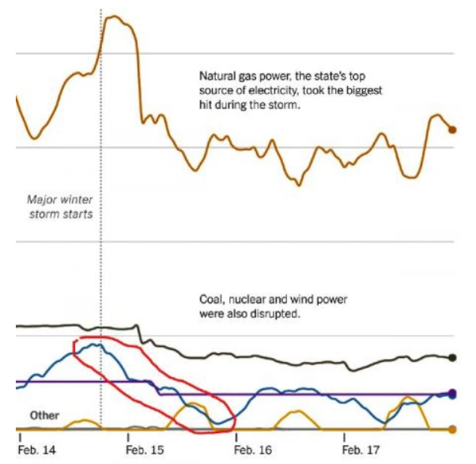
1. Introduction – Relevance for the Topic
How to ensure sufficient investment in generation capacity?
Two approaches:
Missing money problem in energy-only markets
Price for electricity derived by operating costs (merit order)
Idea: Recover fixed costs during times when demand > supply (scarcity price)
Problem:
Scarcity price too low due to price cap or
Times with demand > supply do not occur sufficiently often/do not last long enough
Potential lack of investment leads to blackouts
Winter storms in Texas (2011)
Regulate electricity prices (“energy only”).
Regulate the quantity and quality of generating capacity.
Example Texas (ERCOT):
Market prices are best → energy-only concept
From: https://stoft.com/2021/02/frozen-electric-blackouts-intexas/

Slide 4
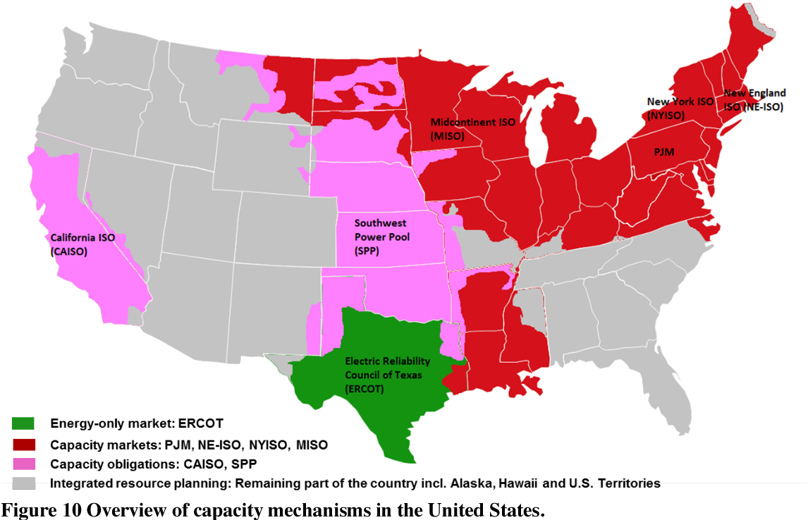
1. Introduction – Research Question
Can Capacity Markets ensure sufficient Investment in Power Generation?
Evidence from US-American Independent System Operators
à Focus on NY ISO
From: Botterud, A., & Auer, H. (2020)

Slide 5



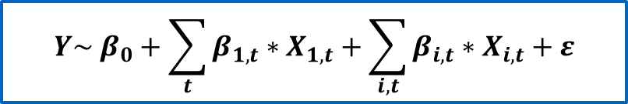


1. Introduction – Methodology
Multiple Regression Analysis
Dependent variable:
Change in generation capacity or difference between capacity and demand:
$Y_{A}= {ΔGeneration}_{installed}$
$Y_{B}= {Generation}_{installed}$ $− {Demand}_{Peak}$
Independent variables:
Capacity market prices
Day-ahead electricity prices
Wholesale fuel prices
UCAP
$$Y\sim β_{0}+\sum_{t}{β_{1,t}∗X_{1,t}}+\sum_{i, t}{β_{i, t}∗X_{i, t}}+ε$$
$Y$: installed capacity
$X_{1,t}$: price in capacity auctions
$X_{i, t}$: control variables
$ε$: error term
Potential problem with multicollinearity

Slide 6

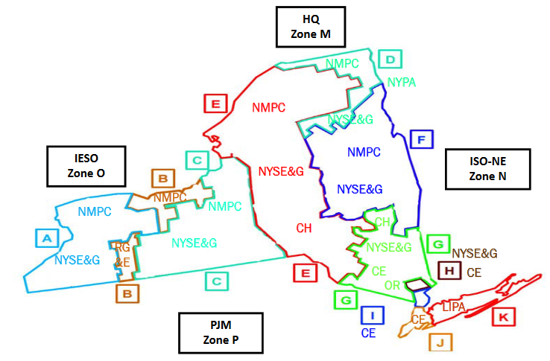
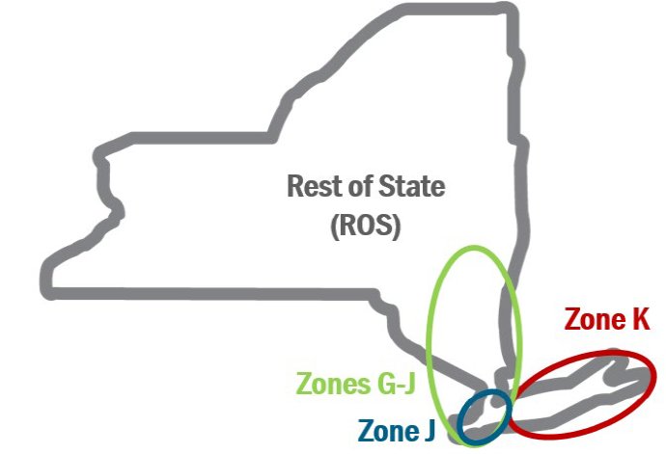


2. Context and Data
New York Installed Capacity Market (ICAP)
Since the formation of the NY ISO in 1999
3 different kinds of auctions:
Compulsory (spot)
Optional (monthly, strip)
Installed capacity requirement:
Derived from load forecast
Adjusted by safety margin (IRM)
Tailored to the 4 localities
NYCA
Long Island
G-J
NYC
From: NYISO Training Documents

Slide 7
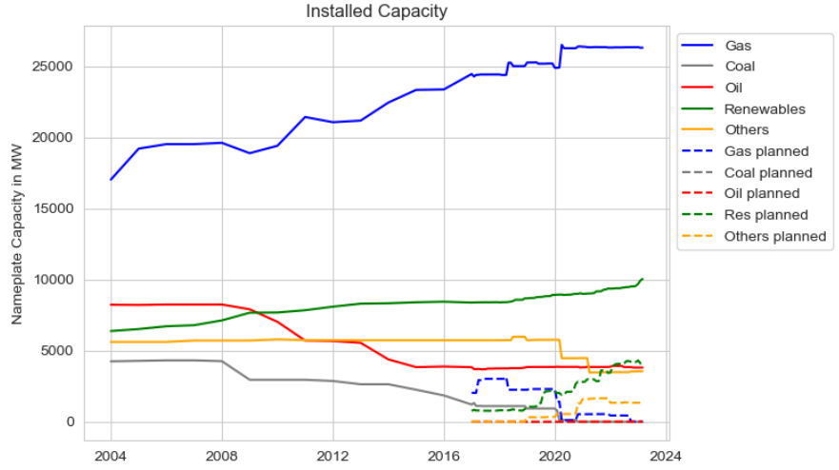
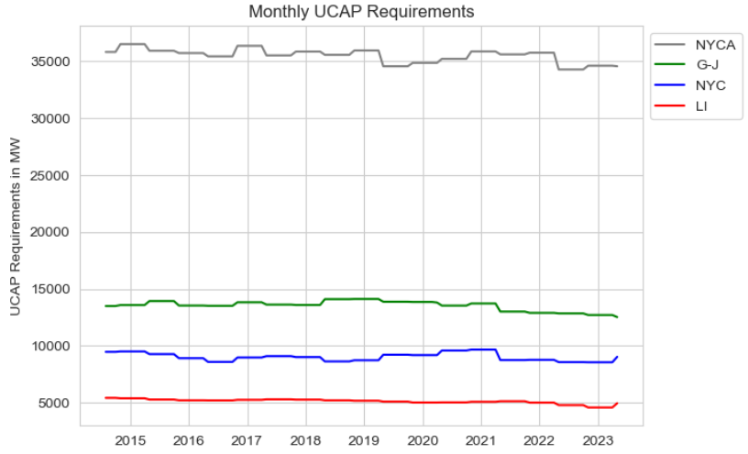
2. Context and Data
Generation Capacity
UCAP

Slide 8
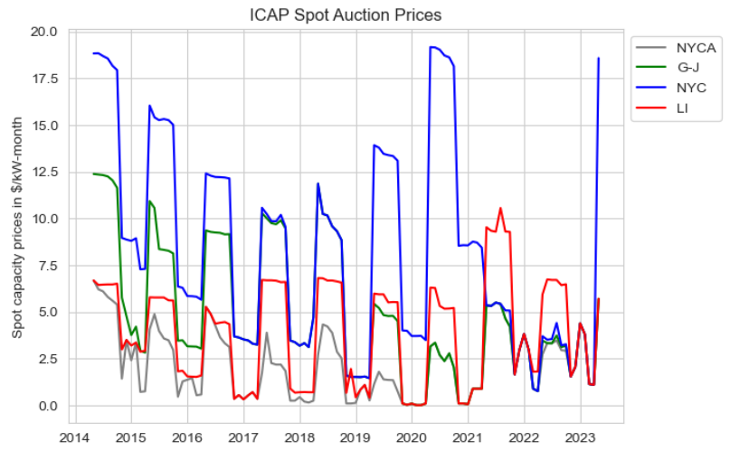
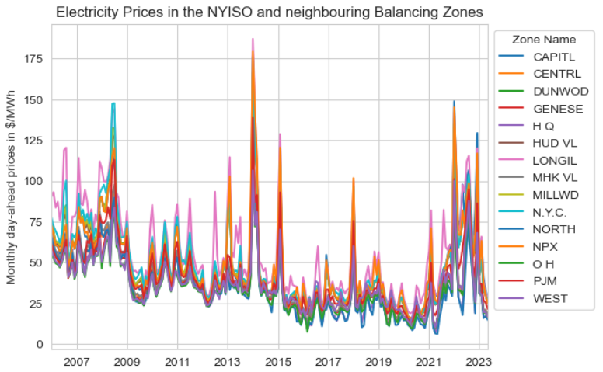
2. Context and Data
ICAP Capacity Prices
Wholesale Electricity Prices

Slide 9
3. Empirical Strategy
Workflow
Basic model idea
Data collec-tion
Separate model for each locality
Feature engi-neering
Adjust independent variables to decrease multicollinearity

Slide 10


3. Empirical Strategy
Data Wrangling and Feature Engineering
Installed Capacities:
Mapping to localities: electricity market zones ≈ counties → Assign power plants to zones → Aggregate zones to localities
Upsampling (yearly → monthly) for data before 2017
Prices:
Natural gas power plants are constructed in approximately 2-4 years → Prices of today‘s auctions cannot influence today‘s capacity expansion → Time lags of 2 to 4 years considered (account for planning period)
Mapping zonal prices to localities (mean)
Downsampling (hourly → monthly)
NYCA
Long Island
G-J
NYC

Slide 11
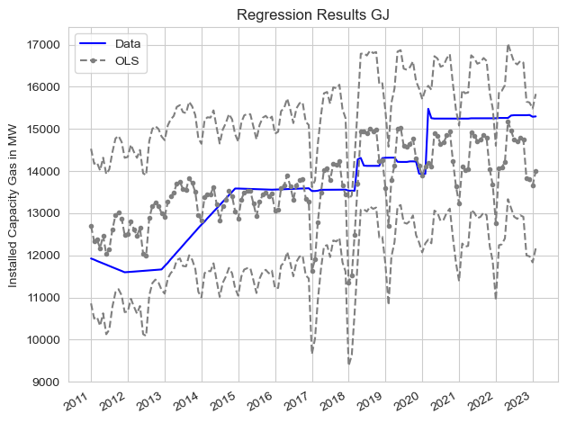
3. Empirical Strategy
Model A
Results:
4-year-lagged capacity prices are significant with positive coefficient
3- and 4-year-lagged day-ahead prices are significant with small negative coefficient
Conclusion:
High multicollinearity due to correlation between power and gas price features

Slide 12
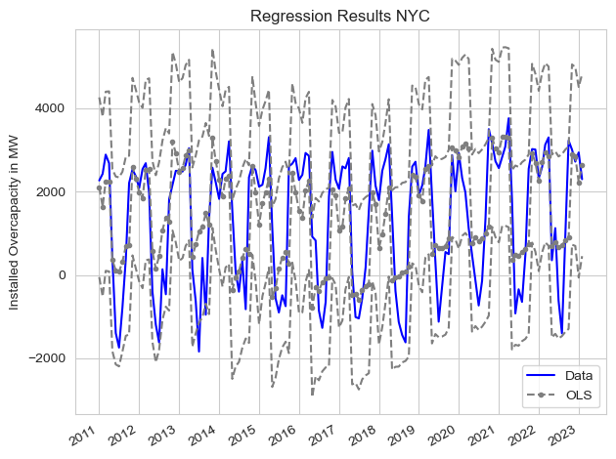
4. Results
Model B
Results:
Stronger models for NYCA and NYC
ICAP prices are significant with negative coefficients
Day-ahead prices are insignificant
Conclusion:
This model describes the capacity market fundamental
Inverse: marginal effect of oversupply on ICAP prices

Slide 13


4. Results
Model evaluation:
Statistically significant parameters:
Capacity price features
Wholesale power prices
Variance in installed capacity / oversupply that can be described by the models: R² = 33-55%, depending on locality
Interpretation:
Reliability of supply is not significantly ensured by capacity prices
Reliability forced by calculated UCAP that each load serving entity has to procure
Capacity prices are the reflection of a technical decision made by the ISO

Slide 14
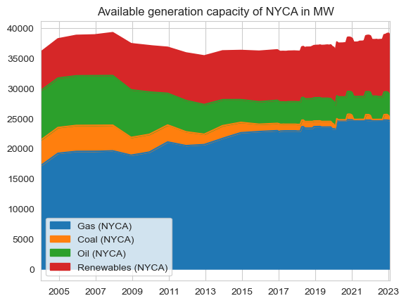
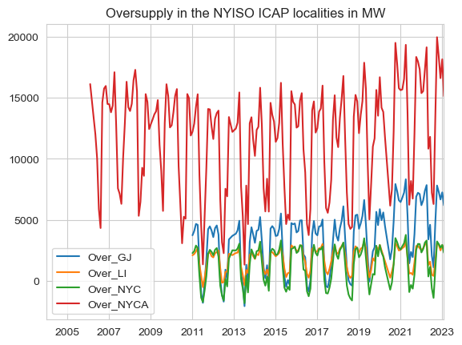
5. Discussion
Model results vs. data:
Statistical problems:
Multicollinearity
Autocorrelation
Right time lags (investors‘ hesitation)
Omitted variables

Slide 15




6. Conclusion
Installed capacity is not significantly driven by capacity prices acc. to our models
→ Model B shows fundamental correlation between price and installed capacity – rather than capacity expansion
However, in first years after installation of capacity markets (early 2000‘s), we see an increase in installed capacity
Security of supply is given
→ Missing money problem solved but no increase in consumer benefit
Expert surveys
confirm that the reliability goal has been achieved
but
suspect economically inefficient market design due to excess generation capacity
Initial goal “ensure sufficient investment in generation capacity“ achieved

Slide 16
7. References
Data:
http://www.energyonline.com/Data/GenericData.aspx?DataId=13 (accessed on 14.06.2023)
http://www.energyonline.com/Data/GenericData.aspx?DataId=14&NYISO___ISO_Load_Forecast (accessed on 14.06.2023)
https://www.eia.gov/electricity/data/eia860M/ (accessed on 03.05.2023)
https://www.nyiso.com/installed-capacity-market (accessed on 20.05.2023)
https://www.nyiso.com/energy-market-operational-data
http://icap.nyiso.com/ucap/public/auc_view_spot_detail.do
Literature:
https://stoft.com/2021/02/frozen-electric-blackouts-intexas/
See, P. C., Fosso, O. B., Wong, K. Y., & Molinas, M. (2015). Flow-based forward capacity mechanism: an alternative to the regulated capacity remuneration mechanisms in electricity market with high RES penetration. IEEE Transactions on Sustainable Energy, 7(2), 830-840.
Botterud, A., & Auer, H. (2020). Resource Adequacy with Increasing Shares of Wind and Solar Power: A Comparison of European and U.S. Electricity Market Designs. Economics of Energy and Environmental Policy, 9.
NYISO Training Documents: Installed Capacity (ICAP) Market, LSEs Capacity Obligations (https://www.nyiso.com/documents)
Bhagwat, P. C., de Vries, L. J., & Hobbs, B. F. (2016). Expert survey on capacity markets in the US: Lessons for the EU. Utilities Policy, 38, 11-17.

Slide 17
Thank you for your attention!

Slide 18
Back-up slides

Slide 19
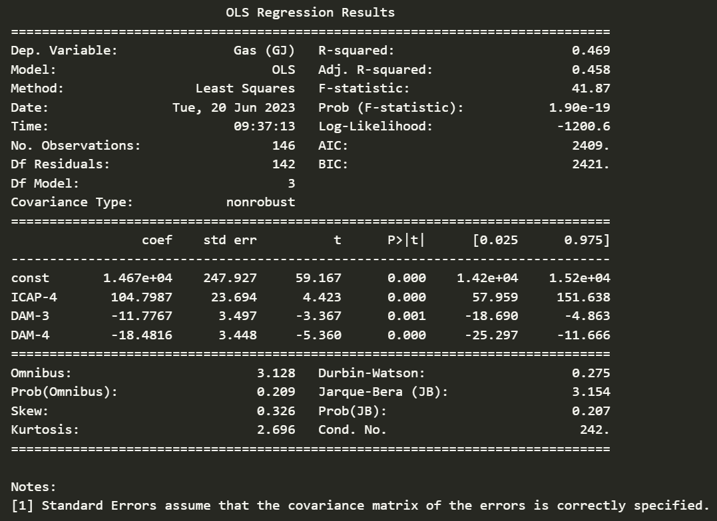
Regressions

Slide 20
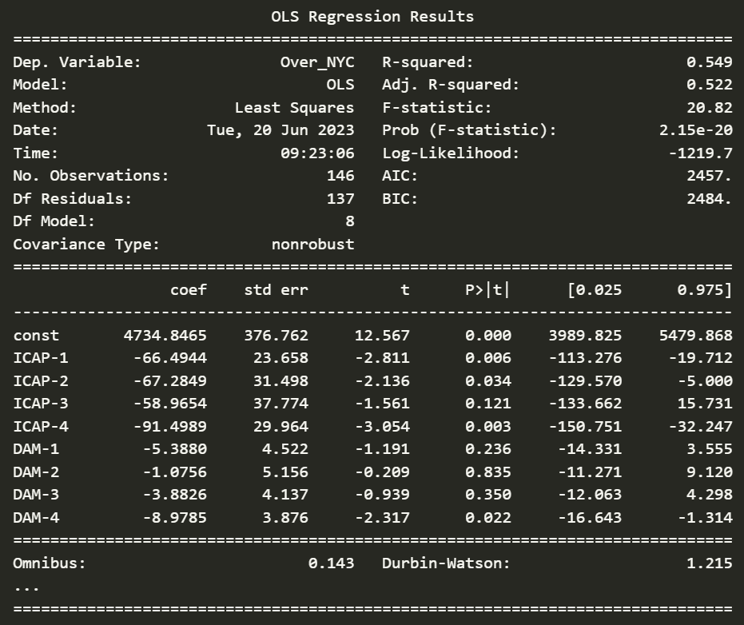
Regressions (Gas)

Slide 21
Safety-copy slides (duplicated versions)

Slide 22
1. Introduction – Relevance for the Topic
How to ensure sufficient investment in generation capacity?
Winter storms in Texas (2011)
Missing money problem in energy-only markets
Price for electricity derived by operating costs (merit order)
Idea: Recover fixed costs during times when demand > supply (scarcity price)
Problem:
Scarcity price too low due to price cap or
Times with demand > supply do not occur sufficiently often/do not last long enough
Potential lack of investment leads to blackouts
https://stoft.com/2021/02/frozen-electric-blackouts-intexas/

Slide 23
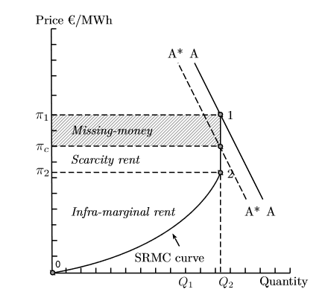
1. Introduction – Relevance for the Topic
Missing Money Problem in Energy-only Markets
Price for electricity derived by operating costs (merit order)
Idea: Recover fixed costs during times when demand > supply (scarcity price)
Problem:
Scarcity price too low due to price cap or
Times with demand > supply do not occur sufficiently often/do not last long enough
Price cap: A*
From: See, P. C., Fosso, O. B., Wong, K. Y., & Molinas, M. (2015)

