Slide 1

Can Capacity Markets foster Investment? Evidence from US-American Independent System Operators
Máté Borvendég, Susanne Hantke
Technische Universität München
TUM School of Management
Center of Energy Markets
Munich, 21st June 2023

Slide 2
Contents
Introduction
1.1 Relevance for the Topic
1.2 Research Question
1.3 Methodology
Context and Data
Empirical Strategy
Results
Discussion
Conclusion
References

Slide 3
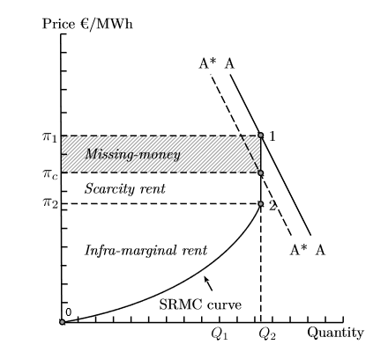
1. Introduction – Relevance for the Topic
Missing Money Problem in Energy-only Markets
Price for electricity derived by operating costs (merit order)
Idea: Recover fixed costs during times when demand > supply (scarcity price)
Problem:
Scarcity price too low due to price cap or
Times with demand > supply do not occur sufficiently often/do not last long enough
Price cap: A*
From: See, P. C., Fosso, O. B., Wong, K. Y., & Molinas, M. (2015). Flow-based forward capacity mechanism: an alternative to the regulated capacity remuneration mechanisms in electricity market with high RES penetration. IEEE Transactions on Sustainable Energy, 7(2), 830-840.

Slide 4
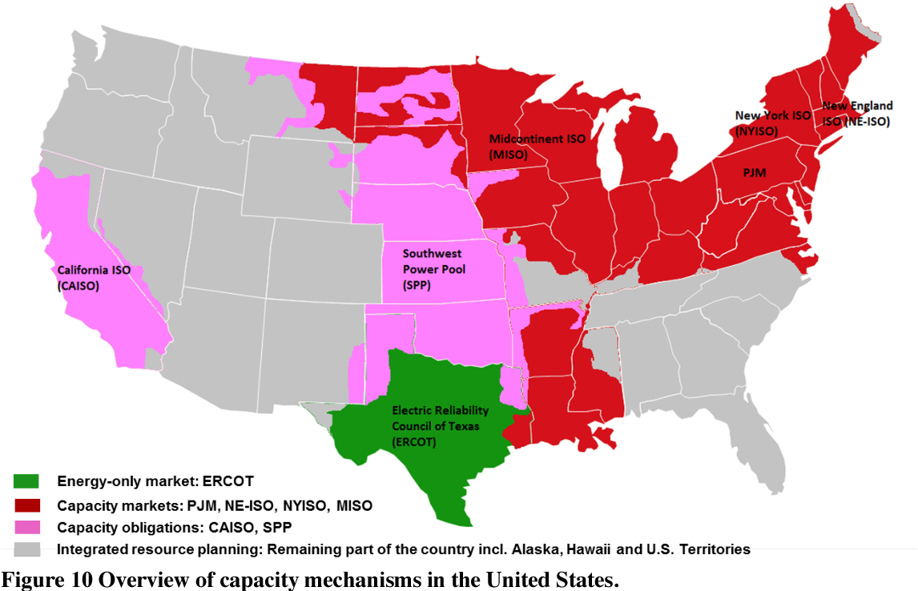
1. Introduction – Research Question
Can Capacity Markets foster Investment?
Drivers of Investments in Capacity Markets
Evidence from US-American Independent System Operators
à Focus on NY ISO
From: Botterud, A., & Auer, H. (2020). Resource Adequacy with Increasing Shares of Wind and Solar Power: A Comparison of European and U.S. Electricity Market Designs. Economics of Energy and Environmental Policy, 9.

Slide 5

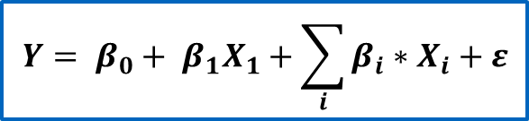
1. Introduction – Methodology
Econometric model:
Dependent variable:
Available/planned generation capacity OR
Change in available generation capacity
Independent variables:
Capacity market prices
Revenue/cost drivers
Wholesale electricity and reserve prices
Wholesale fuel prices
Installed Reserve Margin (IRM), demand, UCAP
$$Y= β_{0}+ β_{1}X_{1}+\sum_{i}{β_{i}∗X_{i}}+ε$$
$Y$: installed capacity
$X_{1}$: price in capacity auctions
$X_{i}$: control variables
$ε$: error term

Slide 6
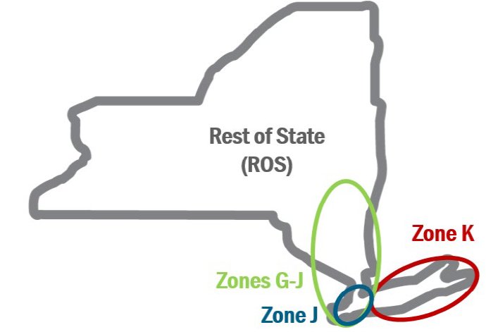
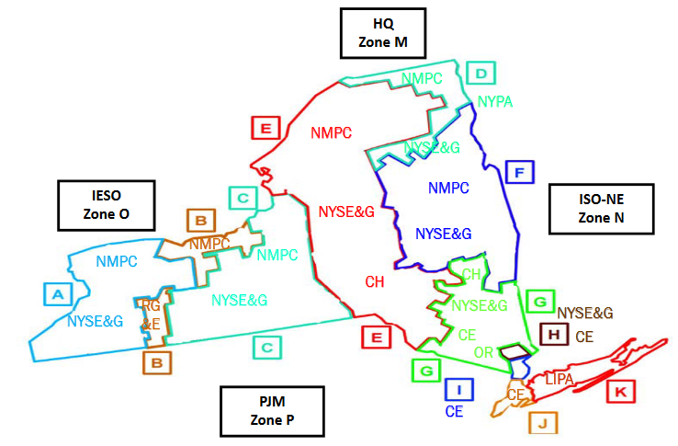
2. Context and Data
NYCA
New York Installed Capacity Market (ICAP)
Long Island
Since the formation of the NY ISO in 1999
11 balancing zones → 4 localities
2 capability periods: summer, winter
3 different kinds of auctions:
Compulsory (spot)
Optional (monthly, strip)
Installed capacity requirement derived from load forecast, adjusted by safety margin (IRM) and tailored to localities
G-J
NYC
Island
From: NYISO Training Documents: Installed Capacity (ICAP) Market, LSEs Capacity Obligations (https://www.nyiso.com/documents)

Slide 7
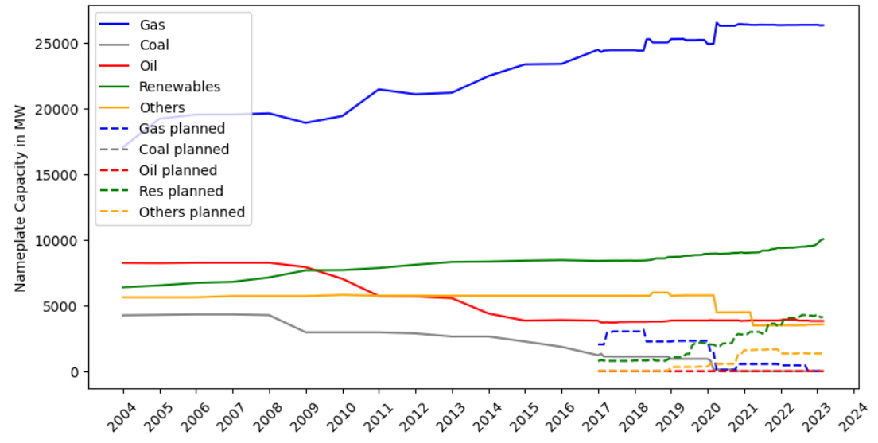
2. Context and Data
Generation Capacity
UCAP
Installed Capacity Resources 2023: ca. 40 GW
Installed Capacity
Plot UCAP for all localities with Python
Title with Python, smaller width
Source: NPCC 2022 Interim New York Area Review of Resource Adequacy, NYISO, 2022; Preliminary Monthly Electric Generator Inventory (https://www.eia.gov/electricity/data/eia860M/)

Slide 8
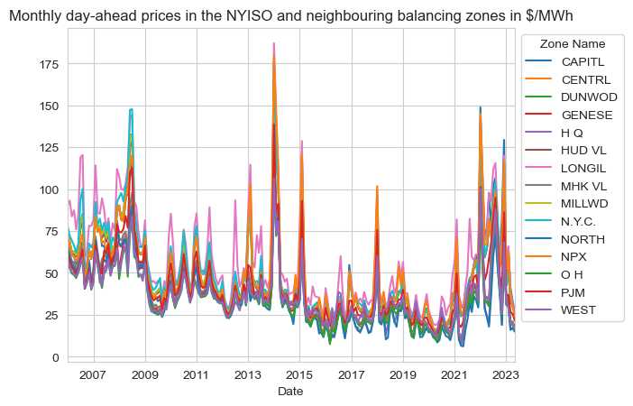
2. Context and Data
ICAP Capacity Prices
Wholesale Electricity and Fuel Prices
Put legend into plot?
Plot with Python
From: NYISO Market Prices, Custom Report for Day-Ahead Electricity Prices, NYISO, 2023 (https://www.nyiso.com)
From: NYISO Market Prices, Custom Report for Day-Ahead Electricity Prices, NYISO, 2023 (https://www.nyiso.com)

Slide 9
3. Empirical Strategy
Data → Features → Model for each locality separately → Model enhancement: minimize multicollinearity

Slide 10
3. Empirical Strategy
Data Wrangling and Feature Engineering
Installed Capacities:
Upsampling (years → months) for data before 2017
Mapping to localities: Electricity market zones ~ Counties → Assign power plants to zones → Aggregate zones to localities (not MECE)
Prices:
Natural gas power plants build in approximately 2 years → Prices of today‘s auctions cannot influence today‘s capacity → Time lags of 2 to 4 years considered (account for planning period)
Electricity prices mapped to localities (mean)
What else done with prices?

Slide 11
3. Empirical Strategy
First Model
All parameters → multicollinearity

Slide 12
4. Results
Best Model or even all 4 models

Slide 13
4. Results
Which parameters are statistically significant?
How much of the variance in installed capacities can be described by the model?

Slide 14
5. Discussion
Differences in results in different localities (which locality is best described by capacity prices, which worst?)
Statistical problems:
Multicollinearity
Stationarity (time series)
Right time lags?
Omitted variables
a

Slide 15
6. Conclusion
Installed capacity is (not) driven by capacity prices
Main driver according to model is xy
However, in first years after installation of capacity markets (early 2000‘s), we see an increase in installed capacity
Security of supply is given
Oversupply → refer to paper

Slide 16
7. References

Slide 17
Thank you for your attention!

Slide 18
Back-up slides

