Slide 1
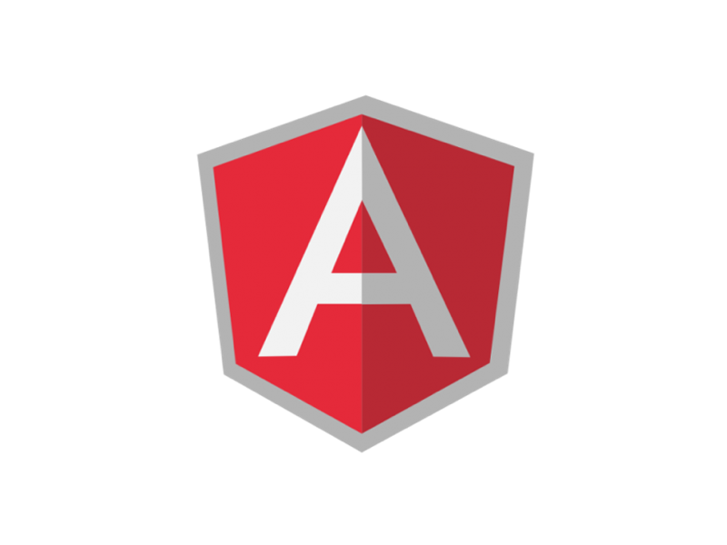

Slide 2

Borja andrés
Front-end Developer
@borya09
http://es.linkedin.com/in/borjaandres/
http://www.borjaandres.com

Slide 3
¿Qué es?
Framework MVW
Aplicaciones SPI
Extiende sintaxis HTML

Slide 4
¿POR Qué (ME) MOLA?
Arquitectura
Two way data binding
Templates
Inyección de dependencias
Testing
Directivas

Slide 5
MVC - ¿Quién es quién?
MODEL
SERVICES
CTRL
VIEW

Slide 6
Demo
https://github.com/borya09/curso-vsw-angularjs
https://github.com/borya09/curso-vsw-node-rest

Slide 7
LINKS DE INTERES
http://www.yearofmoo.com/
http://blog.koalite.com/2013/05/angularjs-conceptos-basicos/
http://www.revillweb.com/tutorials/angularjs-in-30-minutes-angularjs-tutorial/
http://www.designyourway.net/blog/resources/so-you-want-to-learn-angularjs-start-with-these-tutorials-and-resources/
http://newtriks.com/2013/06/11/automating-angularjs-with-yeoman-grunt-and-bower/
http://www.befundoo.com/university/tutorials/angularjs-directives-tutorial/
http://seanhess.github.io/2013/10/14/angularjs-directive-design.html
http://trochette.github.io/Angular-Design-Patterns-Best-Practices/

