Slide 1


Slide 2
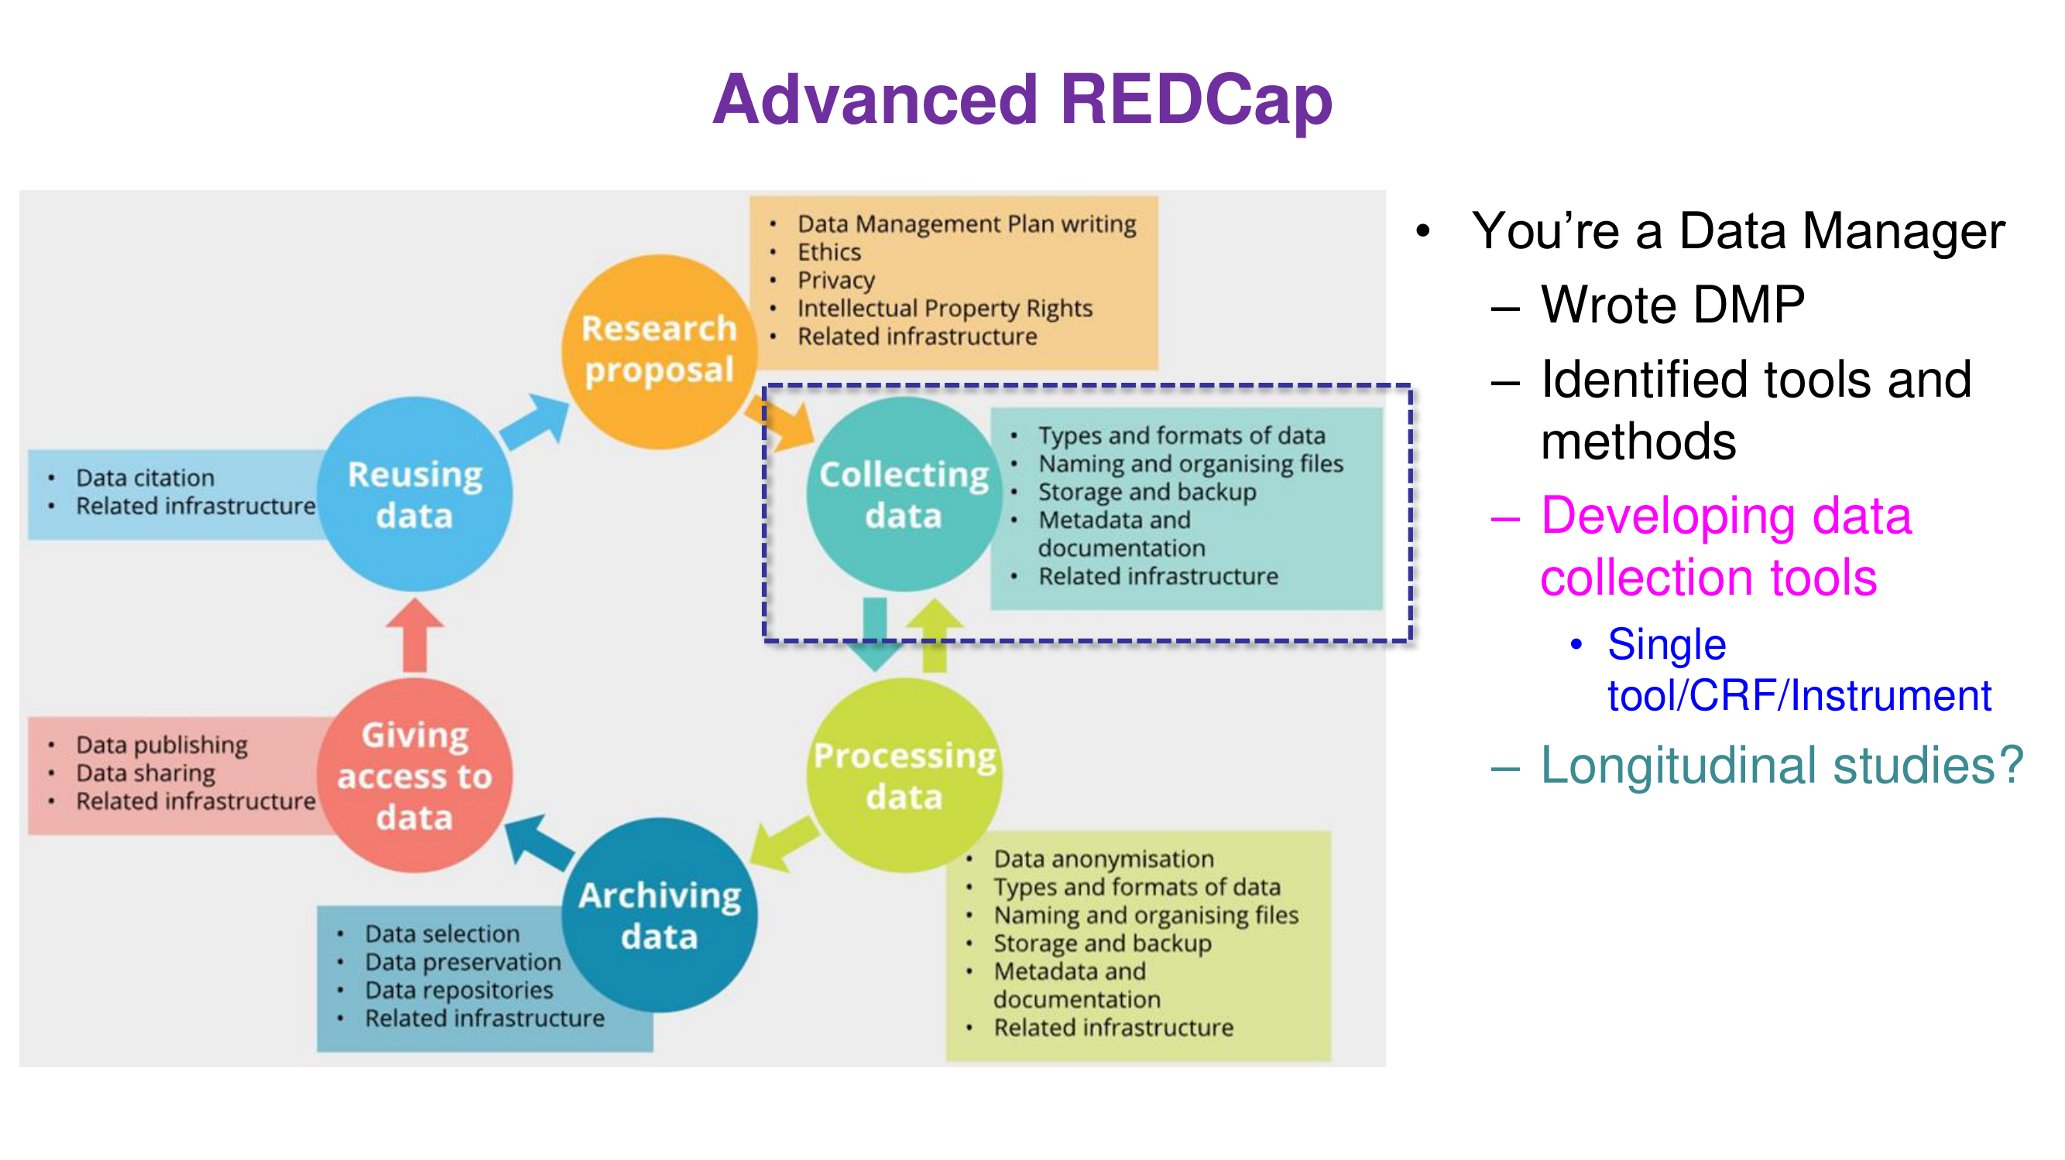

Slide 3
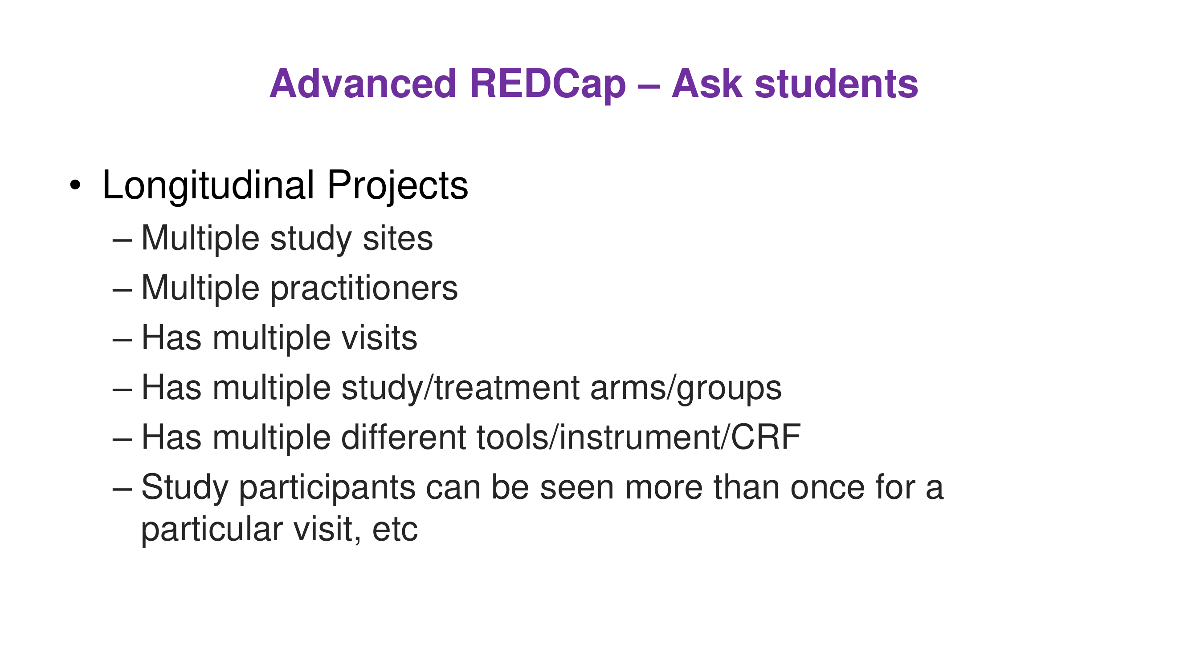

Slide 4
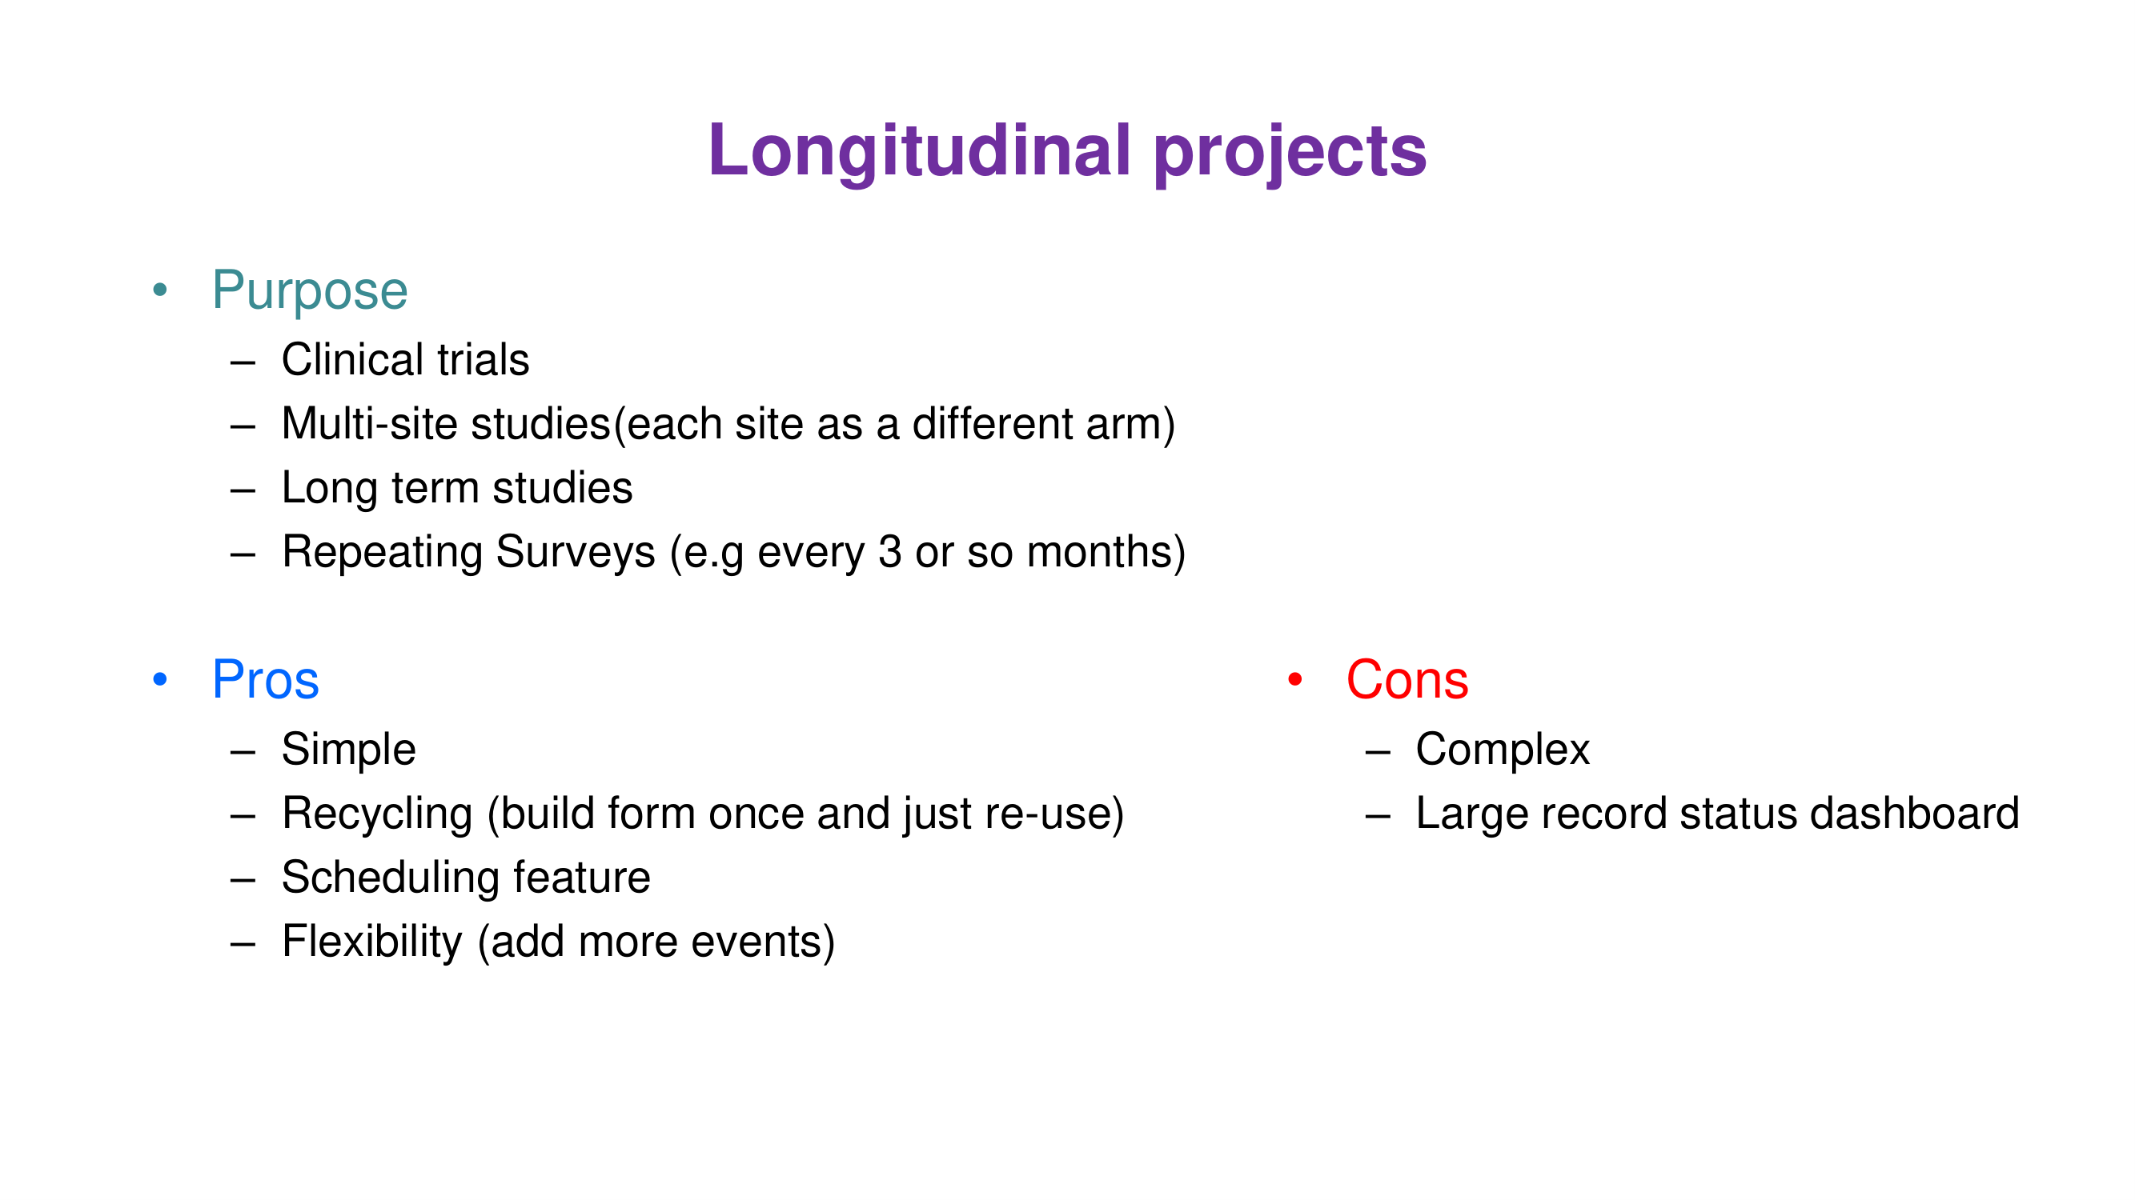

Slide 5
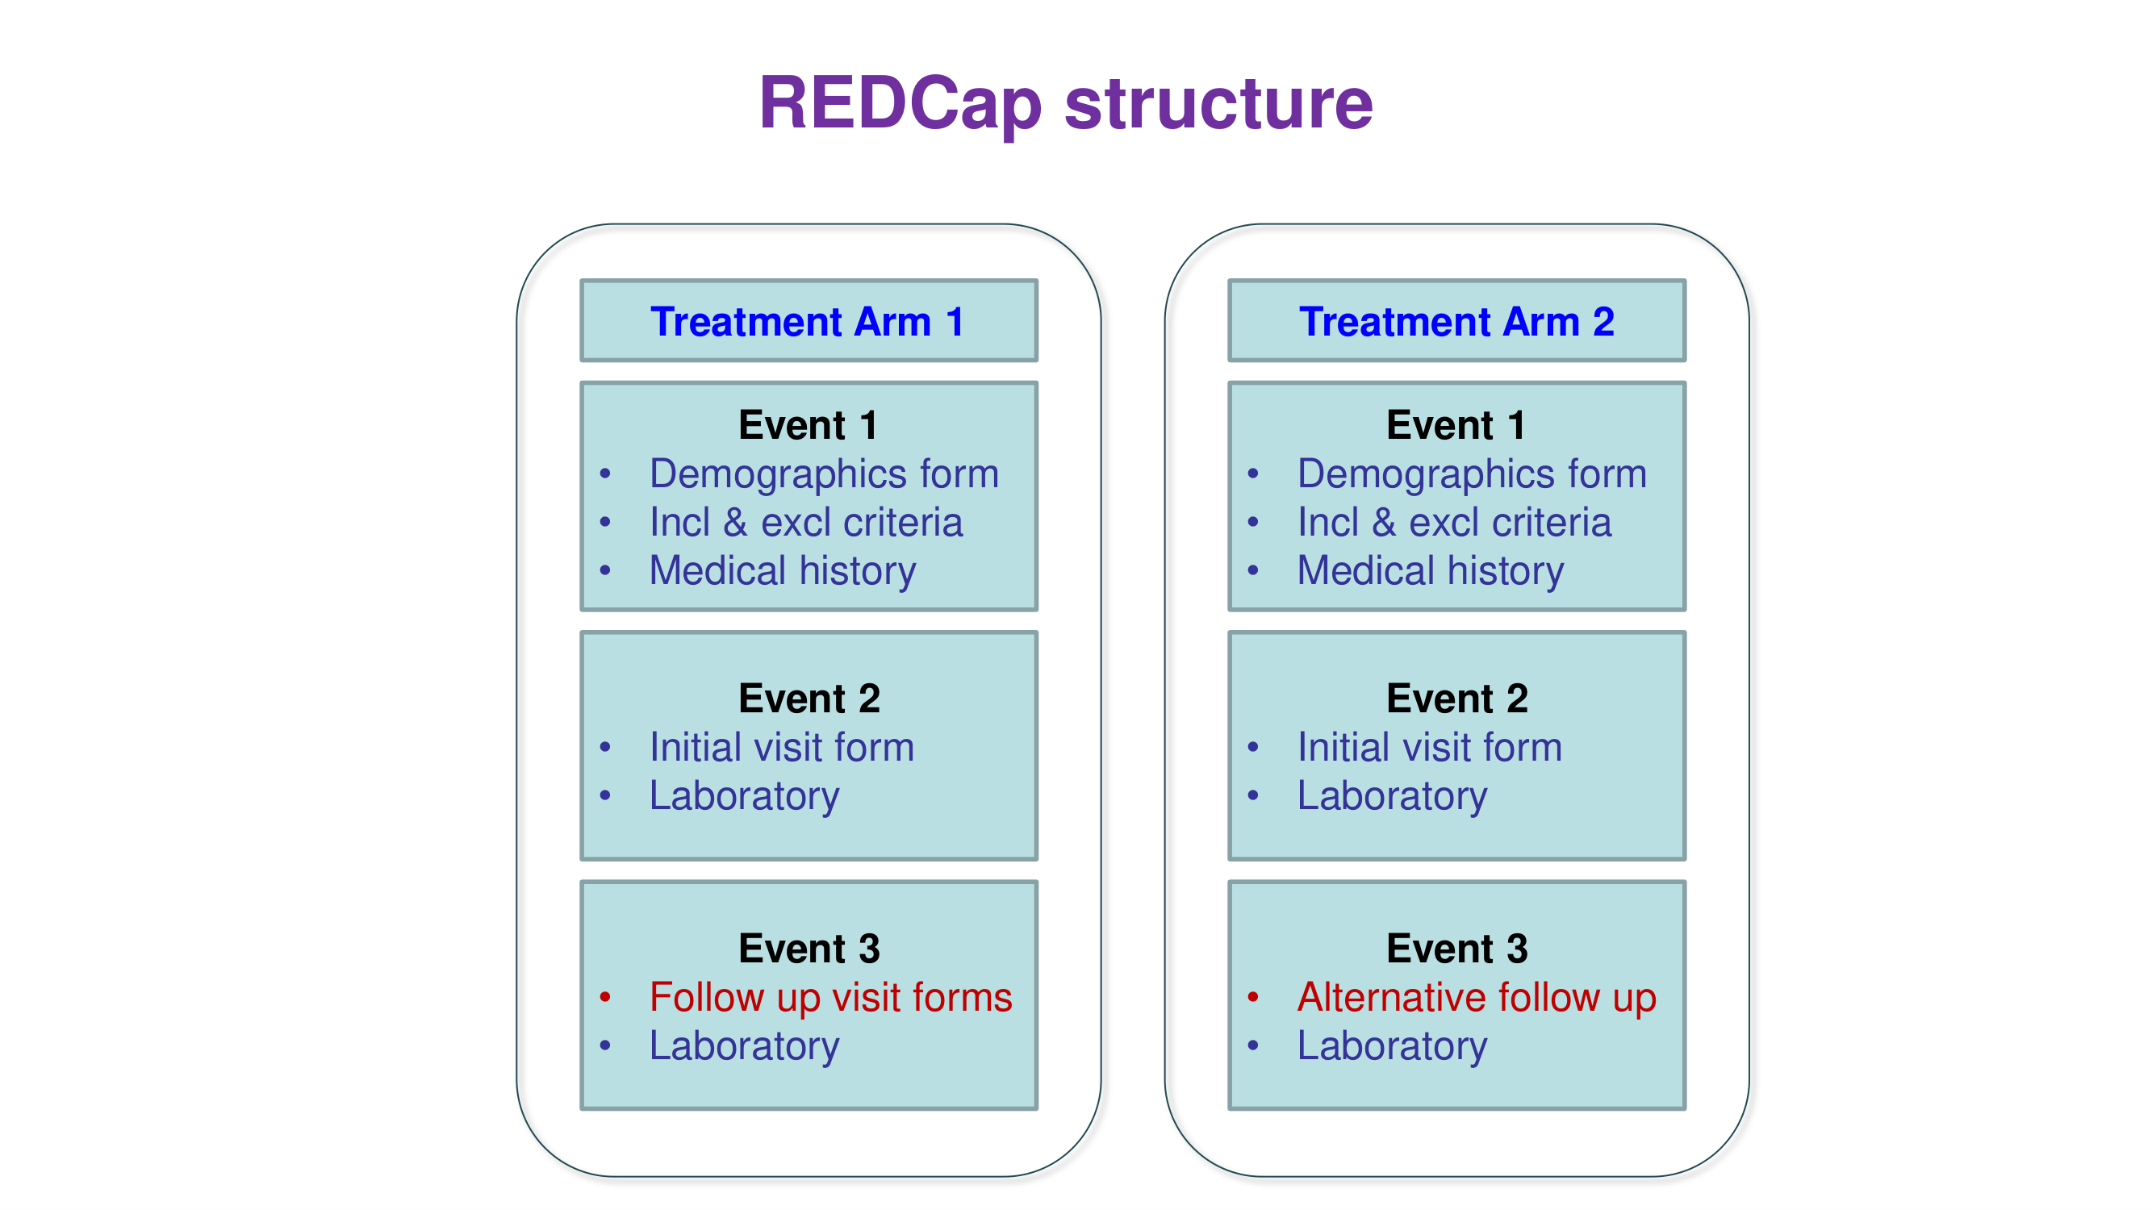

Slide 6
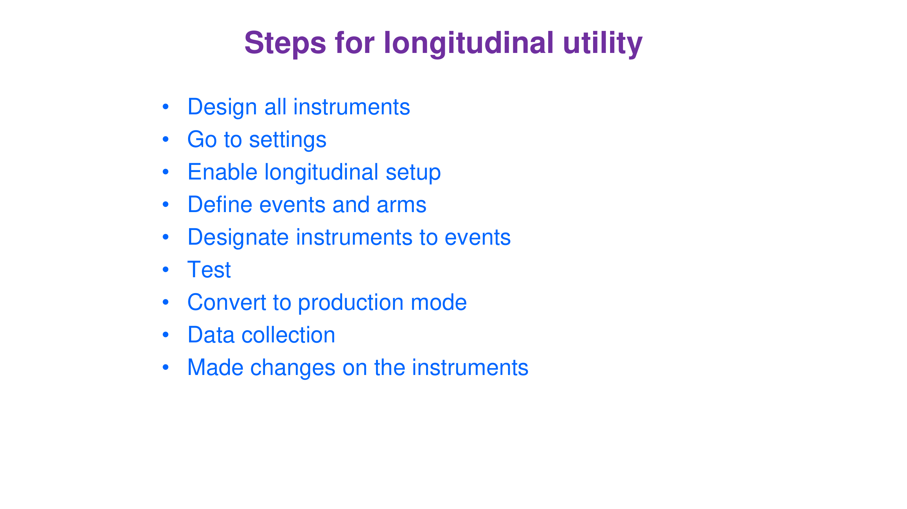

Slide 7
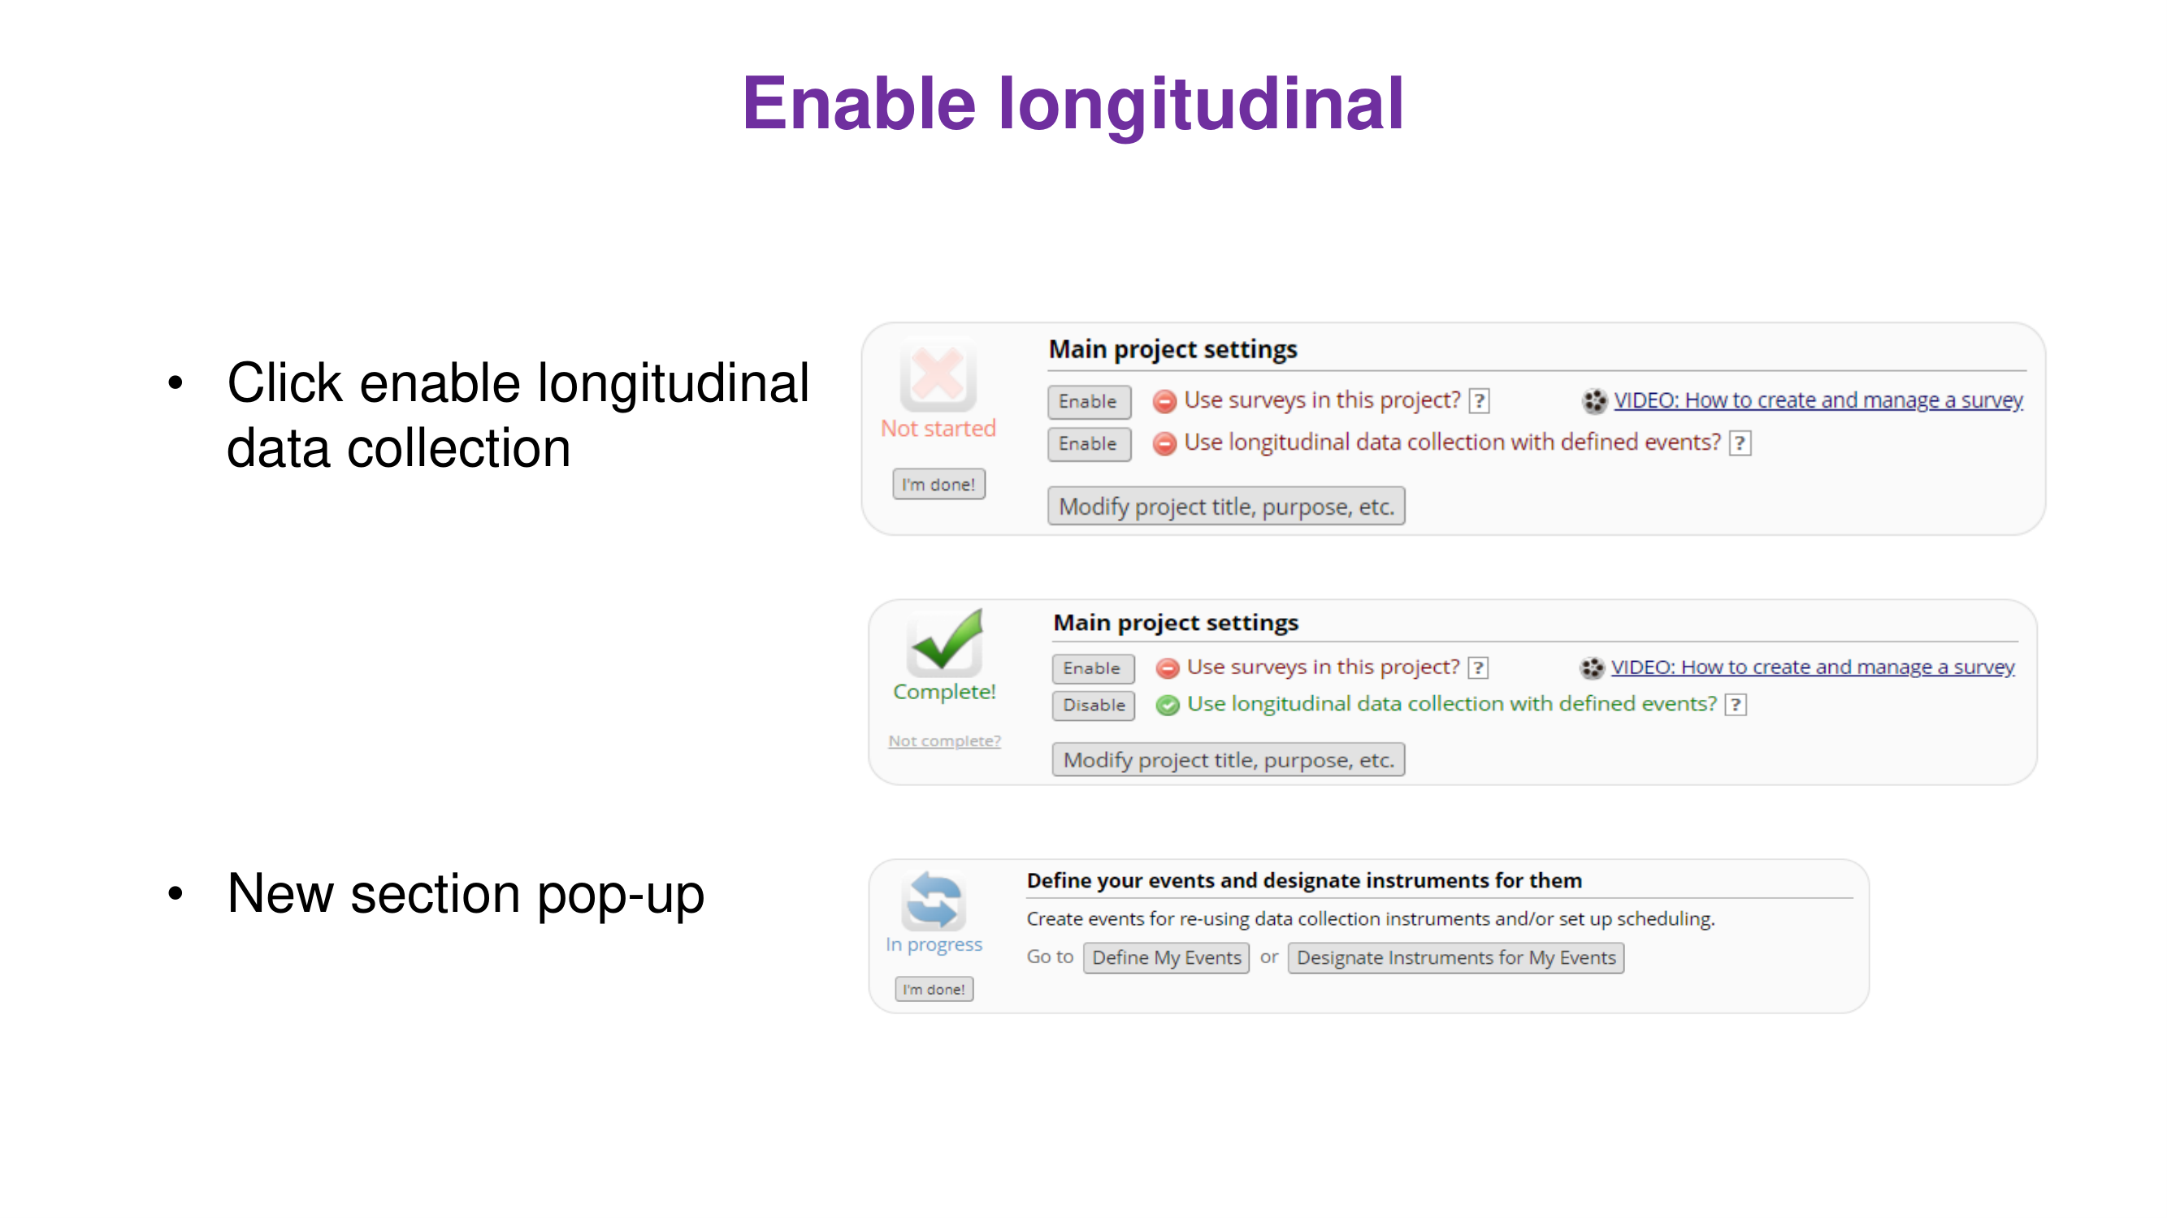

Slide 8
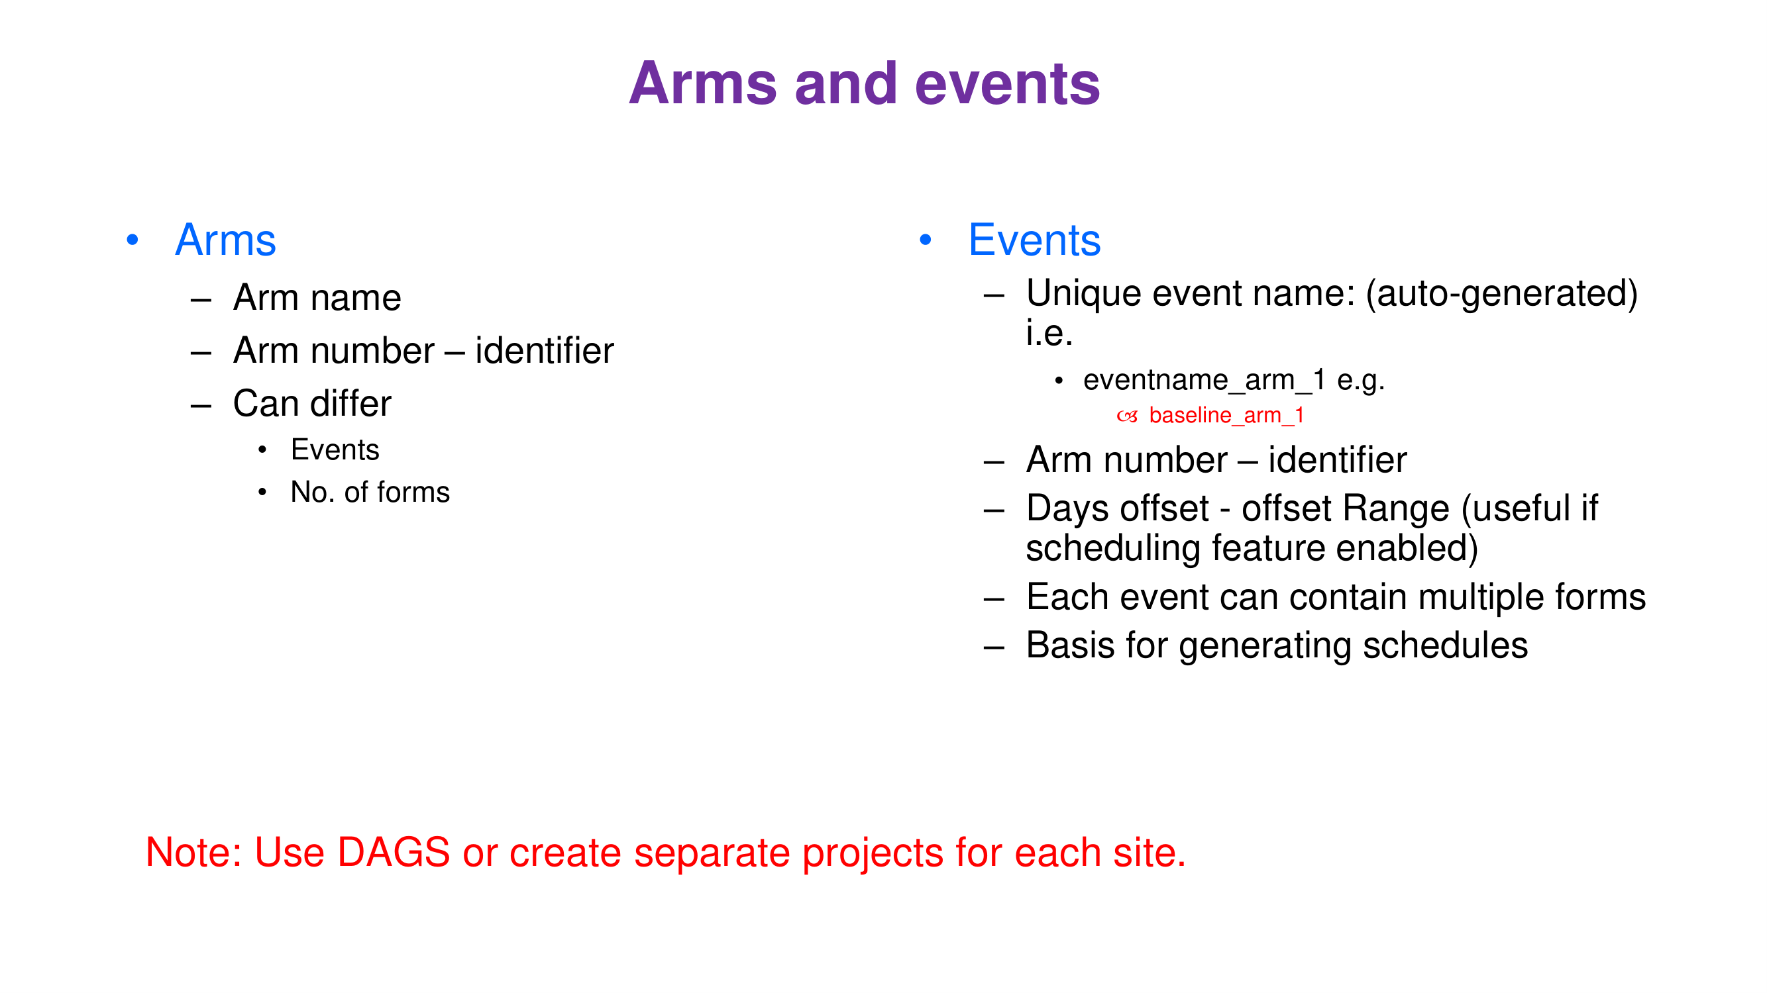

Slide 9
Data Access Groups (DAGs)
• Multi-centre studies
  – One project, one group per site
  – Users in a DAG see only their own site’s records
  – Users without a DAG (data managers) see all records
• Advantages
  – Same instruments and codes at every site
  – One export for the pooled analysis
• Example: PISTIC 2026
  – Dar es Salaam, Mwanza, Mbeya: three DAGs

Slide 10
Setting up DAGs
• Applications → Data Access Groups
  – Create one DAG per site
• User Rights
  – Assign each site user to a DAG
  – Keep data managers without a DAG
• Record auto-numbering
  – New record IDs get the DAG prefix (e.g. 2-1)
• Data import and export
  – Column redcap_data_access_group (unique group name)
  – Reports can be filtered by DAG

Slide 11
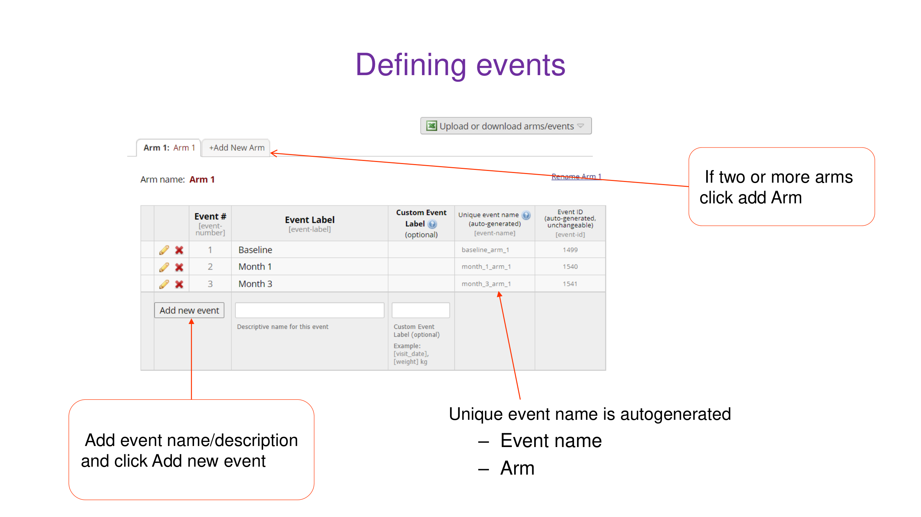

Slide 12
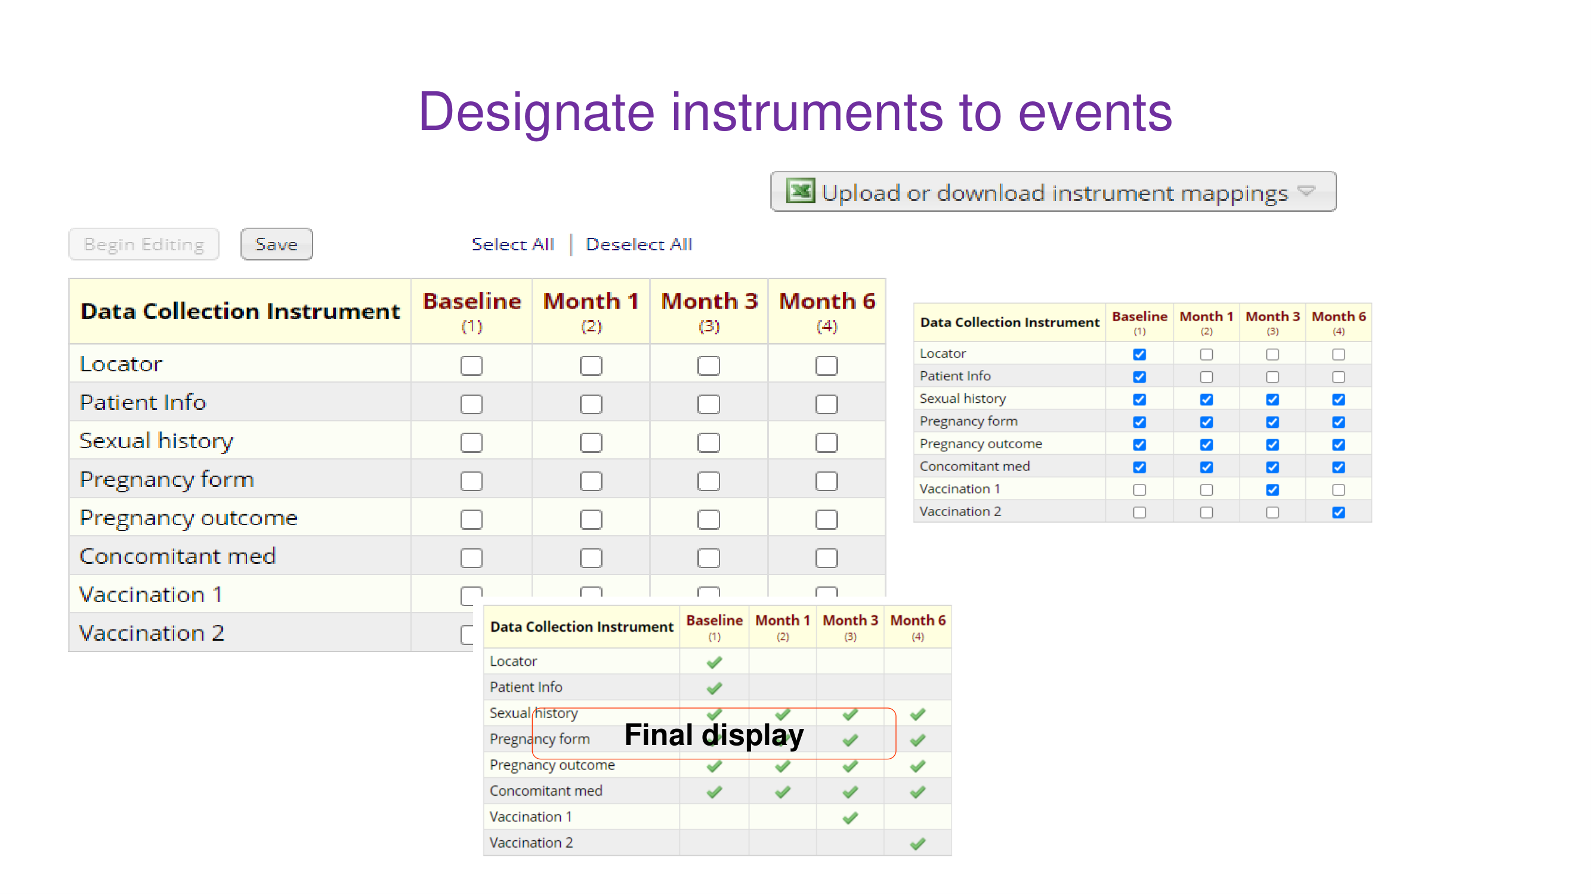

Slide 13
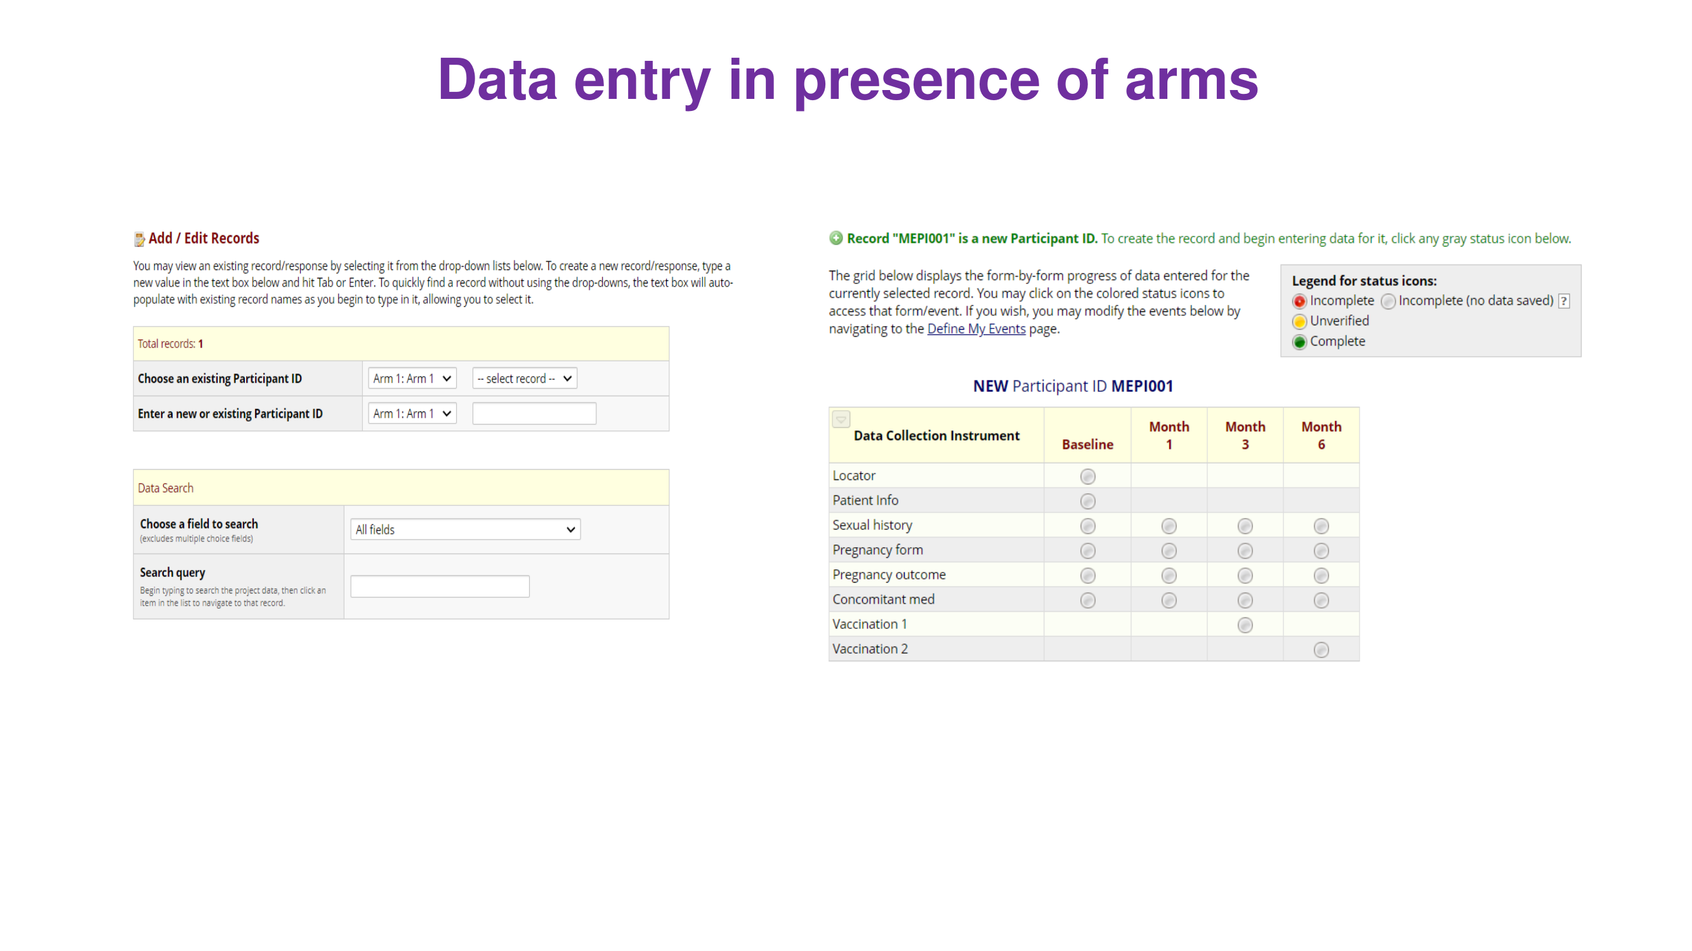

Slide 14
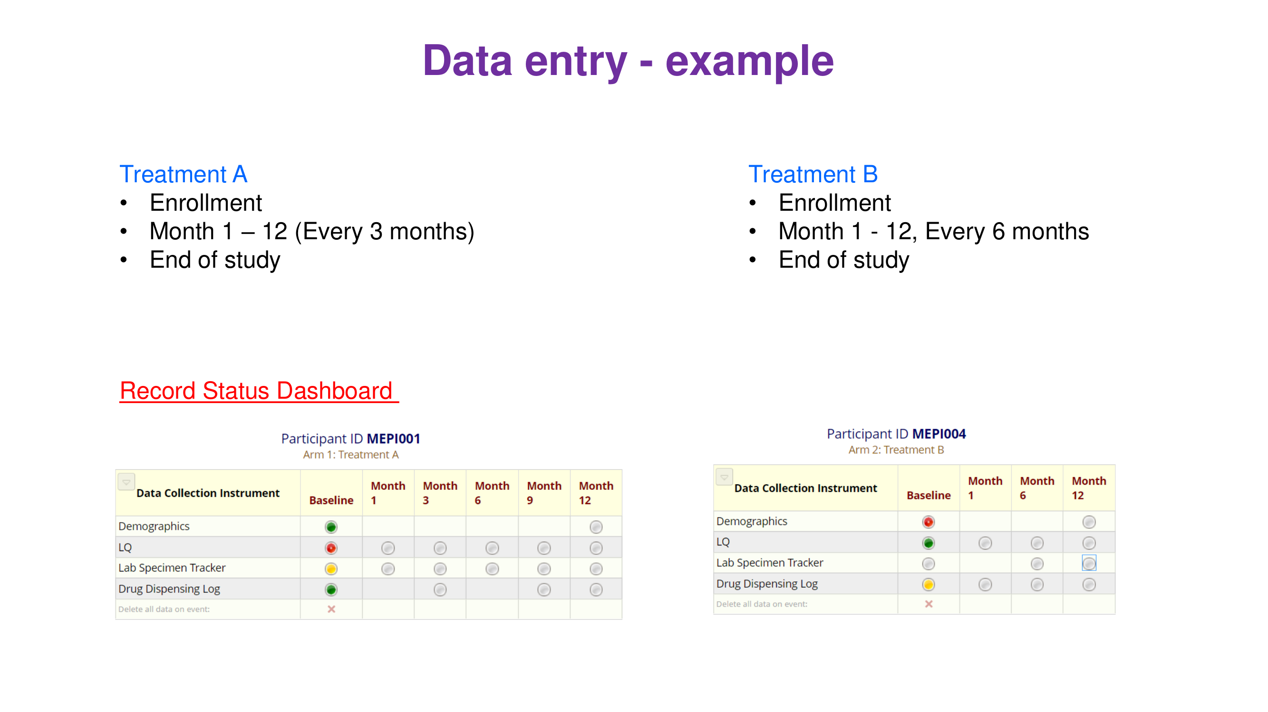

Slide 15
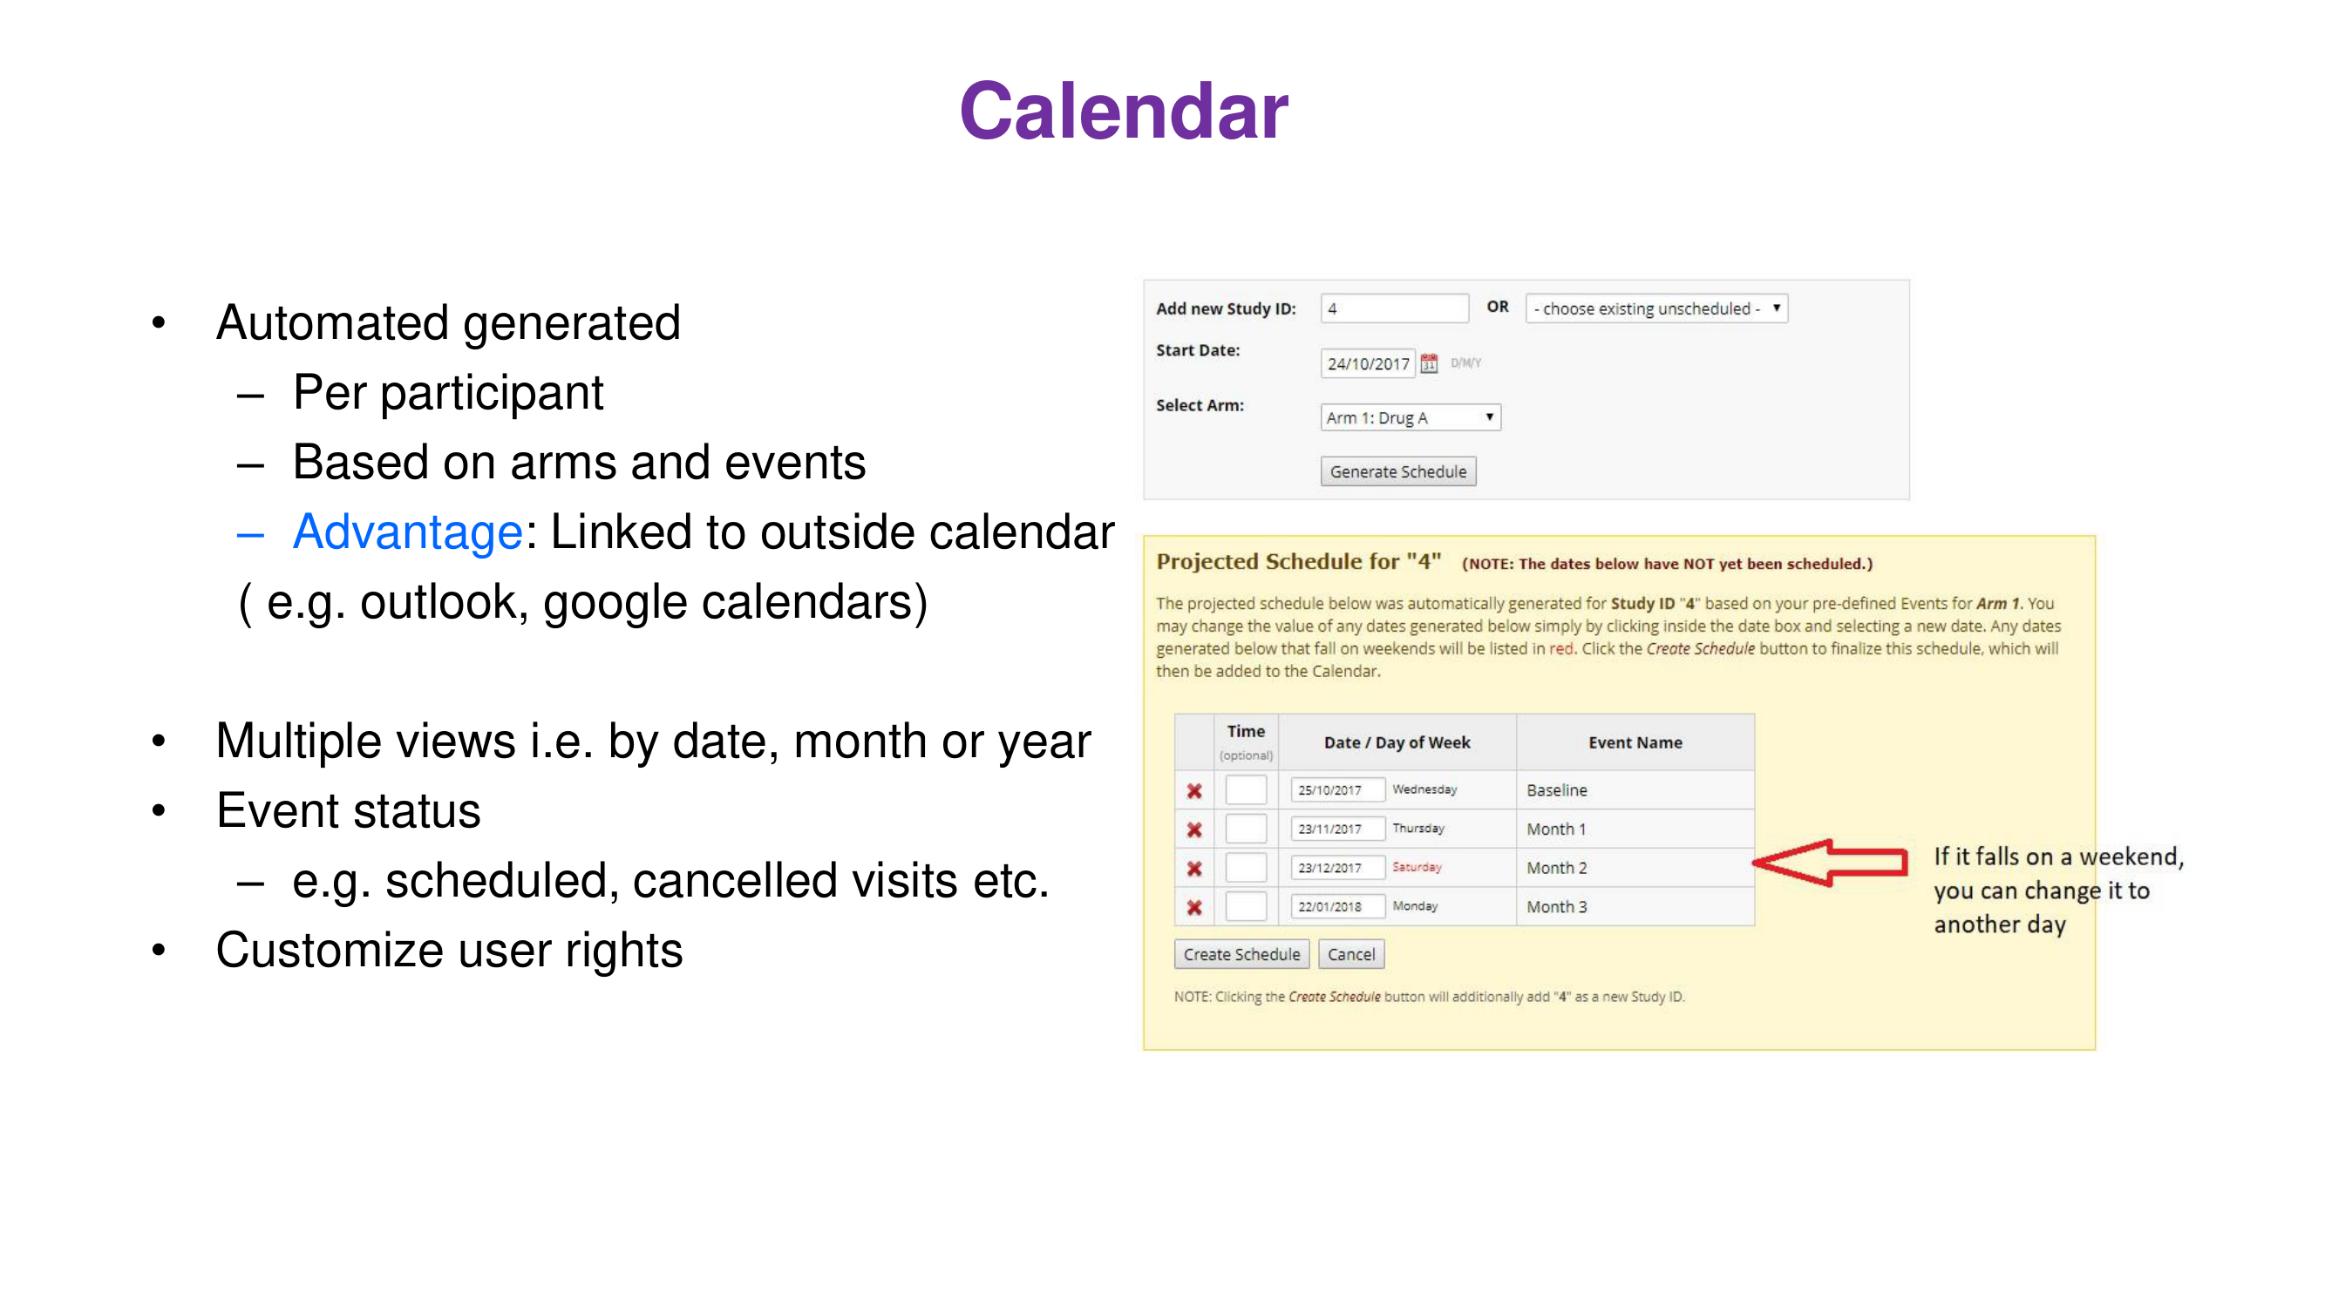

Slide 16
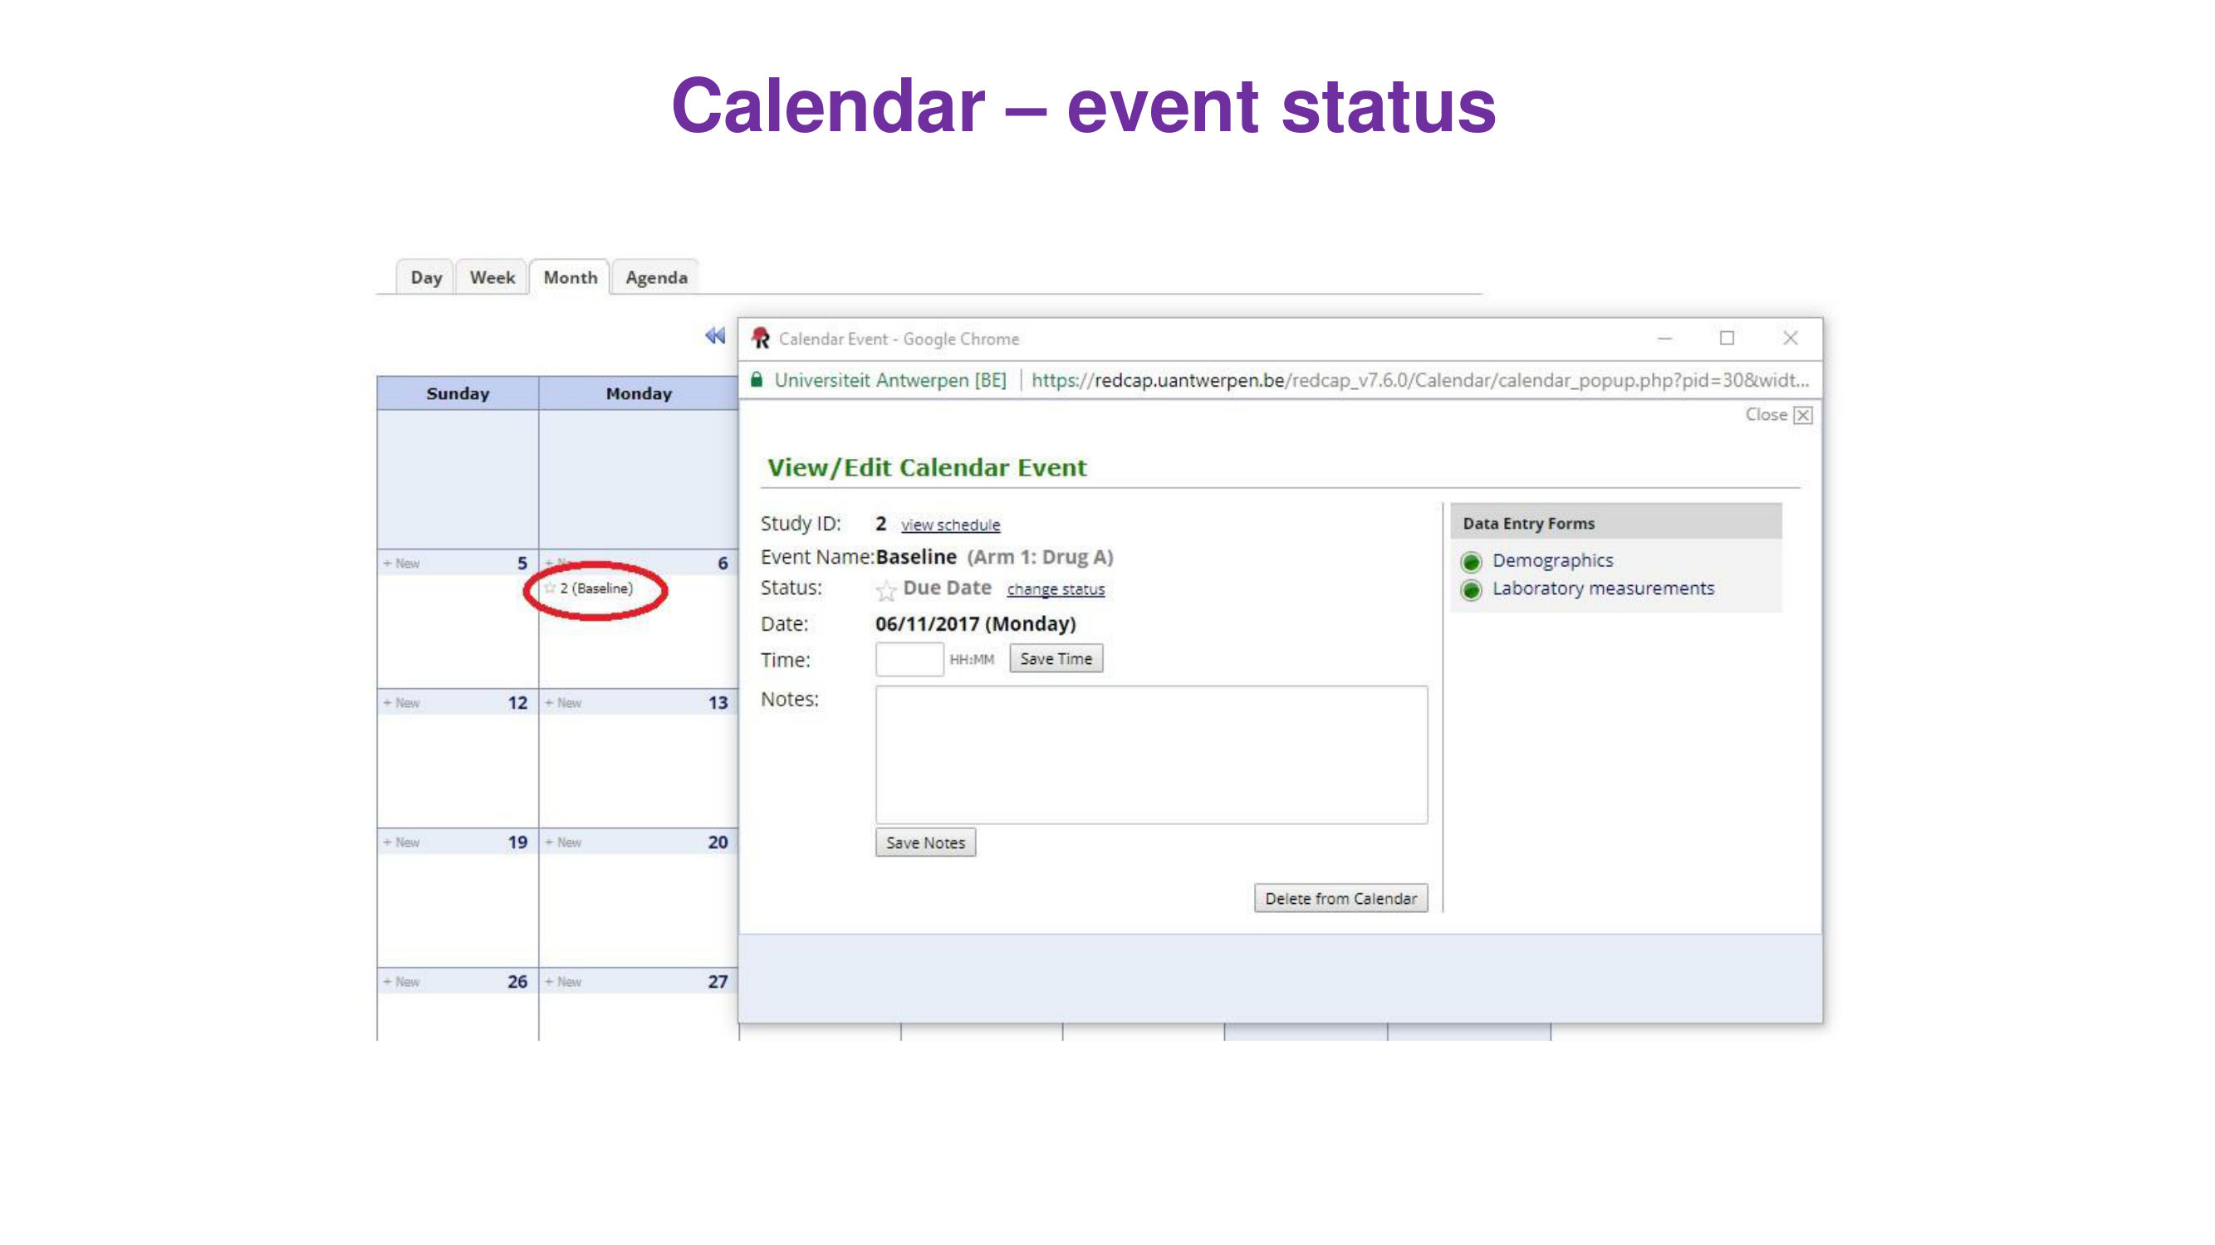

Slide 17
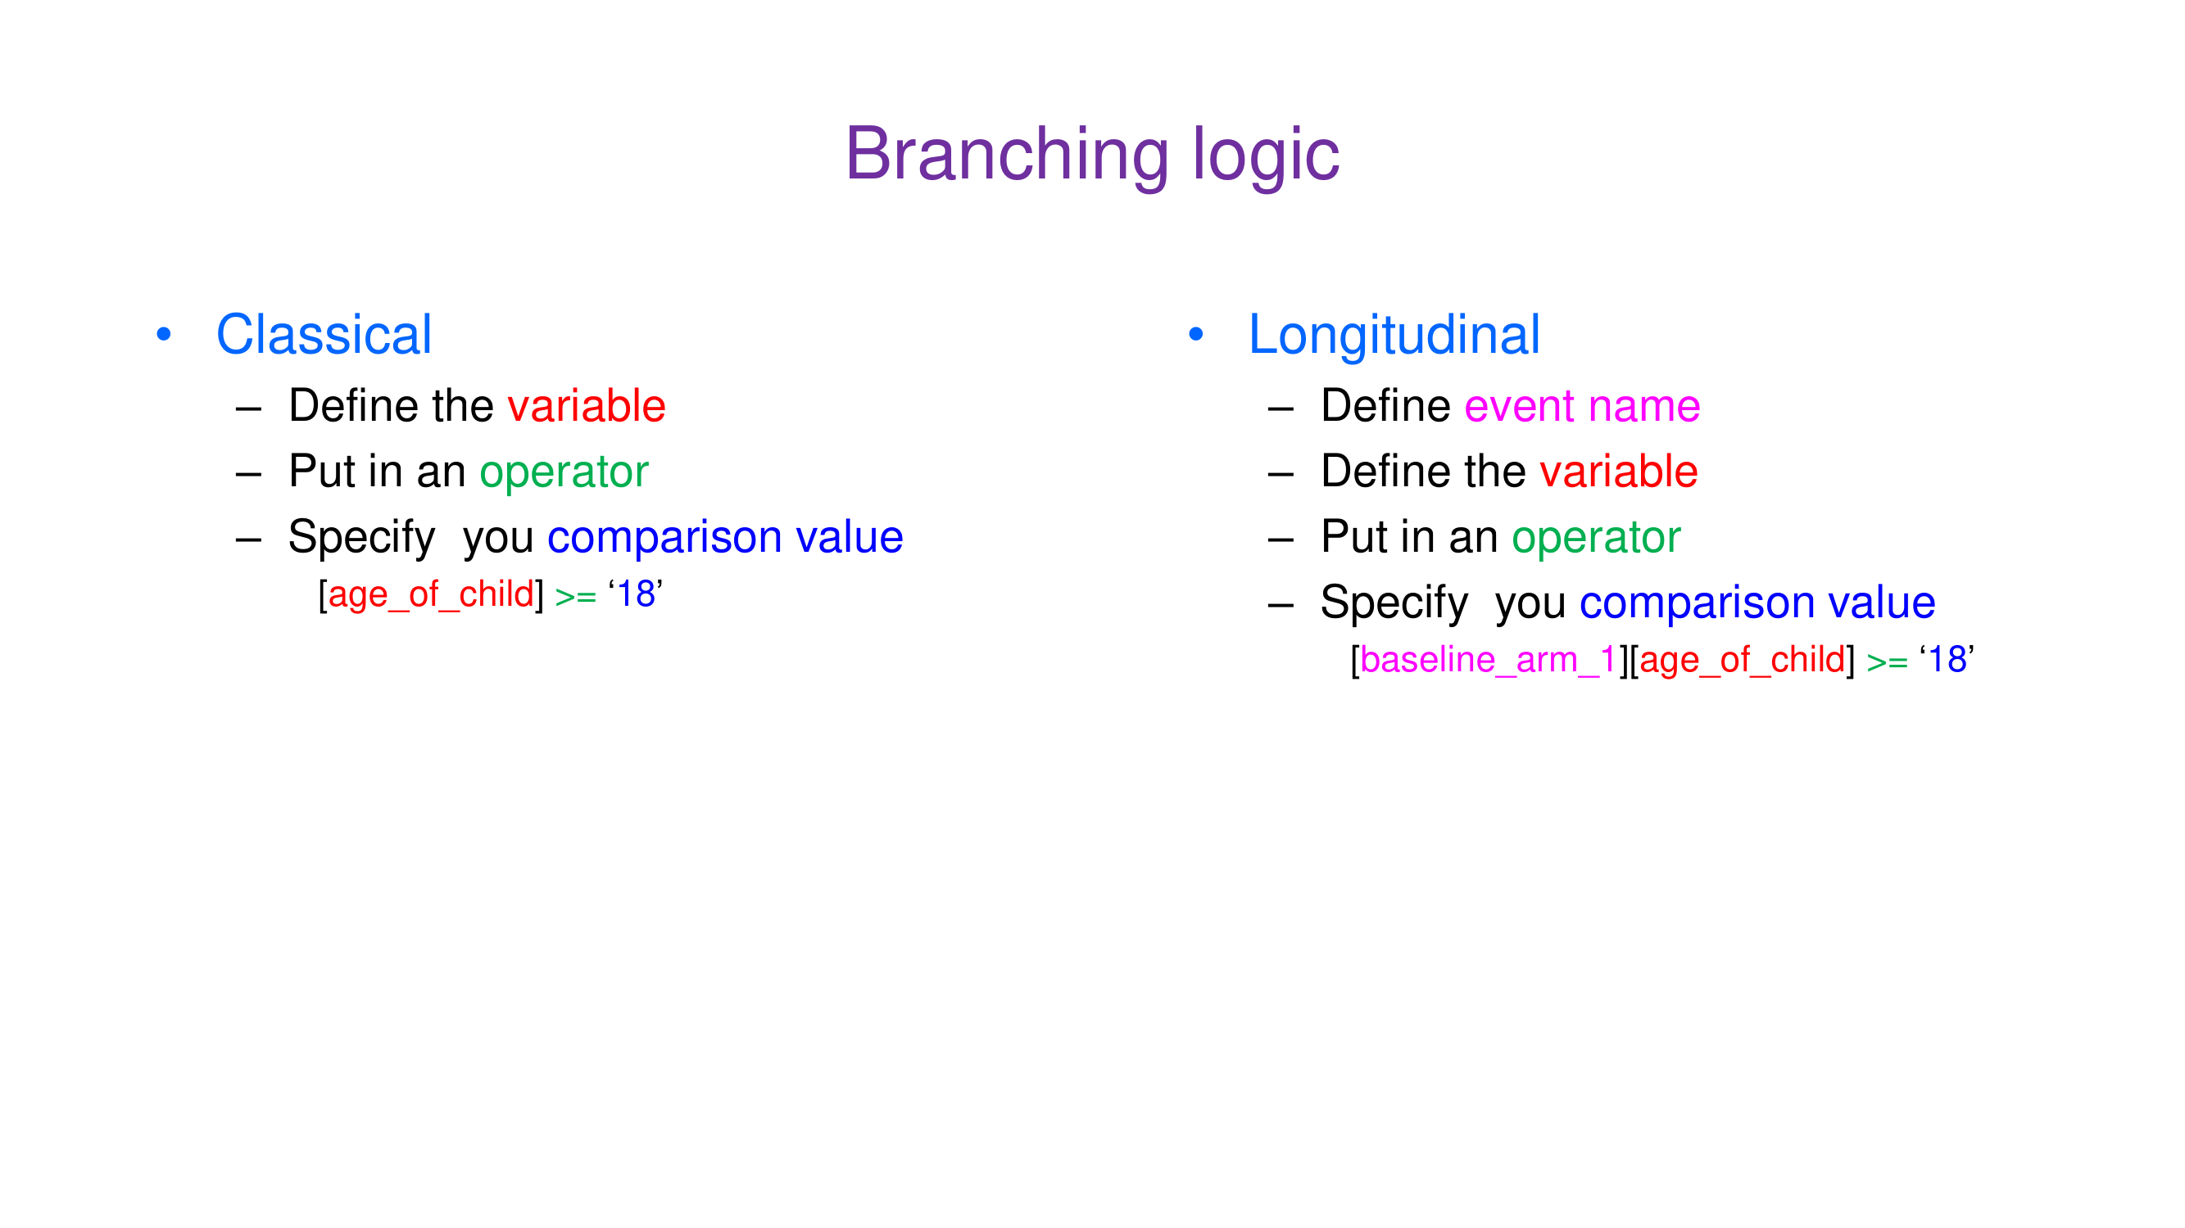

Slide 18
Field embedding
• What
  – Place a field inside the label of another field
  – Write the variable name in curly brackets: {weight_kg}
  – Only on the same instrument (same survey page)
• Example: a table in a descriptive field
  – <table><tr><td>Weight {weight_kg}</td><td>Height {height_cm}</td></tr></table>
• Use for
  – Grids and tables (signs, test results), compact forms

Slide 19
Piping
• What
  – Insert a value already collected into text: [variable]
• Examples
  – Of these [sex_times] times, how many times was a condom used?
  – [sex] shows the label, [sex:value] the code
  – [baseline_arm_1][age]: value from another event
• Where
  – Field labels and notes, section headers, choice labels
  – Survey instructions, invitations, @DEFAULT

Slide 20
Action tags
• Written in the Field Annotation
  – @TODAY, @NOW: today’s date or time
  – @HIDDEN, @HIDDEN-SURVEY, @READONLY
  – @CHARLIMIT=n, @WORDLIMIT=n
  – @CALCTEXT(…), @CALCDATE(…)
  – @HIDECHOICE='3', @NONEOFTHEABOVE
  – @LATITUDE, @LONGITUDE, @DEFAULT='…'

Slide 21
Smart variables and special functions
• Smart variables
  – [record-name], [event-name], [arm-number]
  – [first-event-name], [record-dag-name], [user-name]
• Special functions
  – rounddown(datediff([dob], 'today', 'y'))
  – if([weight] > 100, 1, 0)
  – round(), sum(), mean(), isblankormissingcode()

Slide 22
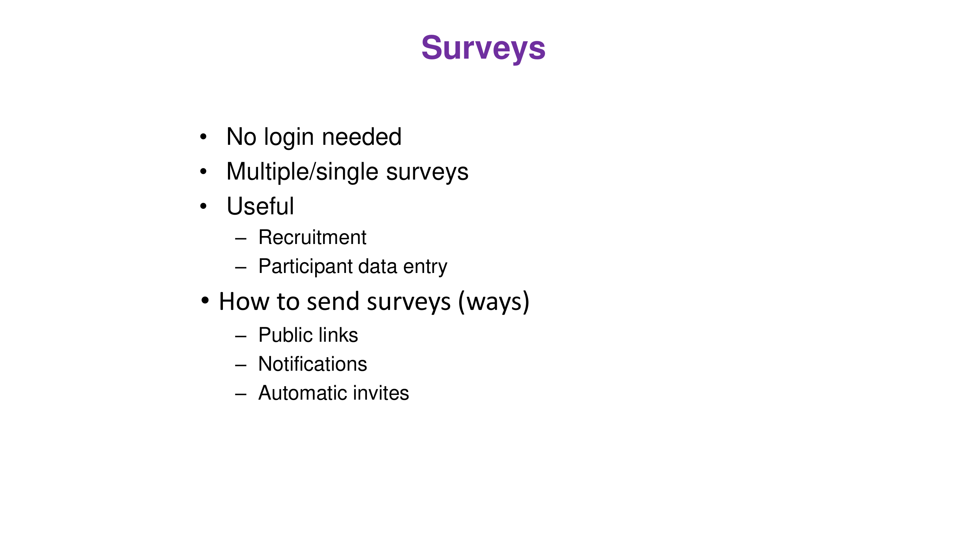

Slide 23
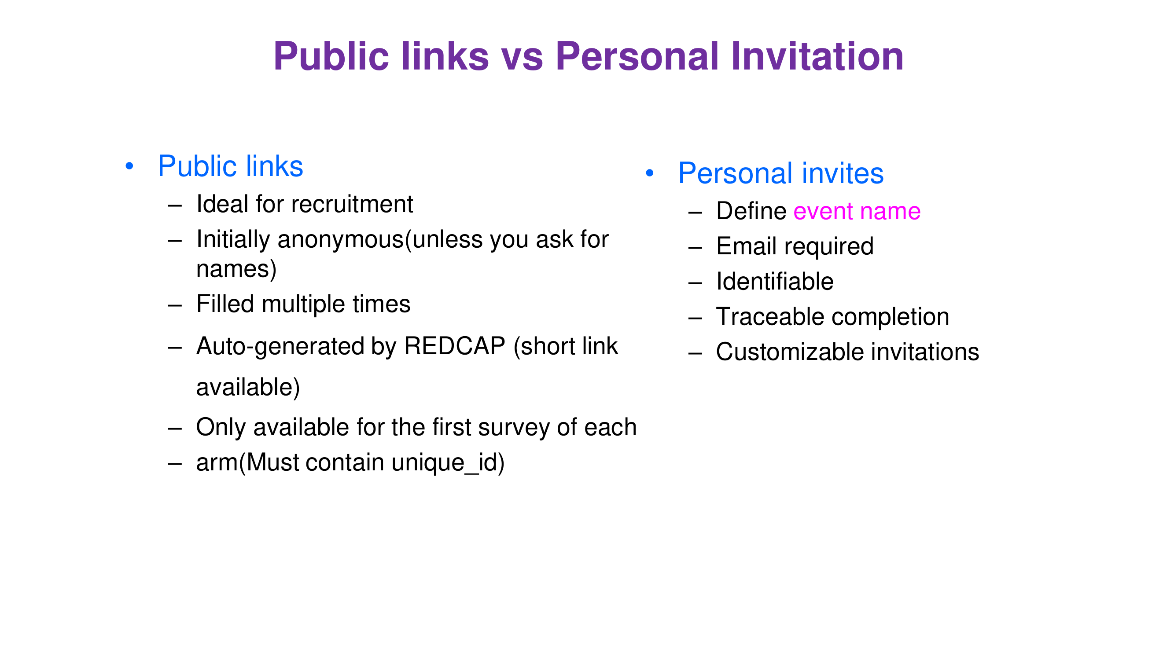

Slide 24
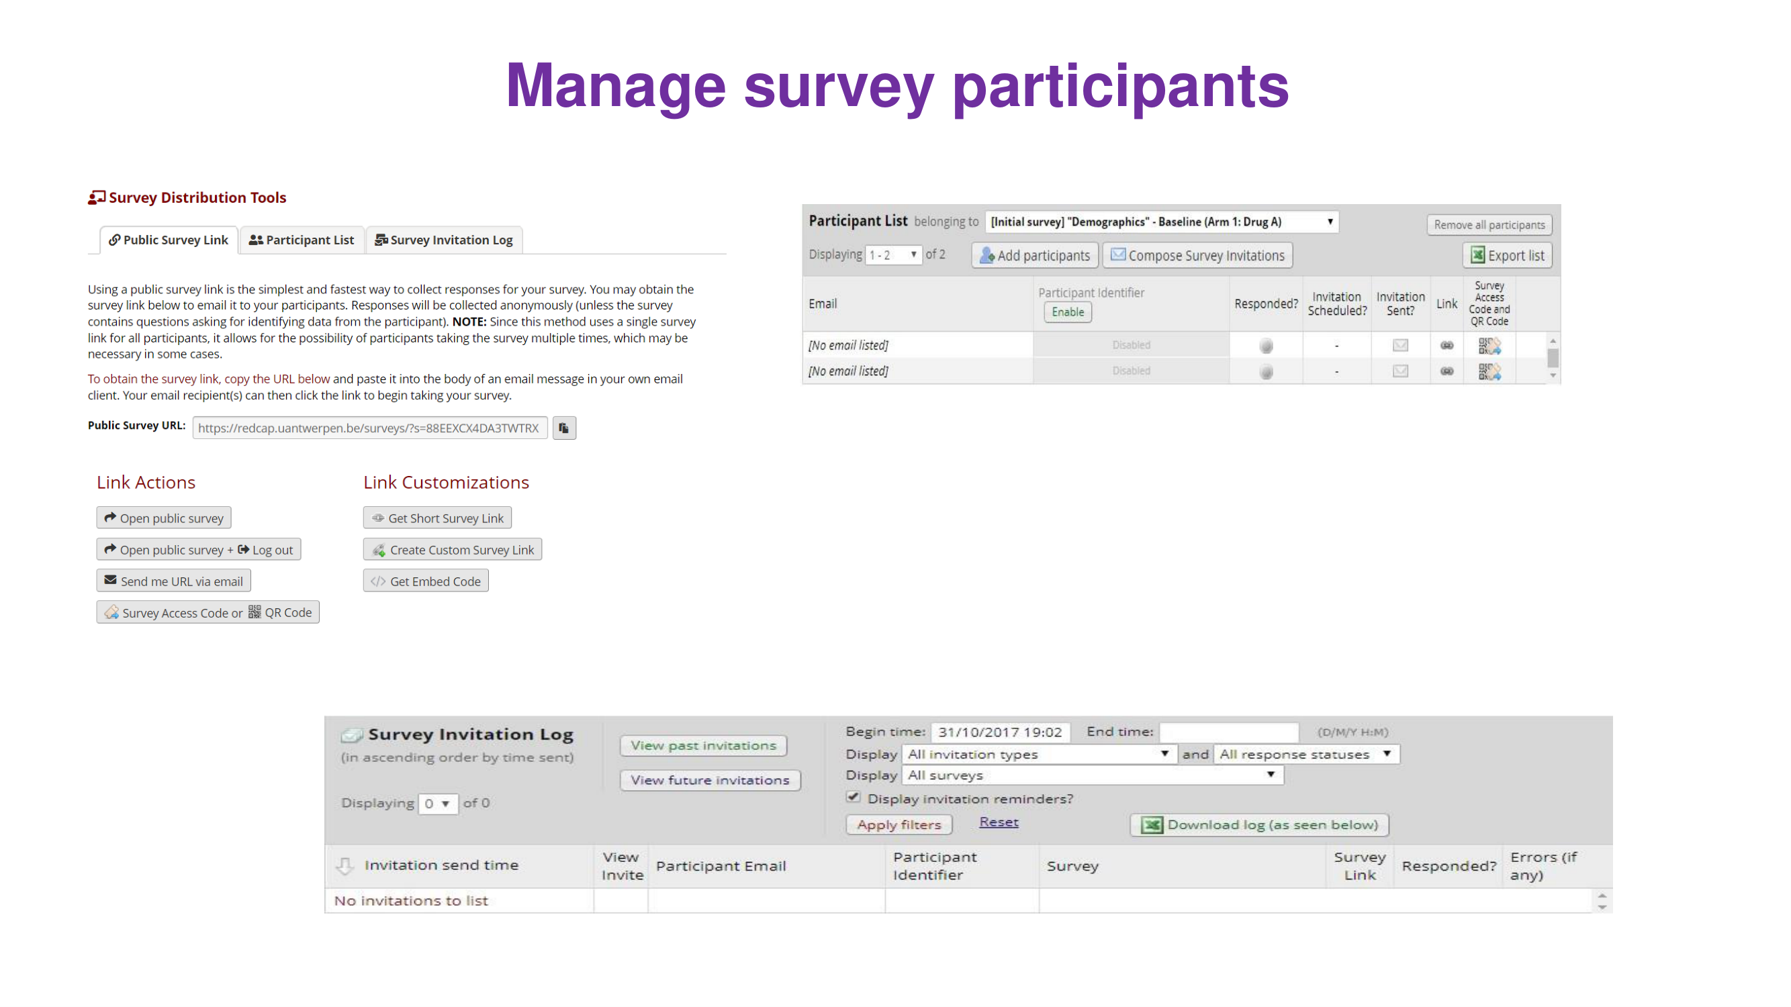

Slide 25
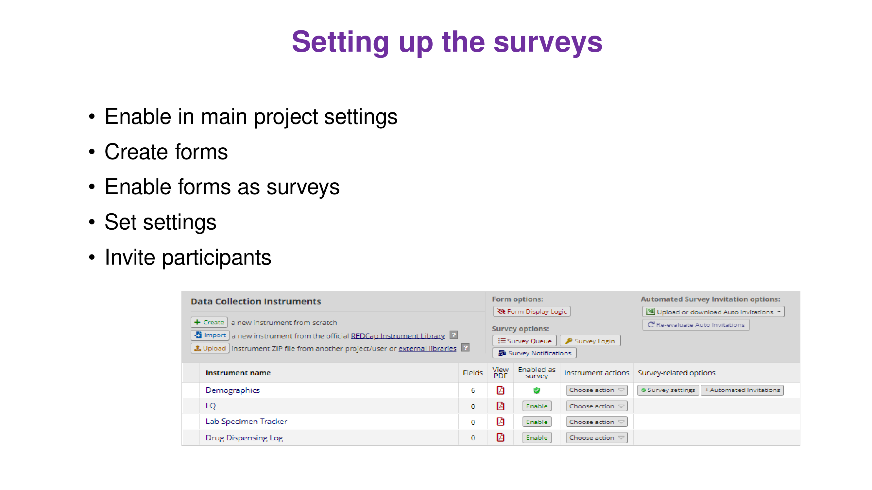

Slide 26
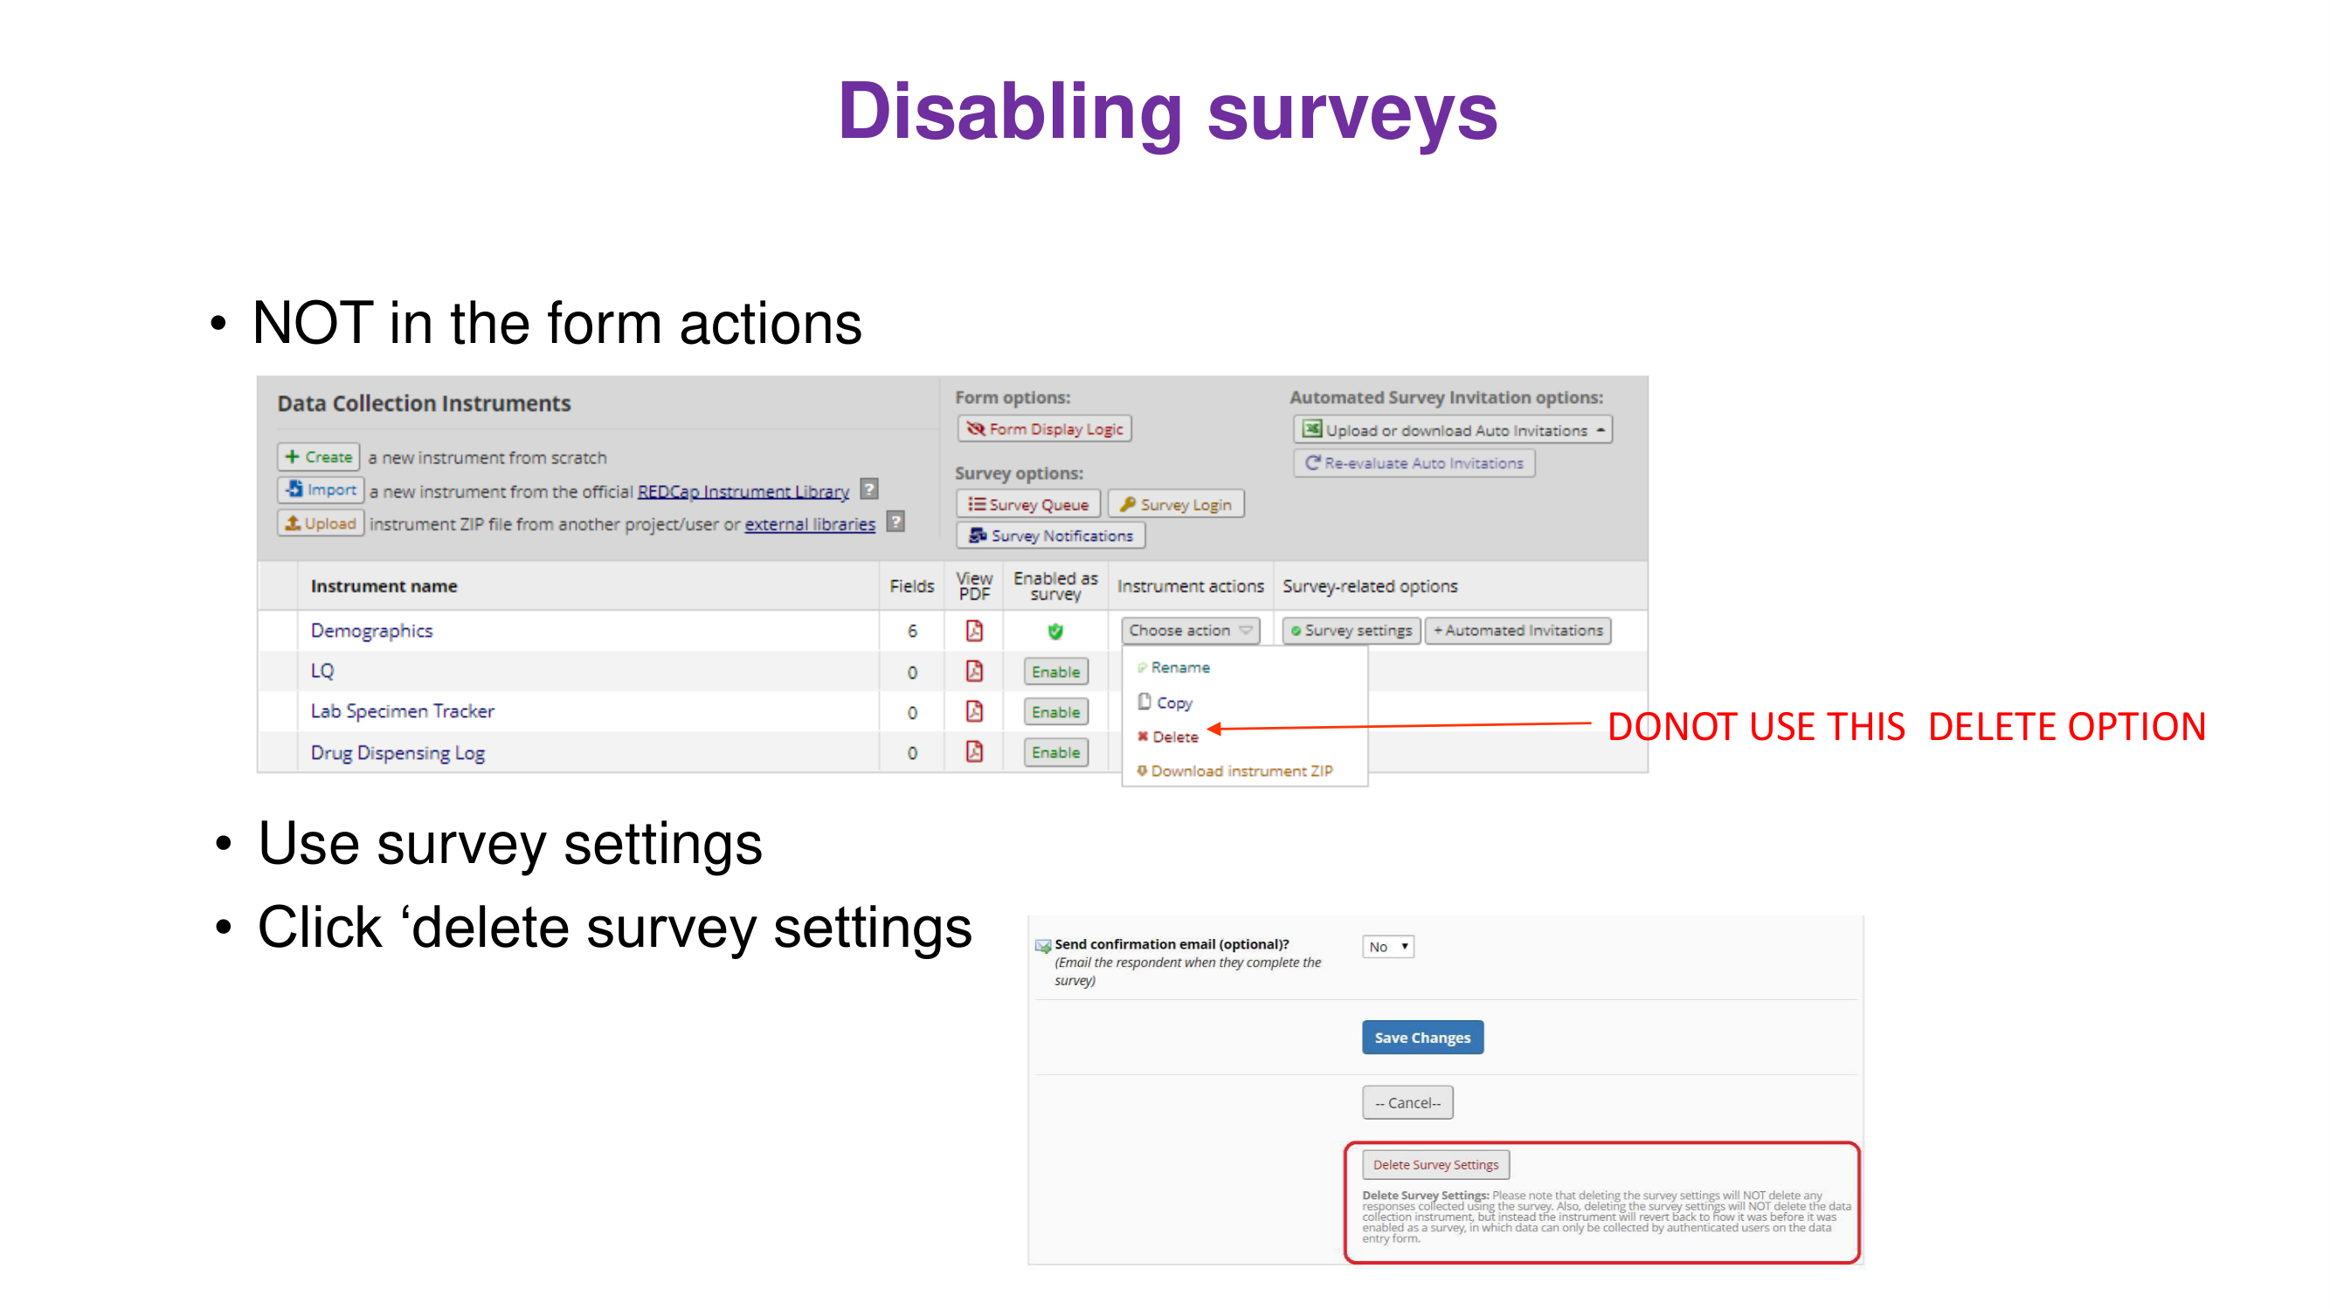

Slide 27
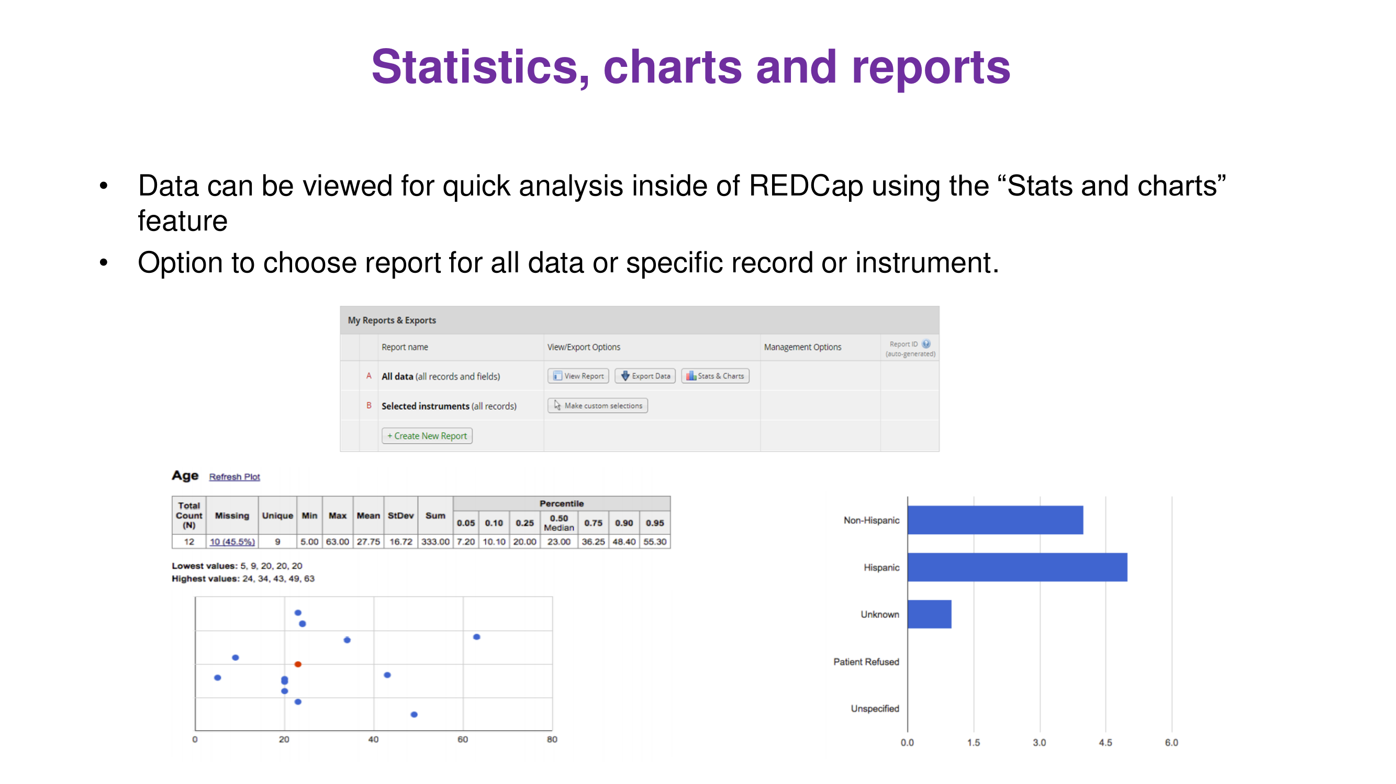

Slide 28
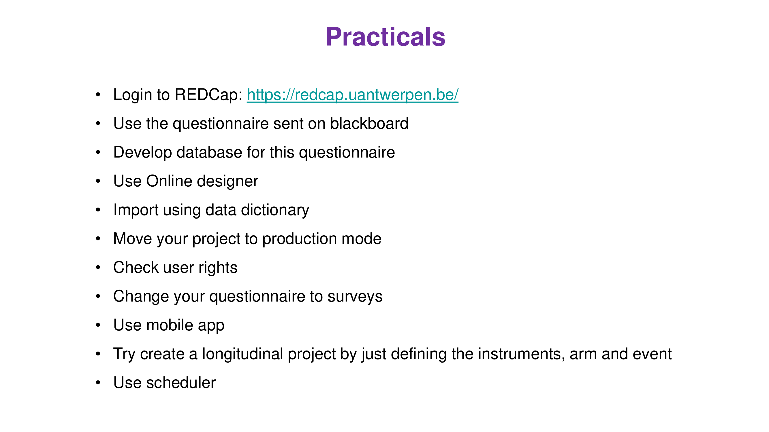

Slide 29
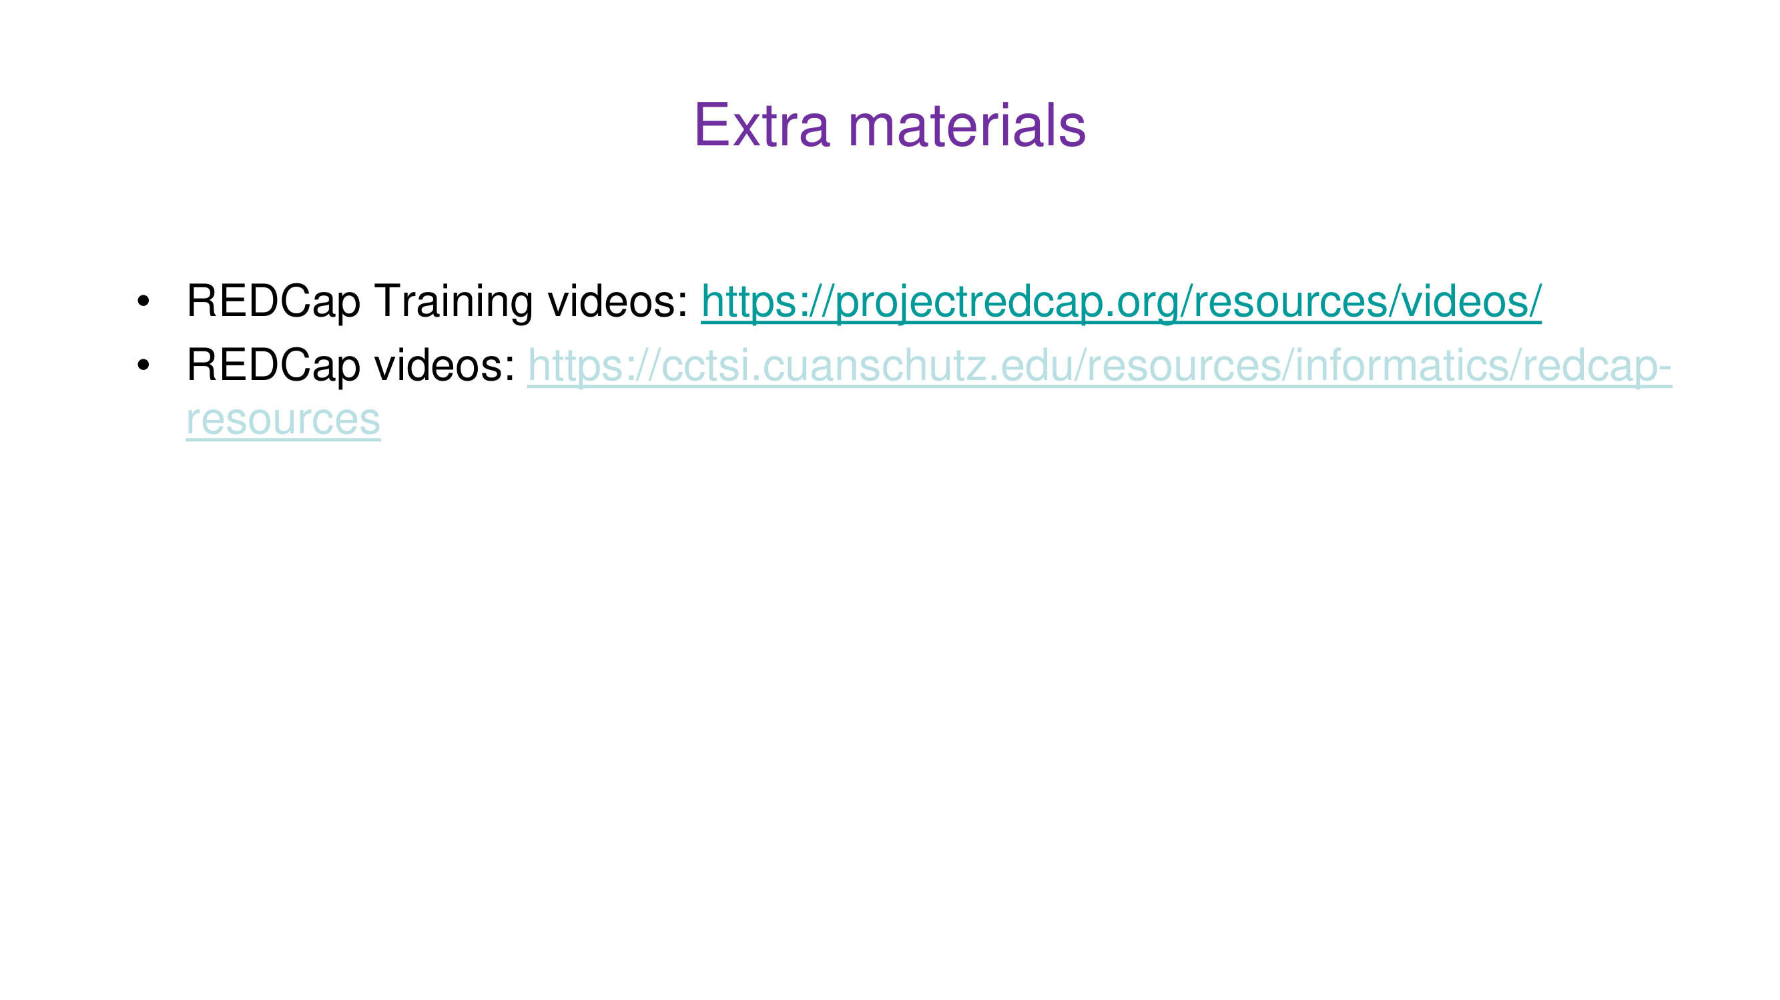

Slide 30
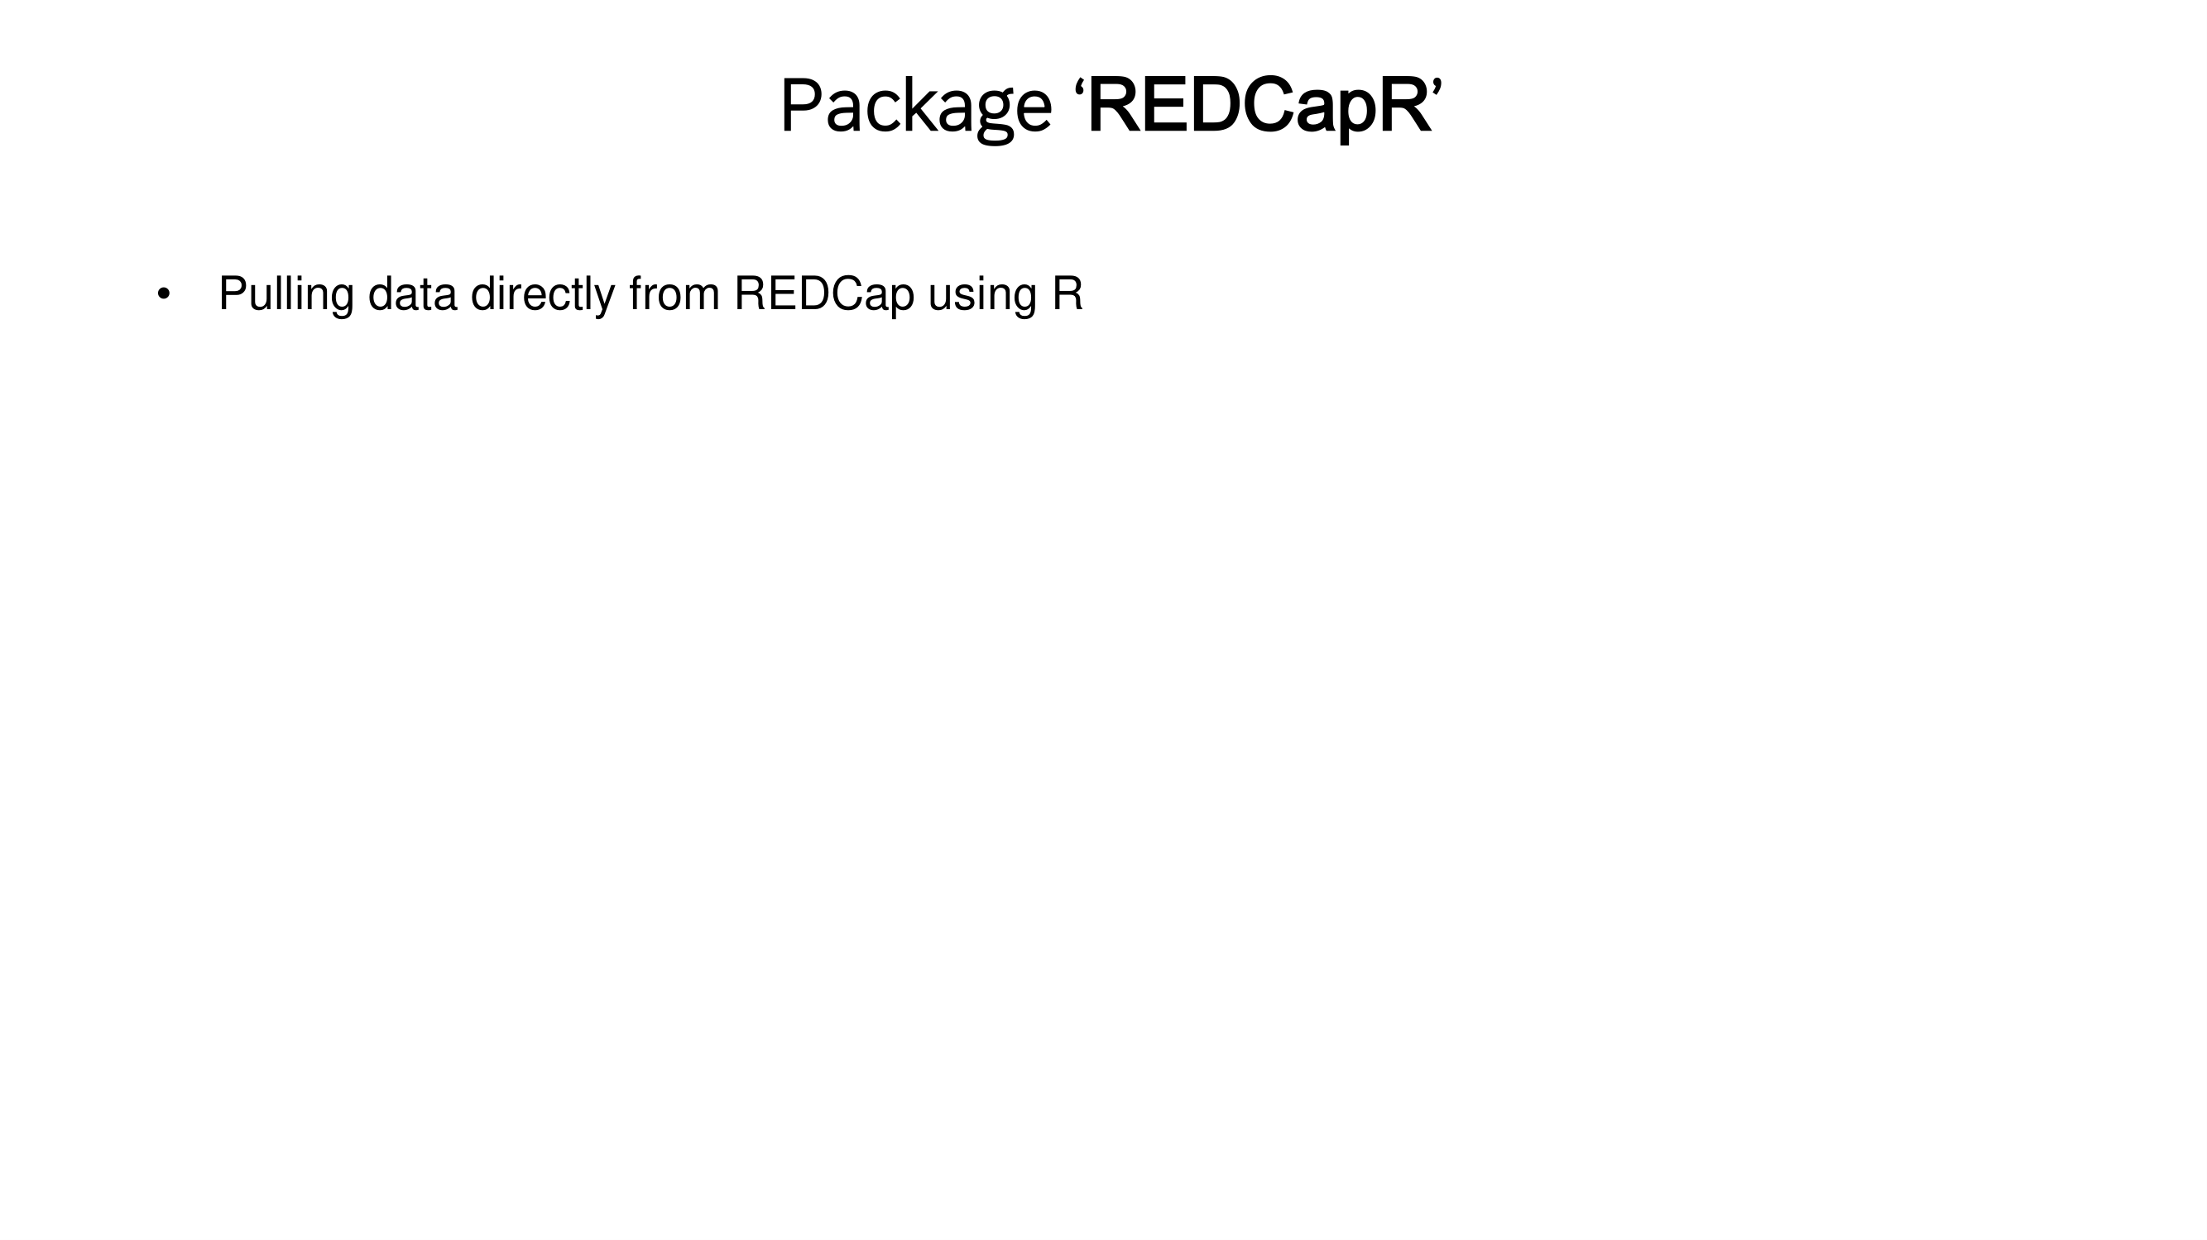

Slide 31
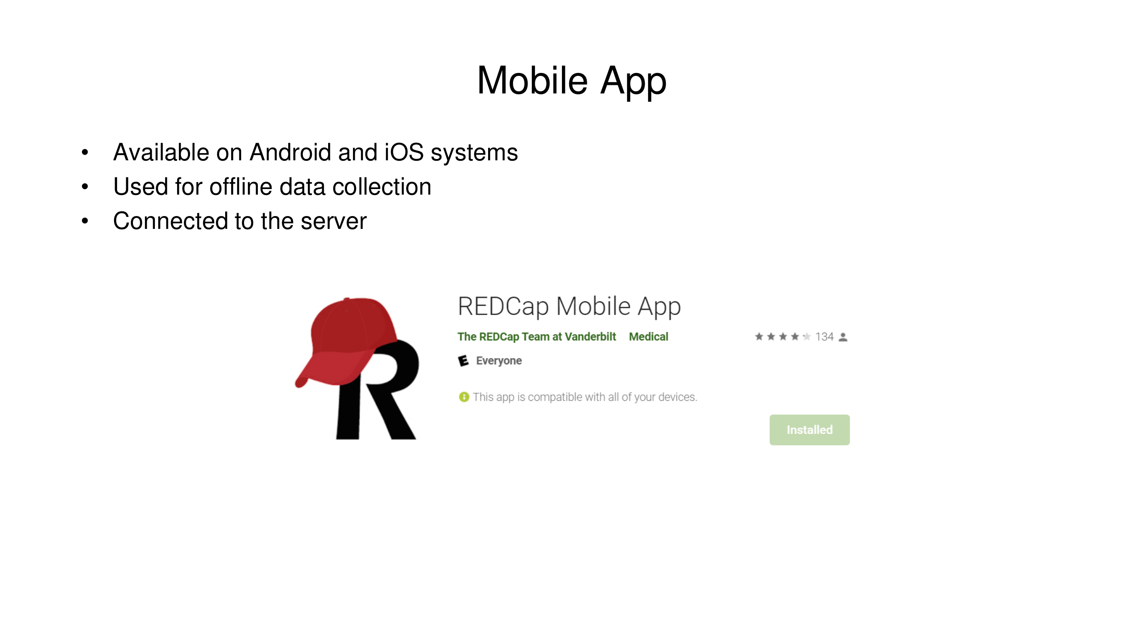

Slide 32
Homework: PISTIC 2026
• Build the PISTIC study in REDCap (groups)
  – Protocol and CRFs: REDCap Protocol and CRFs – Assignment
  – Instructions: REDCap HW Instructions 2026
• New this year
  – Multi-centre: Dar es Salaam, Mwanza, Mbeya
  – Data Access Groups: one per site
• Deadline
  – 13 December 2026, 11:00

Slide 33


Slide 34


