Slide 1


#BCX17 Connected Building & CITY
Bosch surveillance cameras

Slide 2
Bosch surveillance cameras on #BCX17 Information for Hackers
Which (telemety) data is available?
How to access data?
How to interact with the device or the system?
Optical sensor
Audio sensor
Events
Webbrowser (recommended IE with ActiveX enabled)
BoschVideoSDK
RTSP client (e.g. VLC player)
Get Videostream (RTSP, RTP)
Interfaces HTTP / RCPP / CGI / ONVIF
Set up IVA tasks (ActiveX)
Get autonomous triggered alarms / events
Alarm email / messages
Anything else that is important for the hackers?
What events are available?
MicrosoftCognitiveServiceExample (C# example for connection to the camera and analyze data via MS Cognitve Services)
Alarm task script example (own Bosch script language)
RCP+ and VideoSDK documentation will be provided
CognitiveServiceExample (Java example [in Arbeit])
Generally all alarm tasks / rules which can triggered with the camera (see next slide)

Slide 3
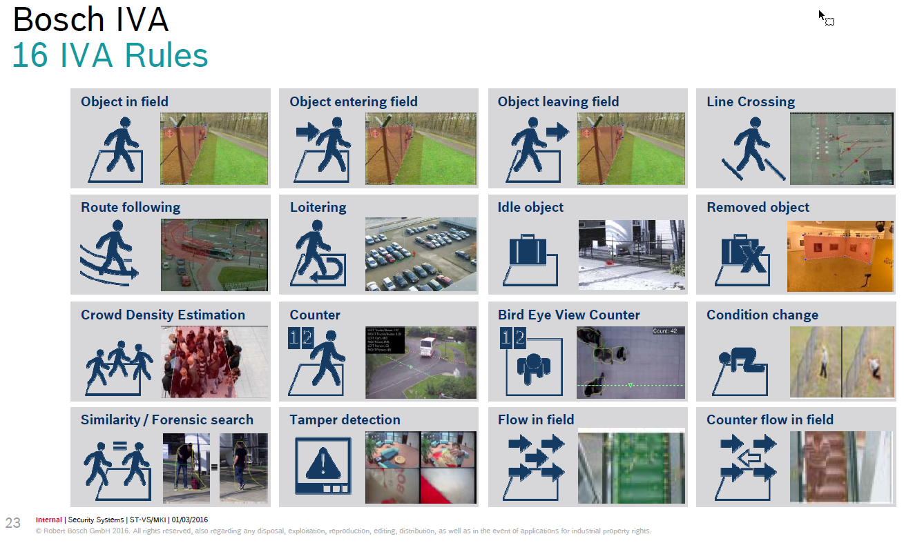
3
Internal | Business Unit, Department | --/--/----
© Robert Bosch GmbH 2016. All rights reserved, also regarding any disposal, exploitation, reproduction, editing, distribution, as well as in the event of applications for industrial property rights.

Slide 4







Your Contact #BCX17
David Lauterbach
David.Lauterbach@de.bosch.com
+49(911)93456-175
Follow us on

