Slide 1
ISO 15037-compliant filter
design and verification
(vehicle dynamics of heavy trucks and buses)

Slide 2
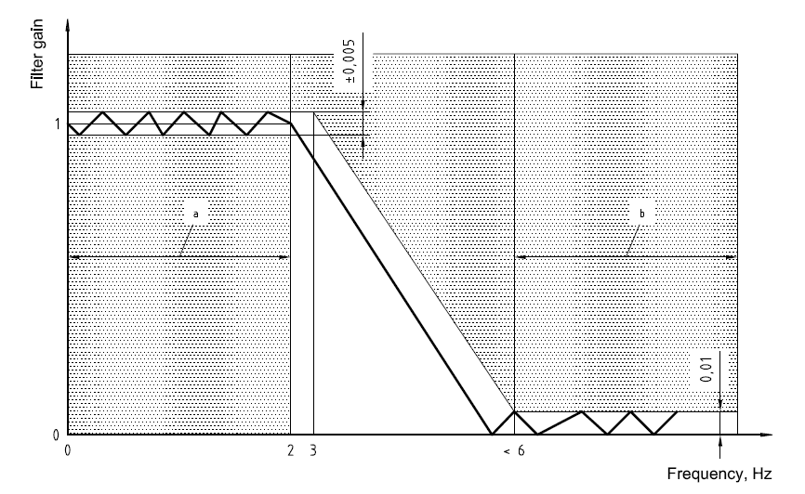
ISO 15037:
Allowed frequency response

Slide 3
Filter design, see:
02_Matlab_script/Butterworth_7th_ord_final.m
b_transfer_s_function.pdf
c_recursive_function.pdf

Slide 4
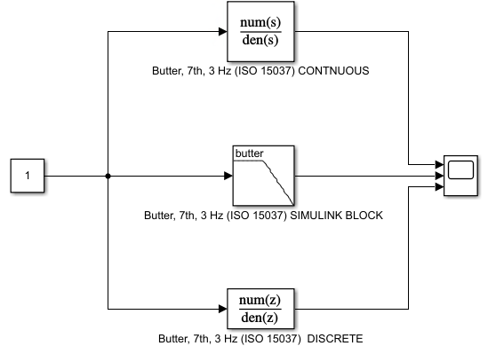



Filter test/comparison:
Setup (step response)
$$continuous$$
$$standard block$$
$$discrete$$

Slide 5
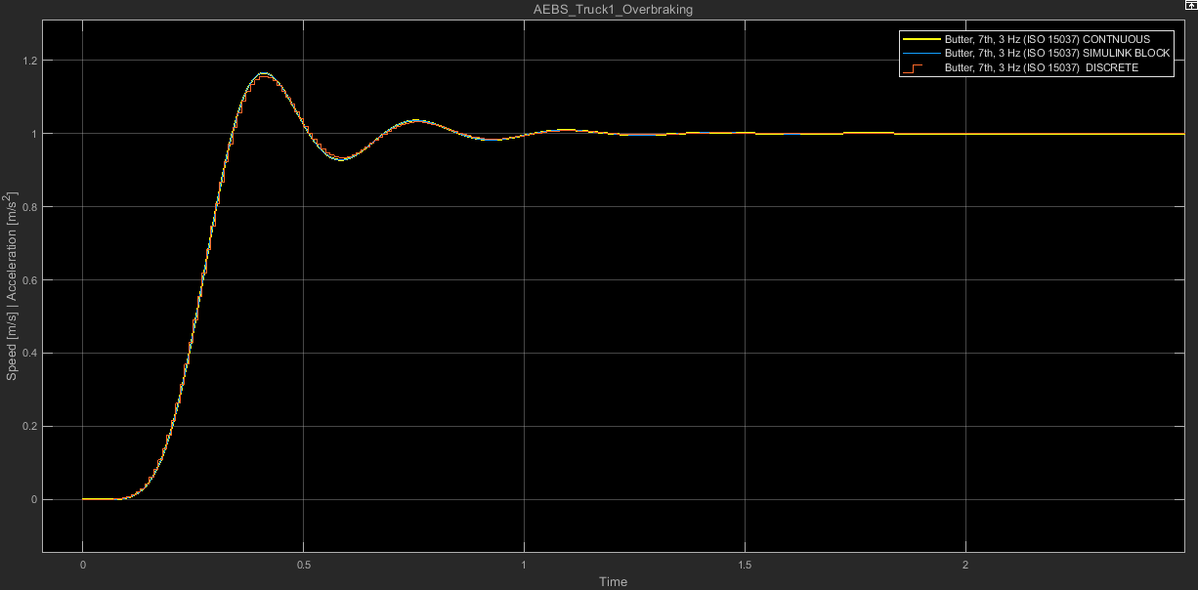
Filter test/comparison:
Result (step response)

Slide 6
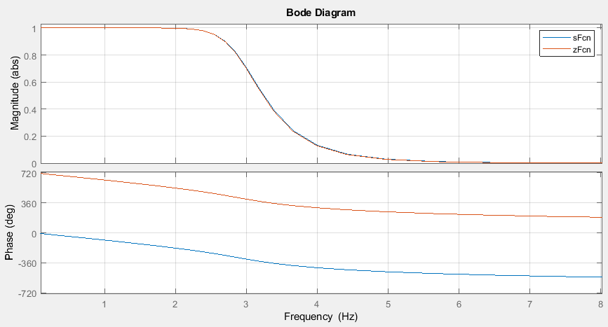
Filter test/comparison:
Frequency responses

