Slide 1
Impact of average calculation on brake deceleration considerations

Slide 2
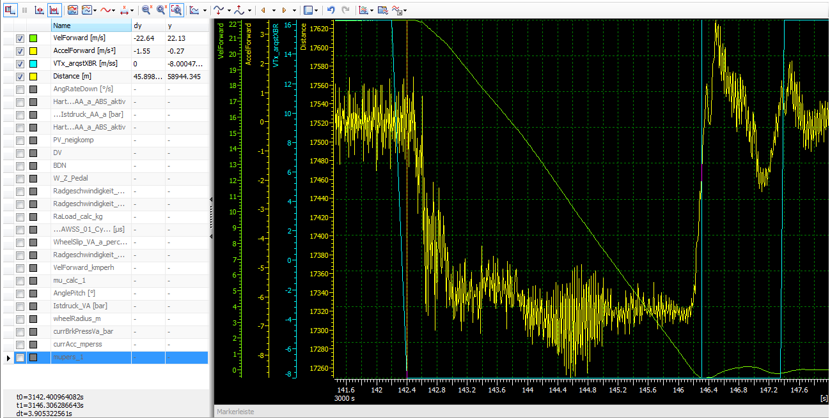
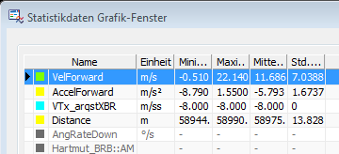
Full stop measurement: XBR „-8“ 80 >> 0 (OXTS IMU measurements)
brake distance: x_meas = 45,9 m
via SPD: avg_dec = dv/dt = -22,64/3,905 = -5,798 m/ss
both valid
via DEC: avg_dec = AVG(all dec) = -5,793 m/ss

Slide 3
BACKWARDS: Calculation of braking distance (via avg deceleration)
Formula: x = v_init * t_stop – 0.5 * avg_dec * (t_stop)^2
avg_dec = 5.795 m/ss: x_calc = 22.13 * 3.905 – 0.5 * 5.795 * (3.905)^2
>> x_calc = 42,2 m
UPCOMING PROBLEM:
x_meas ↔ x_calc
45,9 m ↔ 42,2 m

Slide 4
ASSUMPTION:
real/ramped (PT1) deceleration results in a braking distance being higher
than
the braking distance determined via average deceleration
?

Slide 5
INVESTIGATION via Matlab/Simulink:
braking distance „PT1-deceleration“
VS.
braking distance „average of PT1-deceleration“

Slide 6
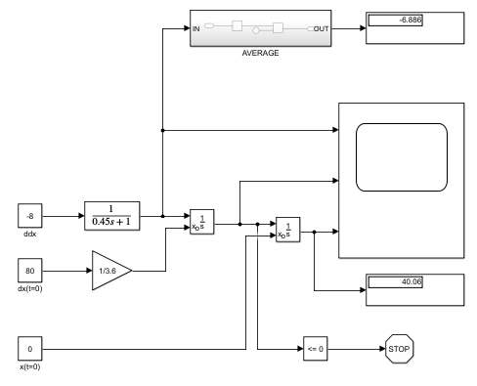
braking distance „PT1-deceleration“ - MODEL
example average deceleration: avg_ex_dec = -6,886 m/ss
example brake distance „PT1“: x_ex_PT1 = 40,1 m

Slide 7
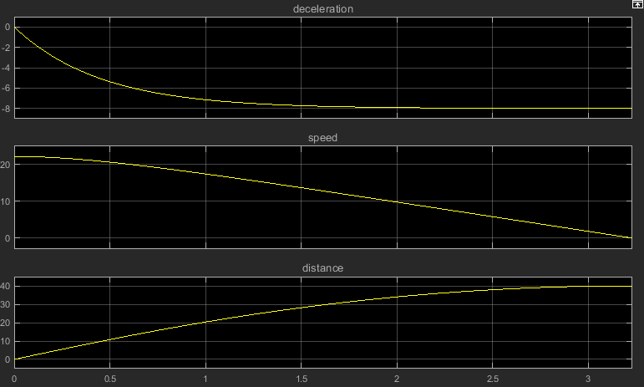
braking distance „PT1-deceleration“ - GRAPHS

Slide 8
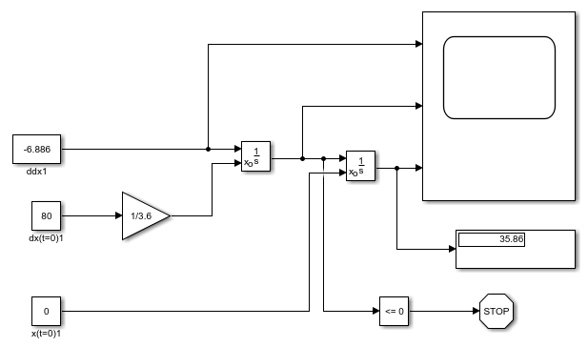
braking distance „average of PT1-deceleration“- MODEL
avg_ex_dec = -6,886 m/ss m
example brake distance „average of PT1“: x_ex_avg = 35,9 m

Slide 9
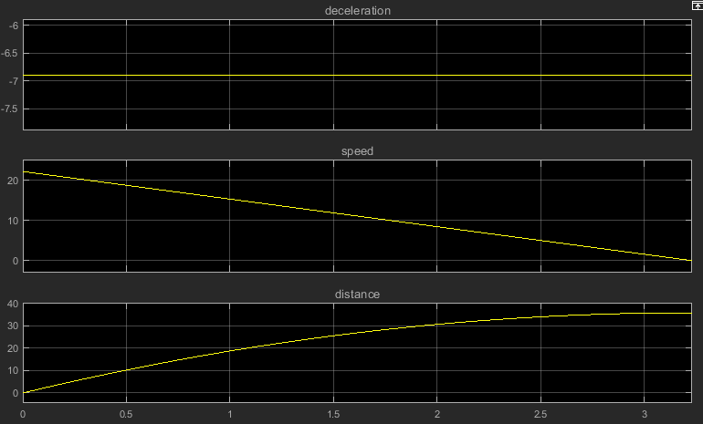
braking distance „average of PT1-deceleration“ - GRAPHS

Slide 10
RESULT:
x_ex_avgPT1 < x_ex_PT1
35,9 m < 40,1 m
LESSON:
!
… the average-consideration of the deceleration (slightly) sophisticates
the calculated brake distance

