Slide 1

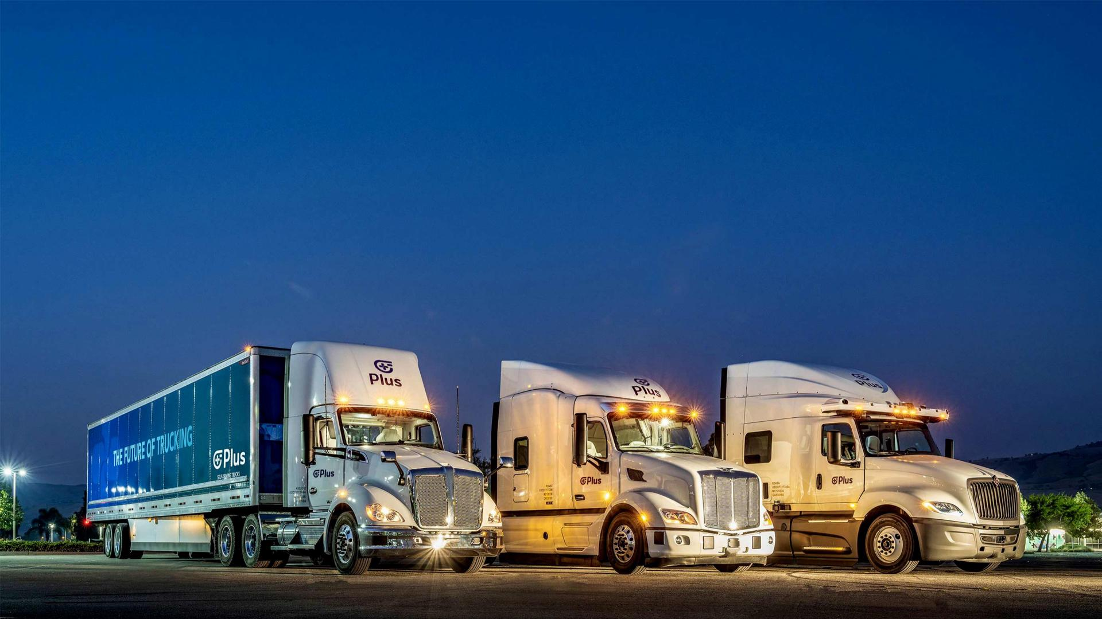


Balocco test plan and acceptance
05/31/2022
©2022 PLUSAI, INC. | CONFIDENTIAL AND PROPRIETARY | ALL RIGHTS RESERVED | ‹#›
Notes:
TITLE SLIDE FROM MASTER

Slide 2
Headway keeping, with stop and go, cut-in, cut-out, cut through handling
Test # | Test description | Qualitative behavior expected | KPI desired | KPI achieved | Test result
1 | Ego ACC speed 90 kph. Lead at 60 kph | Ego follows at 60 kph. Maintains headway distance | Ego speed = 60 kph Headway distance = headway time * ego speed
2 | Ego ACC speed 90 kph. Lead at 70 kph | Ego follows at 70 kph. Maintains headway distance | Ego speed = 70 kph Headway distance = headway time * ego speed
3 | Ego ACC speed 90 kph. Lead at 80 kph | Ego follows at 80 kph. Maintains headway distance | Ego speed = 80 kph Headway distance = headway time * ego speed
Same desired KPI for CAT 2 and CAT 3
CAT 3 also includes testing in low light conditions
NOTE: ODD can be restricted to conditions where the desired KPI is achieved

Slide 3
Headway keeping, with stop and go, cut-in, cut-out, cut through handling
Test # | Test description | Qualitative behavior expected | KPI desired | KPI achieved | Test result
4 | Ego ACC speed 90 kph. Lead at 60 kph until ego is also at 60 kph. Lead brakes at -0.3 m/s^2 and comes to complete stop. | Ego either slows and comes to a complete stop behind the lead or overtakes | Min distance from lead = 10 m
5 | Ego ACC speed 90 kph. Lead at 70 kph until ego is also at 70 kph. Lead brakes at -0.3 m/s^2 and comes to complete stop. | Ego either slows and comes to a complete stop behind the lead or overtakes | Min distance from lead = 10 m
6 | Ego ACC speed 90 kph. Lead at 80 kph until ego is also at 80 kph. Lead brakes at -0.3 m/s^2 and comes to complete stop. | Ego either slows and comes to a complete stop behind the lead or overtakes | Min distance from lead = 10 m
For CAT 3 release, tests should work at -0.4 m/s^2
CAT 3 also includes testing in low light conditions
NOTE: ODD can be restricted to conditions where the desired KPI is achieved

Slide 4
Headway keeping, with stop and go, cut-in, cut-out, cut through handling
Test # | Test description | Qualitative behavior expected | KPI desired | KPI achieved | Test result
7 | Ego ACC speed 90 kph. Lead cuts in 100 kph at higher speed at 40 m and slows down to 70 kph at -0.3 m/s^2 | Ego slows down and maintains headway at 70 kph | Min distance from lead = 10 m
8 | Ego ACC speed 90 kph. Lead cuts in 100 kph at higher speed at 40 m and slows down to 50 kph at -0.3 m/s^2 | Ego slows down and maintains headway at 50 kph | Min distance from lead = 10 m
9 | Ego ACC speed 90 kph. Lead cuts in 100 kph at higher speed at 40 m and slows down to 30 kph at -0.3 m/s^2 | Ego slows down and maintains headway at 30 kph | Min distance from lead = 10 m
For CAT 3 release, tests should work at -0.4 m/s^2
CAT 3 also includes testing in low light conditions

Slide 5
Headway keeping, with stop and go, cut-in, cut-out, cut through handling
Test # | Test description | Qualitative behavior expected | KPI desired | KPI achieved | Test result
10 | Ego ACC speed 40 kph. Lead at 30 kph. Lead brakes at -0.3 m/s^2 to come to a complete stop. | Ego slows down and stops behind lead | Min distance from lead = 10 m
11 | Ego ACC speed 90 kph. Initially, lead stopped in front of ego. Initially, ego stopped behind lead. Lead speeds up at 0.3 m/s^2 | Ego speeds up maintaining reasonable headway distance | Max distance from lead = headway time * ego speed
For CAT 3 release, tests should work at -0.4 m/s^2
CAT 3 also includes testing in low light conditions

Slide 6
Overtake
Slow moving lead
Third lane or shoulder
AV
CAT 3 not applicable

Slide 7
Overtake
Test # | Test description | Qualitative behavior expected | KPI desired | KPI achieved | Test result
1 | Ego ACC speed 90 kph. Lead slows down to less than 45 kph in straight section. | Ego slows down, changes lane to left, overtakes and changes lane to right | Min longitudinal distance from lead > 30 m. Min lateral distance from lead = 3 m ( center to center)
2 | Ego ACC speed 80 kph. Lead slows down to less than 45 kph in straight section. | Ego slows down, changes lane to left, overtakes and changes lane to right | Min longitudinal distance from lead > 30 m. Min lateral distance from lead = 3 m ( center to center)
3 | Ego ACC speed 70 kph. Lead slows down to less than 45 kph in straight section. | Ego slows down, changes lane to left, overtakes and changes lane to right | Min longitudinal distance from lead > 30 m. Min lateral distance from lead = 3 m ( center to center)
CAT 3 not applicable

Slide 8
Automatic lane change for stopped vehicle in lane
Stopped vehicle
Third lane or shoulder
AV
CAT 3 not applicable

Slide 9
Automatic lane change for stopped vehicle in lane
Test # | Test description | Qualitative behavior expected | KPI desired | KPI achieved | Test result
1 | Ego ACC speed 90 kph. Lead stopped in lane in straight section > 300 m from ego | Ego slows down, changes lane to left, overtakes and changes lane to right | Min longitudinal distance from lead > 30 m. Min lateral distance from lead = 3 m ( center to center)
2 | Ego ACC speed 80 kph. Lead stopped in lane in straight section > 300 m from ego | Ego slows down, changes lane to left, overtakes and changes lane to right | Min longitudinal distance from lead > 30 m. Min lateral distance from lead = 3 m ( center to center)
3 | Ego ACC speed 70 kph. Lead stopped in lane in straight section > 300 m from ego | Ego slows down, changes lane to left, overtakes and changes lane to right | Min longitudinal distance from lead > 30 m. Min lateral distance from lead = 3 m ( center to center)
CAT 3 not applicable

Slide 10
Lane centering
Test # | Test description | Qualitative behavior expected | KPI desired | KPI achieved | Test result
1 | Ego ACC speed 90 kph CW | Ego stays in center of lane. No LDW | Max lane center offset < 0.5 m. Avg lane center offset < 0.2 m
2 | Ego ACC speed 80 kph CW | Ego stays in center of lane. No LDW | Max lane center offset < 0.5 m. Avg lane center offset < 0.2 m
3 | Ego ACC speed 70 kph CW | Ego stays in center of lane. No LDW | Max lane center offset < 0.5 m. Avg lane center offset < 0.2 m
Same desired KPI for CAT 2 and CAT 3
CAT 3 also includes testing in low light conditions
NOTE: ODD can be restricted to conditions where the desired KPI is achieved
Notes:
what is ego_lateral_acceleration? (in failed ODD)

Slide 11
Lane centering
Test # | Test description | Qualitative behavior expected | KPI desired | KPI achieved | Test result
1 | Ego ACC speed 90 kph CCW | Ego stays in center of lane. No LDW | Max lane center offset < 0.5 m. Avg lane center offset < 0.2 m
2 | Ego ACC speed 80 kph CCW | Ego stays in center of lane. No LDW | Max lane center offset < 0.5 m. Avg lane center offset < 0.2 m
3 | Ego ACC speed 70 kph CCW | Ego stays in center of lane. No LDW | Max lane center offset < 0.5 m. Avg lane center offset < 0.2 m
Same desired KPI for CAT 2 and CAT 3
CAT 3 also includes testing in low light conditions
NOTE: ODD can be restricted to conditions where the desired KPI is achieved
Notes:
what is ego_lateral_acceleration? (in failed ODD)

Slide 12
Stopping in lane for stopped vehicle in lane
Stopped vehicle
Stopped vehicle
Third lane or shoulder
AV
Notes:
start applying brakes 20m before and a bit stronger as per driver. increase retarder percent usage

Slide 13
Stopping in lane for stopped vehicle in lane
Test # | Test description | Qualitative behavior expected | KPI desired | KPI achieved | Test result
1 | Ego ACC speed 90 kph | Ego stops at a comfortable distance behind lead | Min distance to lead > 10 m
2 | Ego ACC speed 80 kph | Ego stops at a comfortable distance behind lead | Min distance to lead > 10 m
3 | Ego ACC speed 70 kph | Ego stops at a comfortable distance behind lead | Min distance to lead > 10 m
Same desired KPI for CAT 2 and CAT 3
CAT 3 also includes testing in low light conditions
NOTE: ODD can be restricted to conditions where the desired KPI is achieved

Slide 14
Nudge
Stopped vehicle
Third lane or shoulder
AV

Slide 15
Nudge
Test # | Test description | Qualitative behavior expected | KPI desired | KPI achieved | Test result
1 | Ego ACC speed 90 kph | Ego nudges away from obstacle well before reaching it | Min lateral offset away from lane center > 0.5 m when passing obstacle. Nudge starts > 40 m away
2 | Ego ACC speed 80 kph | Ego nudges away from obstacle well before reaching it | Min lateral offset away from lane center > 0.5 m when passing obstacle. Nudge starts > 40 m away
3 | Ego ACC speed 70 kph | Ego nudges away from obstacle well before reaching it | Min lateral offset away from lane center > 0.5 m when passing obstacle. Nudge starts > 40 m away
Same desired KPI for CAT 2 and CAT 3
CAT 3 also includes testing in low light conditions
NOTE: ODD can be restricted to conditions where the desired KPI is achieved

Slide 16
Road works handling
Cones blocking road
Third lane or shoulder
AV

Slide 17
Road works handling
Test # | Test description | Qualitative behavior expected | KPI desired | KPI achieved | Test result
1 | Ego ACC speed 70 kph | Ego slows and changes lane before approaching cones | Min longitudinal distance from cones > 30 m. Min lateral distance from cone = 3 m ( center to center)
2 | Ego ACC speed 60 kph | Ego slows and changes lane before approaching cones | Min longitudinal distance from cones > 30 m. Min lateral distance from cone = 3 m ( center to center)
For CAT 3 release, ego should slow down and come to a stop at least 10 m before the cones
CAT 3 also includes testing in low light conditions
NOTE: ODD can be restricted to conditions where the desired KPI is achieved

