Slide 1
Accurate Mass Spectrometry Lab
February 1, 2008
Jon Karty

Slide 2
What is Resolution?
Resolution is the ability to separate ions of nearly equal mass/charge
  e.g. C₆H₅Cl and C₆H₅OF @ 112 m/z
      C₆H₅Cl = 112.00798 amu (all ¹²C, ³⁵Cl, ¹H)
      C₆H₅OF = 112.03244 amu (all ¹²C, ¹⁶O, ¹H, ¹⁹F)
      Resolving power of 4600 required to resolve these two
Two definitions
  Resolution = Δm / m (0.015 / 112.03 = 0.00013 or 1.3*10⁻⁴)
  Resolving power = m / Δm (112.03 / 0.015 = 7,468 or 7.5*10⁺³)
High resolution facilitates high precision measurements
  High resolution, high accuracy MS can replace elemental analysis for chemical formula confirmation
High resolution is considered RP ≥ 5,000
  MAT-95 is capable of 60,000 resolving power
  LCT is capable of 5,000 resolving power
  MALDI-TOF-TOF has RP of 10,000-15,000
  FTMS instruments can have RP > 10⁵ to 10⁶

Slide 3
New “-omics” from MS
Metabolomics
  Application of accurate mass spectrometry to identify small molecule metabolites in biological systems
    Sertraline’s metabolite has significantly reduced SSRI activity
    Fluoxetine’s metabolite has same activity, but longer half-life
    Accurate mass spectrometry determined chemical formula of THG (designer steroid)
Petroleomics
  Application of high resolution, accurate mass spectrometry to the study of fossil fuels

Slide 4
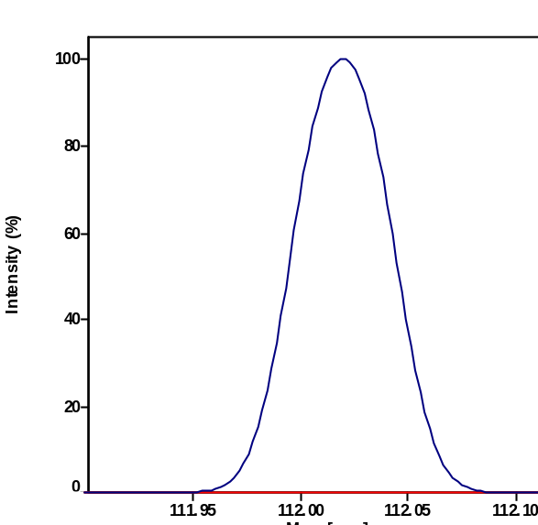
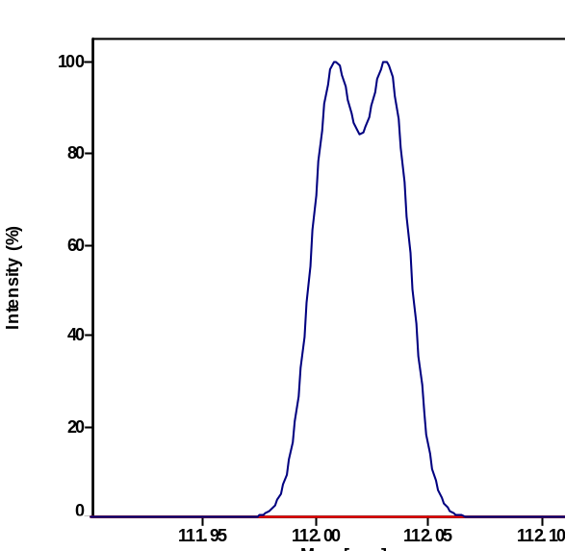
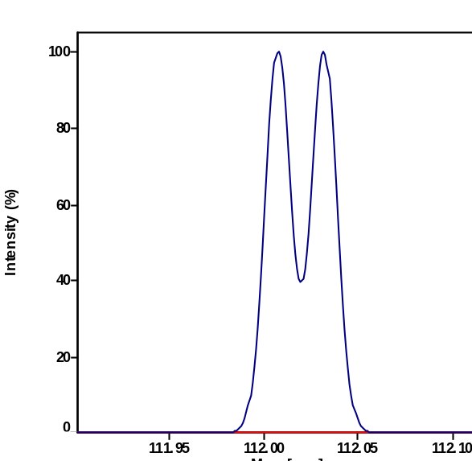
Resolving Power Example
RP= 3,000
RP= 5,000
RP= 7,000
C₆H₅Cl
C₆H₅OF
All resolving powers are FWHM

Slide 5
Calibration
Calibration equation determines relationship between observed signals and actual m/z ratios
External Calibration: mass spectrum of calibration compounds is acquired in a different experiment than the analyte compound
  Instrument drift can introduce errors
    Power supply voltages, temperature in the lab, etc.
Internal Calibration: mass spectrum of calibration compounds are recorded at the same time as analyte compound
  Provides most accurate data
  Requirement to observe both calibrant and analyte ions in same experiment can be a significant challenge
LockSpray on LCT is a unique solution to internal calibration problem

Slide 6
Mass Accuracy
Mass spectrometer accuracy often reported as a relative value
  ppm = parts per million (1 ppm = 0.0001%)
    5 ppm @ m/z 300 = 300 * (5/10⁶) = ±0.0015 Th
    5 ppm @ m/z 3,000 = 3,000 * (5/10⁶) = ±0.015 Th
High resolving power facilitates precise mass measurements
Mass accuracies for MSF instruments
  MAT-95: <5 ppm is standard precision (int. calib.)
  LCT: <50 ppm (ext. calib.), <5 ppm (int. calib.)
Accurate mass measurement is defined is better than 5 ppm error
Accurate mass spectrometry facilitates determination of chemical formula directly from mass spectrum

Slide 7
Formula Matching Basics
Atomic weights are not integers (except ¹²C)
  ¹⁴N = 14.0031 Da; ¹¹B = 11.0093 Da; ¹H = 1.0078 Da
  ¹⁶O = 15.9949 Da; ¹⁹F = 18.9984 Da; ⁵⁶Fe = 55.9349 Da
Difference from integer mass is called “mass defect” or “fractional mass”
  Related to binding energy of the nucleus
Sum of the mass defects depends on composition
  H, N increase mass defect
    Hydrogen-rich molecules have high mass defects
    Heptadecane (C₁₇H₃₆)= 228.2812
  O, Cl, F, Na decrease it
    Hydrogen deficient species have low mass defects
    Morphine, (C₁₇H₁₉NO₃) = 285.1365

Slide 8
More Formula Matching
Accurate mass measurements narrow down the possible formulae for a particular molecular weight
  301 entries (150 formulae) in NIST’02 @ nominal MW 321
  4 compounds within 0.0016 Da (5 ppm) of 321.1000.
Mass spectrum and user info complete the picture
  Isotope distributions indicate/eliminate elements
    (e.g. Cl, Br, Cu)
  User-supplied info eliminates others
    (e.g. no F, Co, I in reaction)
  Suggested formula has to make chemical sense
    C₆H₂₈O₂ is not reasonable nor is Cl₃H₂Co₄
Isomers are not distinguished in this analysis

Slide 9
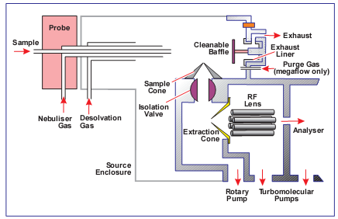
ESI Source Diagram
760 torr
3 – 4 kV
45 V
5 V
10⁻³ torr
10⁻⁶ torr
1 torr

Slide 10
Characteristics of ESI Ions
ESI is a thermal process (1 atm in source)
  Little fragmentation due to ionization (cf EI)
Solution-phase ions are preserved in MS
  e.g. organometallic salts
ESI ions are generated by ion transfer
  (M+H)⁺, (M+Na)⁺, or (M-H)⁻, rarely M^{+•} or M^{-•}
  Ions are almost always EVEN electron ions
ESI often generates multitply charged ions
  (M+2H)²⁺ or (M+10H)¹⁰⁺
  Most ions are 500-1500 m/z even for LARGE polymers
ESI spectrum x-axis must be mass/charge (m/z or Th, not amu or Da)

