Slide 1
Git & GitHub
Training Manual
Kartik Bose - Sep 2021

Slide 2
What is Git?
Git is a free, open-source version control software. This basically means that Git is a content tracker.
Real life projects generally have multiple developers working in parallel. So they need a version control system like Git to make sure that there are no code conflicts between them.
Also, the requirements in such projects change often. So a version control system allows developers to revert and go back to an older version of their code.
The branch system in Git allows developers to work individually on a task (For example: One branch -> One task OR One branch -> One developer).

Slide 3
What is Git?
Basically think of Git as a small software application that controls your code base, if you’re a developer.

Slide 4
Git Repositories
A repository (or “Repo” for short) is a project that contains multiple files. In our case a repository will contain code-based files.
There are two ways you can host your repositories. One is online (on the cloud) and the second is offline (self-installed on your server).
There are three popular Git hosting services: GitHub (owned by Microsoft), GitLab (owned by GitLab) and BitBucket. We’ll use GitHub as our hosting service.
Git is the tool that tracks the changes. GitHub is the website where you host all the of your Git Repos.

Slide 5
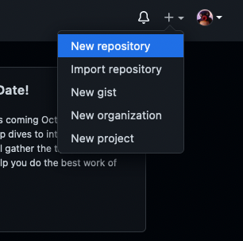
Working with GitHub projects
Type 1: Create the repository, clone it to your PC, and work on it.(Recommended)
Create a new repository by clicking the “New repository” option on the GitHub web page.

Slide 6
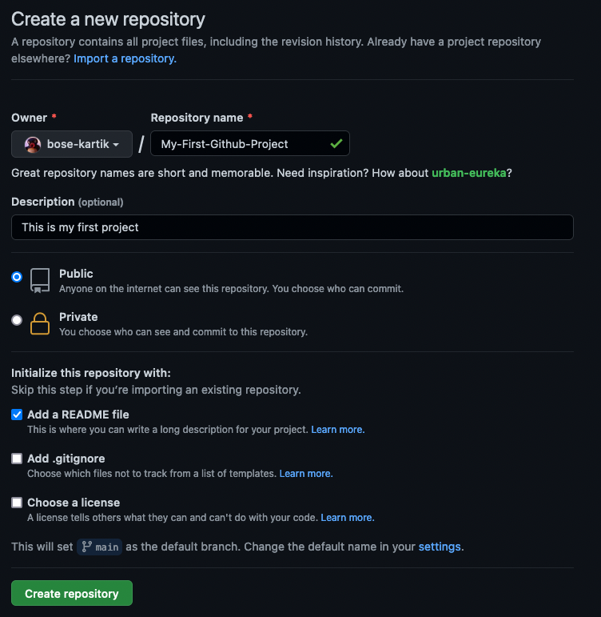
Working with GitHub projects
Type 1: Create the repository, clone it to your PC, and work on it.(Recommended)
Pick a name for your first repository, add a small description, check the ‘Initialize this repository with a README file, and click on the “Create repository” button.

Slide 7
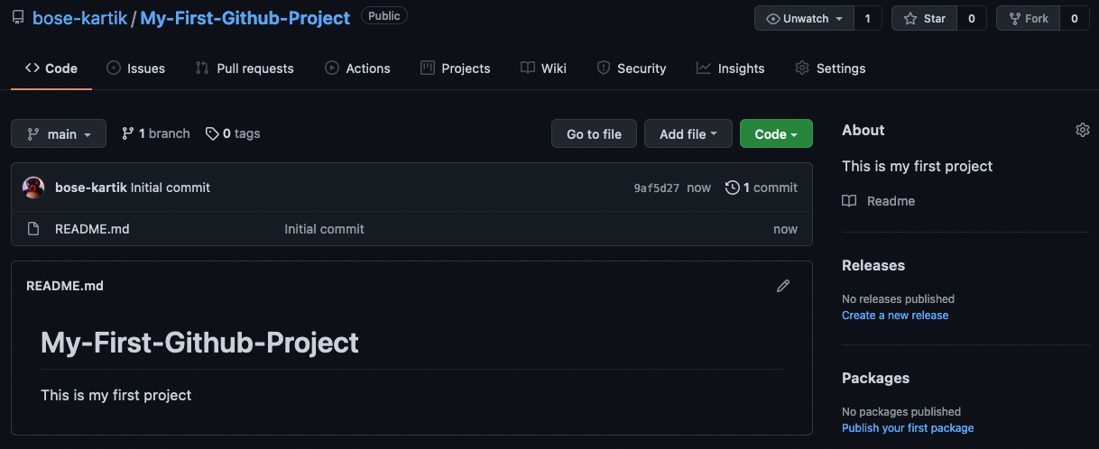
Working with GitHub projects
Type 1: Create the repository, clone it to your PC, and work on it.(Recommended)
Well done! Your first GitHub repository is created.

Slide 8
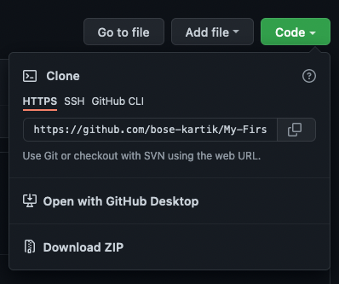
Working with GitHub projects
Type 1: Create the repository, clone it to your PC, and work on it.(Recommended)
Now we need to clone this repo to your local machine from Github.
Copy the HTTPS address for the GitHub (remote) repo.

Slide 9
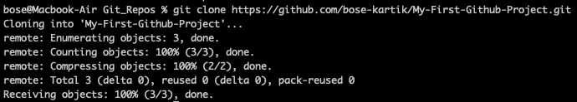
Working with GitHub projects
Type 1: Create the repository, clone it to your PC, and work on it.(Recommended)
Once you have the address of the repository, you need to use your terminal.
This command will make a local copy of the repository hosted at the given address.

Slide 10
Working with GitHub projects
Type 1: Create the repository, clone it to your PC, and work on it.(Recommended)
Now, your repository is on your computer. You need to move in it with the following command.

Slide 11
Working with GitHub projects
Type 1: Create the repository, clone it to your PC, and work on it.(Recommended)
Now, in the terminal, you’re in your repository directory.
There are 4 steps in a commit. All the following steps must be performed within your project:
‘status’
‘add’
‘commit’
‘push’

Slide 12
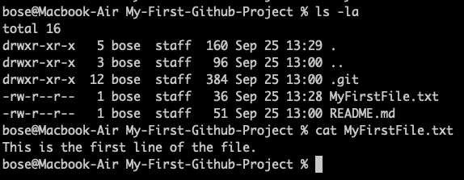
Working with GitHub projects
Type 1: Create the repository, clone it to your PC, and work on it.(Recommended)
Before we move on with the commit procedure - create a file, put data in it and save it.
Create a text file in the current folder.
Add some data in it and save the file.

Slide 13
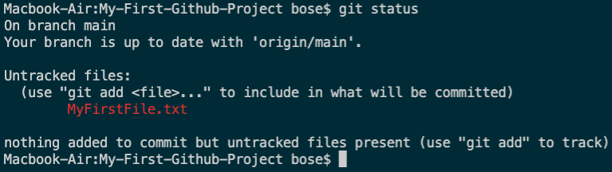
Working with GitHub projects
Type 1: Create the repository, clone it to your PC, and work on it.(Recommended)
“status”: The first thing you need to do is to check the files you have modified.
To do this, you can type the following command to make a list of changes appear.

Slide 14
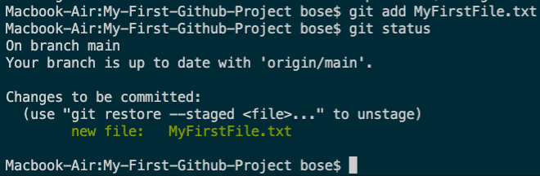
Working with GitHub projects
Type 1: Create the repository, clone it to your PC, and work on it.(Recommended)
“add”: With the help of the change list, you can add all files you want to upload with the following command.
In our case, we’ll add MyFirstFile.txt file and check it’s status.

Slide 15
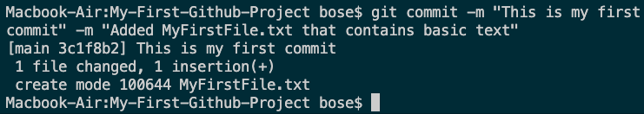
Working with GitHub projects
Type 1: Create the repository, clone it to your PC, and work on it.(Recommended)
“commit”: Now that we have added the files of our choice, we need to write a message to explain what we have done.
This message may be useful later if we want to check the change history. Here is an example of what we can put in our case.

Slide 16
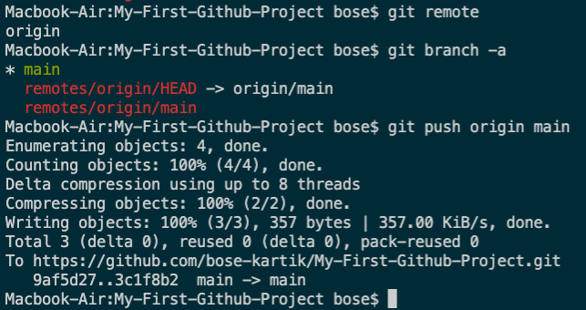
Working with GitHub projects
Type 1: Create the repository, clone it to your PC, and work on it.(Recommended)
“push”: Now we can put our work on GitHub. To do that we have to ‘push’ our files to Remote.
Remote is a duplicate instance of our repository that lives somewhere else on a remote server. To do this, we must know the remote’s name (Mostly remote is named origin).

Slide 17
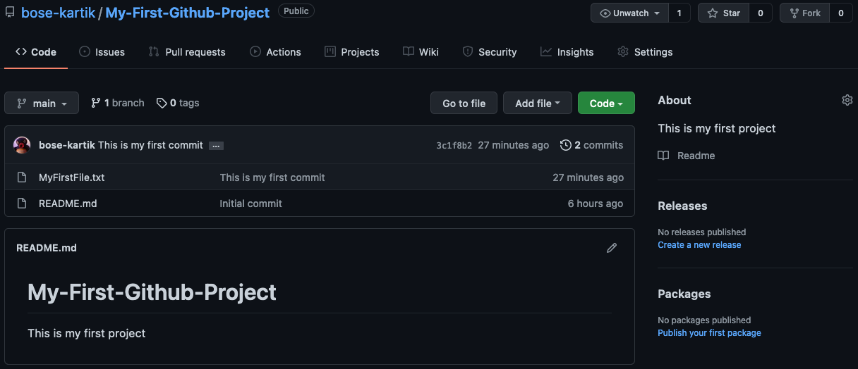
Working with GitHub projects
Type 1: Create the repository, clone it to your PC, and work on it.(Recommended)
Now, if we go to our repository on the GitHub web page, we can see the MyFirstFile.txt file that we’ve pushed to remote — GitHub!

