Slide 1

Predicting customer buying behavior
23/01/2022

Slide 2
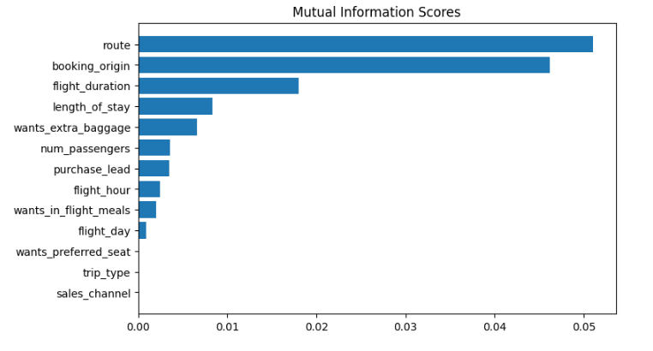
predictive model to understand factors that influence buying behaviour
ACCURACY: 85.08(RandomForest)
AUC score: 0.558(RandomForest)
ACCURACY: 84.7(Logistic Regression)
ACCURACY: 84.83(Xgboost)
ACCURACY: 84.86(GradientBoosting)
route
booking_origin
flight_duration
wants_extra_baggage
length_of_stay
are the top 5 features which influence
Customer buying behavior
We need to increase the AUC score.

