Slide 1
Java Training

Slide 2
Generic programming in Java

Slide 3
Topics
background and goals of generic programming
basics of generic classes = parameterized types
generic methods for general algorithms
inheritance rules for generic types
bounded type parameters
generic code and the Java Virtual Machine
restrictions and limitations
wildcard types and wildcard type capture

Slide 4
Why generic programming
Background
old version 1.4 Java collections were Object-based and required the use of ugly casts
cannot specify the exact type of elements
must cast to specific classes when accessing
Java generics
lets you write code that is safer and easier to read
is especially useful for general data structures, such as ArrayList
generic programming = programming with classes and methods parameterized with types

Slide 5
Why generic programming (cont.)
generic types are a powerful tool to write reusable object-oriented components and libraries
however, the generic language features are not easy to master and can be misused
their full understanding requires the knowledge of the type theory of programming languages
especially covariant and contravariant typing
the following introduces the main aspects of Java generics and their use and limitations
we mostly inspect illustrative samples of what is and what is not allowed, with some short glimpses inside the JVM implementation

Slide 6
Why generic programming (cont.)
Java generics
in principle, supports statically-typed data structures
early detection of type violations
cannot insert a string into ArrayList <Number>
also, hides automatically generated casts
superficially resembles C++ templates
C++ templates are factories for ordinary classes and functions
a new class is always instantiated for given distinct generic parameters (type or other)
in Java, generic types are factories for compile-time entities related to types and methods

Slide 7
Definition of a simple generic class
class Pair <T> { public T first; public T second; public Pair (T f, T s) { first = f; second = s; } public Pair () { first = null; second = null; } }
you instantiate the generic class by substituting actual types for type variables, as: Pair <String>
you can think the result as a class with a constructor
public Pair (String f, String s), etc . .
you can then use the instantiated generic class as it were a normal class (almost):
Pair <String> pair = new Pair <String> ("1","2");

Slide 8
Multiple type parameters allowed
you can have multiple type parameters
class Pair <T, U> { public T first; public U second; public Pair (T x, U y) { first = x; second = y; } public Pair () { first = null; second = null; } }
to instantiate: Pair <String, Number>

Slide 9
Generic static algorithms
you can define generic methods both inside ordinary classes and inside generic classes
class Algorithms { // some utility class
public static <T> T getMiddle (T [ ] a) {
return a [ a.length / 2 ];
}
. . .
}
when calling a generic method, you can specify type
String s = Algorithms.<String>getMiddle (names);
but in most cases, the compiler infers the type:
String s = Algorithms. getMiddle (names);

Slide 10
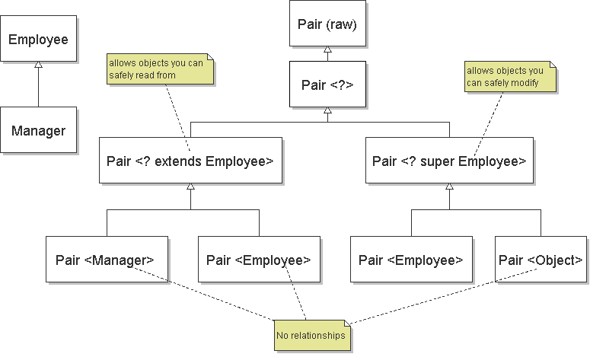
Inheritance rules for generic types

Slide 11
Comments on inheritance relations
Pair<Manager> matches Pair<? extends Employee> => subtype relation (covariant typing)
Pair<Object> matches Pair<? super Employee> => subtype relation (contravariant typing)
Pair<Employee> can contain only Employees, but Pair<Object> may be assigned anything (Numbers) => no subtype relation
also: Pair<T> <= Pair<?> <= Pair (raw)
List <String> sl = new LinkedList <String> (); List x = sl; // OK x.add (new Integer (5)); // type safety warning . . String str = sl.get (0); // throws ClassCast.

Slide 12
Bounds for type variables
consider the min algorithm: find the smallest item in a given array of elements
to compile this, must restrict T to implement the Comparable interface that provides compareTo
public static <T extends Comparable>
T min (T [ ] a) { // this is almost correct
if (a.length == 0) throw new InvalidArg.. (..);
T smallest = a [0];
for (int i = 1; i < a.length; i++)
if (smallest.compareTo (a [i]) > 0) // T constraint
smallest = a [i];
return smallest;
}

Slide 13
Bounds for type variables (cont.)
however, Comparable is itself a generic interface
moreover, any supertype of T may have extended it
public static <T extends Object & // bounding class Comparable <? super T>>
T min (T [ ] a) { . . . // the more general form
T smallest = a [0];
for (int i = 1; i < a.length; i++)
if (smallest.compareTo (a [i]) > 0) // T constraint
smallest = a [i];
return smallest;
}
cannot inherit multiple different instantiations of the same generic type (class or interface)
an inherited generic type is fixed for subtypes, too

Slide 14
Generic code and the JVM
the JVM has no instantiations of generic types
a generic type definition is compiled once only, and a corresponding raw type is produced
the name of the raw type is the same name but type variables removed
type variables are erased and replaced by their bounding types (or Object if no bounds); e.g.:
class Pair { // the raw type for Pair <T> public Object first; public Object second; public Pair (Object f, Object s) { . . } }
byte code has some generic info, but objects don't

Slide 15
Generic code and the JVM (cont.)
Pair <String> and Pair <Employee> use the same bytecode generated as the raw class Pair
when translating generic expressions, such as
Pair <Employee> buddies = new Pair < . .;
Employee buddy = buddies.first;
the compiler uses the raw class and automatically inserts a cast from Object to Employee:
Employee buddy = (Employee)buddies.first;
in C++, no such casts are required since class instantiations already use specific types
if multiple constraints (Object & Comparable. .) then the type parameter is replaced by the first one

Slide 16
Overriding of methods of generic type
consider a generic class with a non-final method:
class Pair <T> { // parameter T is erased from code
public void setSecond (T s) { second = s; } . .
to override such type-erased methods, the compiler must generate extra bridge methods:
class DateInterval extends Pair <Date> {
public void setSecond (Date high) { // override
if (high.compareTo (first) < 0) throw new . .
second = high; // otherwise OK
}
public void setSecond (Object s) { // bridge method
setSecond ((Date)s); // generated by compiler
} . .

Slide 17
Restrictions and limitations
in Java, generic types are compile-time entities
in C++, instantiations of a class template are compiled separately as source code, and tailored code is produced for each one
primitive type parameters (Pair <int>) not allowed
in C++, both classes and primitive types allowed
objects in JVM have non-generic classes:
Pair<String> strPair = new Pair<String> . .;
Pair<Number> numPair = new Pair<Number> . .;
b = strPair.getClass () == numPair.getClass ();
assert b == true; // both of the raw class Pair
but byte-code has reflective info about generics

Slide 18
Restrictions and limitations (cont.)
instantiations of generic parameter T are not allowed
new T () // ERROR: whatever T to produce?
new T [10]
arrays of parameterized types are not allowed
new Pair <String> [10]; // ERROR
since type erasure removes type information needed for checks of array assignments
static fields and static methods with type parameters are not allowed
class Singleton <T> {
private static T singleOne; // ERROR
since after type erasure, one class and one shared static field for all instantiations and their objects

Slide 19
Wildcard types
note that the raw class Pair is not equal Pair <?>
Pair pair1 = . .;
pair1.first = new Double (10.0); // WARNING
Pair <?> pair2 = . .;
pair2.first = new Double (10.0); // ERROR
but some operations have no type constraints:
public static boolean hasNulls (Pair <?> p) {
return p.first == null || p.second == null;
}
alternatively, you could provide a generic method
public static <T> boolean hasNulls (Pair <T> p)
generally, prefer wildcard types (but use generic method with type T when multiple parameters)

Slide 20
Wildcard capture
the wildcard type ? cannot be used as a declared type of any variables (as in the previous slide)
Pair <?> p = new Pair <String> ("one", "two"); . . p.first = p.second; // ERROR: unknown type
but, can sometimes use a generic method to capture the wildcard:
public static <T> void rotate (Pair <T> p) {
T temp = p.first; p.first = p.second;
p.second = temp;
}
the compile checks that such a capture is legal
e.g., the context ensures that T is unambiguous

Slide 21
Collections and algorithms
goal: design a minimal interface that you need
e.g., for max, implement to take any Collection
public static <T extends Object & Comparable <? super T>> T max (Collection <? extends T> c) { // a hypothetical implementation: Iterator <T> it = c.iterator (); T largest = it.next (); // or throws NoSuchElement while (it.hasNext ()) { T val = it.next (); if (largest.compareTo (val) < 0) largest = val; } return largest; }

