Slide 1

SCUDEM 2025 – TEAM USC (1136)
Problem B: An AI Ouroboros
Bose Kaikini (Lexington, SC, US)
Roberto Rigoni (Hartsville, SC, US)
Jon Zhou (Fort Mill, SC, US)
Coach: Dr. Paula Vasquez (Columbia, SC, US)

Slide 2
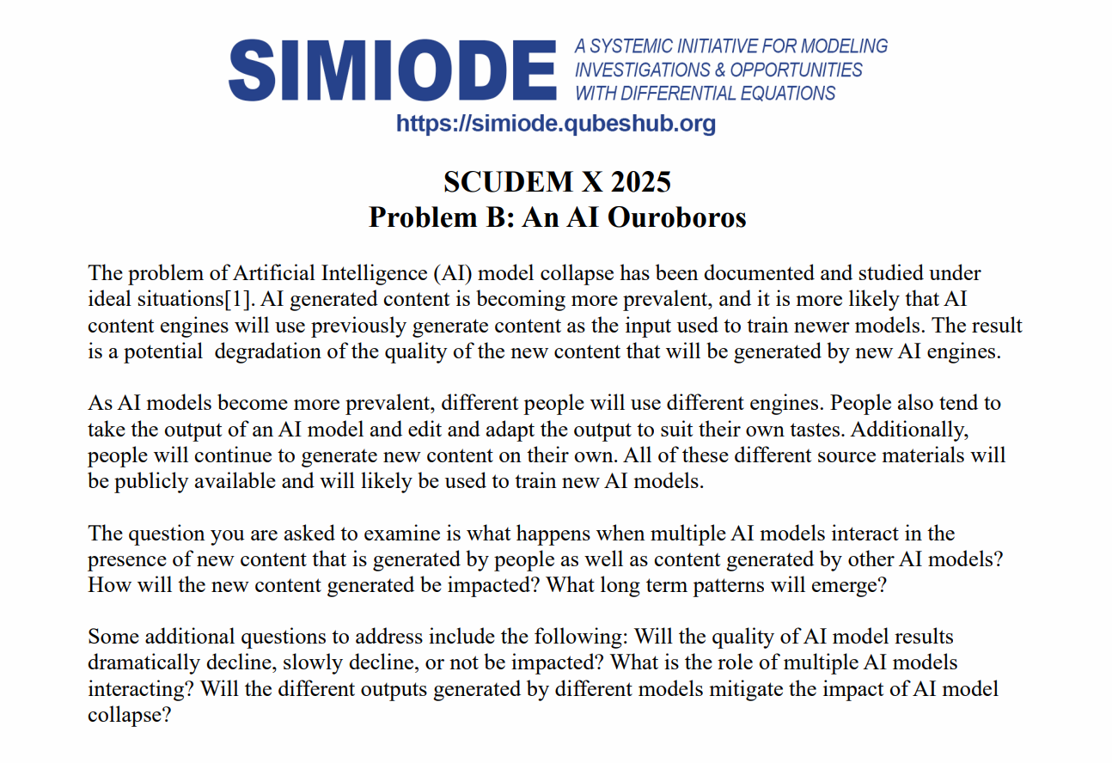
Overview
LLMs continue producing more and more content
Overlap between LLM output and training data
Key questions
  What is the impact of model poisoning over time?
  Can multiple (synthetic) sources combat this poisoning?
  Can synthetic and human sources combat this poisoning?

Slide 3
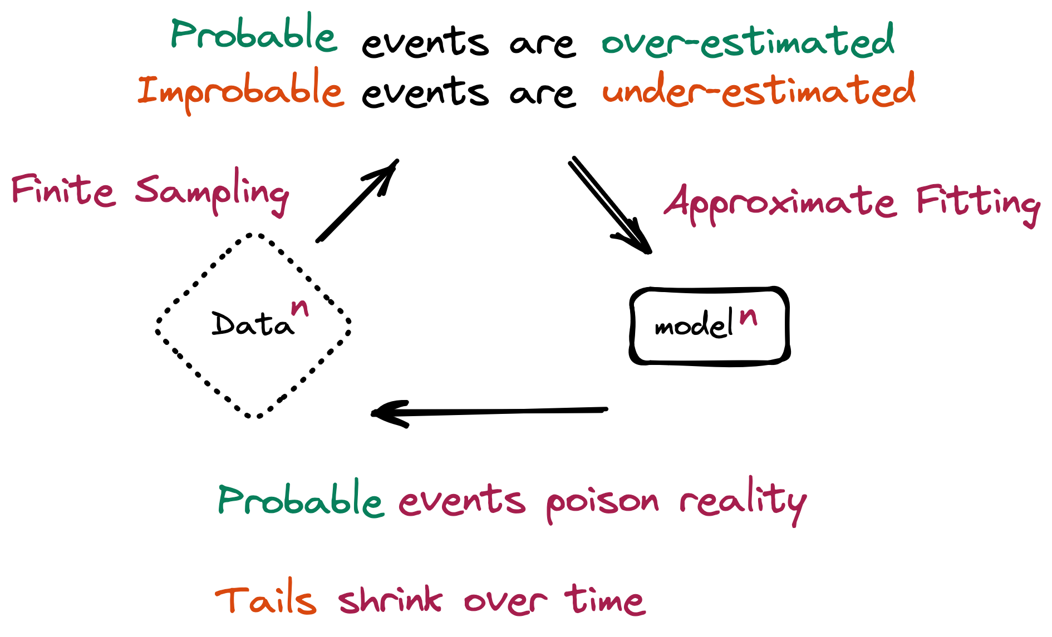
Model collapse + paper explanation
‘AI Models Collapse When Trained on Recursively Generated Data’ (2024), Shumailov et al.
Different model types over generations to track metrics of data distribution
Training on previously AI-made content → models misperceive reality
  Rare data disappears, originally more common data becomes overrepresented
  Model outputs converge to constrained and repetitive results
Fig 1: Timeline from Shumailov et al. supplementary materials

Slide 4
Mathematical basis
We used the simple Gaussian collapse data
  Best for efficient building and testing
  Mathematical basis holds for LLMs and VAEs (statistical approximation error is true even for higher dimensional data)
Standard deviation is equivalent to log perplexity (for LLMs), SD for VAEs, and the SD for more robust Gaussians as well.
Universal trend has multiple factors (information loss)
  A model is trained on too much synthetic data
  A model has a finite sample size
  A model takes biased samples

Slide 5
Explicit RELATION
Any sample variance σₙ₊₁² of M data points is drawn from the previous model’s distribution, 𝒩(μₙ, σₙ²).
Sample variance σ̂ₙ² is a random variable, so it has its own variance. Var(σ̂ₙ²) = (2σₙ⁴) / (M − 1) ≈ (2σₙ⁴) / M.
Average variance loss E[σₙ₊₁² − σₙ²] is directly proportional to this estimation error. σₙ₊₁² ≈ σₙ² − A · (σₙ⁴ / M).
The loss is non-linear (∝ σₙ⁴) and inversely proportional to sample size (M).
We track a general measure of diversity (e.g., negative log-perplexity, L). Lₙ₊₁ ≈ Lₙ − Error(Lₙ, M). Error(Lₙ, M) ∝ f(Lₙ) / M, where f(Lₙ) is a non-linear function, like Lₙᵏ, k > 1

Slide 6
Basic assumptions and model creation
Complete synthetic training provides a good theoretical baseline to understand model collapse
Information loss, leading to model collapse, is inescapable
Initial normal model distribution and values (some randomness) approximates real world data with high probability (our model data spread)
‘Authentic’ data generated via μₙ and σₙ² (initial 1.0 and 1.0) Models created in Python

Slide 7
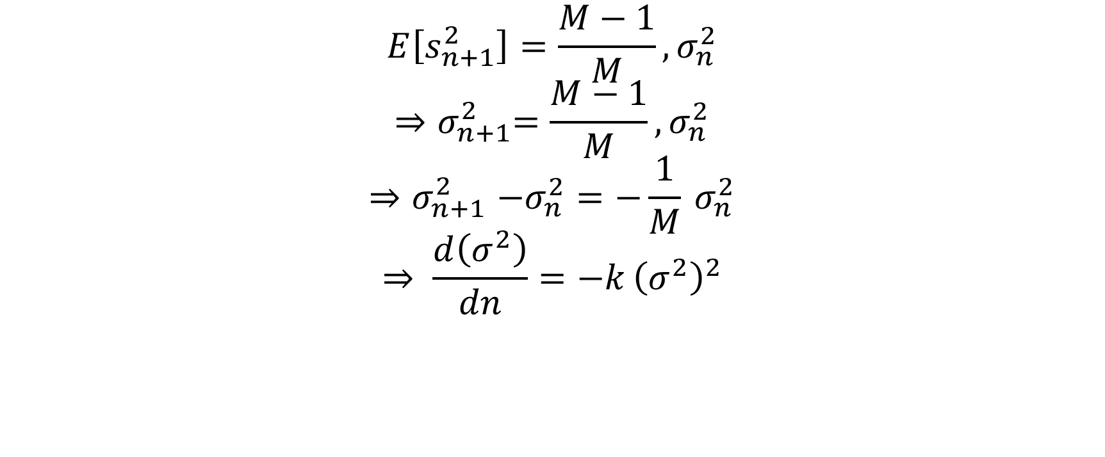
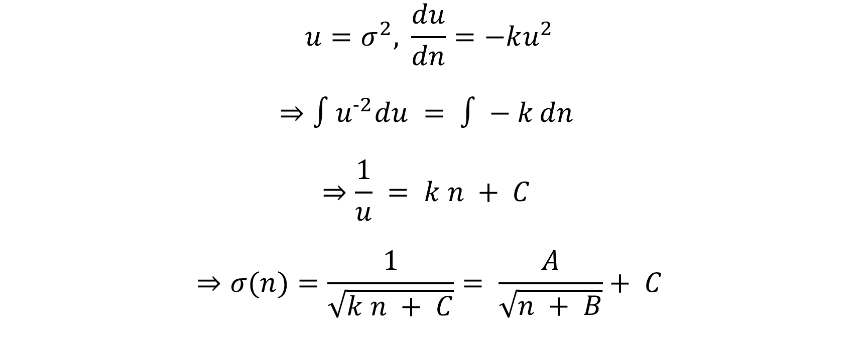
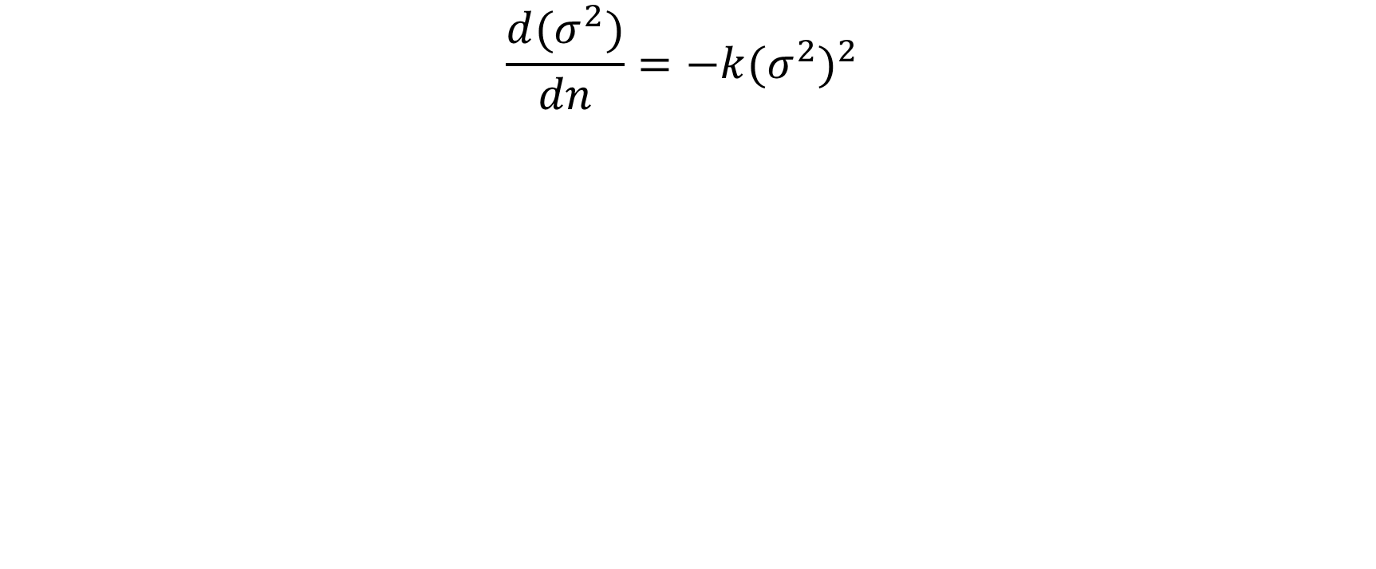
Model overview
Each generation draws from an approx. that already lost variance, so represented as quadratic dependence instead of linear

Slide 8
Parameter refinement and stability analysis
A and K: Decay amplitude
  Rate of decay
B: Offset
  Determines how early collapse becomes severe
C: Fitted STD floor (added to solution of our ODE)
Values depend on amount of synthetic data (generated by Scipy Python library)
STDs approach C as generations go on

Slide 9
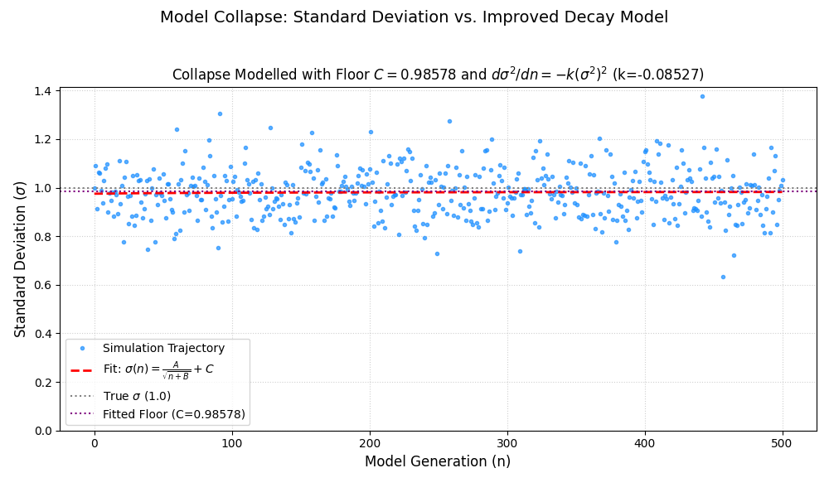
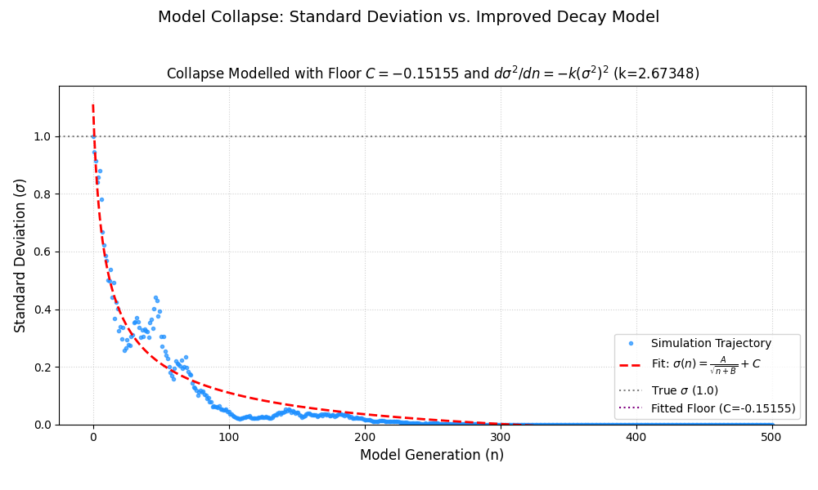
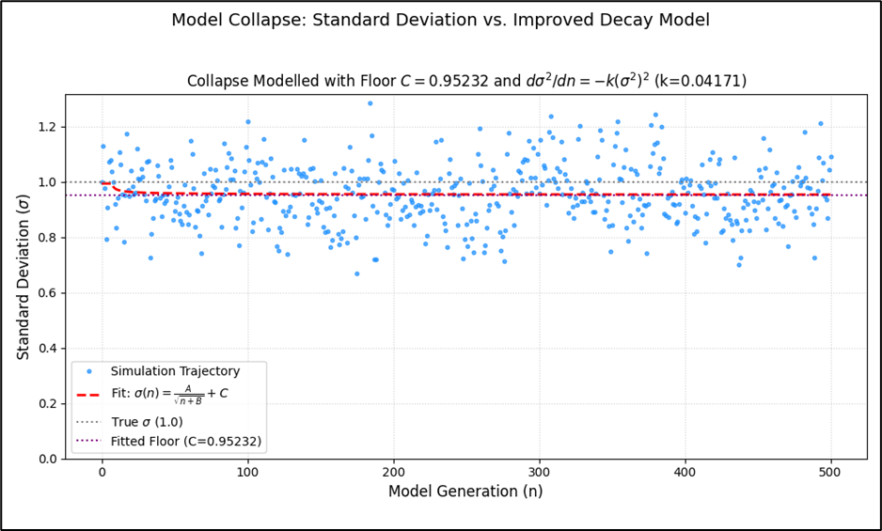
Results

Slide 10
Limitations and strengths
Because of the constrained generation method, the datapoints will always have minute differences between samples, so we have to gather many samples for a comprehensive model – multiple trajectories are averaged for each generation
Our sample diversity measure through standard deviation mathematically approximates the log perplexity for LLM tracking and is less computationally expensive
Experiments are easily replicable
Allows for flexible modeling and data can be extrapolated to a variety of key questions

Slide 11
Implications for key questions
Model degradation – mathematically guaranteed
Model interaction can lead to similar results
‘Human’ data injections significantly alleviates impact

Slide 12
Scudem 2025
TEAM USC
Bose Kaikini, Roberto Rigoni, Jon Zhou

