Slide 1
Identifying Top Ball-playing Center Backs from Statsbomb 2018 World Cup Data
For : Norwich City Football Club
Created by : Soumyajit Bose

Slide 2
Table of Contents :
Player Selection
Metrics chosen
Brief Overview of Methodology
Exploration of Possession-based metrics
Common Standout Names
Exploration of defensive metrics
Common Standout Names
Top 3 Choice of Players
Player Percentile Bar Charts
Pick top 3 names
Some more details for the three players
Progressive Passes and Carries
Conclusion

Slide 3
Player Selection
102 center backs in the dataset
Minimum minutes - 180
Minimum open play passes - 100
Number of center backs reduced to - 51

Slide 4
Metrics Chosen
In-possession :
Expected Threat Created
Expected Threat Facilitated
Pass Completion above Expectation
Final Third Passes and Carries
Progressive Passes and Carries
Successful Passes and Carries
Turnovers
xG Buildup
Pass Success % overall and under pressure
Out-of-possession :
Possession-adjusted Defensive Actions
Possession-adjusted Pressures
Aerial Challenges Win %
True Tackle Win %
(Details of these metrics will be described in subsequent slides)

Slide 5
Methodology
Normal metrics like Passes, Carries, Final Third Entries - events counted directly from dataset.
Pass Completion above Expectation - an Expected Pass Completion model was built using the dataset and machine-learning classification algorithm (Random Forest and XGBOOST) and compared to actual Pass completion.
Expected Threat - Karun Singh’s xT model has been used to quantify threat values of successful passes and carries.
xG Buildup - Made use of Statsbomb’s Possession Sequences to identify players who contribute to buildup to open play shots and reward them with xG value of those open play shots.
Defensive metrics are possession-adjusted.

Slide 6
Exploration of In-Possession Metrics
In the next set of slides, several in-possession metrics will be presented to gauge ball-playing abilities of the chosen set of center-backs.
For each case, the “standout” names – players who perform better than the median will be listed out separately.

Slide 7
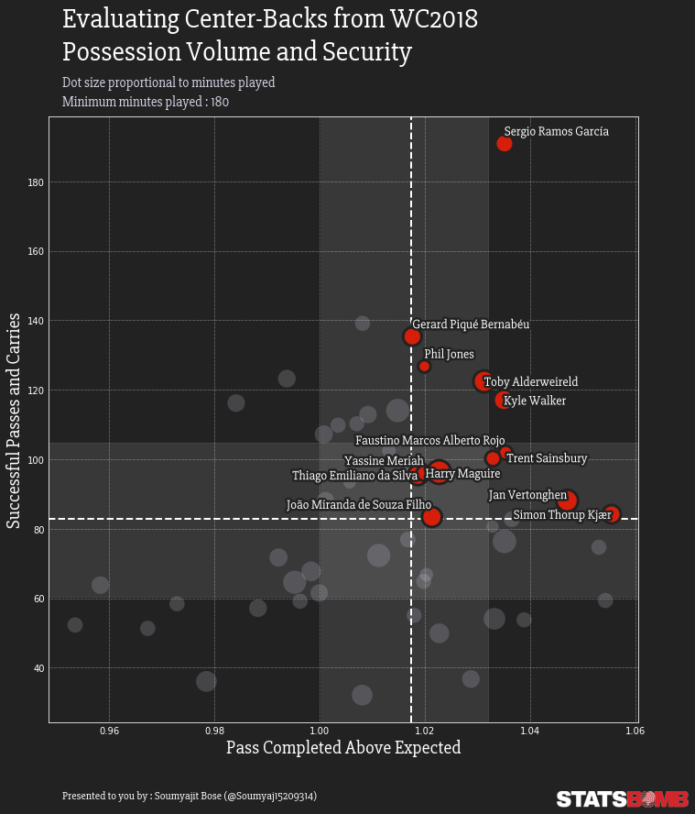
Possession Volume and Expected Pass Completion
Pass Completed Above Expected – greater than implies pass completion rate is better than what’s expected from an average player.
Standout names – Ramos, Pique, Alderweireld, Walker, Rojo, Jones, Sainsbury, Maguire, Vertonghen, Kjaer, Thiago Silva, Miranda

Slide 8
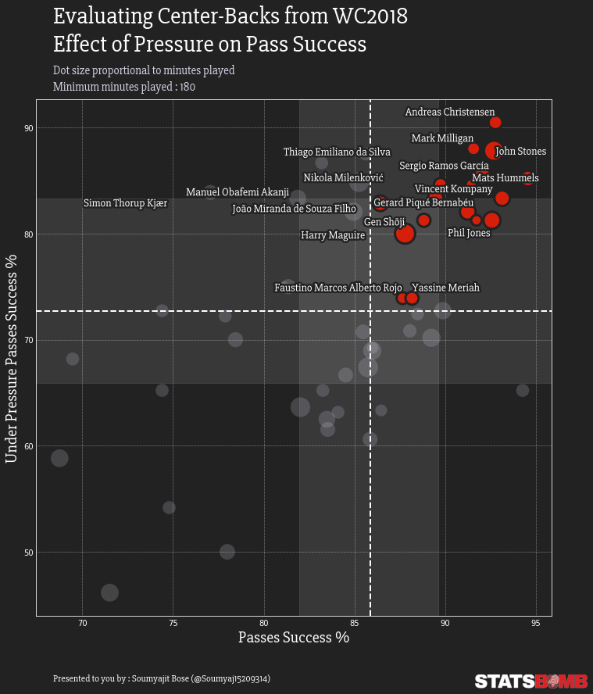
Pass Success % and Effect of Pressure
Standout names – Christensen, Milligan, Stones, Ramos, Hummels, Kompany, Thiago Silva, Pique, Jones, Shoji, Milenkovic, Akanji, Miranda, Kjaer, Maguire, Rojo, Meriah

Slide 9
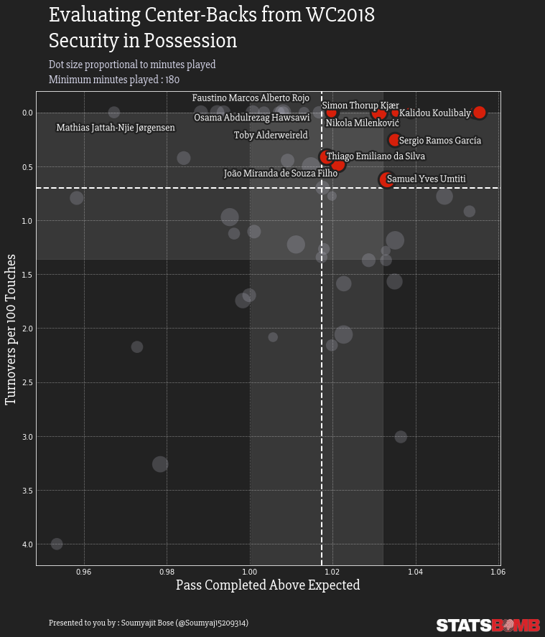
Turnovers and Expected Pass Completion
Turnovers per 100 Touches -> Turnovers divided by number of carries and attempted dribbles
The y-axis has been inverted so that the best players appear at the top right corner.
Standout names – Koulibaly, Kjaer, Milenkovic,Rojo, Ramos,Thiago Silva,Umtiti, Miranda, Alderweireld, Hawsawi, Jorgensen

Slide 10
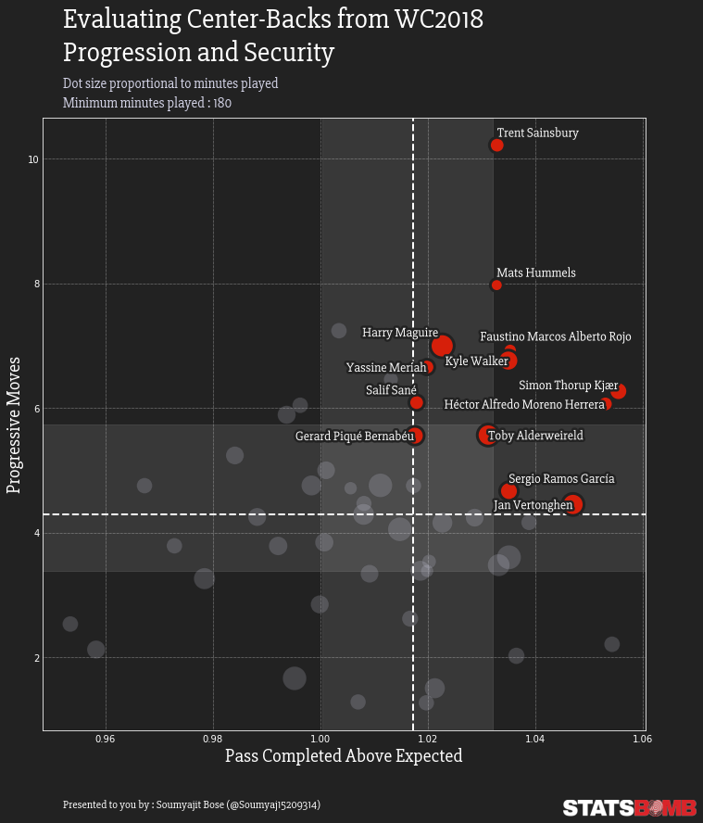
Ball Progression and Expected Pass Completion
Progressive moves -> Progressive passes + carries.
Definition of “progressive” -> Any pass or carry that moves the ball closer to the opposition goal by 25 %, or moves the ball into the opposition box from outside.
Standout names – Sainsbury, Hummels, Rojo, Maguire, Walker, Kjaer, Herrera, Meriah,Sane, Alderweireld, Pique, Ramos, Vertonghen.

Slide 11
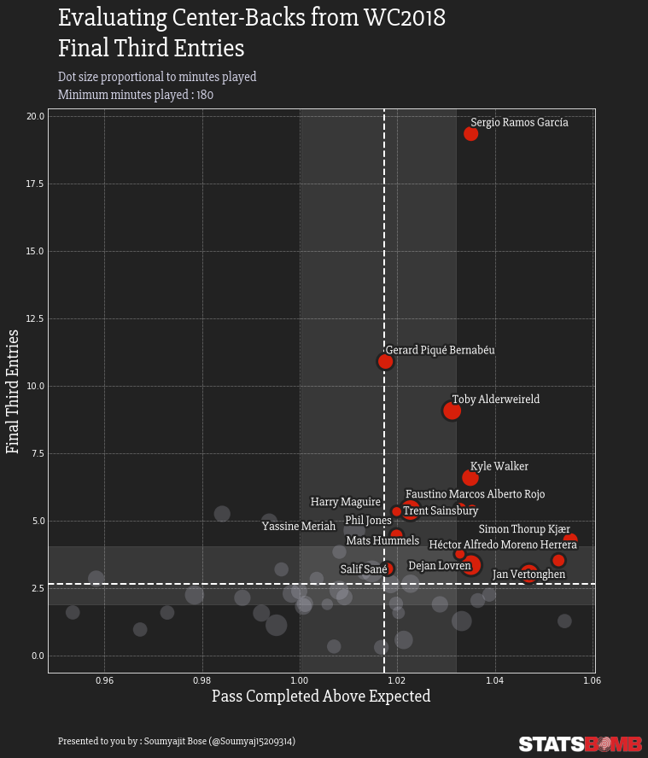
Final Third Entries and Expected Pass Completion
Final Third Entries -> Successful Passes and Carries into the final third
Standout names - Ramos, Pique, Alderweireld, Walker, Rojo, Sainsbury, Maguire, Kjaer, Herrera, Vertonghen, Lovren, Hummels, Jones, Meriah, Sane

Slide 12
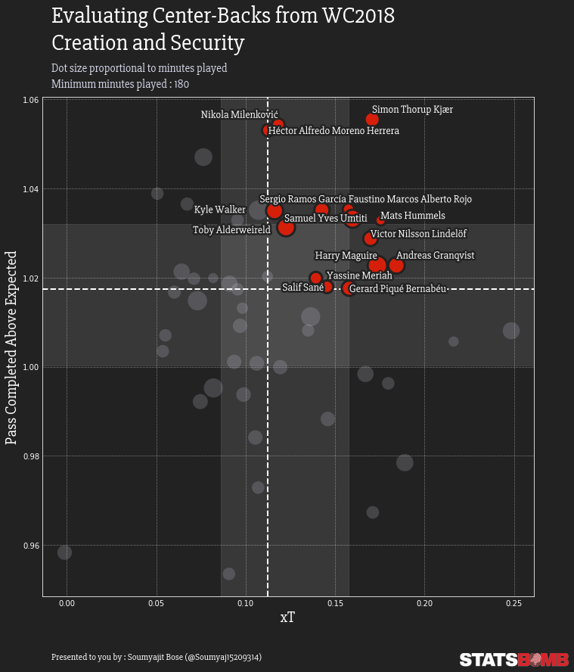
Threat Creation and Expected Pass Completion
xT -> calculated per 100 successful passes and carries.
Standout names - Kjaer, Herrera, Milenkovic, Ramos, Rojo, Hummels, Umtiti, Lindelof, Granqvist, Walker, Alderweireld, Maguire, Meriah, Sane, Pique

Slide 13
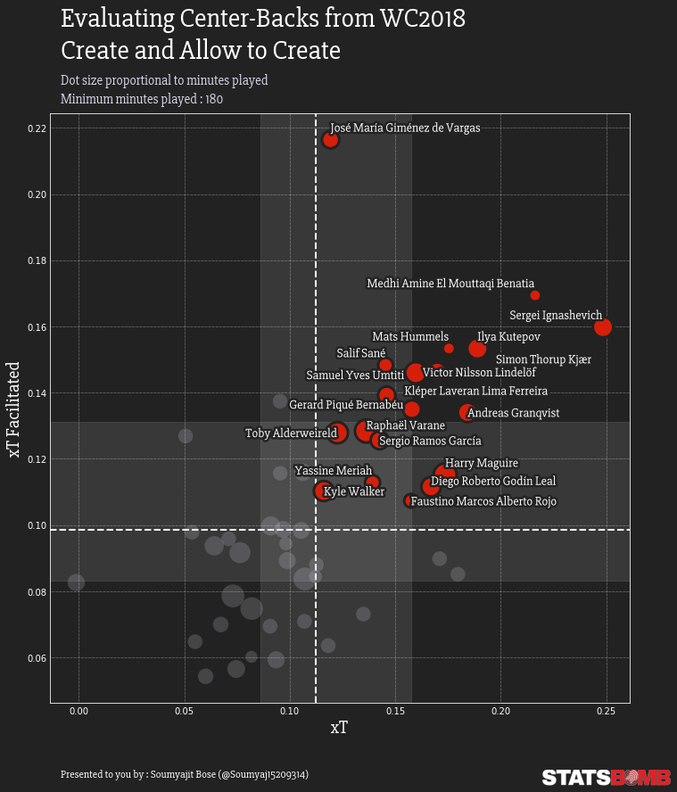
Threat Creation and Facilitation
xT Facilitated -> the xT of the next player’s moves. This captures the fact that sometimes players will invite pressure and suck the opposition in, before releasing a team-mate and allow them to create danger.
Standout names - Gimenez, Benatia, Ignashevich, Kutepov, Kjaer, Hummels, Lindelof, Sane, Umtiti, Pepe (Klepnar), Granqvist, Pique, Varane, Ramos, Alderweireld, Maguire, Godin,Meriah, Walker, Rojo

Slide 14
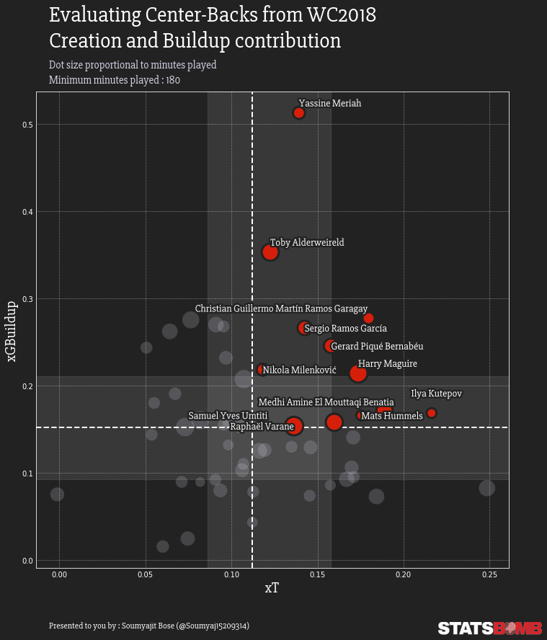
Threat Creation and Buildup Participation
xGBuildup -> calculated per 10 open play shots by the team.
Standout names - Meriah, Alderweireld, Garagay, Ramos, Pique, Maguire, Milenkovic, Benatia, Kutepov, Hummels, Umtiti, Varane.

Slide 15
Brief Note :
Why have xT/xT Faciliated and xGBuildup been adjusted ?
To accommodate for the difference in number of passes+carries for the players, and of open play shots for the teams.

Slide 16
Names that have stood out repeatedly
Absolute standouts - Ramos, Pique, Alderweireld, Walker, Rojo, Maguire, Kjaer, Hummels, Milenkovic, Meriah, Umtiti, Sane.
Honorable mentions – Jones, Thiago Silva, Miranda, Herrera, Sainsbury.

Slide 17
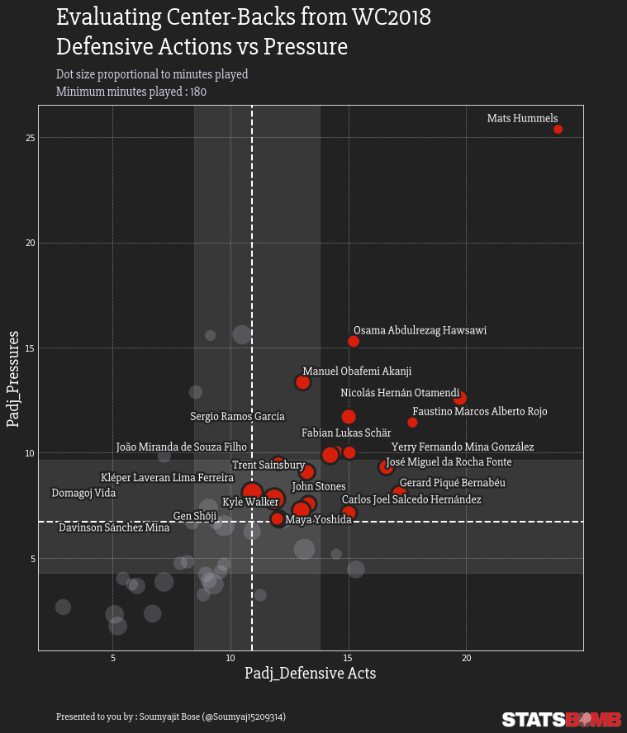
Possession-adjusted defensive activities and Pressure
Defensive acts -> Tackles+Interceptions+Blocks+Ball Recoveries.
Possession-adjusted to mitigate the effect of possession-heavy team styles.
Standout names - Hummels, Hawsawi, Akanji, Otamendi, Rojo, Schar, Mina, Fonte, Ramos, Pique, Miranda, Sainsbury, Stones, Hernandez, Pepe, Vida, Davinson, Walker, Shoji, Yoshida

Slide 18
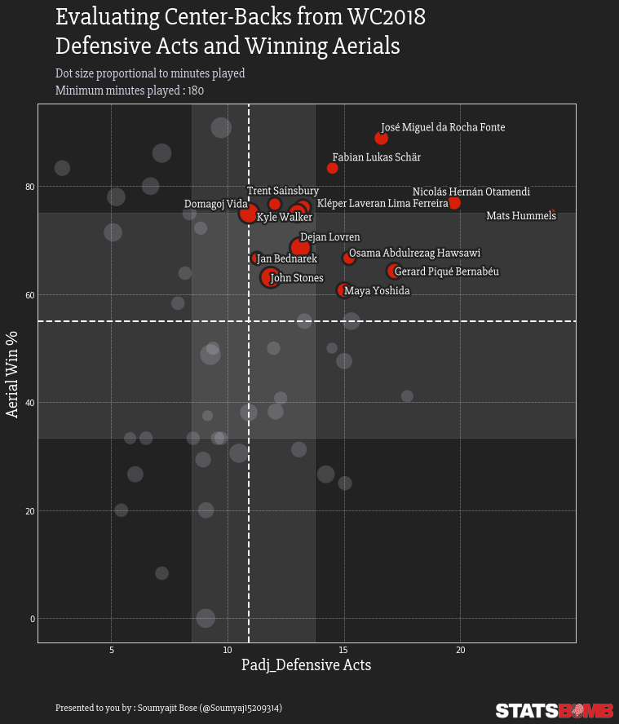
Aerial Dominance and Defensive Acts
Standout names - Fonte, Schar, Otamendi, Hummels, Pepe, Sainsbury, Vida, Walker, Lovren, Hawsawi, Pique, Bednarek, Stones, Yoshida

Slide 19
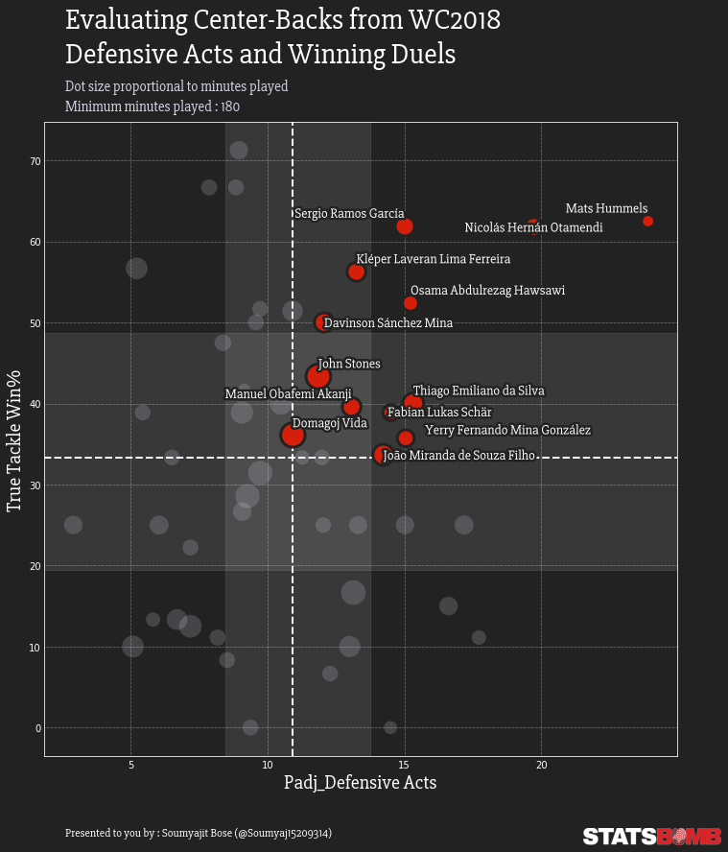
Defensive Acts and Duel Wins
Standout names : Hummels, Otamendi, Ramos, Pepe, Hawsawi, Mina, Stones, Thiago Silva, Schar, Akanji, Vida, Gonzalez, Miranda

Slide 20
Updated list of names that have stood out repeatedly
Absolute standouts – Ramos, Pique, Hummels, Alderweireld, Maguire, Kjaer
Followed by – Rojo, Walker, Meriah.
Let’s have a closer look at the top 6 names by removing the clutter of the scatter plots. We will look at bar charts for each player in the next 6 slides (showing percentile ranks in different attributes).

Slide 21
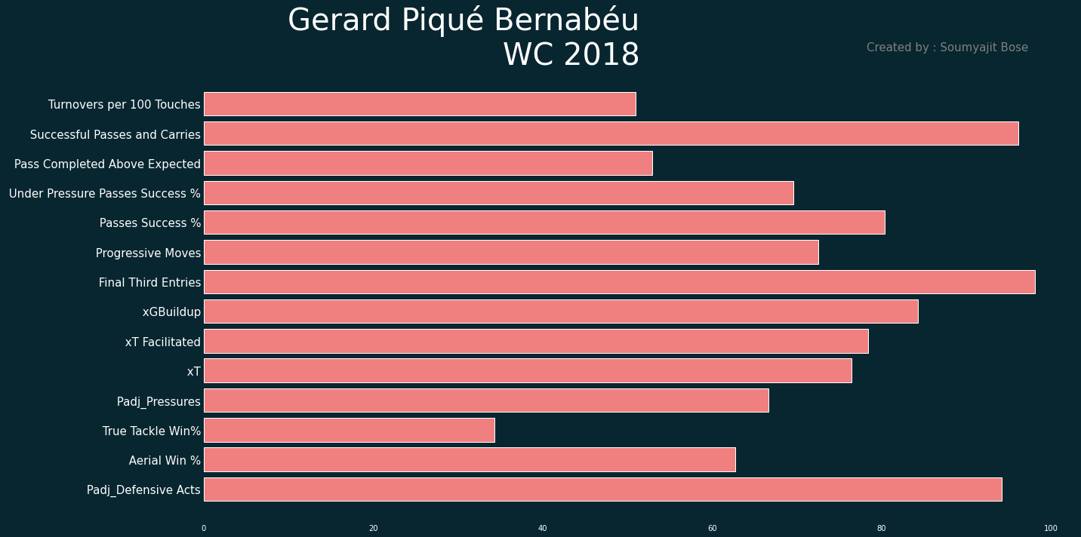

Slide 22
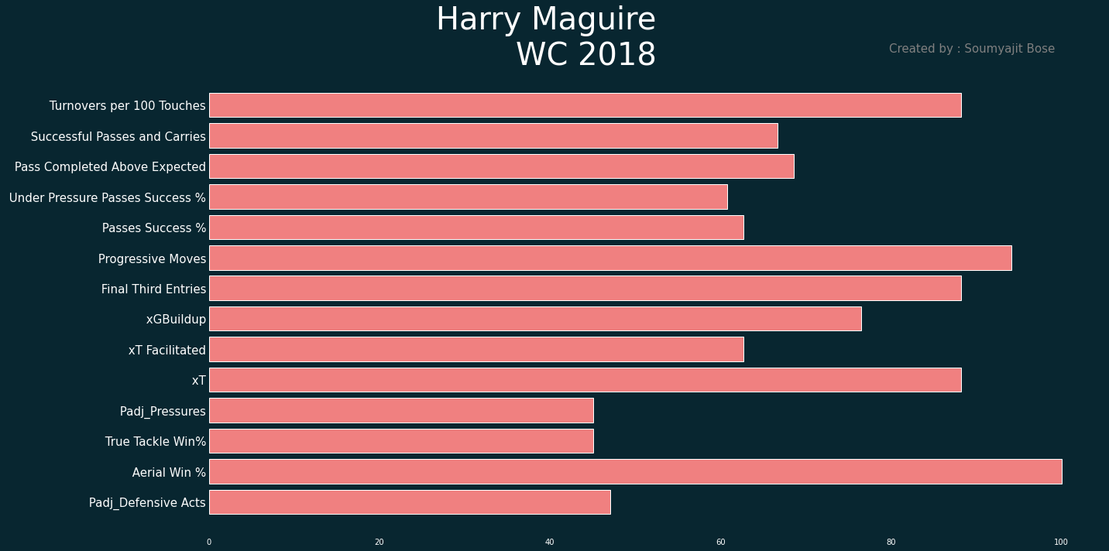

Slide 23
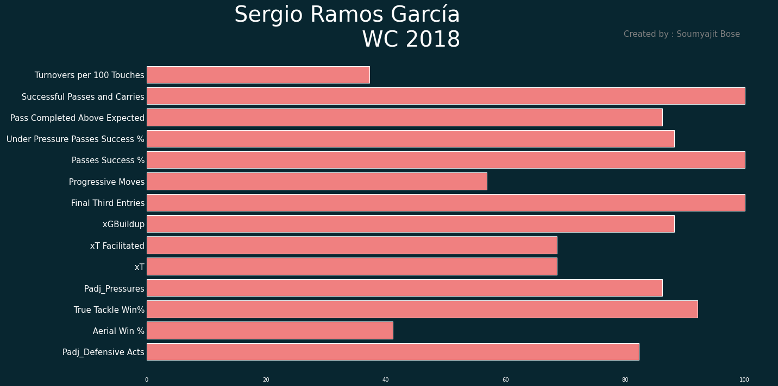

Slide 24
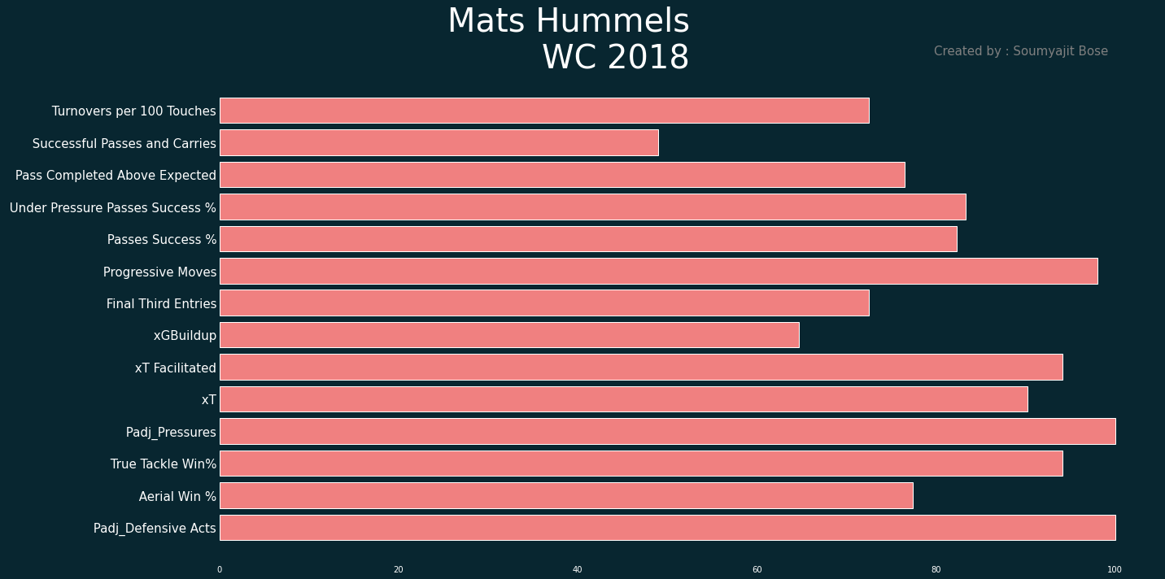

Slide 25
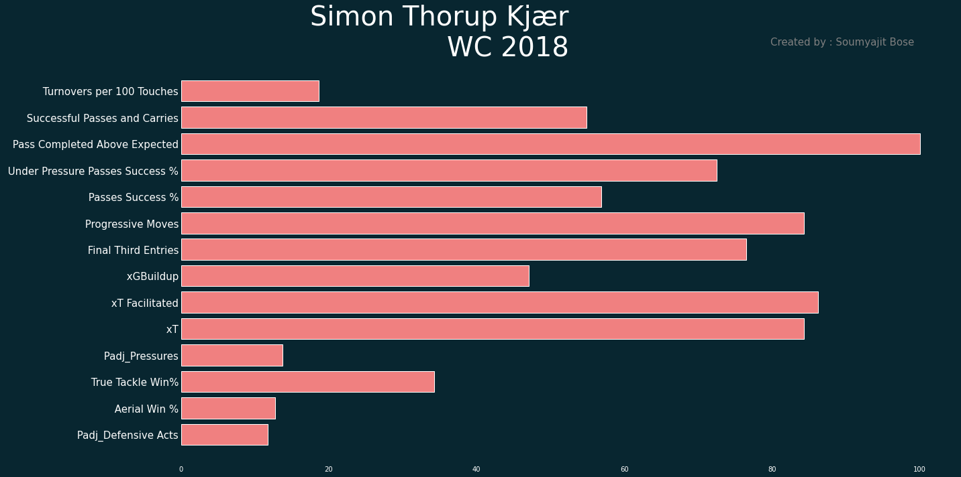

Slide 26
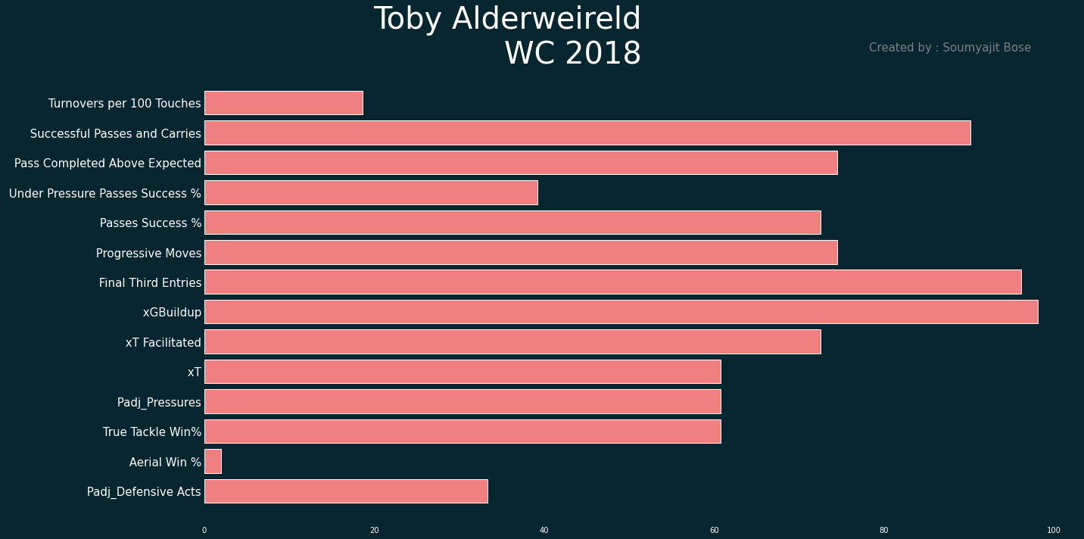

Slide 27
Sergio Ramos and Mats Hummels stand out the most. It’s a tough choice between Gerard Pique and Harry Maguire. I lean towards Maguire as he has fewer turnovers and better defensive duel win %, while the possession metrics are fairly comparable.

Slide 28
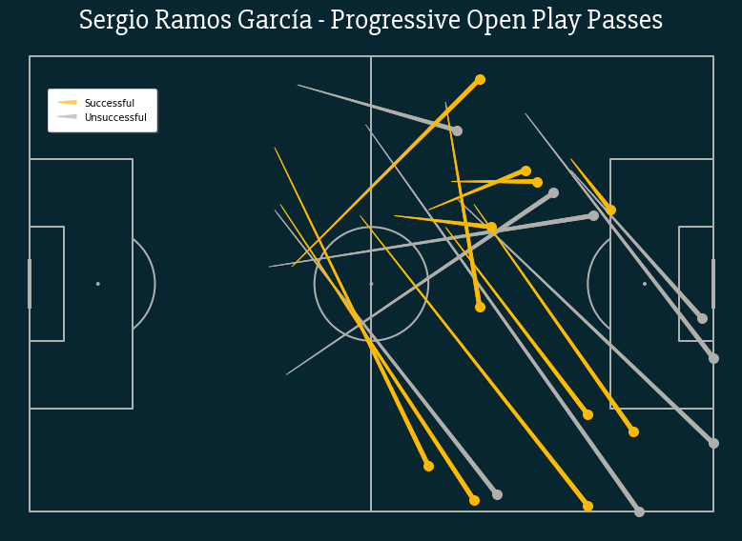
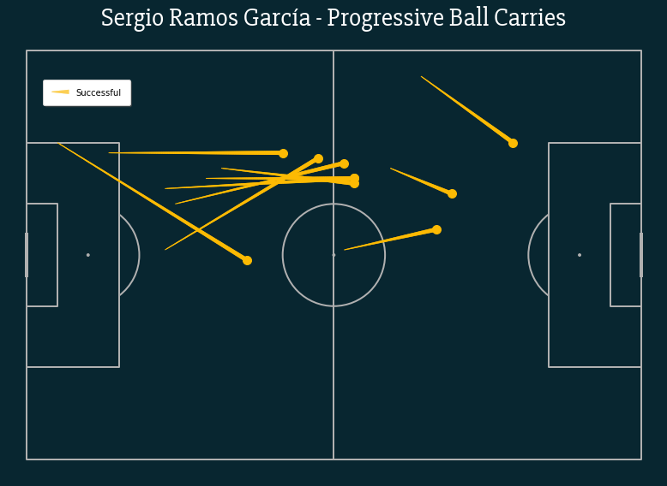
Sergio Ramos Progressive Passes and Carries – lots of cross-field diagonal balls, and stepping up through the center when carrying.

Slide 29
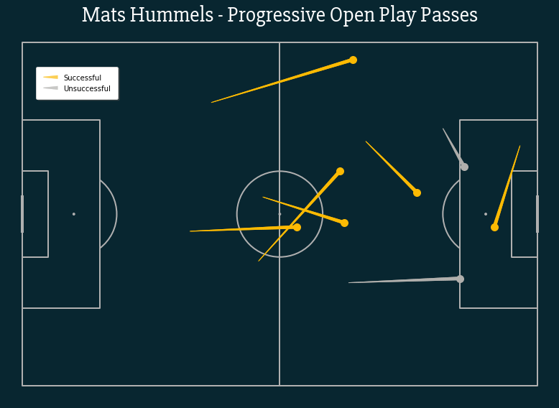
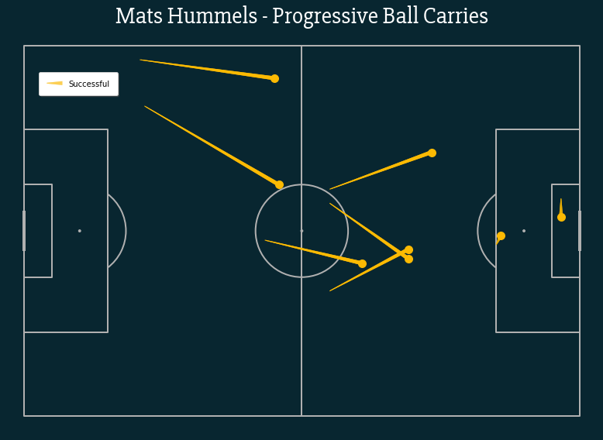
Mats Hummels Progressive Passes and Carries – small sample size, but mostly though the center of the pitch. More vertical.

Slide 30
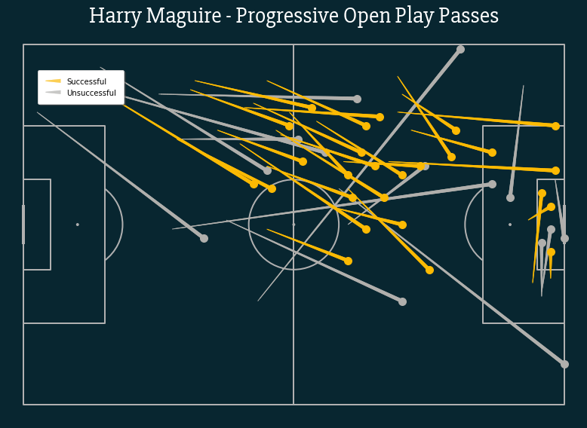
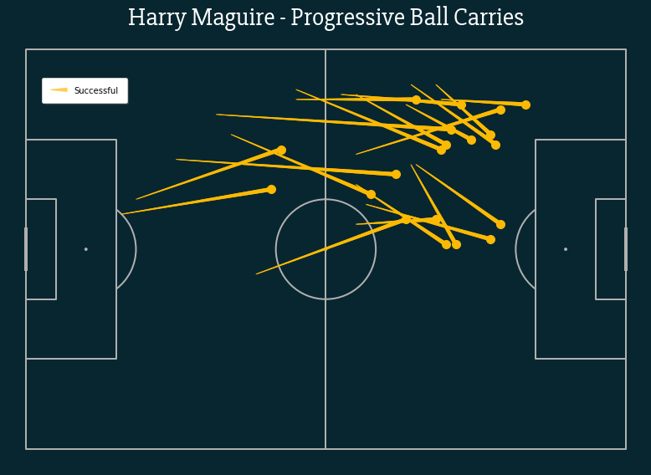
Harry Maguire Progressive Passes and Carries – lots of half-space probing. Long balls into the penalty area as well.

Slide 31
Statsbomb open data was used to identify ball-playing abilities of center back during the World Cup 2018.
Potential caveats – small playing time and sample size for players.
Top 3 ball-playing center backs selected – Sergio Ramos, Harry Maguire and Mats Hummels.
Their attributes and progressive passing/ball-carrying depicted visually.
Thanks to Lee Dunn at Norwich City FC for this wonderful opportunity.

