Slide 1



Slide 2
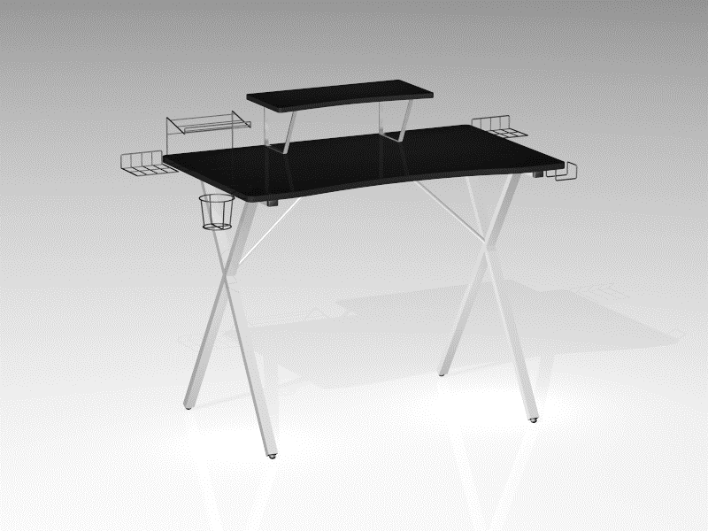
Get in the Game with the New AIRLIFT Gaming Desk Series
The AIRLIFT brand debuted in 2017 with several height-adjustable standing desks designed for multipurpose use in homes and offices.
Today, AIRLIFT is expanding into the world of computer gaming desks, leveraging the experience gained from popular units like the AIRLIFT S3 and the AIRLIFT Glass Desk.
Gaming desks have become more popular in recent years with the growth of the gaming hobby in general. Websites like Twitch and YouTube have made streaming popular, profitable, and accessible, while competitive eSports have found considerable success.
Gaming continues to be seen as a more general hobby than a child's pastime. As the demographic continues to grow, the demand for desk with features that support gamers will grow as well.
These desks are designed to stand apart from normal desks with designs, colors, finishes and features you won't normally find in a standard computer desk.
Monitor Riser
Game Holder
Headphone Holster
Speaker Stand
Cup Holder

Slide 3
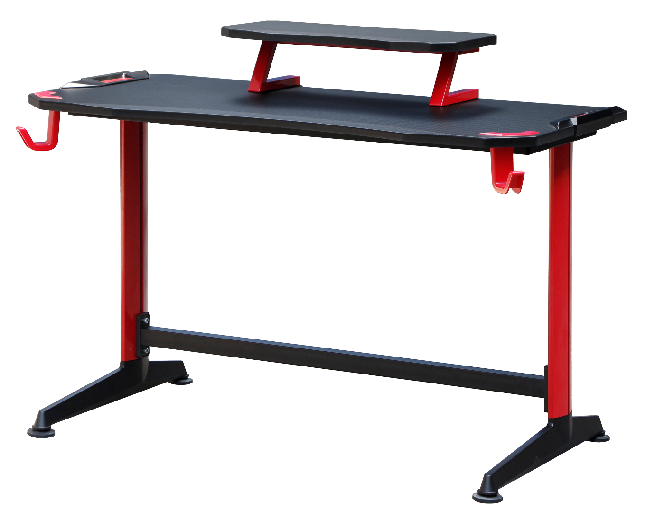
Monitor Riser
Accents
AIRLIFT Red TYPE-C
47.2" W x 25.6" D x 29.5" H
Built-in monitor riser
Dual headphone holsters
Heavy-duty crossbar
High-tech aluminum frame
"Carbon fiber" vinyl finish
Red and black accents and cladding
Headphone Holster
Heavy-Duty Crossbar
Leveling Feet

Slide 4
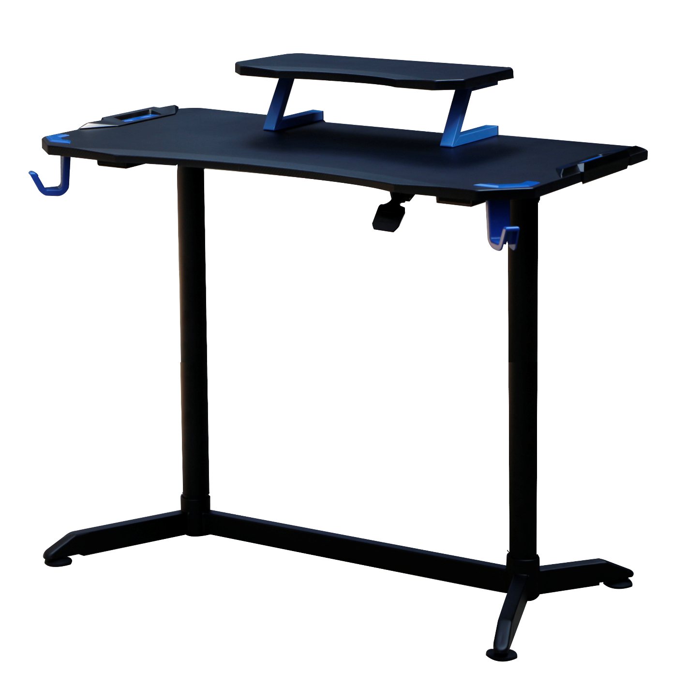
Monitor Riser
Accents
Headphone Holster
AIRLIFT Blue
47.2" W x 25.6" D (28.1" to 49.6" H)
Pneumatic adjustment
Built-in monitor riser
Headphone holsters
Carbon fiber vinyl
Blue accents
AIRLIFT Lever
Leveling Feet

Slide 5
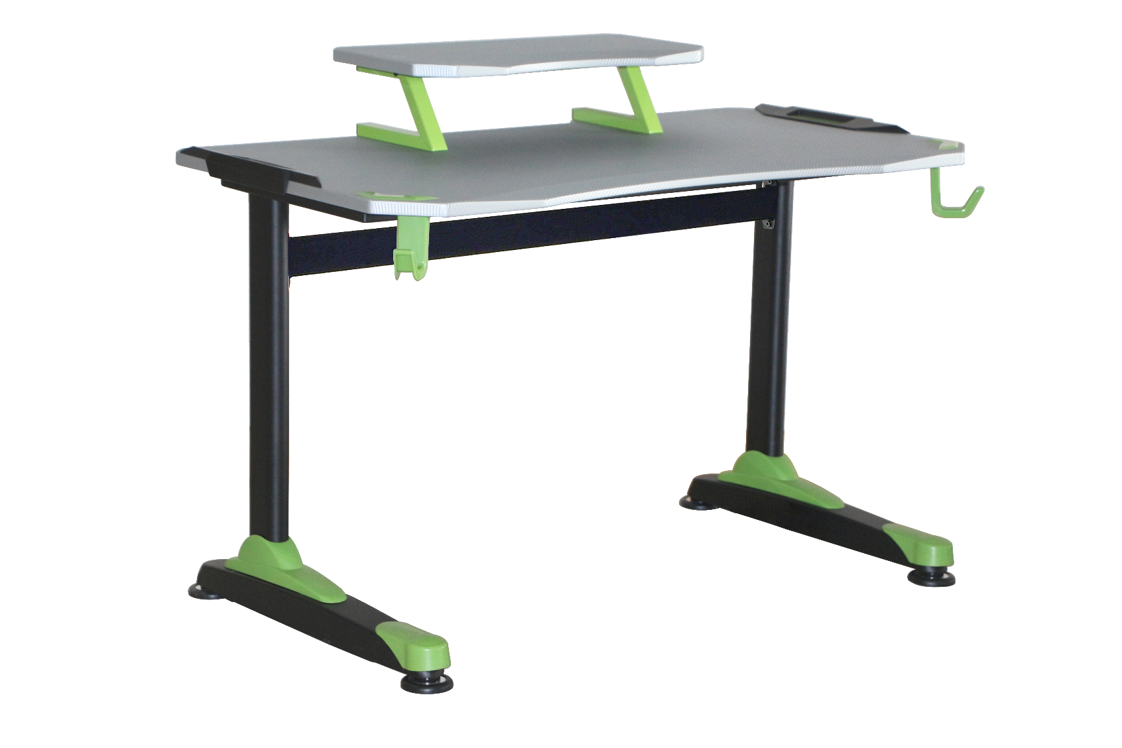
Monitor Riser
AIRLIFT Green
47.2" W x 25.6" D x 29.5" H
Futuristic design
Ergo curve tabletop
Built-in monitor riser
Headphone holsters
Heavy-duty crossbar
Green accents
Headphone Holster
Heavy-Duty Crossbar
Leveling Feet

Slide 6
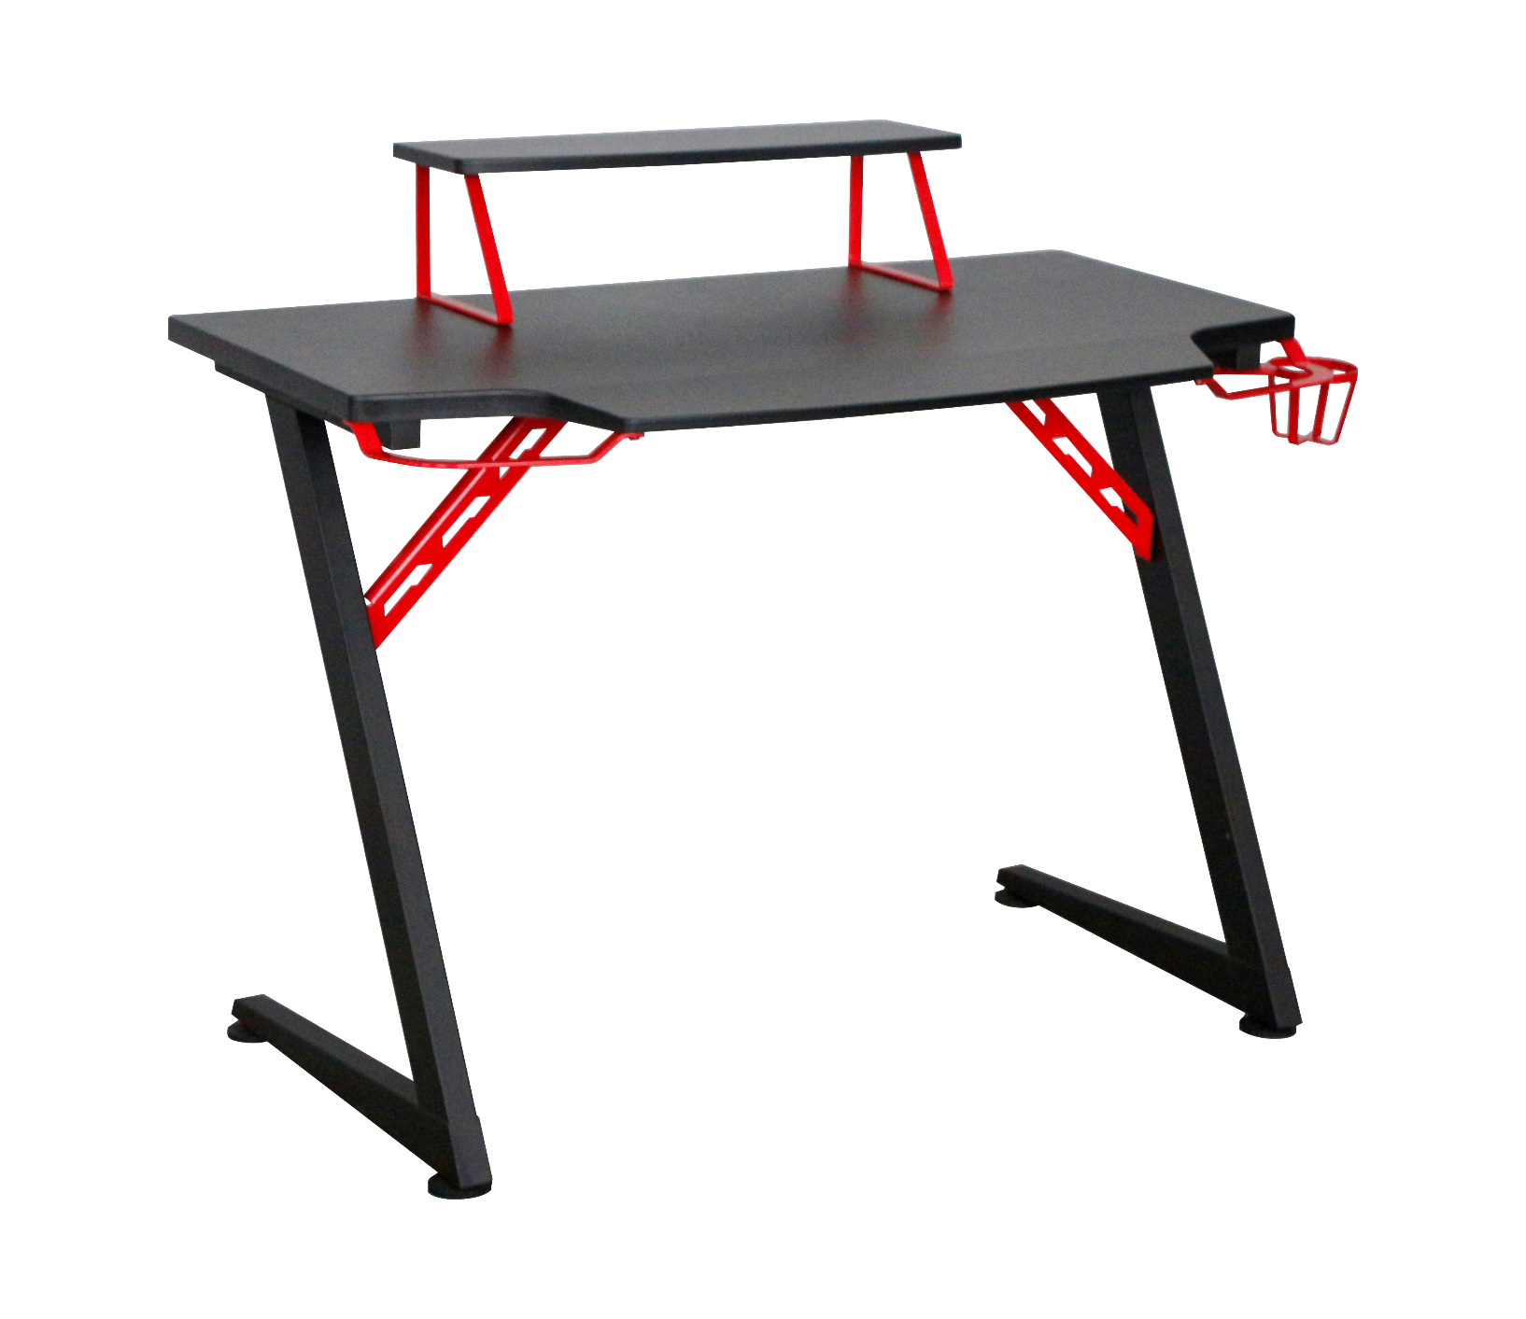
Monitor Riser
Cup Holder
AIRLIFT Red TYPE-Z
40" W x 23.6" D x 34.6" H
Tapered Keyboard extension
Built-in monitor riser
Steel wire cup holder
Headphone holster
Z-frame with dual supports
Carbon fiber vinyl finish
Red accents
Headphone Holster
Leveling Feet

