Slide 1

ScamShield AI
AI for Digital Public Safety — Defeating Counterfeiting, Fraud & Digital Arrest Scams
Economic Times AI Hackathon 2.0 · Phase 2 · Problem Statement PS6
Submitted by a 2nd Year B.Tech CSE (Data Science) Student

Slide 2



THE PROBLEM
Digital fraud is evolving faster than public awareness
Digital Arrest Scams
SMS & Email Phishing
Fake UPI / QR Fraud
Fraudsters impersonate CBI/police on video calls, coercing panicked victims into transferring money.
Fake KYC, lottery, and refund messages trick users into clicking malicious links.
Victims are misled into believing a QR scan can 'receive' money — it can only send it.
Government agencies (RBI, I4C) have issued repeated public advisories — but citizens still lack a fast, free way to verify a suspicious message before acting on it.
02

Slide 3





OBJECTIVES
What ScamShield AI set out to do
Classify SMS / Email / URL content as Safe, Suspicious, or Fraud using ML
Make every AI verdict explainable — show the exact reasons, not a black box
Build a dedicated detector for Digital Arrest scam patterns
Validate UPI IDs and educate users on QR code fraud myths
Let users report scams to build a community fraud database
Give users a personal dashboard and admins a monitoring panel
03

Slide 4


THE SOLUTION
One platform, every major fraud vector covered
SMS & Email Detector
Website URL Scanner
Digital Arrest Shield
UPI & QR Awareness
Scam Reporting
Safety Dashboard
Admin Panel
AI Safety Tips
04

Slide 5
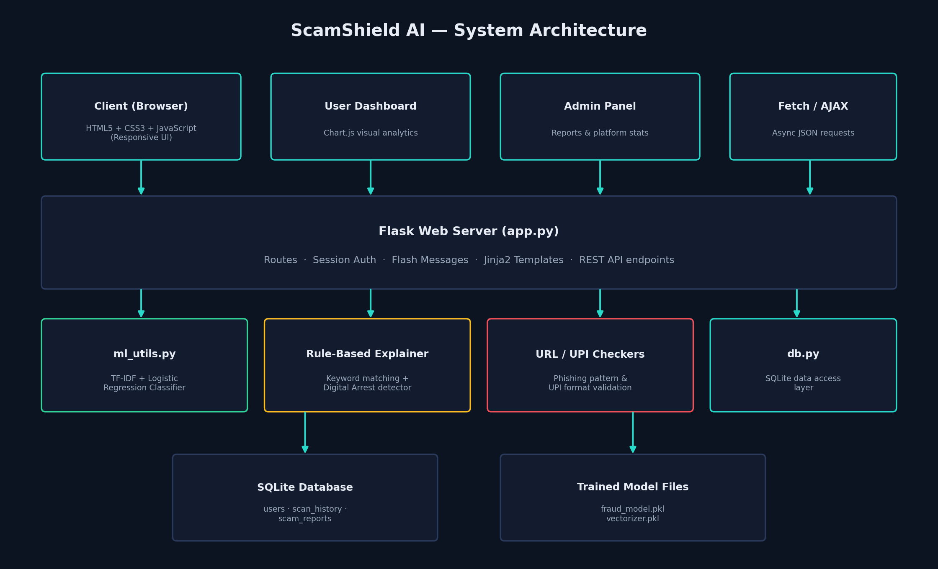
SYSTEM DESIGN
System Architecture
05

Slide 6





TECHNOLOGY
Tech Stack
Frontend
Backend
AI / ML
HTML5, CSS3, JavaScript
Python, Flask
scikit-learn — TF-IDF + Logistic Regression
Database
Visualization
Security
SQLite (default) · MySQL (optional)
Chart.js
Werkzeug password hashing + sessions
06

Slide 7
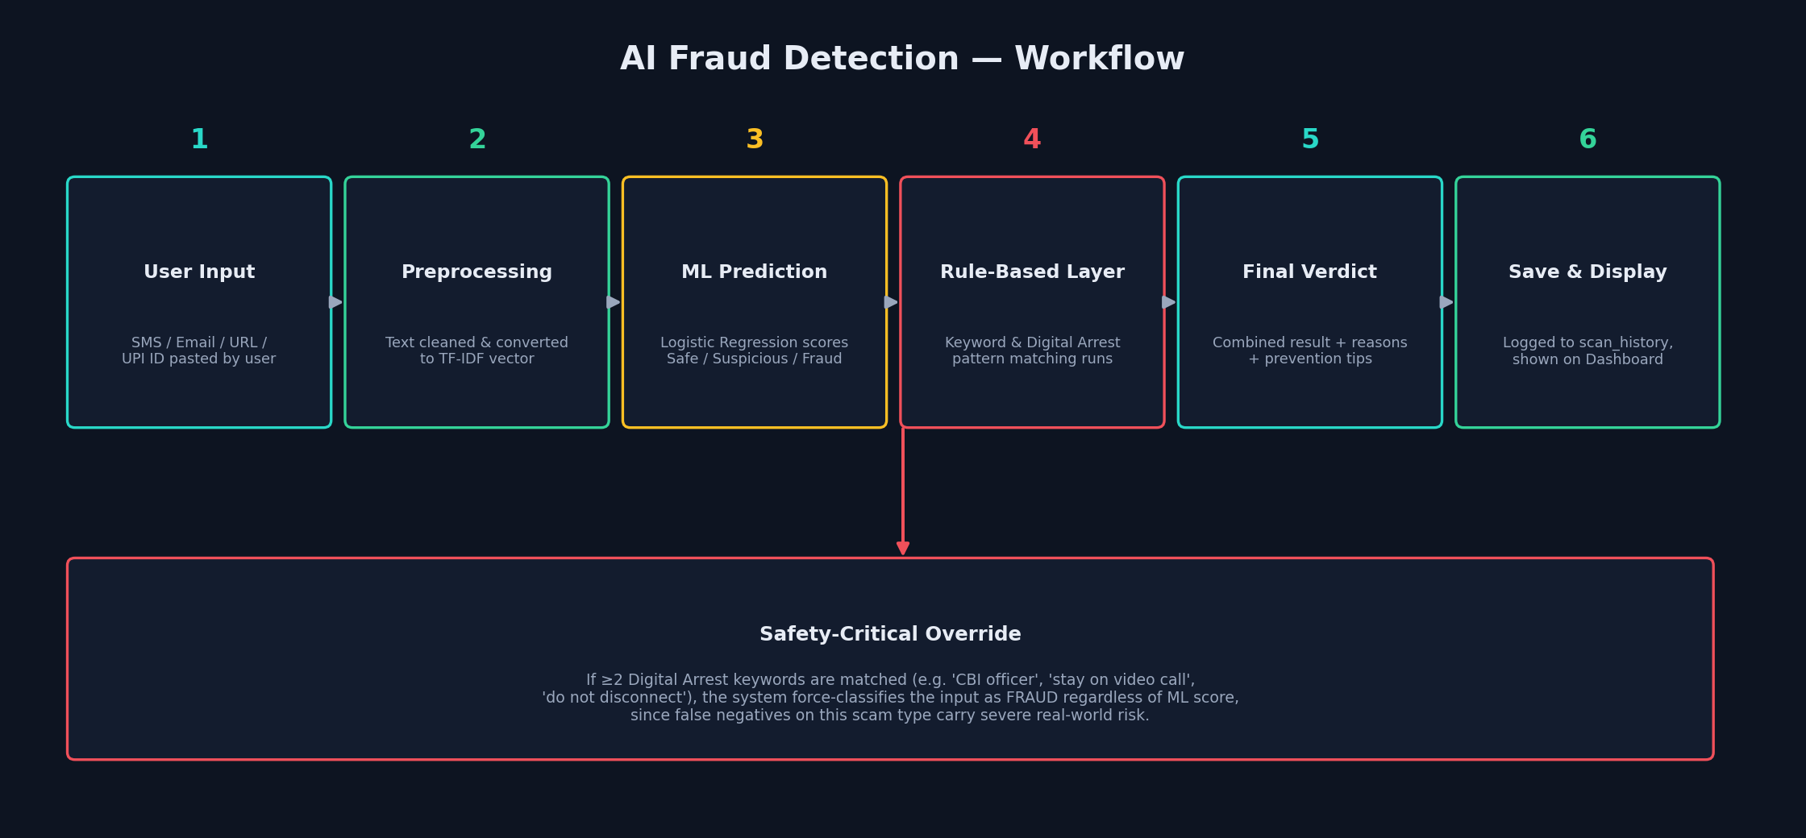
HOW IT WORKS
AI Fraud Detection Workflow
07

Slide 8

WHY TRUST THE AI
Explainable by design, not a black box
Every verdict comes with reasons
Digital Arrest safety override
TF-IDF + Logistic Regression scores the text, while a curated keyword bank explains exactly which red flags were found — lottery language, urgency, KYC/OTP requests, and more.
If 2+ Digital Arrest patterns are matched (e.g. 'stay on video call', 'CBI officer', 'do not disconnect'), the system force-classifies the input as FRAUD — regardless of the raw ML score.
"Contains high-risk fraud keywords: kyc, blocked, urgent"
Because under-flagging this scam type carries severe real-world risk.
08

Slide 9
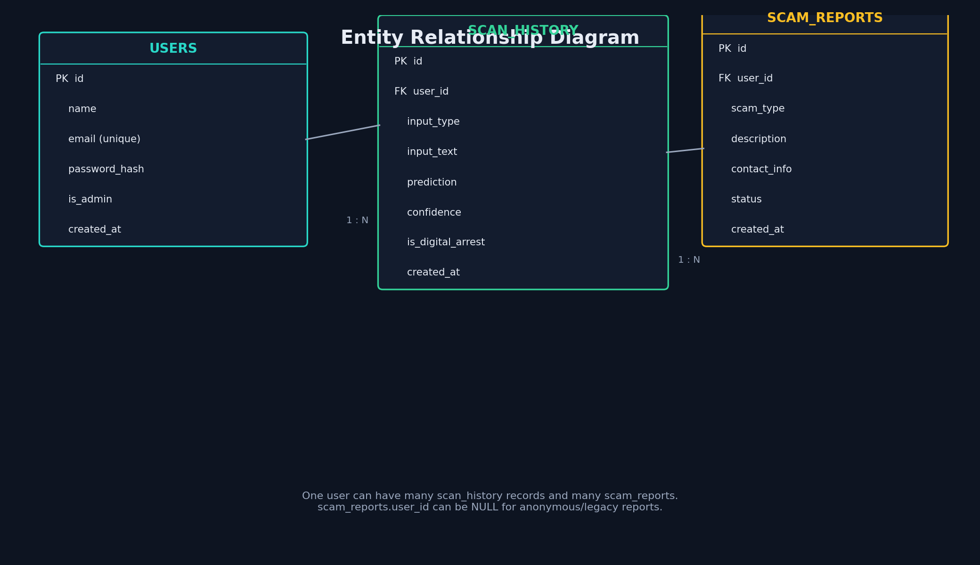
DATABASE DESIGN
Entity Relationship Diagram
09

Slide 10
RESULTS
Model Performance (MVP Dataset)
65
3
~74%
100%
Labeled training samples
Classes: Safe / Suspicious / Fraud
Mean 5-fold CV accuracy
Verdicts include explanation + tips
The model uses a small, hand-curated demo dataset appropriate for a hackathon MVP. Accuracy is expected to improve substantially with a larger, real-world labeled dataset (thousands of samples) collected from actual reported scams — a key next step in the Future Scope.
10

Slide 11
PLATFORM EXPERIENCE
Dashboards for users and administrators
User Dashboard
Admin Panel
Personal scan history (SMS/Email/URL/UPI)
Platform-wide stats: users, scans, fraud detected
Live Chart.js breakdown of Safe/Suspicious/Fraud
Community scam reports table with status triage
Quick actions to jump into any detector
Pending → Reviewed → Resolved workflow
11

Slide 12

WHAT'S NEXT
Future Scope
Deep learning (LSTM/BERT) on larger real-world datasets
Real QR image upload & decode (OpenCV/pyzbar)
Browser extension for real-time link scanning
Direct integration with cybercrime.gov.in reporting API
Multi-language support (Hindi & regional languages)
Production deployment on MySQL/PostgreSQL
12

Slide 13
Thank You
ScamShield AI — Catch the scam before it catches you.
Economic Times AI Hackathon 2.0 · Phase 2 · PS6: AI for Digital Public Safety
Cyber Crime Helpline: 1930 · cybercrime.gov.in

