Slide 1
Clean code
Boško Gogić, Software developer
25/11/2022

Slide 2
What is clean code ?
Clean code is clear, understandable, and maintainable. When you write clean code, you're keeping in mind the other people who may read and interpret your code at a later time. You're helping others understand the purpose of your code so that they can make changes to it eventually.
Clean code principles lead to source code that's highly modular and thus easier to read and test.
"Any fool can write code that a computer can understand. Good programmers write code that humans can understand." – Martin Fowler

Slide 3
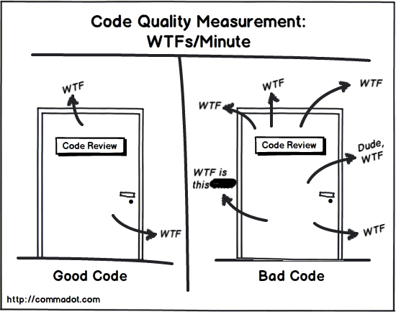

Slide 4
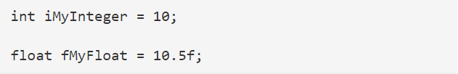
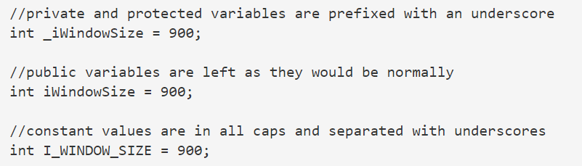
Naming conventions
Using a naming convention is a great way to get started — it keeps things clear and lets you know exactly what you’re working with.

Slide 5


Avoid disinformation
Be careful about words that mean something specific. Do not refer to a grouping of accounts as accountList unless its type is actually a List. The word has a specific meaning and it may lead to false conclusions.

Slide 6
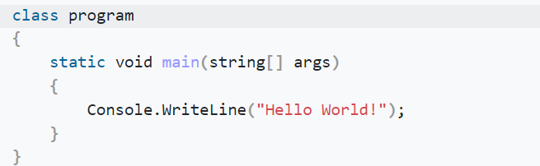

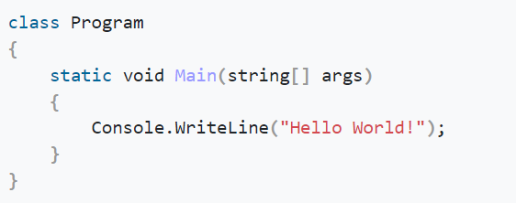

Use Camel/Pascal Case Notation

Slide 7
C# coding standards and naming conventions
https://stackoverflow.com/questions/150479/order-of-items-in-classes-fields-properties-constructors-methods
https://github.com/ktaranov/naming-convention/blob/master/C%23%20Coding%20Standards%20and%20Naming%20Conventions.md#11-do-use-noun-or-noun-phrases-to-name-a-class
C# Naming Conventions (c-sharpcorner.com)

Slide 8
Method & Interface & Class
When writing code, use short methods. Short methods keep your code more organized and readable. Short methods are also easier to debug. If there is a problem with a method, you can quickly isolate it and fix it. That is much harder to do if the method is long and complex.
Use meaningful variables and method names while coding. These names should be self descriptive.

Slide 9
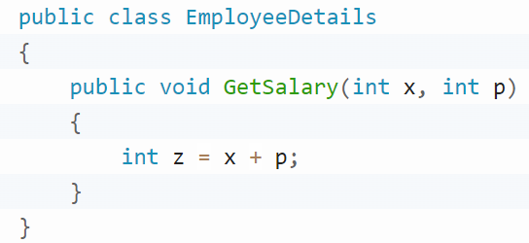
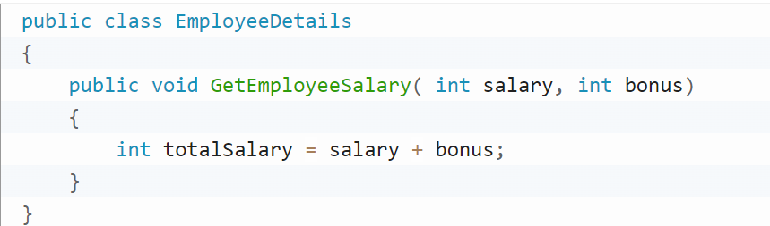
Method & Interface & Class

Slide 10
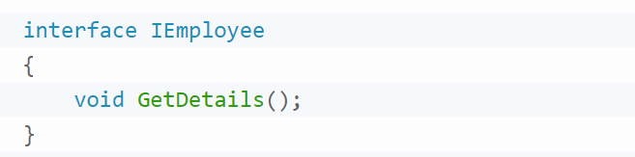
Method & Interface & Class
Always use letter "I" as prefix with name of interface. After letter I, use Pascal case.
According to the Solid Principles, you must segregate classes to small blocks which has a single responsibilty function only. This helps us to acheive loosely coupled code. Make sure that you don’t need to scroll over and over while viewing a class. This can be a general rule of thumb.

Slide 11
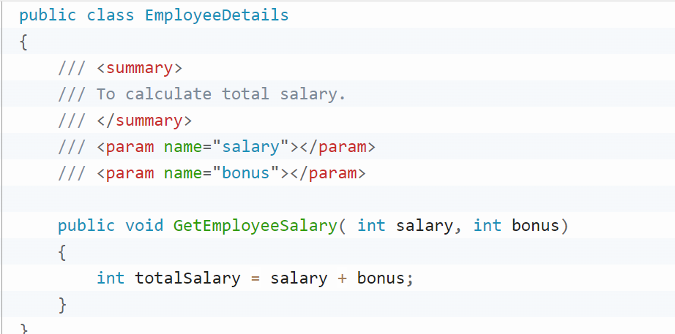
Comments
Commenting saves lives — or at least headaches.
They can quickly show what a complex function is doing or explain the order of certain operations.

Slide 12
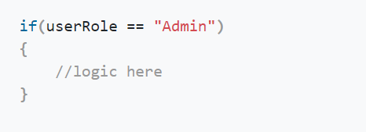
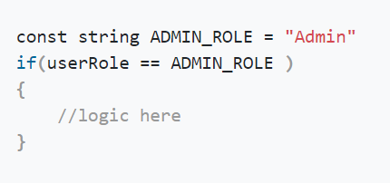
Avoid magic strings/numbers

Slide 13
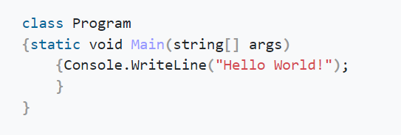
Pay attention to Formatting
Formatting your code improves code readability.
It’s clear how should it be.

Slide 14
DRY & KISS
Don’t repeat yourself principle (DRY) is a software design principle aimed at reducing the repetition of duplicate code in the application. DRY is a valuable principle in software development that keeps a system clean and understandable.
The KISS principle says that “Keep It Simple, Stupid.” The design of each module should be simple, straightforward, and should accomplish its task using the least possible number of entities.

Slide 15
Other important things
Reuse code.
Use design patterns.
Remove unused code.
Use ternary operator instead of if statement.

Slide 16
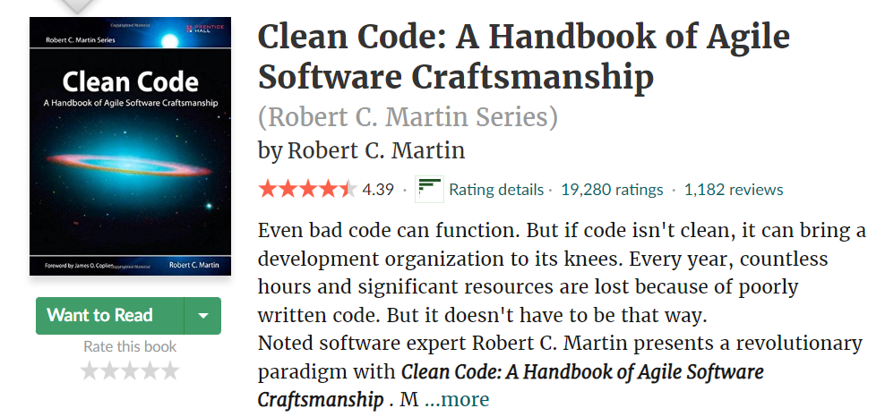
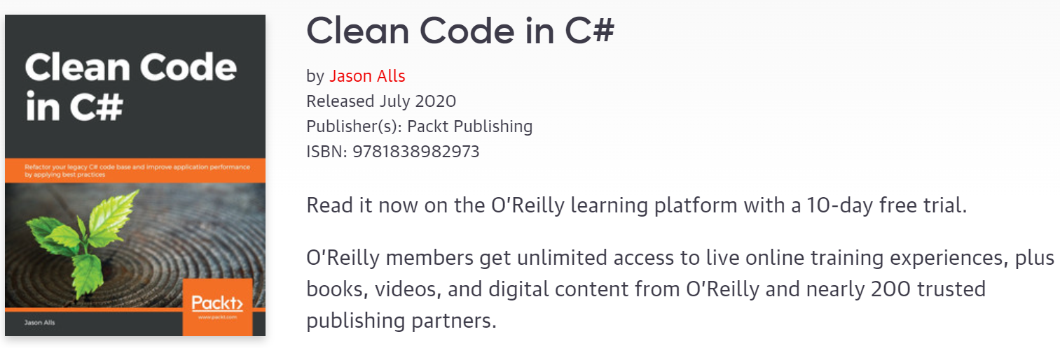
Books

Slide 17
Q & A ?

Slide 18
Thanks for listening !

