Slide 1
Project 1: Comet Pinball
Patrick Haring & Christian Bürgi

Slide 2

Overview
Key features
Technologies
System design
Overview
Dependency Injection
Model / Persistence
Presentation / Physics
Logic
Q & A

Slide 3
Key features

Slide 4
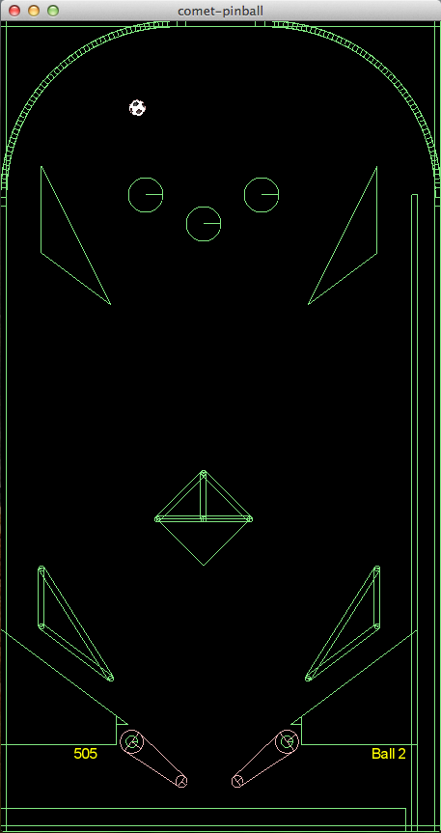
Key features
Game physics
Customizability
Expandability
Portability

Slide 5
Technologies

Slide 6




Technologies
http://upload.wikimedia.org/wikipedia/en/thumb/3/39/Java_logo.svg/500px-Java_logo.svg.png http://box2d.org/forum/styles/subsilver2/imageset/title.gif
http://libgdx.badlogicgames.com/img/logo.png http://www.opengl.org/img/opengl_logo.jpg http://www.lwjgl.org/_gfx/logo.png

Slide 7





Technologies
JAXB 2.0
JUnit
http://picocontainer.com/images/pico_logo.png http://slf4j.org/images/logos/slf4j-logo.jpg http://logback.qos.ch/images/logos/lblogo.jpg
http://commons.apache.org/images/commons-logo.png http://mockito.googlecode.com/svn/wiki/images/logo.jpg

Slide 8








Tools
http://www.eclipse.org/eclipse.org-common/themes/Nova/images/eclipse.png http://astah.net/resources/images/logos/AstahCommunity.png http://maven.apache.org/images/maven-logo-2.gif
http://www.redmine.org/boards/1/topics/1183?page=2 http://git-scm.com/images/logo@2x.png http://upload.wikimedia.org/wikipedia/commons/thumb/b/b3/GitHub.svg/500px-GitHub.svg.png
http://ci.m02.ch/artifactory/webapp/wicket/resource/org.artifactory.web.ui.skins.GreenSkin/images/header/header_logo.gif http://www.eclipse.org/juno/images/eclipse_juno242x132.jpg

Slide 9
System design

Slide 10
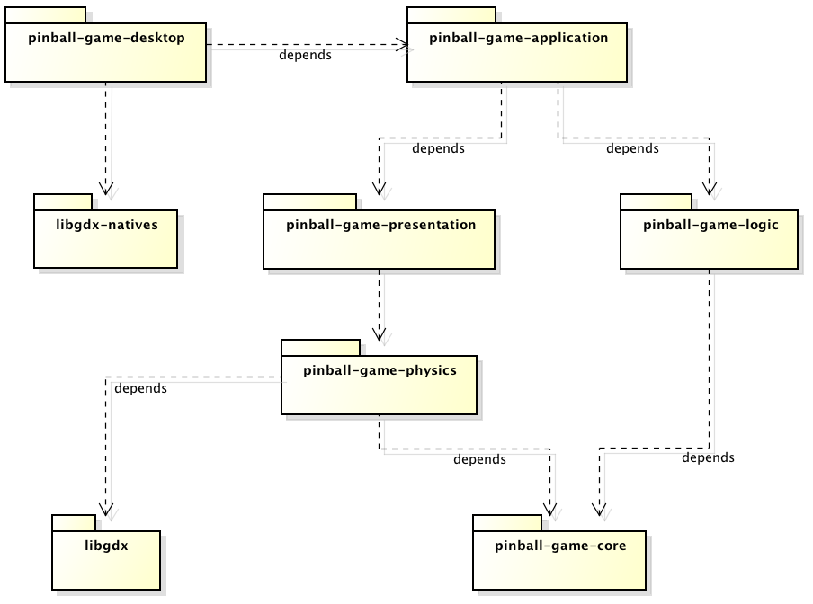
Overview

Slide 11
Overview
Main class
Natives
Pure Java

Slide 12
Overview
No libgdx!

Slide 13
Overview
Rendering
Physics calculation
Game logic
Persistence

Slide 14
Overview
Dependency Injection wiring
Abstractions,
Interfaces

Slide 15
System design Dependency Injection

Slide 16
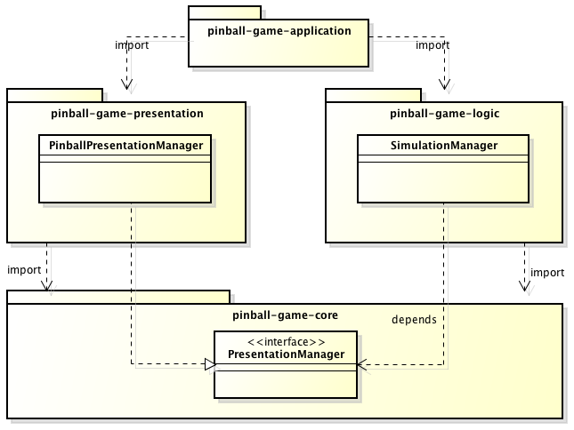
Good design

Slide 17
Problem
How get an instance of PresentationManager?

Slide 18
Possible solution
Only possible in package pinball-game-application!
public class Pinball {
...
public void needsSimulationManager() {
PresentationManager m =
new PinballPresentationManager();
SimulationManager s =
new SimulationManager(m);
// do things with SimulationManager
}
}

Slide 19
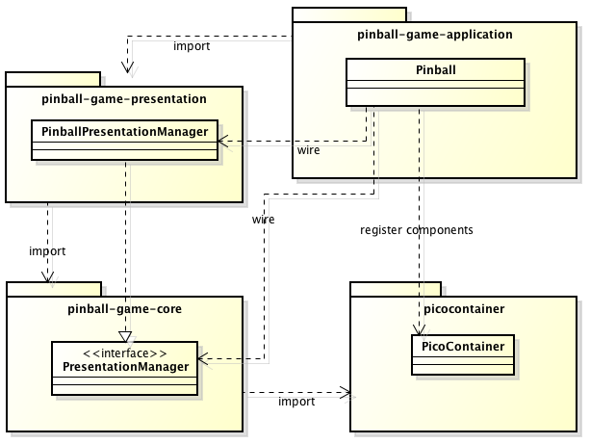
Wiring components

Slide 20
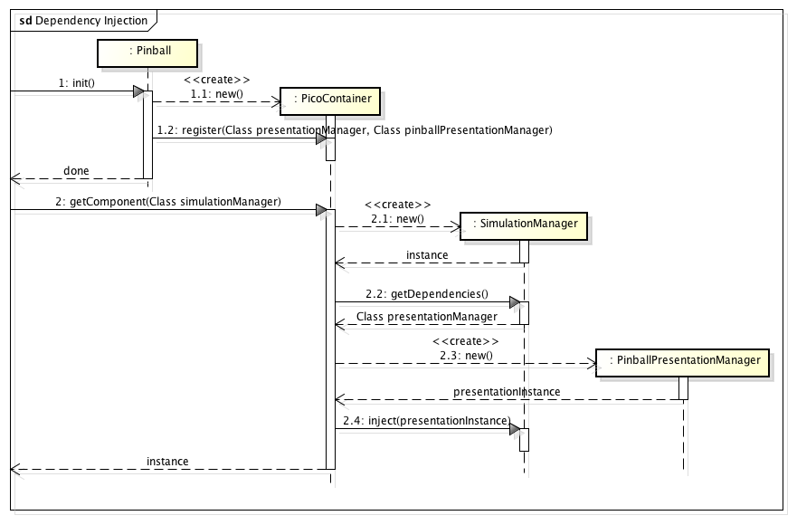
How it works

Slide 21
Better solution
public class AnyWhere {
@Inject
PicoContainer context;
public void needsSimulationManager() {
// PicoContainer injects PresentationManager
// into SimulationManager
SimulationManager s =
context.getComponent(
SimulationManager.class);
// do things with SimulationManager
}
}

Slide 22
System design Model / Persistence

Slide 23
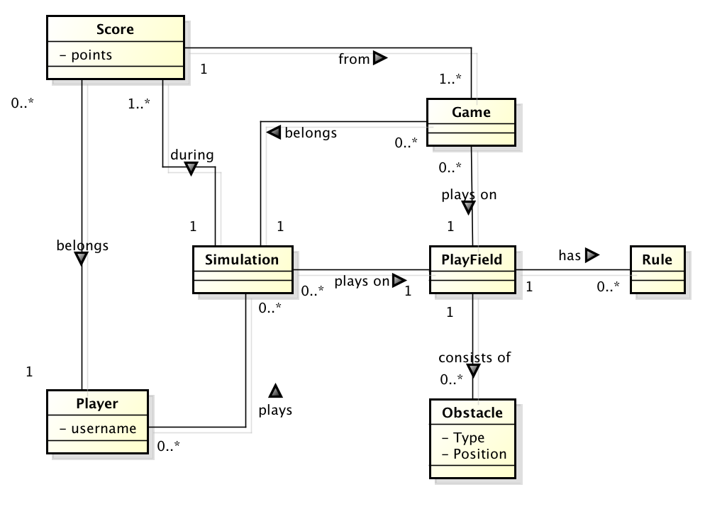
Domain model

Slide 24
Domain model
Not held persistent
(only in game logic)
Transaction data:
Object serialization
Master data:
JAXB

Slide 25
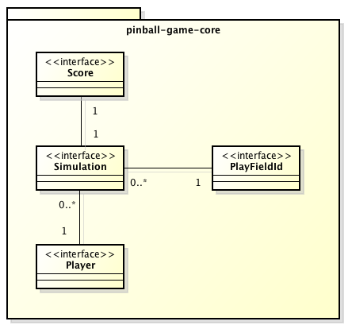
Transaction data
Human readability not required
Simple solution
Modelling through interfaces

Slide 26
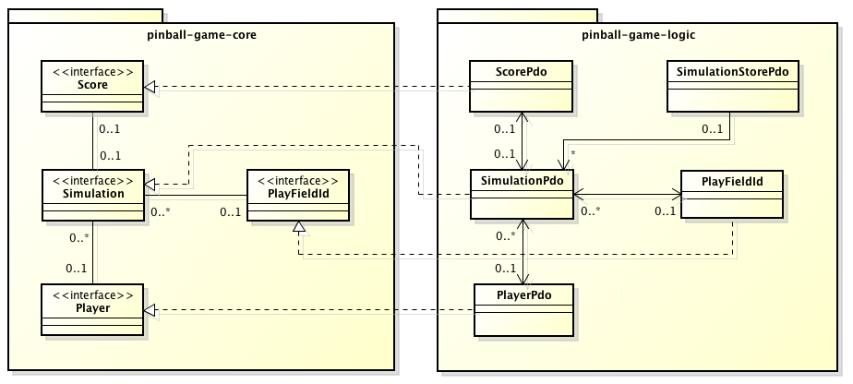
Model vs persistence data objects (PDO)
A data access object (DAO) persists a single instance of SimulationStorePdo

Slide 27
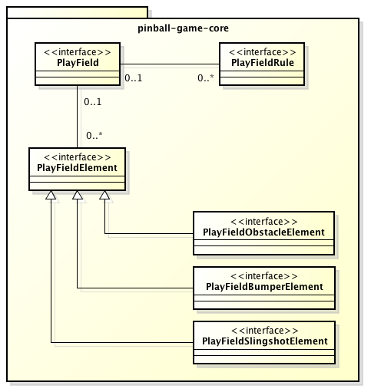
Master data
Human readability mandatory
Syntax checking possible using XSD-Schema

Slide 28
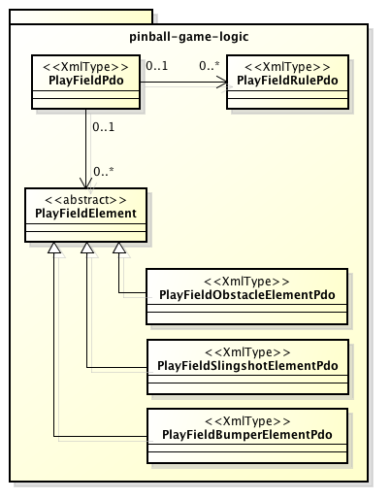
XML-persistence data objects
Java classes are mapped to XML using JAXB annotations
Again, PDO-classes implement interfaces from core-package
Unmarshalling of playfields.xml file returns a List of PlayFieldPdo

Slide 29
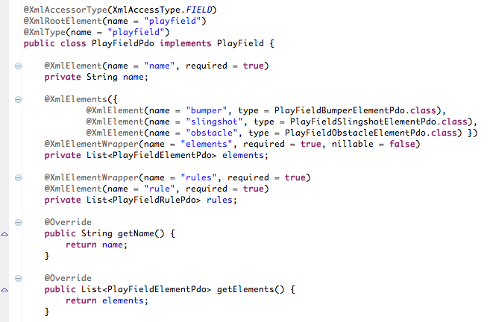
Java JAXB bindings

Slide 30
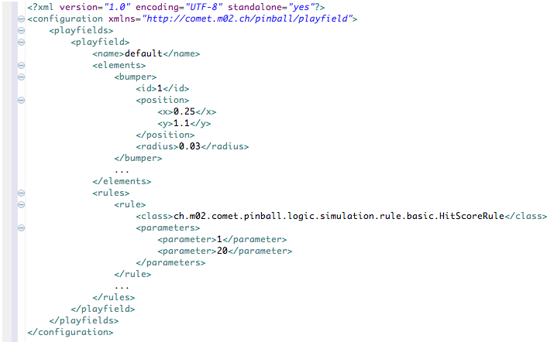
Playfield in XML

Slide 31
System design Presentation

Slide 32
System design Logic

Slide 33
Questions & Answers

