Slide 1
Project 1: Comet Pinball
Patrick Haring & Christian Bürgi

Slide 2

Overview
Key features
Technologies
System design
Overview
Dependency Injection
Model / Persistence
Communication
Logic
Q & A

Slide 3
Key features

Slide 4
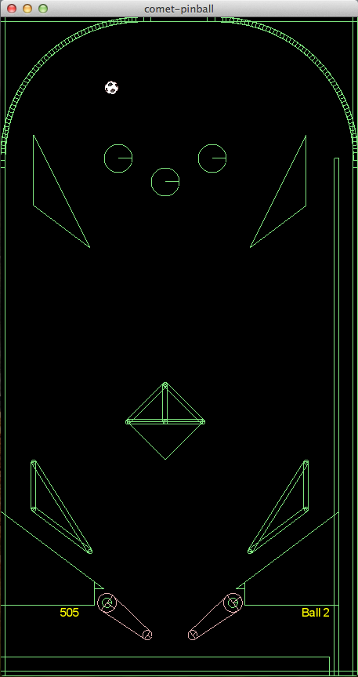
Key features
Game physics (Box2D)
Customizability (XML, JAXB)
Expandability (software design, dependency injection)
Portability (Java)
Focus of this talk

Slide 5
Technologies

Slide 6





Technologies
JAXB 2.0
http://upload.wikimedia.org/wikipedia/en/thumb/3/39/Java_logo.svg/500px-Java_logo.svg.png http://box2d.org/forum/styles/subsilver2/imageset/title.gif
http://libgdx.badlogicgames.com/img/logo.png http://www.opengl.org/img/opengl_logo.jpg http://logback.qos.ch/images/logos/lblogo.jpg http://picocontainer.com/images/pico_logo.png

Slide 7
System design

Slide 8
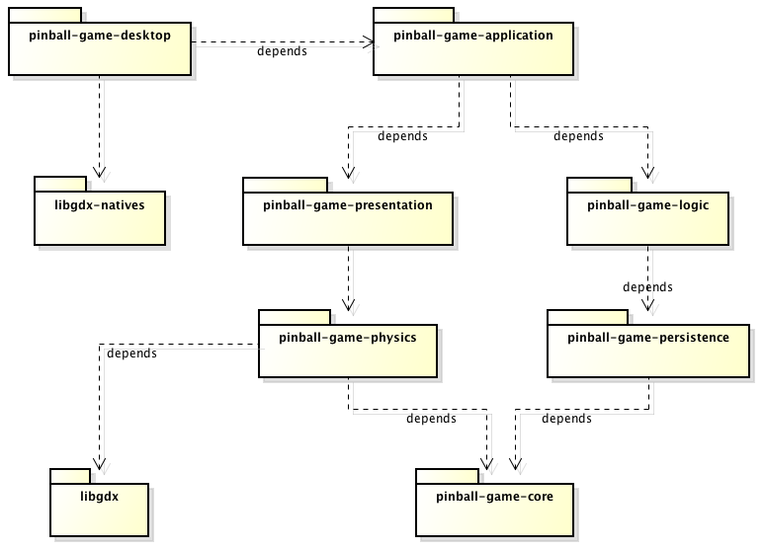
Overview

Slide 9
Overview
Bootstrapping
Natives
Pure Java

Slide 10
Overview
Game logic
Persistence
Rendering
Physics calculation

Slide 11
Overview
No libgdx!

Slide 12
Overview
Dependency wiring
Abstractions,
Interfaces,
Model

Slide 13
System design Model / Persistence

Slide 14
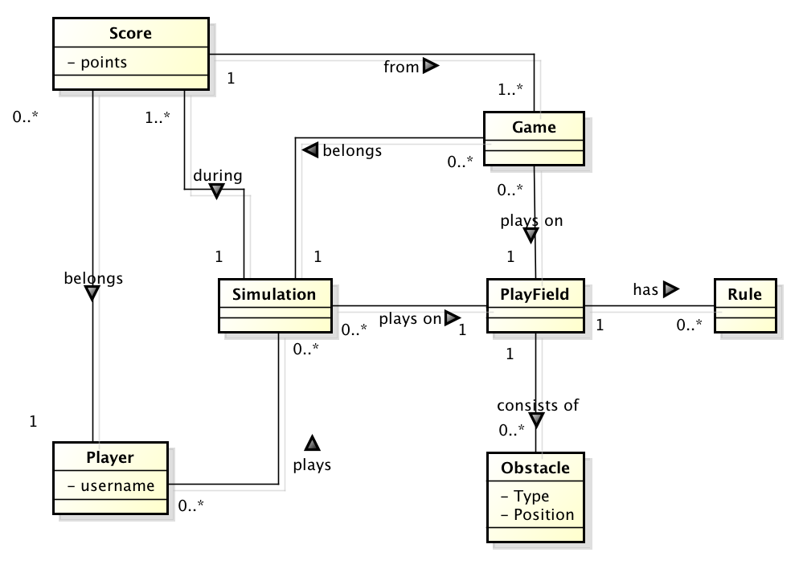
Domain model

Slide 15
Domain model
Not held persistent
(only in game logic)
Transaction data:
Object serialization
Master data:
JAXB

Slide 16
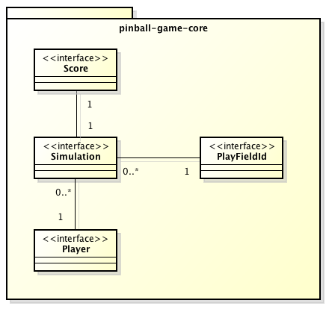
Transaction data
Human readability not required
Simple solution
Modelling through interfaces

Slide 17
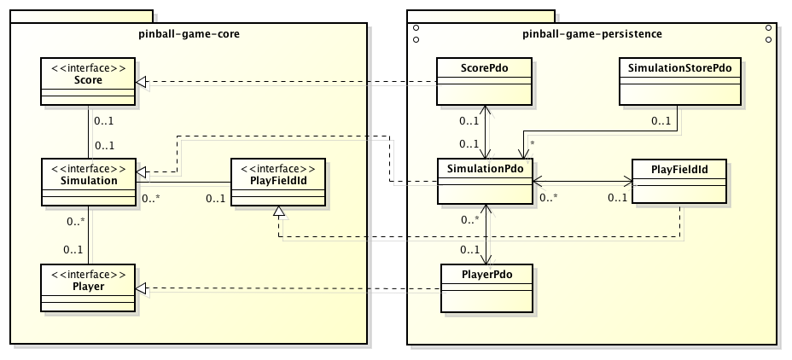
Model vs persistence data objects (PDO)
A data access object (DAO) persists a single instance of SimulationStorePdo

Slide 18
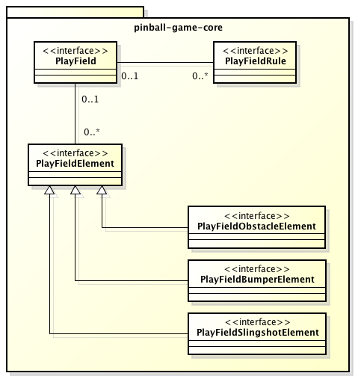
Master data
Human readability mandatory
Syntax checking possible using XSD-Schema

Slide 19
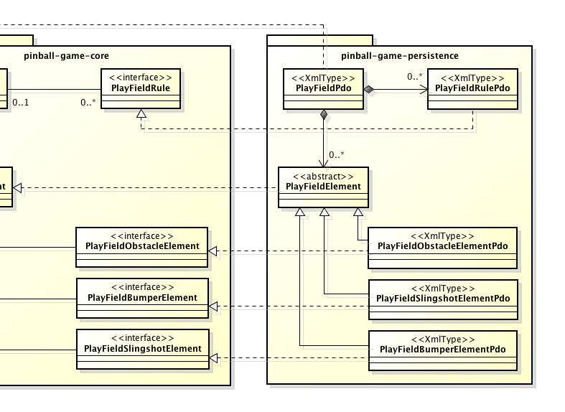
XML-persistence data objects
Java classes are mapped to XML using JAXB annotations
Again, PDO-classes implement interfaces from core-package
Unmarshalling of playfields.xml file returns a List of PlayFieldPdo

Slide 20
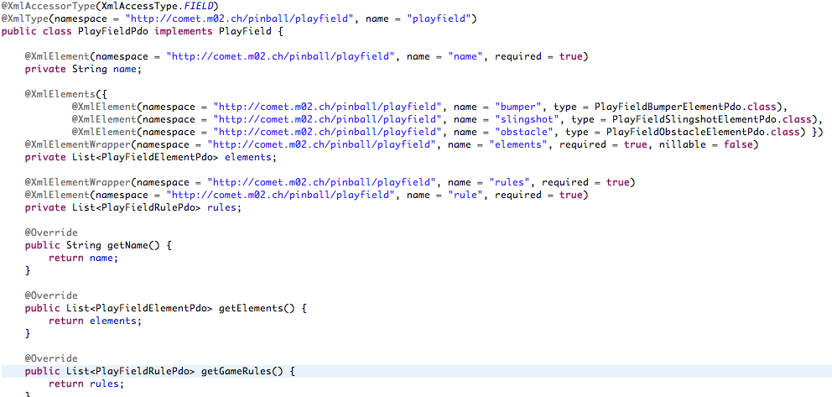
Java JAXB bindings

Slide 21
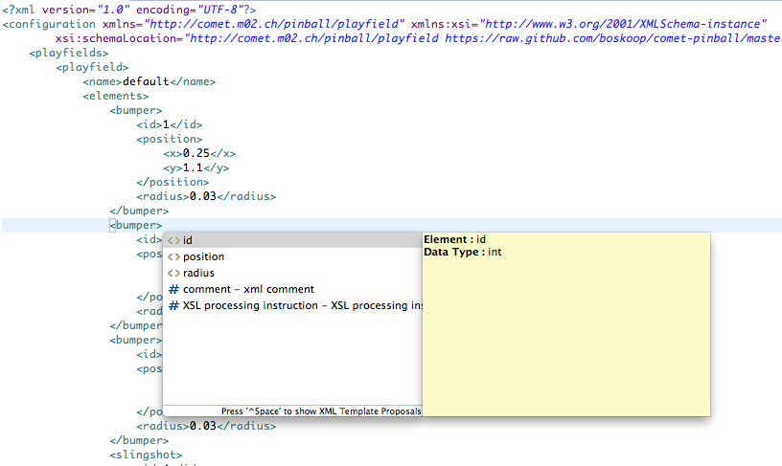
Playfield in XML

Slide 22
System design Dependency Injection

Slide 23
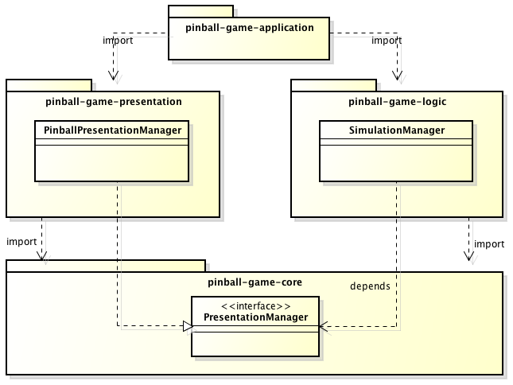
Good design

Slide 24
Problem
How get an instance of PresentationManager?

Slide 25
Possible solution
Only possible in package pinball-game-application!
public class Pinball {
...
public void needsSimulationManager() {
PresentationManager m =
new PinballPresentationManager();
SimulationManager s =
new SimulationManager(m);
// do things with SimulationManager
}
}

Slide 26
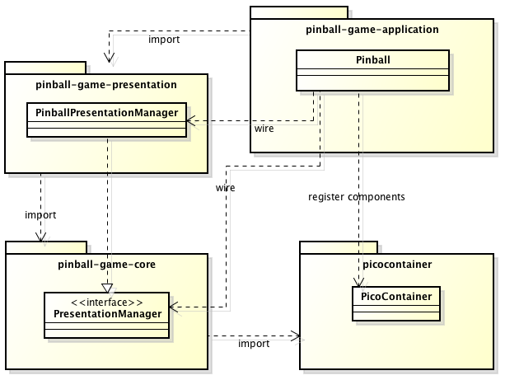
Wiring components

Slide 27
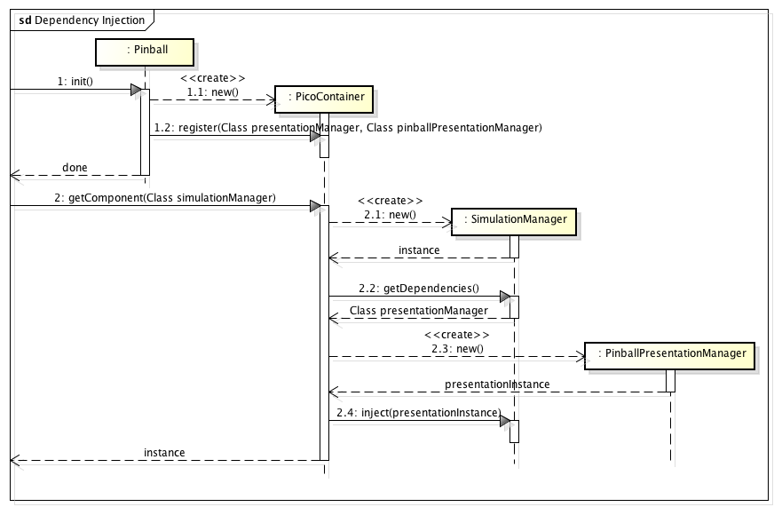
How it works

Slide 28
Better solution
public class AnyWhere {
@Inject
PicoContainer context;
public void needsSimulationManager() {
// PicoContainer injects PresentationManager
// into SimulationManager
SimulationManager s =
context.getComponent(
SimulationManager.class);
// do things with SimulationManager
}
}

Slide 29
System design Communication

Slide 30
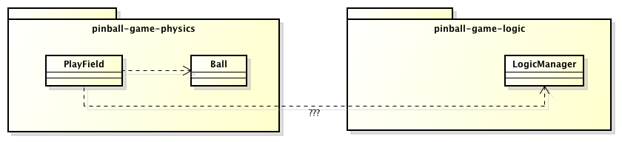
Problem
How does PlayField notifies LogicManager if Ball went through drain?

Slide 31
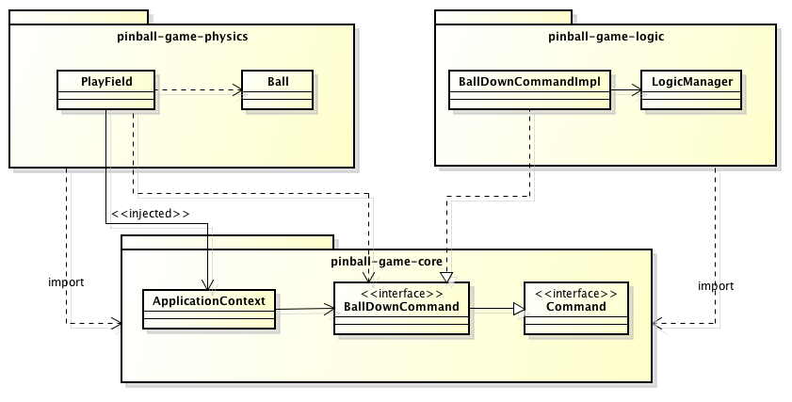
Command pattern!
Command c = context.getComponent(
BallDownCommand.class);
c.execute();

Slide 32
System design Logic

Slide 33
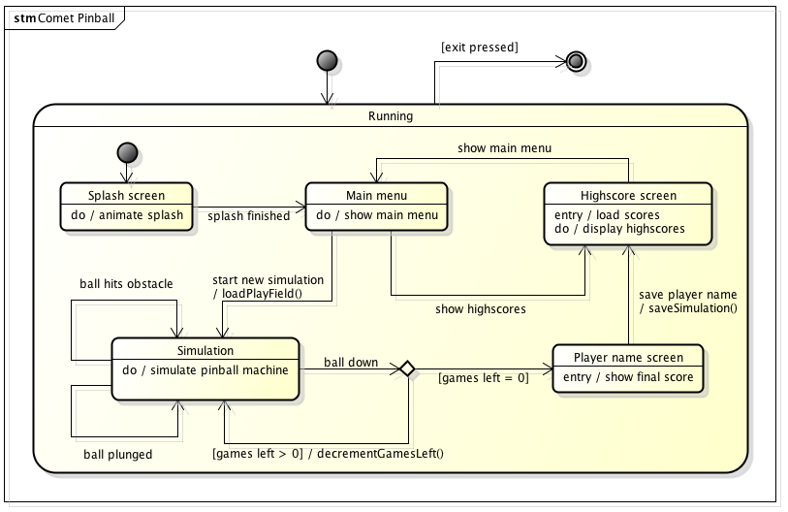
Game logic

Slide 34
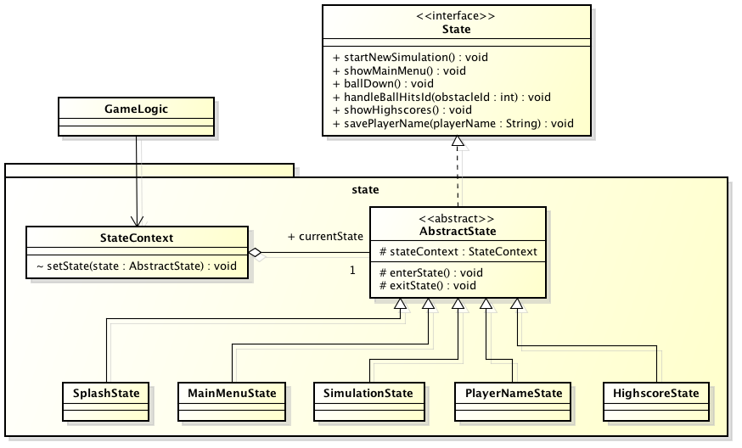
State pattern

Slide 35
Questions & Answers

Slide 36
Questions & Answers

Slide 37
Questions & Answers

Slide 38








Tools
http://www.eclipse.org/eclipse.org-common/themes/Nova/images/eclipse.png http://astah.net/resources/images/logos/AstahCommunity.png http://maven.apache.org/images/maven-logo-2.gif
http://www.redmine.org/boards/1/topics/1183?page=2 http://git-scm.com/images/logo@2x.png http://upload.wikimedia.org/wikipedia/commons/thumb/b/b3/GitHub.svg/500px-GitHub.svg.png
http://ci.m02.ch/artifactory/webapp/wicket/resource/org.artifactory.web.ui.skins.GreenSkin/images/header/header_logo.gif http://www.eclipse.org/juno/images/eclipse_juno242x132.jpg

Slide 39




Further Technologies
JUnit
http://slf4j.org/images/logos/slf4j-logo.jpg http://www.lwjgl.org/_gfx/logo.png
http://commons.apache.org/images/commons-logo.png http://mockito.googlecode.com/svn/wiki/images/logo.jpg

