Slide 1
Project 1: Comet Pinball
Patrick Haring & Christian Bürgi

Slide 2

Overview
Key features
Technologies
System design
Overview
Dependency Injection
Model / Persistence
Presentation / Physics
Logic
Q & A

Slide 3
Key features

Slide 4
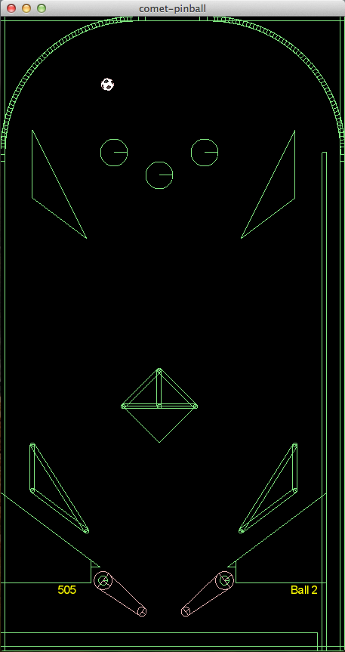
Key features
Game physics
Customizability
Expandability
Portability

Slide 5
Technologies

Slide 6




Technologies
http://upload.wikimedia.org/wikipedia/en/thumb/3/39/Java_logo.svg/500px-Java_logo.svg.png http://box2d.org/forum/styles/subsilver2/imageset/title.gif
http://libgdx.badlogicgames.com/img/logo.png http://www.opengl.org/img/opengl_logo.jpg http://www.lwjgl.org/_gfx/logo.png

Slide 7





Technologies
JAXB 2.0
JUnit
http://picocontainer.com/images/pico_logo.png http://slf4j.org/images/logos/slf4j-logo.jpg http://logback.qos.ch/images/logos/lblogo.jpg
http://commons.apache.org/images/commons-logo.png http://mockito.googlecode.com/svn/wiki/images/logo.jpg

Slide 8






Tools
http://git-scm.com/images/logo@2x.png http://www.eclipse.org/eclipse.org-common/themes/Nova/images/eclipse.png
http://upload.wikimedia.org/wikipedia/commons/thumb/b/b3/GitHub.svg/500px-GitHub.svg.png http://maven.apache.org/images/maven-logo-2.gif http://ci.m02.ch/artifactory/webapp/wicket/resource/org.artifactory.web.ui.skins.GreenSkin/images/header/header_logo.gif http://www.eclipse.org/juno/images/eclipse_juno242x132.jpg

Slide 9
System design

Slide 10
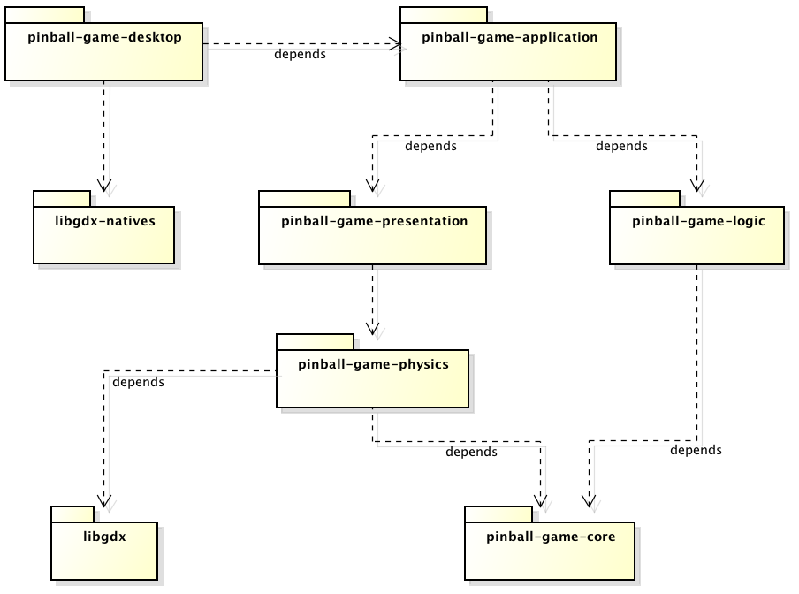
Overview

Slide 11
Overview
Main class
Natives
Pure Java

Slide 12
Overview
No libgdx!

Slide 13
Overview
Rendering
Physics calculation
Game logic
Persistence

Slide 14
Overview
Dependency Injection wiring
Abstractions,
Interfaces

Slide 15
System design Dependency Injection

Slide 16
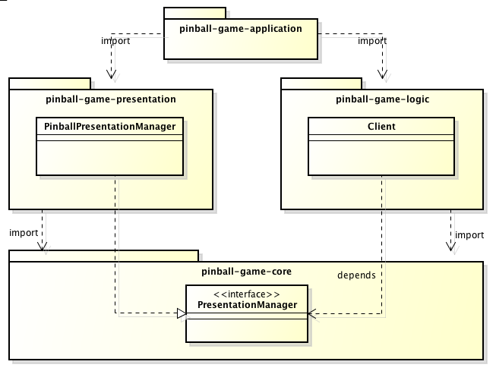
Good design

Slide 17
System design Model / Persistence

Slide 18
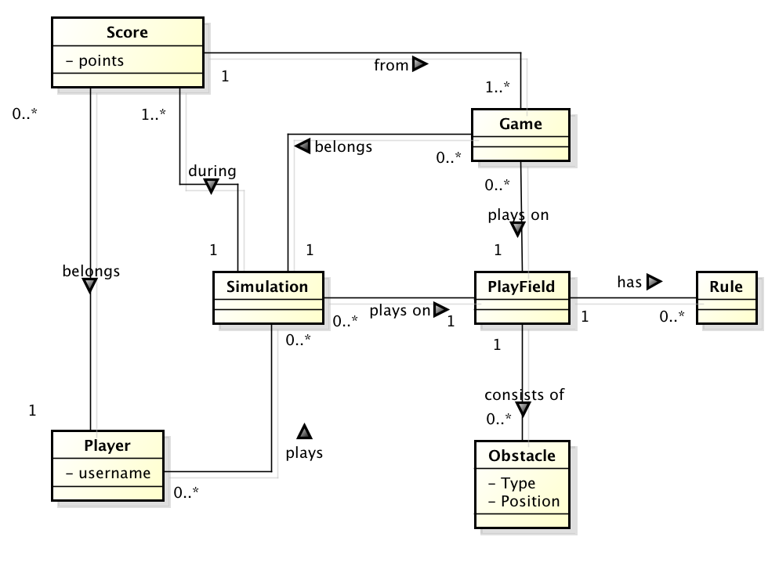
Domain model

Slide 19
System design Presentation

Slide 20
System design Logic

Slide 21
Questions & Answers

