Slide 1
Project 1: Comet Pinball
Patrick Haring & Christian Bürgi

Slide 2

Overview
Key features
Technologies
Domain model
System design
Model / Persistence
Presentation
Logic
Q & A

Slide 3
Key features

Slide 4
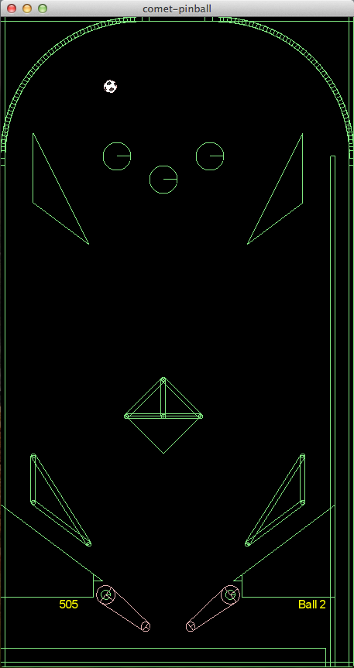
Key features
Game physics
Customizability
Expandability

Slide 5
Technologies

Slide 6




Technologies
http://upload.wikimedia.org/wikipedia/en/thumb/3/39/Java_logo.svg/500px-Java_logo.svg.png http://box2d.org/forum/styles/subsilver2/imageset/title.gif
http://libgdx.badlogicgames.com/img/logo.png http://www.opengl.org/img/opengl_logo.jpg http://www.lwjgl.org/_gfx/logo.png

Slide 7





Technologies
JAXB 2.0
JUnit
http://picocontainer.com/images/pico_logo.png http://slf4j.org/images/logos/slf4j-logo.jpg http://logback.qos.ch/images/logos/lblogo.jpg
http://commons.apache.org/images/commons-logo.png http://mockito.googlecode.com/svn/wiki/images/logo.jpg

Slide 8






Tools
http://git-scm.com/images/logo@2x.png http://www.eclipse.org/eclipse.org-common/themes/Nova/images/eclipse.png
http://upload.wikimedia.org/wikipedia/commons/thumb/b/b3/GitHub.svg/500px-GitHub.svg.png http://maven.apache.org/images/maven-logo-2.gif http://ci.m02.ch/artifactory/webapp/wicket/resource/org.artifactory.web.ui.skins.GreenSkin/images/header/header_logo.gif http://www.eclipse.org/juno/images/eclipse_juno242x132.jpg

Slide 9
Domain model

Slide 10
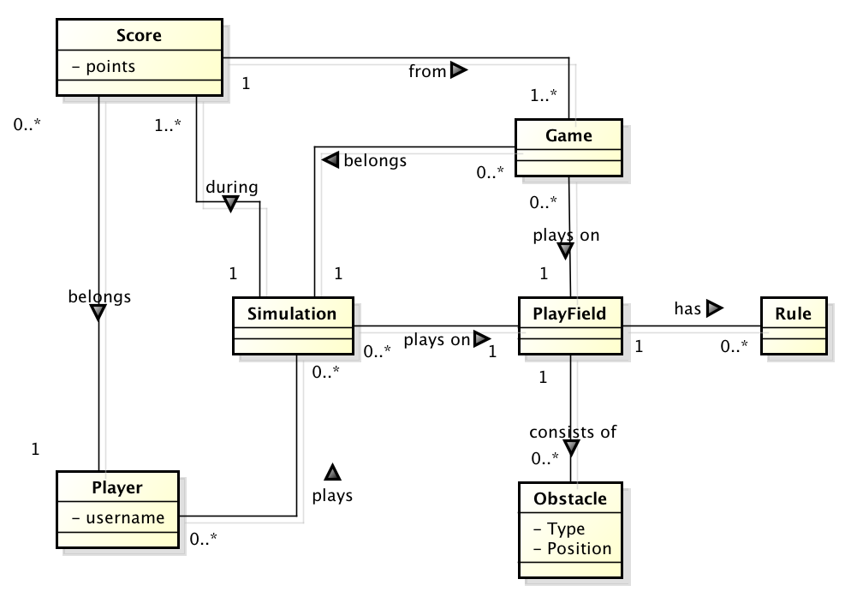
Domain model

Slide 11
System design

Slide 12
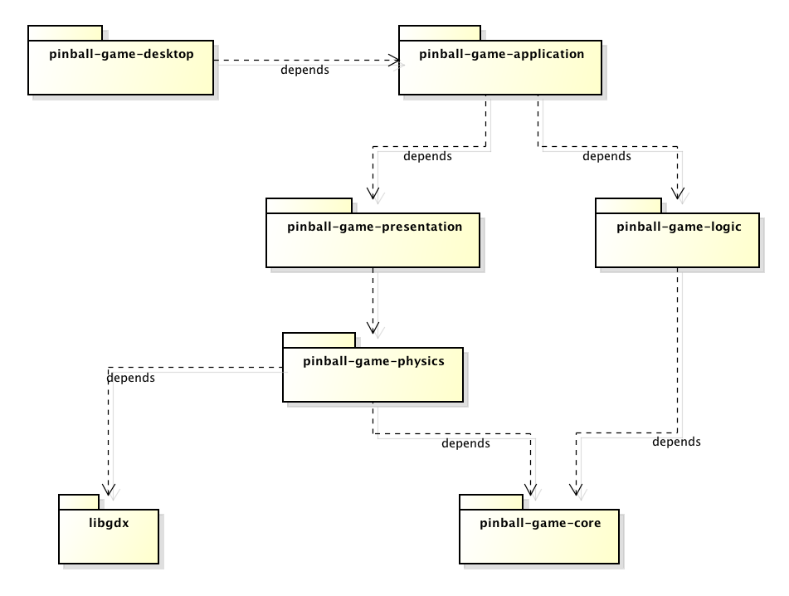
Overview

Slide 13
System design Model / Persistence

Slide 14
System design Presentation

Slide 15
System design Logic

Slide 16
Questions & Answers

