Slide 1
計算機實習 06
2021/11/5

Slide 2
CONTENTS
ASCII
Recursive Function

Slide 3
ASCII

Slide 4
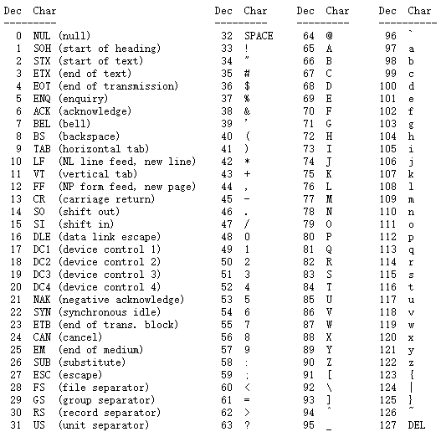
ASCII Table

Slide 5

ASCII in Python
ord() # convert character to ascii code
chr() # convert ascii code to character
hello = ‘hello’
# hello[0] == ‘h’
# No char type
# string with length one

Slide 6
Recursive Function

Slide 7
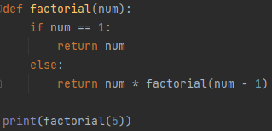

Recursion
Function中再呼叫自己
右邊的例子以遞迴計算階層
階乘 5! = 5*4*3*2*1 = 120

Slide 8
Factorial(5) = 5 * Factorial(4)
Factorial(4) = 4 * Factorial(3)
Factorial(3) = 3 * Factorial(2)
Factorial(2) = 2 * Factorial(1)
Factorial(1) = 1
Factorial(5) == 5 * 4 * 3 * 2 * 1
終止條件
遞迴式

Slide 9
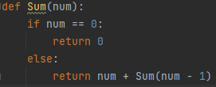
例2
Sum(5) = 5 + Sum(4)
Sum(4) = 4 + Sum(3)
Sum(3) = 3 + Sum(2)
Sum(2) = 2 + Sum(1)
Sum(1) = 1 + Sum(0)
Sum(0) = 0
Sum(5) = 5 + 4 + 3 + 2 + 1 + 0

Slide 10
課堂練習06

Slide 11
練習06
目標：使用遞迴創建Function
F(n) = 2 + F( n/2 ) ,如果n是正偶數 (整數除法)
3 + F( (n所有位數的總和) - 5 ) ,如果n是正奇數
0 ,如果n<=0
Input: test.txt (每行一個10進位整數n)
Output: 直接輸出，不用寫檔 (每行對應的F(n))
繳交截止日期：2021/11/5 23:55

Slide 12
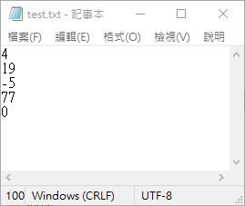
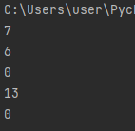
練習06
範例

Slide 13
繳交規範

Slide 14
繳交內容
只需繳交.py檔 (P6-1xxxxxxxx.py)
不用截圖

Slide 15
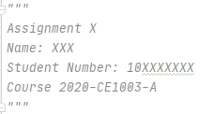
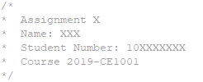
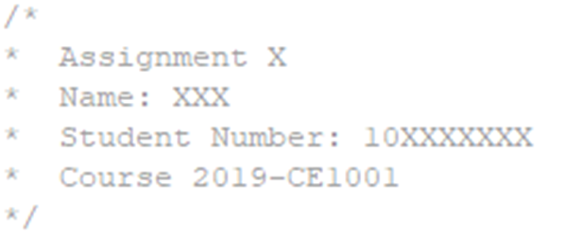
繳交格式
程式碼開頭要有以下文字
C++
Python
計算機概論Ⅰ : 2021-CE1001
計算機實習ⅠA : 2021-CE1003-A
計算機實習ⅠB : 2021-CE1003-B
作業: Assignment
練習: Practice

