Slide 1

NURS 4700
Lesson #1
Caring for patients with Stroke

Slide 2
Stroke
Ischemia is inadequate blood flow
Stroke occurs when there is ischemia to a part of the brain that results in the death of brain cells
Also known as brain attack
A major public health concern

Slide 3
Stroke (cont’d)
Functions are lost or impaired:
  E.g., movement, sensation, or emotions that were controlled by the affected area of the brain
Severity of the loss of function varies, according to the location and extent of the brain involved

Slide 4
Stroke (cont’d)
Risk factors
  Modifiable:
    Hypertension, heart disease, diabetes, increased serum cholesterol, excessive alcohol intake, obesity, metabolic syndrome, lack of exercise, oral contraceptives
  Nonmodifiable:
    Age, gender, race, family history, genetic factors

Slide 5
Stroke Etiology and Pathophysiology
The brain requires a continuous supply of blood to provide the oxygen and glucose neurons need to function.
If blood flow to brain is totally interrupted:
  Neurological metabolism is altered in 30 seconds
  Metabolism stops in 2 minutes
  Cellular death occurs in 5 minutes

Slide 6
Stroke Etiology and Pathophysiology (cont’d)
Cerebral autoregulation
Factors affecting blood flow to brain:
  Systemic blood pressure
  Cardiac output
  Blood viscosity
Collateral circulation

Slide 7
Stroke Etiology and Pathophysiology (cont’d)
Atherosclerosis
  Major cause of stroke
Transient ischemic attack (TIA)
  In response to ischemia, a series of metabolic events (ischemic cascade) occur
  If adequate blood flow can be restored early (< 3 hours), the ischemic cascade can be interrupted

Slide 8
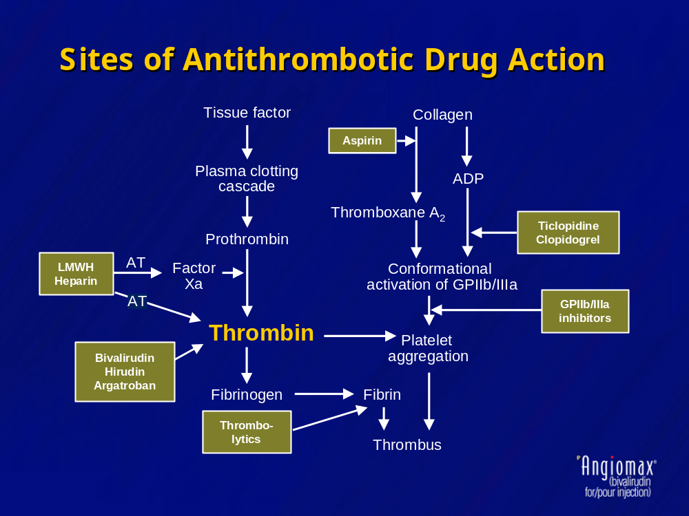
Notes:
“When a blood vessel is severed or injured, clotting begins within minutes to stop bleeding. Coagulation factors and calcium are necessary for normal clotting. Clotting occurs through 2 different pathways: the intrinsic and extrinsic. The intrinsic is activated when plasma comes in contact with the damaged vessels surface. The extrinsic pathway is activated when tissue thromboplastin is released by damaged endothelial cells, then comes in contact with one of the clotting factors. “ from Pathophysiology made Incredibly easy

Slide 9
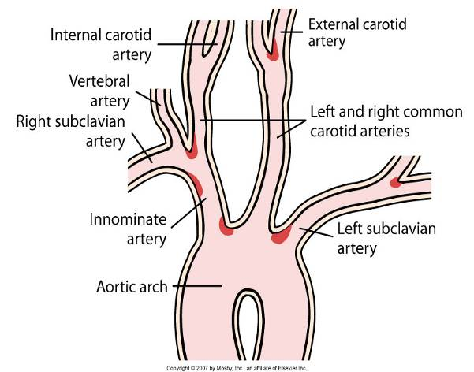
Stroke Etiology and Pathophysiology (cont’d)
Common sites for the development of atherosclerosis

Slide 10
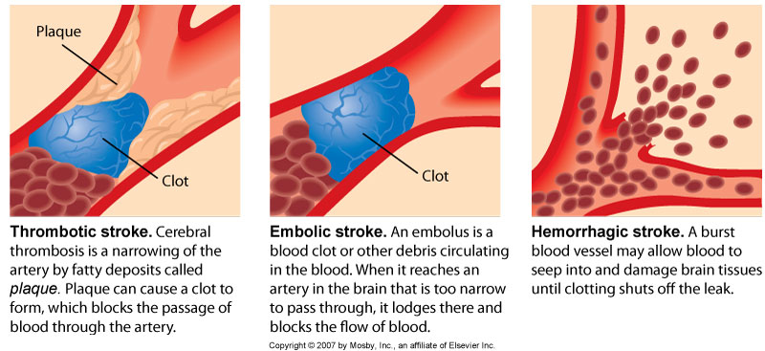
Types of Stroke (cont’d)

Slide 11
Stroke
Clinical Manifestations
Affects many body functions:
  Motor function
  Communication
  Affect
  Intellectual function
  Spatial-perceptual alterations
  Elimination

Slide 12
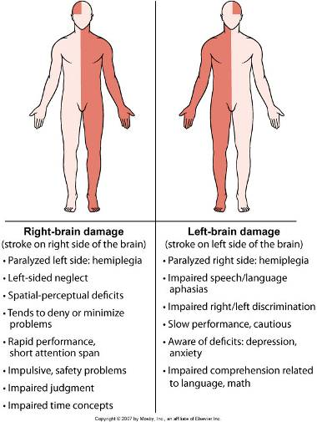
Stroke Clinical Manifestations (cont’d)
Manifestations of right-brain and left-brain stroke

Slide 13
Stroke Diagnostic Studies (cont’d)
When symptoms of a stroke occur, diagnostic studies are done to:
  Confirm that it is a stroke
  Identify the likely cause of the stroke
Computed tomography (CT) scan is the primary diagnostic test used after a stroke

Slide 14
Stroke Diagnostic Studies (cont’d)
Other studies to diagnose a stroke, including extent of involvement:
  Computed tomography angiography (CTA)
  Magnetic resonance imaging (MRI), and Magnetic resonance angiography (MRA)
  Single photon emission computed tomography (SPECT)
  Positron emission tomography (PET)
  Magnetic Resonance Spectroscopy (MRS)

Slide 15
Stroke Diagnostic Studies (cont’d)
Additional studies:
  Complete blood count (CBC)
  Platelets, prothrombin time, activated partial thromboplastin time
  Electrolytes, blood glucose
  Renal and hepatic studies
  Lipid profile

Slide 16
Stroke Patient Care (cont’d)
Priority for decreasing morbidity and mortality from stroke
Goals of stroke prevention include:
  Health promotion for the well individual
  Education and management of modifiable risk factors to prevent a stroke
Drug therapy
Surgical therapy

Slide 17
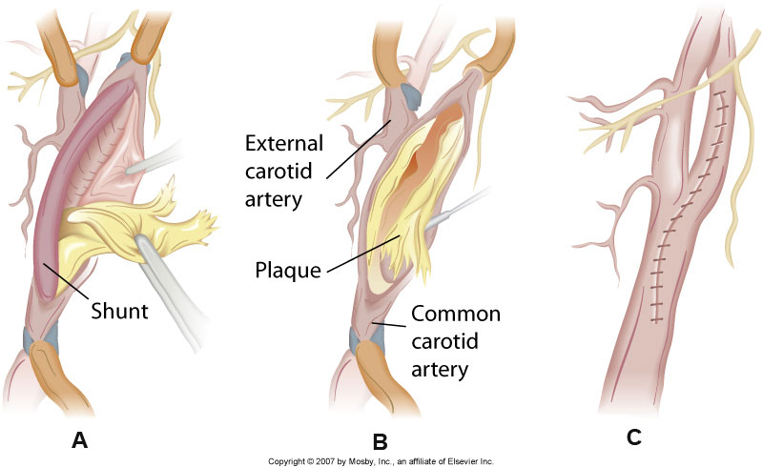
Stroke PatientCare (cont’d)

Slide 18
Stroke PatientCare (cont’d)
Acute:
  Preserving life
  Preventing further brain damage
  Reducing disability
Treatment differs according to type of stroke and changes as client progresses from acute to rehabilitation phase

Slide 19
Stroke Patient Care (cont’d)
Begins with managing the ABCs
Assessment findings:
  Altered level of consciousness
  Weakness, numbness, or paralysis
  Speech or visual disturbances
  Severe headache
  ↑ or ↓ heart rate
  Respiratory distress
  Unequal pupils

Slide 20
Stroke Patient Care (cont’d)
Assessment findings:
  Hypertension
  Facial drooping on affected side
  Difficulty swallowing
  Seizures
  Bladder or bowel incontinence
  Nausea and vomiting
  Vertigo

Slide 21
Stroke Patient Care (cont’d)
Interventions: Initial
  Ensure open airway
  Call stroke code or stroke team
  Remove dentures
  Perform pulse oximetry
  Maintain adequate oxygenation
  IV access with normal saline
  Maintain BP according to guidelines

Slide 22
Stroke PatientCare (cont’d)
Interventions: Initial
  Remove clothing
  Obtain CT scan immediately
  Perform baseline laboratory tests
  Position head midline
  Elevate head of bed 30 degrees if no symptoms of shock or injury

Slide 23
Stroke Patient Care (cont’d)
Interventions: Initial
  Institute seizure precautions
  Anticipate thrombolytic therapy for ischemic stroke

Slide 24
Stroke Patient Care (cont’d)
Hypertension is common immediately after stroke
Fluid and electrolyte balance must be controlled carefully
Interventions: Ongoing
  Monitor vital signs and neurological status
  Recombinant tissue plasminogen activator (tPA)
  Aspirin is used within 48 hours of stroke
  Platelet inhibitors and anticoagulants may be used in thrombus and embolus stroke clients after stabilization

Slide 25
Stroke Patient Care (cont’d)
Surgical interventions for stroke
  Immediate evacuation of:
    Aneurysm-induced hematomas
    Cerebellar hematomas (>3 cm)

Slide 26
Stroke Patient Care
Rehabilitation
  After stroke has stabilized for 12 to 24 hours, collaborative care shifts from preserving life to lessening disability and attaining optimal functioning
  Client may be transferred to a rehabilitation unit, outpatient therapy, or home care–based rehabilitation

Slide 27
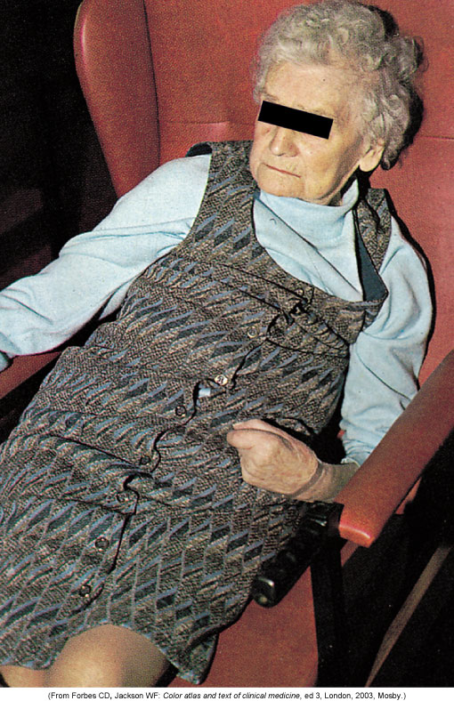
Stroke Patient Care (cont’d)
Loss of postural stability after stroke

Slide 28
Stroke Patient Care (cont’d)
  Nutrition
    First feeding should be approached carefully
    Test the swallowing, chewing, gag reflex, and pocketing before beginning oral feeding

Slide 29
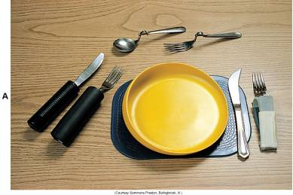
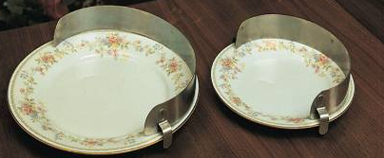
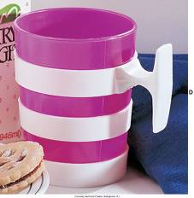
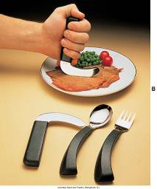
Stroke Patient Care (cont’d)
  Nutrition
    First feeding should be approached carefully
    Test the swallowing, chewing, gag reflex,
    and pocketing before beginning oral feeding
Assistive devices for eating

Slide 30
Stroke Patient Care (cont’d)
Communication
    Nurse’s role in meeting psychological needs of the client is primarily supportive
    Client is assessed for both the ability to speak and the ability to understand
    Speak slowly and calmly, using simple words or sentences
    Gestures may be used to support verbal cues

Slide 31
Stroke Patient Care (cont’d)
Sensory-perceptual alterations
    Blindness in same half of each visual field is a common problem after stroke
      Known as homonymous hemianopsia
    Other visual problems may include
      Diplopia (double vision)
      Loss of the corneal reflex
      Ptosis (drooping eyelid)

Slide 32
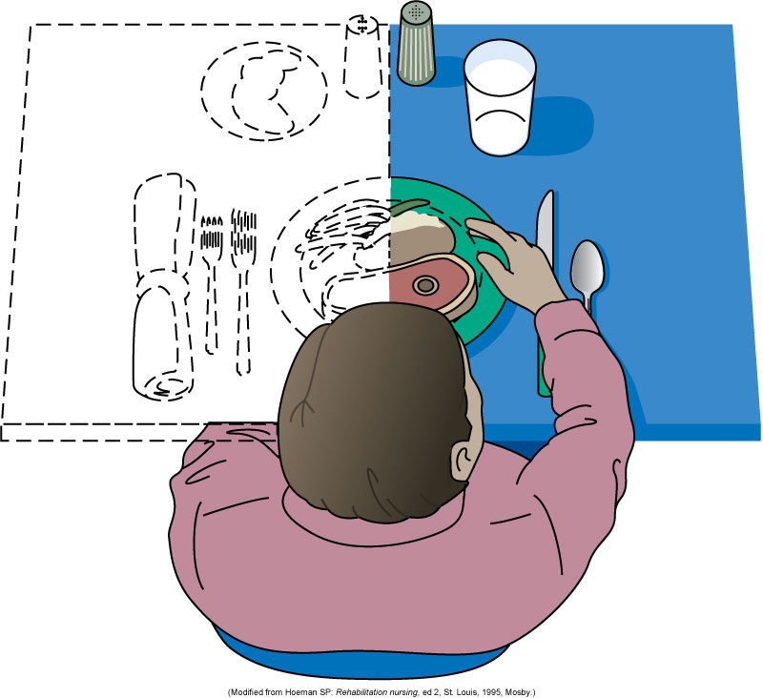
Stroke Patient Care (cont’d)
Homonymous hemianopsia (food on left side is not seen)

Slide 33
Stroke Patient Care (cont’d)
Coping
Ambulatory and home care
    Client is usually discharged from the acute care setting to home, an intermediate or long-term care facility, or a rehabilitation facility
    Rehabilitation is the process of maximizing the client’s capabilities and resources to promote optimal functioning
    Focus of care is on preventing additional loss
    Dietitian and speech therapist

Slide 34
Stroke Patient Care (cont’d)
  Ambulatory and home care
    Family members must cope with three aspects of client’s behaviour:
      1. Recognition of behavioural changes resulting from neurological deficits that are not changeable.
      2. Responses to multiple losses both by the client and the family.
      3. Behaviours that may have been reinforced during the early stages of stroke as continued dependency.

Slide 35
Stroke Age-Related Changes
Rehabilitative phase can be challenging
Clients may be fearful, depressed
Changes may occur in client–spouse relations
Stroke dependency may be threatening
Nurse assists client and family through acute hospitalization, rehabilitation, long-term care, and home care
Goal is to optimize quality of life

Slide 36
Activities-Case Study-
Suzanne Lacroix & Care of Patient
Answer questions related to Case study-Suzanne Lacroix
Complete the Care of patient after stroke

