Slide 1
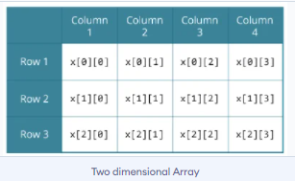
Two-Dimensional (2D) array
An array of arrays is known as 2D array. The two dimensional (2D) array in C is also known as matrix. A matrix can be represented as a table of rows and columns.
Here, x is a two-dimensional (2d) array. The array can hold 12 elements. You can think the array as a table with 3 rows and each row has 4 columns.
float x[3][4];

Slide 2
Initialization of a 2d array
// Different ways to initialize two-dimensional array
int c[2][3] = {{1, 3, 0}, {1, 5, 9}};
int c[][3] = {{1, 3, 0}, {1, 5, 9}};
int c[2][3] = {1, 3, 0, 1, 5, 9};

Slide 3
Example 1: Two-dimensional array to store and print values
#include <stdio.h>
int main()
{
int i,j,temp[2][2];
// Using nested loop to store values in a 2d array
for ( i = 0; i < 2; i++)
{
for (j = 0; j < 2; j++)
{
printf(“Row %d, Col %d: ", i + 1, j + 1);
scanf("%d", &temp[i][j]);
}
}

Slide 4
printf("\nDisplaying values: \n\n");
// Using nested loop to display values of a 2d array
for (i = 0; i < 2; i++)
{
for (j = 0; j < 2; j++)
{
printf("%d", temp[i][j]);
}
}
return 0;
}

Slide 5
WAP to print a 2D array and calculate the sum.

Slide 6
WAP in C to find the sum of two matrices of order 2*2

Slide 7
WAP in C to find the sum of two matrices of order 2*2
Sample Input & Output
Enter elements of 1st matrix
Enter a11: 2;
Enter a12: 0.5;
Enter a21: -1.1;
Enter a22: 2;
Enter elements of 2nd matrix
Enter b11: 0.2;
Enter b12: 0;
Enter b21: 0.23;
Enter b22: 23;
Sum Of Matrix:
2.2 0.5
-0.9 25.0

Slide 8
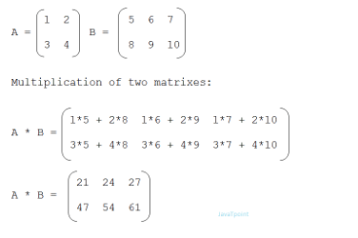
Matrix Multiplication
In matrix multiplication first matrix one row element is multiplied by second matrix all column elements.

Slide 9
Exercise
WAP to find the multiplication of two matrices

Slide 10
#include<stdio.h>
int main(){
int a[10][10],b[10][10],mul[10][10],m,n,p,q,i,j,k,sum;
printf("enter the number of row of first matrix=");
scanf("%d",&m);
printf("enter the number of column of first matrix=");
scanf("%d",&n);
printf("enter the first matrix element=\n");
for(i=0;i<m;i++)
{
for(j=0;j<n;j++)
{
scanf("%d",&a[i][j]);
}
}

Slide 11
printf("enter the number of row of 2nd matrix=");
scanf("%d",&p);
printf("enter the number of column of 2nd matrix=");
scanf("%d",&q);
printf("enter the second matrix element=\n");
for(i=0;i<p;i++)
{
for(j=0;j<q;j++)
{
scanf("%d",&b[i][j]);
}
}

Slide 12
if(n!=p)
{
printf("multiplication not possible");
}
else
{
printf("multiplication of the matrix=\n");
for(i=0;i<m;i++)
{
for(j=0;j<q;j++)
{
sum=0;
for(k=0;k<n;k++)
{
sum+=a[i][k]*b[k][j];
}
mul[i][j]=sum;
}
}

Slide 13
//for printing result
for(i=0;i<m;i++)
{
for(j=0;j<q;j++)
{
printf("%d\t",mul[i][j]);
}
printf("\n");
}
}
return 0;
}

Slide 14
