Slide 1

COMPSCI 1 1 Principles of Programming
Lecture 2 - Variables, program execution, doing calculations, print()

Slide 2
Learning outcomes
At the end of this lecture, students should be able to:
perform calculations using standard arithmetic operators
use variables to store values
describe differences between int and float types
print numbers and strings to standard output

Slide 3
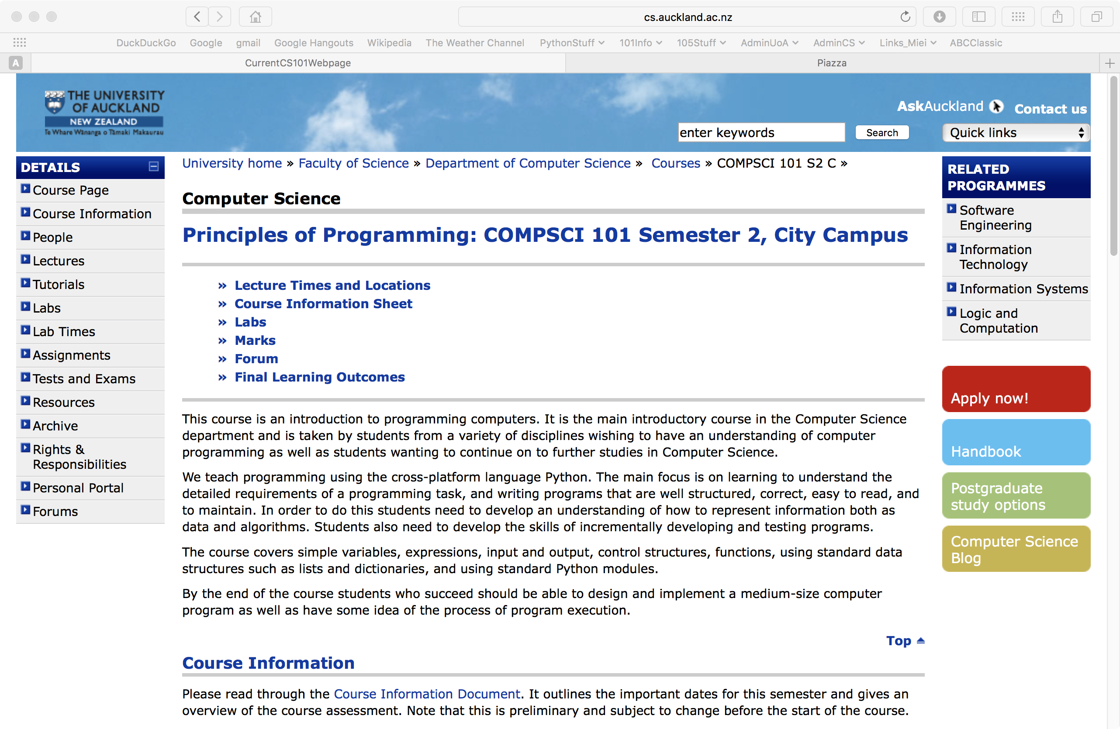
Installing Python 3
Go to the resources page of the CompSci 101 website. You will see the link to python.org where you will be able to download the python installer. Make sure you install .
Python 3
Resources
https://www.cs.auckland.ac.nz/courses/compsci101ssc/resources/
Notes:
Change pic. Get there through Canvas lecture management system

Slide 4
A program is a sequence of instructions
A program is a sequence of instructions which performs a specific task
Instructions are specified in a sequence
Computers execute the instructions one after the other
Instructions are specified using a formal language
Natural languages are the languages spoken by people
Formal languages are designed by people for a specific purpose, e.g., mathematical notation, chemical structure of molecules, programming languages
We shall be writing our programs in the Python 3 programming language
Notes:
Formal languages are languages that are designed by people for specific applications. For example,
the notation that mathematicians use is a formal language that is particularly good at denoting relationships
among numbers and symbols. Chemists use a formal language to represent the chemical
structure of molecules. And most importantly:
Programming languages are formal languages that have been designed to express
computations.

Slide 5
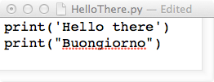
The Python interpreter
Source code (programs) is written in a programming language such as Python.
The Python interpreter translates and executes source code
One instruction at a time is converted into machine code and executed by the interpreter.
1001 0011 1001 0100 0100 1110 1010 1011 1111 0000 0101 0000 1010 0000 1011 0101 0101 0101 0100 0010 0000 1010 1000 1000 1111 1100 1001 0010 1010 1010 0100 0001 0100 1100 1010 0000 1001 0100 1001 0001 0010 0010 0000 1010 1010 1010 0100 0100 1001 0110 0100 1110 0001 0101
INTERPRETER
Hello there
Buongiorno

Slide 6
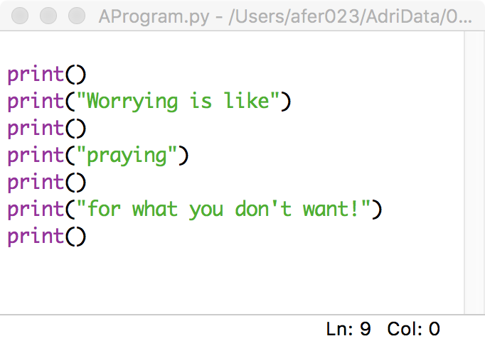
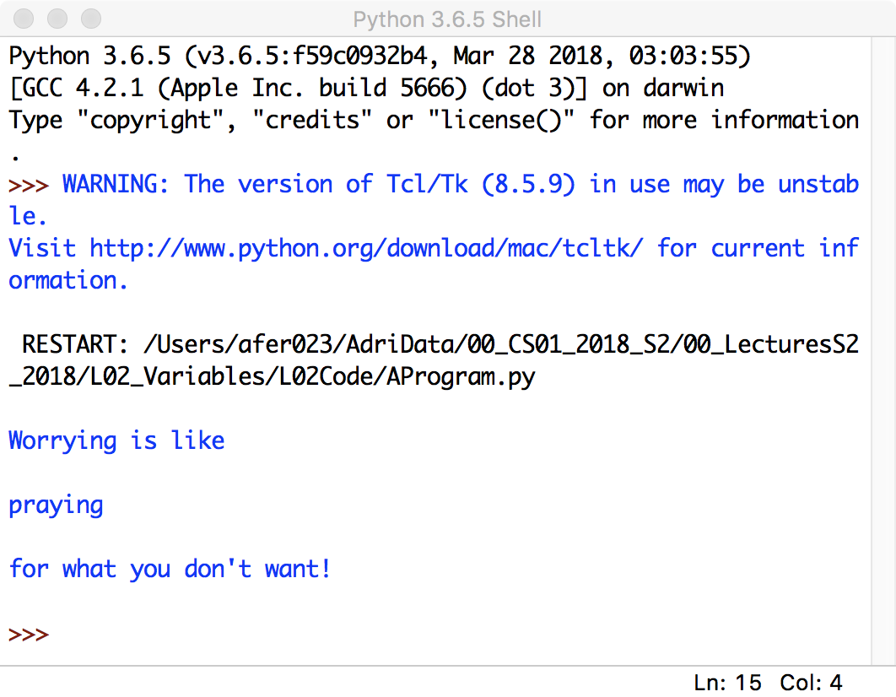
IDLE – The program editor used in CompSci 101
IDLE (Integrated DeveLopment Environment) is an integrated development environment for Python. This is the development environment provided when you download Python.
This is the environment we will be using to write and execute our Python programs.

Slide 7
Programs are deterministic
• the result of the program instructions is well defined,
• rules govern the results of instructions. Once we learn the rules, we can govern what the computer does,
• the output is completely predictable
Notes:
Programs are repeatable
In computer science, a deterministic algorithm is an algorithm which, given a particular input, will always produce the same output, with the underlying machine always passing through the same sequence of states. Deterministic algorithms are by far the most studied and familiar kind of algorithm, as well as one of the most practical, since they can be run on real machines efficiently.
Formally, a deterministic algorithm computes a mathematical function; a function has a unique value for any input in its domain, and the algorithm is a process that produces this particular value as output.

Slide 8
Storing information - variables
Variables are names for storage locations
Almost any name will work – but there are some constraints
A variable stores only one value at a time
Assign a value to a variable location using (the assignment operator)
Refer to the value in a location using the variable name.
=
name = "Adriana"
height = 170.0
age = 21
Three variables used to store three pieces of information.

Slide 9
Variable names
The following are valid variable names:
The following are invalid variable names:
What are the rules for naming variables?
x
age
age_of_child
box1
box_2
_age
age_
3
age of child
age-child
1st
2_box
Notes:
Letters, digits and underscore
Must start with a letter or an underscore
Cannot be a keyword (reserved words)
Can be any length

Slide 10
Variable names conventions
Always choose variables with meaningful names:
The convention when using multiple words,
is to join words with an underscore:
The convention is to use lower case letters for variable names.
Python is case sensitive. For example, the variable, age, is not the same as the variable, Age.
name
age
course
user_input
age_allowed
age_of_child
circle_area
Notes:
Letters, digits and underscore
Must start with a letter or an underscore (not a number)
No spaces in the variable name
Cannot be a keyword (reserved words)
Can be any length
No punctuation
There is a style guide for Python

Slide 11
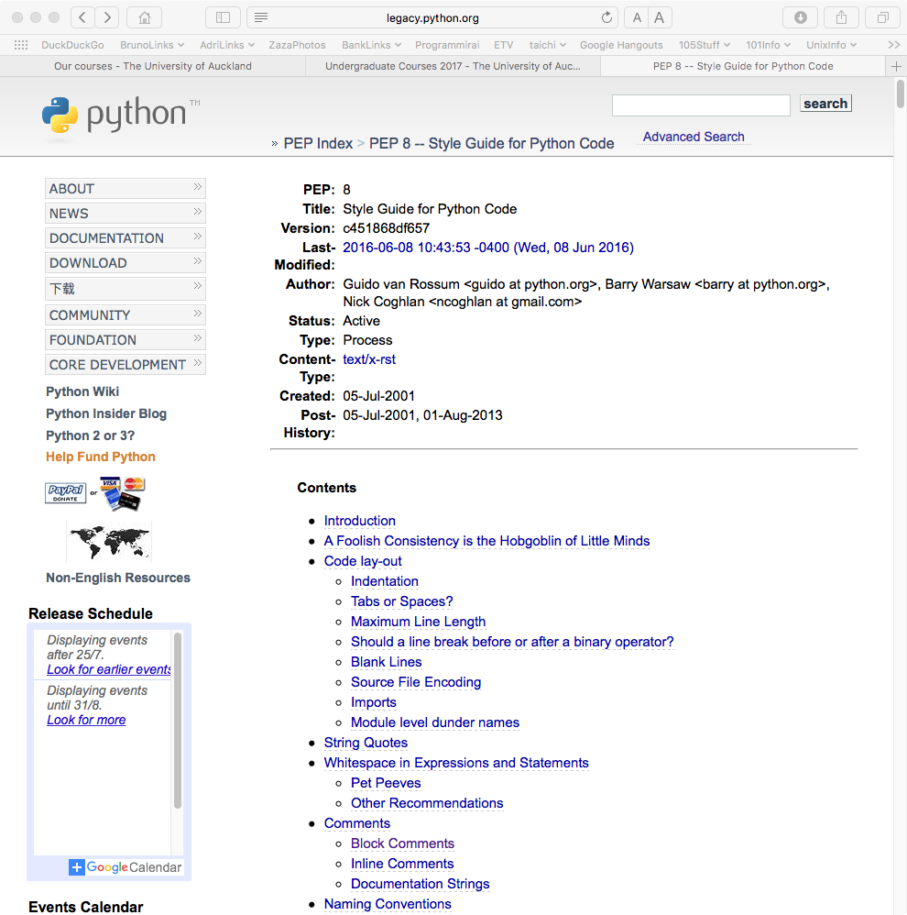
Style guide
http://legacy.python.org/dev/peps/pep-0008/
Notes:
Author: Guido van Rossum <guido at python.org>
One of Guido's key insights is that code is read much more often than it is written. The guidelines provided here are intended to improve the readability of code and make it consistent across the wide spectrum of Python code. As PEP 20 says, "Readability counts".

Slide 12
Variable names should not be keywords
Variable names should not be keywords (also called reserved words):
Look on page 11 of the reference book:
'Think Python – How to think like a computer scientist'.
and elif import raise
as else in return
assert except is try
break finally lambda while
class for nonlocal with
continue from not yield
def global or
del if pass
The electronic copy of the reference book is available from:
https://www.cs.auckland.ac.nz/courses/compsci101ssc/resources/
Notes:
Letters, digits and underscore
Must start with a letter or an underscore
Cannot be a keyword (reserved words)
Can be any length

Slide 13
What kind of information can our programs store?
Information in a program is categorised into different types. There are four basic types in Python:
integer
floating point
string
boolean
Integer values are numbers with no decimal point. They can be positive, 0 or negative:
Floating point numbers are numbers with decimal points. They can be positive, 0 or negative:
202
0
-32
1.0
-3.405
0.0
3.3333333
Note that the precision of floating point numbers is limited.

Slide 14
Assigning to a variable
=
The assignment operator is used to assign a value to a variable, i.e., to store some information in the program memory:
result1 = 54
my_age = 21
bank_balance = 2019
The left hand side of the assignment operator is always a variable.

Slide 15
Doing Calculations
The following mathematical operators can be used with integers and with floating point numbers:
Addition +
Subtraction -
Multiplication *
Division /
Exponentiation **
result1 = 54 + 4
result2 = 15 / 5
bank_balance = 2019 * 2
solution = 4 ** 3

Slide 16
Expressions
An expression always evaluates to a single value, e.g.,
-3 + 5
6 * 2 + 1
52 – 3 * 2.3
4.6
The right hand side of an assignment statement is always an expression.
Firstly the expression on the right hand side of the assignment operator is evaluated, and, then, the resulting value is assigned to the variable on the left hand side of the assignment operator.
result1 = 54 + 4 / 5
result2 = 15 / 5
bank_balance = 2019 * 3 / 100
age = 1 + 2 + 1 + 1
result3 = 7

Slide 17
Expressions
An expression can be used anywhere a single value can be used.
A variable can be used anywhere a single value can be used.
result1 = 54 + 4 / 5
result2 = result1 / 10
bank_balance = 2019 * 3 / result2
age = 5
age = age + 4
age = age * 3

Slide 18
Printing to the standard output
The print() function is used to print values to the standard output.
print(45.67)
print(100000)
print(44)
Notice that round brackets (parentheses) are used with functions. After printing whatever is to be printed (whatever is inside the round brackets), a new line is printed, i.e., the pen moves to the next line.
principal = 100
years = 15
print(43)
print(principal)
print(2 * years + 1)
43
100
31

Slide 19
Printing a blank line
The print() statement with no arguments simply prints a blank line.
principal = 100
years = 15
print(43)
print()
print(principal)
print()
print()
print(2 * years + 1)
43
100
31

Slide 20
An Example Python Program
The formula for working out the final amount when a sum is invested at compound interest is: + i ) where:
M is the final amount including the principal.
P is the principal amount.
i is the rate of interest (a whole number indicating the % interest) per year.
n is the number of years invested.
Complete the code which calculates the final amount when $100 is invested for 15 years at 10% compound interest. The output prints the principal on one line followed by the final amount on the next line:
M = P(1 + i)^{n}
principal = 100
years = 15
rate = 10
final_amount =
100
417.7248169415656

Slide 21
Strings – Another Python Built-in Type
A string consists of a collection of characters delimited by single quotes (' … ') or by double quotes (" … "), e.g.,
"Meravigioso"
'The final result is:'
"5 + 2 * 5"
""
The program from the previous slide could be written with more information in the output:
principal = 100
years = 15
rate = 10
final_amount = principal * (1 + rate /100) ** years
print("Initial amount")
print(principal)
print("Final amount")
print(final_amount)
Initial amount
100
Final amount
417.7248169415656
Notes:
Point out the difference between the empty string and a string with one space

Slide 22
Printing more than one value on a single line
The print() statement can be used to print more than one variable (or value) on a single line. Each value to be printed is separated by a comma, e.g.,
print(1, "Meraviglioso", "Fabulous")
print('The final results are:', 56, "and", 44)
The default separator between the items to be printed is a single blank space, e.g.,
1 Meraviglioso Fabulous
The final results are: 56 and 44
principal = 100
years = 15
rate = 10
final_amount = principal * (1 + rate /100) ** years
print("Initial amount", principal)
print("Final amount", final_amount)
Initial amount 100
Final amount 417.7248169415656

Slide 23
Printing more than one value on a single line
The default separator between the items printed is a single blank space. We can change this by including an optional last argument in the print() statement, sep = "…", e.g.,
print(1, "Meravigioso", "Fabulous", sep = "*")
print('The final results are:', 56, "and", 44, sep = "")
The program from the previous slides can now be improved:
1*Meravigioso*Fabulous
The final results are:56and44
principal = 100
years = 15
rate = 10
final_amount = principal * (1 + rate / 100) ** years
print("Initial amount $", principal, sep = "")
print("Final amount $", final_amount, sep = "")
Initial amount $100
Final amount $417.7248169415656

Slide 24
Exercise
$1 NZ = $0.95 AUS. Write a program which converts $500 NZ to Australian dollars and converts $500 AUS to New Zealand dollars using the above exchange rate. The output of the program should be:
NZ $500 = AUS $475.0
AUS $500 = NZ $526.3157894736842
amount_to_convert = 500
nz_to_aus_rate = 0.95
nz_dollars = amount_to_convert

Slide 25
Summary
In a Python program we can:
use variables, which have valid variable names, to store values,
perform calculations using standard arithmetic operators
describe differences between int and float types
print numbers and strings to standard output

Slide 26
Examples of Python features used in this lecture
use variables to store values, using valid variable names
principal = 100
years = 15
rate = 10
perform calculations using standard arithmetic operators
final_amount = principal * (1 + rate / 100) ** years
describe differences between int and float types
years = 15
rate = 0.01
print numbers and strings to standard output
print("Final amount $", final_amount)
print()
print("Final amount $", final_amount, sep = "")

