Slide 1

COMPSCI 1 1 Principles of Programming
Lecture 18 - Tuples

Slide 2
Learning outcomes
At the end of this lecture, students should be able to:
understand the tuple type
create tuples
manipulate code which contains tuples
return tuples
know the differences between tuples and lists

Slide 3
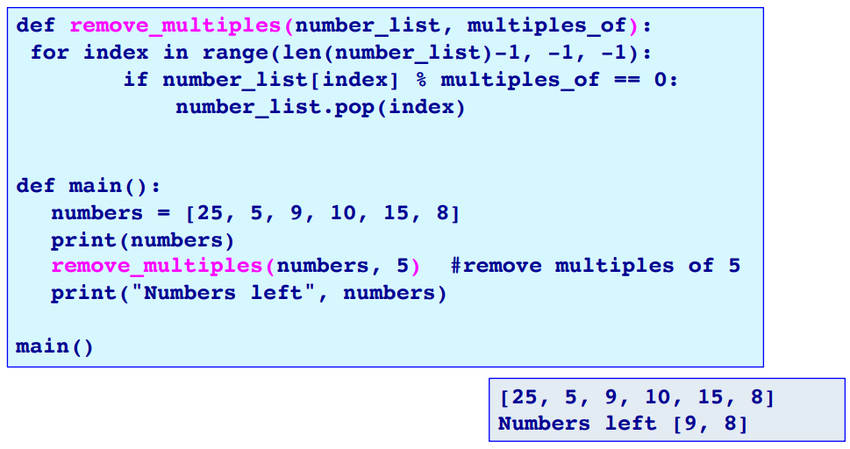
Recap
Understand various operators on lists
Understand various list methods
Lists are mutable

Slide 4
Creating Tuples
Tuples
The items of a tuple are enclosed inside a pair of parentheses, separated by commas even if there is only one item in the tuple
A tuple is an ordered sequence of items of any types
Tuples are sequences - the elements of a tuple have an order.
Create Tuples
an empty tuple
Other tuple creation examples:
tuple1 = ()
or
tuple1 = tuple()
tuple1 = (4, True, "Test", 34.8)
tuple2 = ("red", "blue")
tuple3 = (1, 2, "jim")
tuple4 = (3,)
Needs the comma if only one element in the tuple
Notes:
A tuple with only one element has to be different to an int inside parentheses

Slide 5
Creating Tuples with a single element
Create Tuples
If the tuple contains a single element, a comma is added after the element. This is required as, otherwise, there would be confusion between a tuple and a parenthesised obect, e.g., ( (5) is the same as the integer 5).
tuple1 = (5,)
print( type((5,)) ) #(5,) is a tuple
print( type((5)) ) #(5) is an int (with parentheses around it)
<class 'tuple'>
<class 'int'>
Note that tuple is a built-in type and it should not be used as a variable name.

Slide 6
Printing tuples
Printing the elements of tuples
Use the print() function to print the elements of the tuple.
tuple1 = (3, 6, 8)
print(tuple1)
tuple2 = ("abcdef", "ghij", "klmno")
print(tuple2)
(3, 6, 8)
('abcdef', 'ghij', 'klmno')
Note that tuples use round brackets.

Slide 7
Accessing the elements of a tuple
Accessing tuple elements
Each element in a tuple can be accessed using the index value (starting from index 0) and square brackets.
The elements of a tuple can be accessed from the end of the tuple backwards using a negative index.
for … in loop can be used to visit each element of a tuple (iterate through the tuple).
tuple1 = (3, 6, 8)
print("1.", tuple1[1], tuple1[2], tuple1[0])
print("2.", tuple1[-2], tuple1[-3])
tuple2 = (tuple1[1], tuple1[2], tuple1[0], 1, 7)
print("3.", tuple2)
print()
for element in tuple2:
if element > 3:
print(element)
1. 6 8 3
2. 6 3
3. (6, 8, 3, 1, 7)
6
8
7

Slide 8
+, * and in operators and tuples
Operators + (concatenate), * (repeat), and in (membership) can be used with tuples. The result of the + and * operators is a new tuple object.
tuple1 = (3, 6, 8)
tuple2 = (5, 1, 0, 4)
tuple3 = tuple2 + tuple1
tuple4 = tuple1 * 3
print(0 in tuple1)
print(0 in tuple2)
print("1.", tuple1)
print("2.", tuple2)
print("3.", tuple3)
print("4.", tuple4)
False
True
1. (3, 6, 8)
2. (5, 1, 0, 4)
3. (5, 1, 0, 4, 3, 6, 8)
4. (3, 6, 8, 3, 6, 8, 3, 6, 8)

Slide 9
Slicing tuples
Tuples can be sliced in the same way as strings and lists are sliced. The result is a new tuple.
tuple1 = (3, 6, 8, 0, 1, 2, 7)
print("1.", tuple1[0:6:2])
print("2.", tuple1[2:7:3])
print("3.", tuple1[5:1:-1])
1. (3, 8, 1)
2. (8, 2)
3. (2, 1, 0, 8)

Slide 10
Tuples are immutable
Tuples are "immutable", i.e., the elements of a tuple object cannot be changed.
tuple1 = (3, 6, 8)
tuple2 = tuple1
tuple3 = (tuple2[0], tuple2[1], tuple2[2])
print("1.", tuple1 is tuple2)
tuple1 = tuple1 + (5,)
print("2.", tuple1)
print("3.", tuple2)
print("4.", tuple1 is tuple2)
print("5.", tuple2 == tuple3)
print("6.", tuple2 is tuple3)
1. True
2. (3, 6, 8, 5)
3. (3, 6, 8)
4. False
5. True
6. False

Slide 11
Complete the output
def fiddle_tuples(t1, t2):
t3 = (t1[1], t2[0])
t1 = (t3[1], t2[0])
t2 = t1
return t3
def main():
t1 = (3, 5)
t2 = (4, 7)
t3 = t2
t3 = fiddle_tuples(t1, t2)
print("t1:", t1, "t2:", t2, "t3:", t3)
main()
t1: t2: t3:

Slide 12
Converting tuples into lists
The shortcut way of creating an empty list is:
The alternative way of creating an empty list is:
A tuple can be converted into a list by enclosing the tuple inside list(…), i.e., passing the tuple as an argument. For example,
a_list = []
a_list = list()
tuple1 = (3, 6, 8)
a_list = list(tuple1)
tuple1 = (3, 6, 8, 9, 5)
a_list = list(tuple1)
a_list.sort()
print("1.", tuple1)
print("2.", a_list)
1. (3, 6, 8, 9, 5)
2. [3, 5, 6, 8, 9]

Slide 13
Converting lists into tuples
The shortcut way of creating an empty tuple is:
The alternative way to create an empty tuple is:
A list can be converted into a tuple by enclosing the list
inside tuple(…) , i.e., passing the list as an argument.
a_tuple = ()
a_tuple = tuple()
a_list = [3, 6, 8]
a_tuple = tuple(a_list)
tuple1 = (3, 6, 8, 2, 5)
a_list = list(tuple1)
a_list.sort()
a_tuple = tuple(a_list)
print("1.", a_list)
print("2.", tuple1)
print("3.", a_tuple)
1. [2, 3, 5, 6, 8]
2. (3, 6, 8, 2, 5)
3. (2, 3, 5, 6, 8)

Slide 14
Multiple assignment
Assignment to more than one variable can be done on ONE line.
scores = (56, 78, 91)
(test1, test2, test3) = scores #or test1, test2, test3 = scores
name1, name2, name3 = "Bob", "Jane", "Jill"
name2 = name2 + "-marie"
print("1.", test2, test1, test3)
print("2.", name3, name1, name2)
1. 78 56 91
2. Jill Bob Jane-marie

Slide 15
Returning more than one value
Functions can return a tuple of values.
def get_a_date():
months = ("January", "February", …, "November", "December")
days_in_month = (31, 28, 31, 30, 31, …, 30, 31, 30, 31)
days = ("Sunday", "Monday", …, "Saturday")
day_number = random.randrange(0, len(days))
month_number = random.randrange(0, len(months))
date = random.randrange(1, days_in_month[month_number] + 1)
return (days[day_number], months[month_number], date)
def main():
date = get_a_date()
print("Your best day next year is a", date[0], "around",
date[1], date[2])
date = get_a_date()
print("Next year be careful on a", date[0], "around",
date[1], date[2])
main()
Your best day next year is a Wednesday around February 14
Next year be careful on a Sunday around November 10
Notes:
Unpack the tuple

Slide 16
A tuple method
index(x) returns the index of the first element from the left in the tuple with a value equal to x.
Python throws an error if there is no such value in the list. Because of this, index(x) is usually preceded by a check for that element using the in operator.
tuple1 = (10, 20, 30, 40, 50, 55)
if 40 in tuple1: #check first
index = tuple1.index(40)
print("40 is in position", index, "in the tuple")
else:
print("40 is not in the tuple")
40 is in position 3 in the tuple

Slide 17
Exercise
Complete the get_uniques_tuple() function which returns a tuple made up of all the unique values in the parameter tuple, a_tuple. You may find that you need to work with a list, and, finally, convert the list to a tuple.
def get_uniques_tuple(a_tuple):
def main():
a_tuple = get_uniques_tuple((3, 4, 5, 6, 3, 2, 9, 4,
5, 6, 2, 9))
print("Without duplicates", a_tuple)
main()
Without duplicates (3, 4, 5, 6, 2, 9)

Slide 18
Exercise
Complete the carry_out_transactions() function which is passed an initial balance and a tuple of transactions (positive and negative amounts). The function returns a tuple made up of three values: the final balance, the sum of all the deposits and the sum of all the withdrawals.
def carry_out_transactions(balance, transactions_tuple):
def main():
results = carry_out_transactions(5400, (100, -400, 500,
-800, 600, -100, - 200, 50, 0, -200))
print("Balance $", results[0], ", deposits $", results[1],
", withdrawals $", results[2], sep="")
main()
Balance $4950, deposits $1250, withdrawals $1700

Slide 19
Why tuples?
Tuples cannot be inadvertently changed (remember they are immutable). They are a useful tool if you want to use read-only information.
Tuples are immutable and can be used where only immutable objects can be used ( this becomes important later in course).
Processing tuples is faster than processing lists.
Assignment to multiple variables (packed inside a tuple) can be done
on the same line of code.
A function can return multiple values (packed inside a tuple).
Tuples are processed more quickly than lists. If you are not going to change the elements of a series of objects, use a tuple rather than a list.
Notes:
So what are tuples good for?
Tuples are faster than lists. If you're defining a constant set of values and all you're ever going to do with it is iterate through it, use a tuple instead of a list.
It makes your code safer if you “write-protect” data that does not need to be changed. Using a tuple instead of a list is like having an implied assert statement that shows this data is constant, and that special thought (and a specific function) is required to override that.
Remember that I said that dictionary keys can be integers, strings, and “a few other types”? Tuples are one of those types. Tuples can be used as keys in a dictionary, but lists can't be used this way.Actually, it's more complicated than that. Dictionary keys must be immutable. Tuples themselves are immutable, but if you have a tuple of lists, that counts as mutable and isn't safe to use as a dictionary key. Only tuples of strings, numbers, or other dictionary-safe tuples can be used as dictionary keys.
Tuples are used in string formatting, as you'll see shortly.
Tuples can be converted into lists, and vice-versa. The built-in tuple function takes a list and returns a tuple with the same elements, and the list function takes a tuple and returns a list. In effect, tuple freezes a list, and list thaws a tuple.

Slide 20
Summary
A tuple stores data as a sequence
The operators: +, * and in can be used with tuples
We use a for … in … to iterate through the contents of a tuple
len() returns the number of elements in a tuple
min() returns the minimum of the elements in a tuple
max() returns the maximum of the elements in a tuple
sum() returns the sum of the elements in a tuple
Each element of the tuple can be accessed using the index operator. The index can be negative (starting from the end of the tuple)
Slices of tuple can be obtained by using [slice_start: slice_end: step]
Tuples are immutable and therefore the elements of a tuple can be accessed but not changed
Tuples can be converted into lists and vice versa
Assignment to multiple variables (packed inside a tuple) can be done on the same line of code.
A function can return multiple values (packed inside a tuple).

Slide 21
Python features used in this lecture
tuple1 = (5, 7, 2, 6, 4, 3, 9)
tuple2 = (6, )
for element in tuple1:
…
number_of_elements = len(tuple1)
min_value = min(tuple1)
max_value = max(tuple1)
total = sum(tuple1)
element_from_end = tuple1[-2]
tuple2 = tuple1[1:5:2]
position = tuple1.index(3)
tuple3 = tuple([8, 4, 9])
list1 = list(tuple1)
(a, b, c) = ("ant", "bee", "cat")
def get_results():
return (56, 23, 91)

