Slide 1

COMPSCI 1 1 Principles of Programming
Lecture 19 – Open files, read from files, write to files, close files

Slide 2
Learning outcomes
At the end of this lecture, students should be able to:
understand the file system structure
open and close a file
write data to a file
read data from a file
In CompSci 101 we are dealing with text files only.

Slide 3
Recap
From lecture 18: complete the carry_out_transactions() function which is passed an initial balance and a tuple of transactions (positive and negative amounts). The function returns a tuple made up of three values: the final balance, the sum of all the deposits and the sum of all the withdrawals.
def carry_out_transactions(balance, transactions_tuple):
withdrawals = 0
deposits = 0
for trans in transactions_tuple:
if trans < 0:
withdrawals = withdrawals + abs(trans)
elif trans > 0:
deposits = deposits + trans
balance = balance + trans
return (balance, deposits, withdrawals)
def main():
results = carry_out_transactions(5400, (100, -400, 500,
-800, 600, -100, - 200, 50, 0, -200))
print("Balance $", results[0], ", deposits $", results[1],
", withdrawals $", results[2], sep="")
main()
Balance $4950, deposits $1250, withdrawals $1700

Slide 4
Data which is Processed in a Python Program
Data processed in a program exists while the program is running but it is lost when the program terminates.
To permanently store the data created in a program, we need to save it on a physical storage device.
import random
def main():
my_list = []
for num in range(20):
my_list.append(random.randrange(10, 100))
print(my_list)
main()
[67, 53, 35, 39, 89, 44, 73, 86, 48, 69, 74, 97, 60, 64, 72, 56, 88, 80, 39, 69]

Slide 5
Files
A file is a collection of bytes of information that usually resides permanently on a disk.
The data in a file can be used later by other programs.
Accessing a file means establishing a connection between the file and a program and moving data between the two.
We need to be able to:
read data from a file into a program
write data from a program to a file

Slide 6
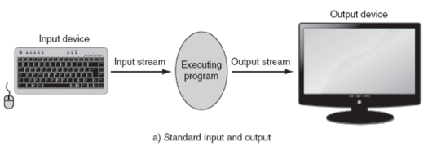
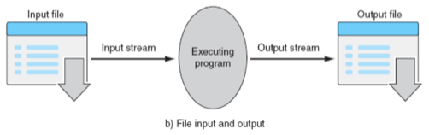
Accessing a file
When a connection has been set up between a Python program and a file, a 'stream of data' is established between the two:

Slide 7
Accessing a file
The file system of a computer organises
files in a hierarchical (tree) structure.
files are placed inside directories. Directories
can contain files or other directories.
A complete description of which directories to visit in order to reach a certain file is called a path, e.g.,
Each path to a file or a directory must be unambiguous.
C:
Python3
Users
Adriana
Documents
prog1.py
prog2.py
input.txt
C:/Users/Adriana/Documents/prog1.py

Slide 8
Path of a file
The file path is the '/' separated list of directories which need to be visited in order to reach the file. For example, if the input.txt file needs to be accessed
from inside the prog2.py program.
This file can be accessed using
the absolute path:
or using the relative path:
C:
Python3
Users
Adriana
Documents
prog1.py
prog2.py
input.txt
'C:/Users/Adriana/Documents/input.txt'
'input.txt'

Slide 9
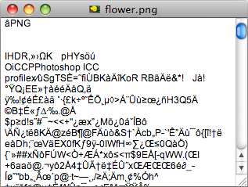
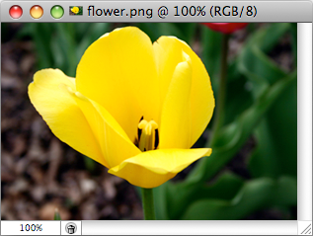
Binary vs text files
Python files are classified into two categories, i.e., text and binary.
text files can be processed using a text editor.
binary files, e.g., images, audio, video files are designed to be read by special applications which 'understand' their format.
If you open a binary file using a text editor, the editor tries to match the binary information to text characters but mostly the file information will be gobbledygook.
Image file displayed by a text editor
Same file displayed by an image viewer

Slide 10
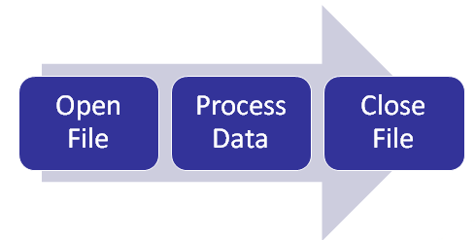
Processing files
To use Python's built in file processing functions you must first open the file. Once open, data within the file is processed using functions provided by Python, and finally the file is closed. Always remember to close the file when you're done so that the resources can be released.

Slide 11
Opening a file
The Python syntax for opening a file is:
The variable, file_variable, is now the connection between the program and the file, and this variable can now be used to read/write to the file.
For example:
file_variable = open(filename, mode)
def main():
input_file = open("stocks.txt", "r")
main()
Note that the filename is the path of the file. In this case the file, "stocks.txt" is in the same directory as the program, i.e., the file path used is the relative path.

Slide 12
File access modes
The Python syntax for opening a file is:
file_variable = open(filename, mode)
Mode Description
'r' Opens a file for reading.
'w' Opens a file for writing.
#The following modes are not used in CompSci 101
'a' Opens a file for appending data. Data is written to the end of the file.
'rb' Opens a file for reading binary data.
'wb' Opens a file for writing binary data.

Slide 13
Closing a file
The Python syntax for closing a file is:
The close() method closes the file (i.e., releases the file resources). After a file has been closed, access to the file contents is no longer available until the file is opened again.
If the mode is write mode, then any as yet unwritten content is flushed to the file.
For example:
file_variable.close()
def main():
input_file = open("stocks.txt", "r")
#process the file
input_file.close()
main()

Slide 14
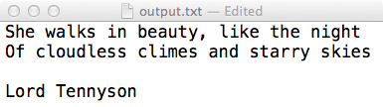
Writing to a file
First, the file needs to be opened for writing:
If the output.txt file does not exist then the open() function creates the file.
If the output.txt file exists then the open() function erases the contents of the file.
The syntax for writing to a file:
For example:
output_file = open("output.txt", "w")
output_file.write(a_string_of_text)
def main():
output_file = open("output.txt", "w")
output_file.write("She walks in beauty, like the night\n")
output_file.write("Of cloudless climes and starry skies\n")
output_file.write("\nLord Tennyson")
output_file.close()
main()
Notes:
1) She walks in beauty, like the night
Of cloudless climes and starry skies;
And all that's best of dark and bright
Meet in her aspect and her eyes:
- She Walks In Beauty Like the Night
Lord Tennyson

Slide 15
Writing to a file continued
The syntax for writing to a file:
and the parameter passed to the write() function is a string. Any numbers need to be converted using the str() function. Any new lines need to be written to the file ("\n"). For example,
output_file.write(a_string_of_text)
def main():
output_file = open("output.txt", "w")
sum_of_nums = int(input("Enter num: "))
sum_of_nums = sum_of_nums + int(input("Enter num: "))
output_file.write(str(sum_of_nums) + "\n")
output_file.close()
main()
Notes:
1) She walks in beauty, like the night
Of cloudless climes and starry skies;
And all that's best of dark and bright
Meet in her aspect and her eyes:
- She Walks In Beauty Like the Night
Lord Tennyson

Slide 16
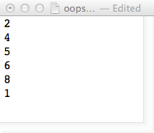
Program with 3 errors
Find the three errors in the following code. The file which should be created by the following code is shown below:
def three_errors(list1):
output_file = open("oops.txt", "w")
for num in list1:
output_file.write(num)
def main():
a_list1 = [2, 4, 5, 6, 8, 1]
three_errors(a_list1)
main()
Notes:
Need to convert the number into a string
Missing a newline character
Must close the file

Slide 17
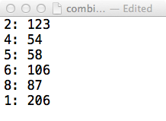
Complete the function
Complete the write_to_file() function which writes the elements of the two parameter lists (one element from both files per line) to the file (given by the parameter, filename). The elements are separated by ": ".
Assume the two files have exactly the same number of elements and that each element is an integer.
def write_to_file(filename, list1, list2):
def main():
a_list1 = [2, 4, 5, 6, 8, 1]
a_list2 = [123, 54, 58, 106, 87, 206]
filename = "combined_lists.txt"
write_to_file(filename, a_list1, a_list2)
main()

Slide 18
Reading a file
First, the file needs to be opened for reading:
If the input.txt file does not exist then an error occurs.
The four ways characters can be read from a file:
input_file = open("input.txt", "r")
input_file.read()
input_file.read(an_integer)
input_file.readline()
input_file.readlines()
Notes:
1) She walks in beauty, like the night
Of cloudless climes and starry skies;
And all that's best of dark and bright
Meet in her aspect and her eyes:
- She Walks In Beauty Like the Night
Lord Tennyson

Slide 19
The read() functions
The read() method returns the entire contents of the file. This method returns a string.
The read(an_integer) method returns the specified number of characters (a string) from the file.
all_contents = input_file.read()
some_characters = input_file.read(an_integer)
Notes:
1) She walks in beauty, like the night
Of cloudless climes and starry skies;
And all that's best of dark and bright
Meet in her aspect and her eyes:
- She Walks In Beauty Like the Night
Lord Tennyson

Slide 20
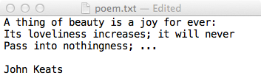
The read() functions - examples
Both the following sections of code use the file below:
input_file = open("poem.txt", "r")
all_contents = input_file.read()
input_file.close()
print(all_contents)
A thing of beauty is a joy for ever:
Its loveliness increases; it will never
Pass into nothingness; ...
John Keat
input_file = open("poem.txt", "r")
some_contents = input_file.read(10)
input_file.close()
print(some_contents)
print(len(some_contents))
A thing of
10
Notes:
1) She walks in beauty, like the night
Of cloudless climes and starry skies;
And all that's best of dark and bright
Meet in her aspect and her eyes:
- She Walks In Beauty Like the Night
Lord Tennyson

Slide 21
A note about the read() functions
Note that the file variable reads from whichever position in the file it is currently pointing to, e.g.,
input_file = open("poem.txt", "r")
some_characters = input_file.read(10)
print(some_characters)
print()
all_contents = input_file.read()
input_file.close()
print(all_contents)
A thing of
beauty is a joy for ever:
Its loveliness increases; it will never
Pass into nothingness; ...
John Keat
Notes:
1) She walks in beauty, like the night
Of cloudless climes and starry skies;
And all that's best of dark and bright
Meet in her aspect and her eyes:
- She Walks In Beauty Like the Night
Lord Tennyson

Slide 22
The readline()/readlines() methods
The readline() method returns the next line of the file. This method returns a string. The new line character is the last character of the string returned.
The readlines() method returns a list of the remaining lines of the file. This method returns a list of strings. The new line character is the last character of each string in the list (except for the last element).
next_line = input_file.readline()
list_of_lines = input_file.readlines()
Notes:
1) She walks in beauty, like the night
Of cloudless climes and starry skies;
And all that's best of dark and bright
Meet in her aspect and her eyes:
- She Walks In Beauty Like the Night
Lord Tennyson

Slide 23
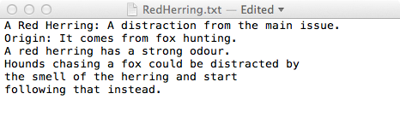
The readline() and readlines() methods - examples
Both the following sections of code use the file below:
input_file = open("RedHerring.txt", "r")
one_line = input_file.readline()
print(one_line)
A Red Herring: A distraction from the main issue.
input_file = open("RedHerring.txt", "r")
list_of_lines = input_file.readlines()
print(list_of_lines[2])
print(list_of_lines[4])
print(len(list_of_lines)
A red herring has a strong odour.
the smell of the herring and start
6
Note that the string read from the text contains the newline character.

Slide 24
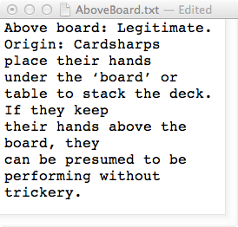
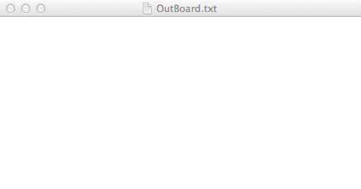
Show the contents of the OutBoard.txt file
def main():
input_file = open("AboveBoard.txt", "r")
output_file = open("OutBoard.txt", 'w')
line_list = input_file.readlines()
for line in line_list:
if line[0] == 'p' or line[0] == 'A':
output_file.write(line)
input_file.close()
output_file.close()
main()
Notes:
Above board: Legitimate.
place their hands
performing without trickery.

Slide 25
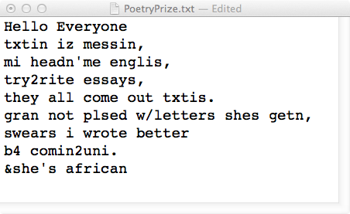
Complete the function
Complete the get_percent_vowels() function which returns the percentage of letters in the text (rounded to a whole number) which are vowels. Ignore all spaces.
def get_percent_vowels(filename):
vowels = "aeiouAEIOU"
def main():
input_f = "PoetryPrize.txt"
percent_vowels = get_percent_vowels(input_f)
print(str(percent_vowels) + "% are vowels")
main()
31% are vowels

Slide 26
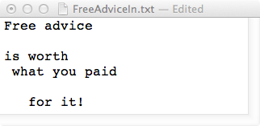
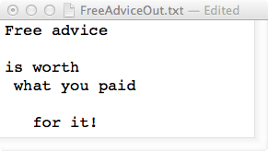
Complete the function
The copy_file() function takes the names of an input file and an output file, copies data from the input file to the output file and returns a string made up of the first and last characters in the file.
def copy_file(filename_in, filename_out):
def main():
input_f = "FreeAdviceIn.txt"
output_f = "FreeAdviceOut.txt"
first_last_chars = copy_file(input_f, output_f)
print(first_last_chars)
main()
F!

Slide 27
Summary
In a Python program:
a 'data stream' can be created between the program and a file
data can be written to a file
data can be read from a file
a file should be closed once the program has finished reading or writing to the file
In CompSci 101 we are dealing with text files only.
The file system is a hierarchical structure

Slide 28
Examples of Python features used in this lecture
def read_poem():
input_file = open("poem.txt", "r")
all_contents = input_file.read()
input_file.close()
print(all_contents)
print()
def write_to_file(filename, list1, list2):
output_file = open(filename, "w")
for i in range(len(list1)):
output_file.write(str(list1[i]))
output_file.write(": ")
output_file.write(str(list2[i]) + "\n")
output_file.close()

