Slide 1

COMPSCI 1 1 Principles of Programming
Lecture 20 – Maintaining a text file of information

Slide 2
Learning outcomes
At the end of this lecture, students should be able to:
read the contents of a text file into a list
obtain, process, and update the data from the file
use the split function to divide a string into different parts
write the updated content back to a text file

Slide 3
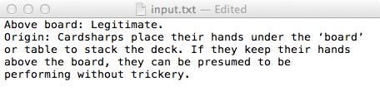
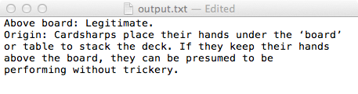
Recap
From lecture 19
a file can be opened and closed
data can be written to a file
data can be read from a file
def copy_file(filename_in, filename_out):
input_file = open(filename_in, "r")
output_file = open(filename_out, "w")
contents = input_file.read()
output_file.write(contents)
input_file.close()
output_file.close()
return contents[0] + contents[-1]
def main():
first_last_chars = copy_file("input.txt", "output.txt")
print(first_last_chars)
main()
A.

Slide 4
Remember the split() function - example
def main():
words = "The budget was unlimited, but I exceeded it " word_list = words.split()
print(words)
print(word_list)
main()
The budget was unlimited, but I exceeded it
['The', 'budget', 'was', 'unlimited,', 'but', 'I', 'exceeded', 'it']
Note about split(). If no separator is defined, whitespace is the separator.

Slide 5
Remember the split() function - example
The split() function separates a single string into a list of the parts of the string using the separator defined. The desired separator is passed to the split() function as a parameter, e.g.,
def main():
words = "The,budget,was,unlimited ,but,I, exceeded,it " word_list = words .split(",")
print("1.", words)
print("2.", word_list)
main()
The,budget,was,unlimited ,but,I, exceeded,it
['The', 'budget', 'was', 'unlimited ', 'but', 'I', ' exceeded',
'it ']

Slide 6

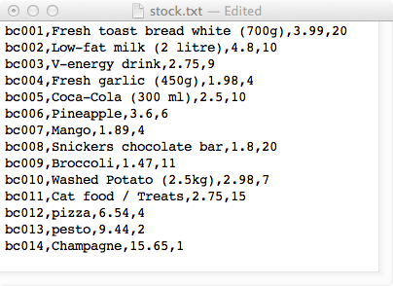
Online shopping example
A file, stock.txt, contains information about the items on sale in a simple online shopping system.
Each line contains the information about one item on sale. The line is made up of the barcode, a description, the price and the quantity (number currently on stock).
During a shopping scenario
users can:
Place an item in the shopping cart.
Update the item when it is bought.
Check out the shopping cart, which
results in the bill being generated.
Save the file of stock.
Note that items are identified by their item code, e.g., 'bc###'.

Slide 7
The GoShopping.py program
def main():
items_list = load_stock("stock.txt")
cart_list = []
selection = 1
while selection > 0:
selection = get_menu_selection()
if selection == 1:
print_list(items_list)
elif selection == 2:
code_num = input(" Enter item code number: ")
barcode = get_code_string(code_num)
index = find_item_index(items_list, barcode)
if index > -1:
user_item = items_list[index]
print(" Added to cart:", user_item)
cart_list.append(user_item)
update_quantity(items_list, index, -1)
else:
print(" This item does not exist.")
elif selection == 3:
print_list(cart_list)
elif selection == 4:
print_list(cart_list)
cost = get_total(cart_list)
print(" Total cost", "$" + str(cost))
print(" ---------------------------------")
print(" ---------------------------------")
save_stock("stock2.txt", items_list)

Slide 8
The GoShopping program – Three helper functions
def main():
….
def get_menu_selection():
print()
print("1. Display stock")
print("2. Add item")
print("3. Display cart")
print("4. Check out shopping cart")
print("0. Exit")
return int(input(" Enter selection: "))
#------------------------------
#Print the list of items
#------------------------------
def print_list(a_list):
for item in a_list:
print(" ", item)
#------------------------------
#Create a code, e.g., bc003
#------------------------------
def get_code_string(num_str):
code = "bc0" + num_str
if int(num_str) < 10:
code = "bc00" + num_str
return code
Assumption: the user never buys an item for which there is 0 quantity in stock.

Slide 9
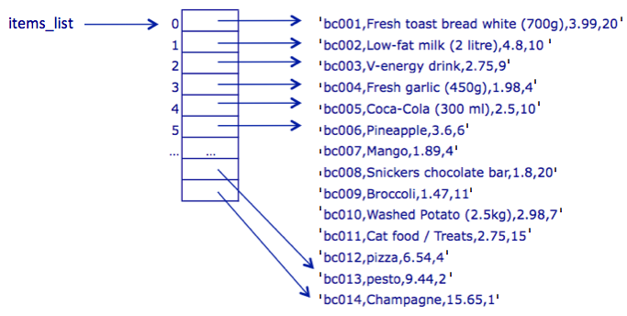
Online shopping - stock.txt file
From the text file into a list of strings.

Slide 10
Online shopping – load the stock into a list
The following slides all use the stock.txt file (see below).
Read in contents of the stock file, and break up the contents of the file into a list of item records. Each list item is a single line (a string) from the stock.txt file. (In the file each line defining an item is separated from the next item by a newline character, "\n").
def load_stock(filename):
def main():
items_list = load_stock("stock.txt")
main()

Slide 11
Online shopping – find an item
Find an item from the list of strings. The function will return the index. For example find bc003 returns the index 2 because this item is in index 2 of the list. Find bc023 returns the index -1 because this item does not exist in the list.
Note that each element is a single string.

Slide 12
Online shopping – find an item
The find_item_index() function looks through the list of items to check whether the given code (e.g., 'bc001', 'bc002') exists. Returns the index if found, -1 if not found.
def find_item_index(items_list, code):
def main():
code_num = input(" Enter item code number: ")
barcode = get_code_string(code_num)
index = find_item_index(items_list, barcode)
if index != -1:
print(" Added to cart:", items_list[index])
else:
print(" This item does not exist.")
main()
Enter item code: 3
Added to cart: bc003,V-energy drink,2.75,9
Enter item code: 23
This item does not exist.

Slide 13
Online shopping – update the quantity
To update the quantity of an item (a string), we need to add/subtract to/from the information at position 3 of the string. The information needs to be converted into an int, the amount added, and, the changed string needs to be assigned to the correct index of the item_list. E.g., the code:
energy_index = 2
update_quantity(items_list, energy_index , 5)
changes:
"bc003,V-energy drink,2.75,9"
into:
"bc003,V-energy drink,2.75,14"

Slide 14
Online shopping – updating the quantity of an item on the stock list of items
When an item is added to (or removed from the shopping cart), its quantity value needs to be updated in the list of stock, items_list, e.g., for the following item:
'bc003,V-energy drink,2.75,9'
9 is the quantity, i.e, the number of this item currently in stock.
When item, 'bc003' is bought (added to the shopping cart), the quantity will decrease by one.
Note: in this program we are assuming that the user only buys an item if there is at least one of the item in stock.

Slide 15
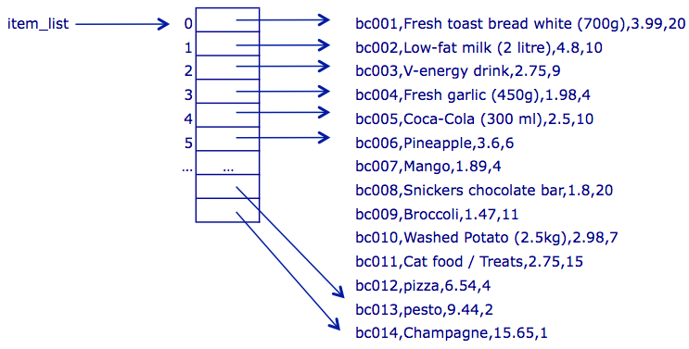
Online shopping – update the quantity
Finally, the changed string:
needs to be assigned to the correct index of the item_list.
"bc003,V-energy drink,2.75,14"
Items_list
'
'
'
'
'
14'
'
'
'
'
'
'
'
'
'
'
'
'
'
'
'
'
'
'
'
'
'
'

Slide 16
Online shopping – updating the quantity of an item on the stock list of items
Complete the update_quantity() function. Note that the quantity should never be less than 0.
def update_quantity(items_list, index, update_amt):
def main():
…
elif selection == 2:
…
index = find_item_index(items_list, barcode)
if index > -1:
user_item = items_list[index]
cart_list.append(user_item)
update_quantity(items_list, index, -1)
…
main()
Note: when an element from the items_list is split into a list of its parts (comma separator), the quantity of the item is in position 3 of the list.

Slide 17
Online shopping – total cost
To get the total cost of the list of items in the cart we need to sum the individual cost of each item.
'
'
bc001,Fresh toast bread white (700g),3.99,20
bc013,pesto,9.44,2
bc009,Broccoli,1.47,11
bc014,Champagne,15.65,100
bc002,Low-fat milk (2 litre),4.8,10
bc011,Cat food / Treats,2.75,15
cart_list
0
1
'
'
2
'
'
3
4
'
'
5
'
'
'
'

Slide 18
Online shopping – total cost
To get the cost from one item (a string), we need to split the single string into a list of strings and obtain the information at position 2 in the list. The information needs to be converted into a float before it can be added to the total. For example,
"bc001,Fresh toast bread white (700g),3.99,20"
One string
bc001
Fresh toast bread white (700g)
3.99
20
split_line
0
1
2
A list of strings
3
"3.99"
A string
3.99
A float

Slide 19
Online shopping – total cost
Complete the get_total() function.
Note: when each element of the cart_list is split into a list of its parts (comma separator), the cost of the item is in position 2 of the list.
def get_total(cart_list):
def main():
…
elif selection == 4:
print_list(cart_list)
cost = get_total(cart_list)
print(" Total cost", "$" + str(cost))
main()
bc006,Pineapple,3.6,6
bc014,Champagne,15.65,5
bc005,Coca-Cola (300 ml),2.5,10
Total cost $21.75

Slide 20
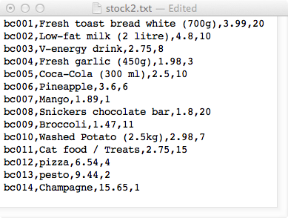
Online shopping – write the list to a file
Write the list of items to the filename file. Each item in the list is written on a new line in the file.
def save_stock(filename, list_of_items):
def main():
items_list = = load_stock("stock.txt")
…
save_stock("stock2.txt", items_list)
main()

Slide 21
Summary
In a Python program:
the contents of a file can be opened and read into a list
data from a file can be obtained, processed, and updated
the split function can be used to divide a string into different parts

Slide 22
Examples of Python features used in this lecture
def update_quantity(items_list, index, update_amt):
item_string = items_list[index]
item_parts = item_string.split(",")
quantity = int(item_parts[3])
quantity = quantity + update_amt
quantity = max(quantity, 0)
updated_str = ""
for pos in range(len(item_parts) - 1):
updated_str = updated_str + item_parts[pos] + ",”
updated_str = updated_str + str(quantity)
items_list[index] = updated_str

