Slide 1
COMPSCI 101 Principles of Programming
Lecture 25 - Using the Canvas widget to draw rows and columns of shapes

Slide 2
Learning outcomes
At the end of this lecture, students should be able to
draw 2D shapes using characters
draw 2D shapes on a Canvas

Slide 3
Drawing 2D shapes using Characters
We write programs to draw 2D shapes using characters
(e.g. asterisks)
The way to conceptualize this is to think about the shape as a sequence of rows and to think carefully about how to describe the i^{th} row, e.g. drawing a triangle.
These kinds of problems will help you learn how to write loops by finding appropriate formulas to describe each iteration of the loop in terms of the iteration variable.
***
***
***
***
*
**
***
****
*
*
*
*

Slide 4
Printing a Row of characters
Example00.py
DEMO
The following example prints only one row of ‘#’ characters using a SINGLE for loop.
def print_row(number_of_cols):
for j in range(number_of_cols):
print('#', end="")
print()
###
Print a new line character (i.e. move to next line)
Notes:
http://www.coderslexicon.com/building-shapes-with-loops/

Slide 5
Printing Multiple Rows of Characters
To create rows and columns of shapes we need nested loops
That is, loops within loops to execute lines of code.
The first (outer) loop is looping through rows, the inner loop is looping through columns.
As we go through each column of a given row, we print an asterisk. The result is that we can build any size rectangle we want.
Set up all the variables needed for the nested loop
for … in loop which dictates how many rows:
Set everything up ready for drawing the row
for … in loop which handles one single row:
draw a single character
move to next line
***
***
***
***

Slide 6
1) Printing a Rectangle of Characters
To print a rectangle, we need two parameters:
number of rows = 4 rows
number of columns = 3 columns
The outer for loop contains two statements:
1) inner for loop
2) print(): move cursor to the next line
The inner for loop contains one statement:
statement which prints a character
***
***
***
***
***
Set up all the variables needed for the nested loop
for … in loop …
for … in loop which handles one single row:
draw 3 asterisks
move to next line
***
***
***

Slide 7
1) Printing a Rectangle of Characters
Example01.py
DEMO
To print a rectangle, we need two parameters:
number of rows = 4 rows
number of columns = 3 columns
***
***
***
***
***
Set up all the variables needed for the nested loop
for … in range … 4 rows
for … in range … 3 columns
draw 1 asterisk
move to next line
***
***
***
def print_square(number_of_rows, number_of_cols):
for i in range(number_of_rows):
for j in range(number_of_cols):
print('*', end="")
print()

Slide 8
2) Printing a right-angle Triangle
To print a right-angle triangle, we need one parameter:
number of rows = 4 rows
The outer for loop contains two statements:
1) inner for loop
2) print(): move cursor to the next line
The inner for loop contains one statement:
statement which prints one or more character(s)
*
Set up all the variables needed for the nested loop
for … in loop … 4 rows
for … in loop which handles one single row:
if it is the first row, draw 1 asterisk
if it is the second row, draw 2 asterisks
if it is the i^{th} row, draw i asterisks
move to next line
*
**
***
****
**
***
****

Slide 9
2) Printing a right-angle Triangle
Example02.py
DEMO
To print a right-angle triangle, we need one parameter:
number of rows = 4 rows
Set up all the variables needed for the nested loop
for … in range … 4 rows
for … in range …
row = 0, number of columns = 1
row = 1, number of columns = 2
row = 2, number of columns = 3
move to next line
*
*
**
***
****
**
***
****
def print_right_angle_triangle(number_of_rows):
for row in range(number_of_rows):
for column in range(row+1):
print('*', end="")
print()

Slide 10
Exercise 1
Task:
Complete the following code fragment to print …
*
**
***
****
def print_right_angle_triangle(number_of_rows):
for row in range(number_of_rows):
print()

Slide 11
Program skeleton
All the programs in this lecture have the following code skeleton.
The draw_shapes() function is different for each exercise.
def main():
root = Tk()
root.title("My first Canvas")
root.geometry("400x300+10+20")
a_canvas = Canvas(root)
a_canvas.config(background="pink") #some colour
a_canvas.pack(fill=BOTH, expand = True)
draw_shapes(a_canvas)
root.mainloop()
main()
Notes:
The place Geometry Manager is the simplest of the three to use. It places the widget either in absolute or relative terms. However, it is a pain to use for general placement of widgets, though can be useful in special cases

Slide 12
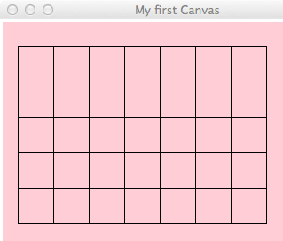
Drawing 2D shapes on a Canvas
In order to draw a 2D shape (e.g. multiples of squares) on a canvas, we need:
The number of rows and number of columns
Size of each square (size=50)
Start point (x_margin, y_margin) = (20, 30)
Nested loops
Coordinates of the top left corner of each square
Example:
1st (20, 30), (70, 30), (120,30) …
2nd (20, 80), (70,80), (120, 80)
…
Size of the squares is 50 pixels by 50 pixels
(120,30)
(70,30)
(20,30)

Slide 13
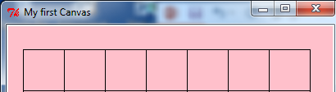
Example 3
Let’s look at ONE row of the shape FIRST:
x = 20 (starts at 20 on each row)
Coordinates of the first square: (20, 30, 70, 80)
…Second square: (70, 30, 120, 80)
…Third square(120, 30, 170, 80)
(70,30)
(120,30)
(20,30)
x_left = left_hand_side
for j in range(number_of_colums):
rect = (x_left, y_down , x_left + size, y_down + size)
a_canvas.create_rectangle(rect)
x_left += size
modify x-coordinate of the square in each iteration

Slide 14
Drawing … on a Canvas
Now, we look at the entire shape. We need nested loops!
The outer loop iterates number of rows.
1st row : coordinate of the top left corner: (20, 30) and the next one is (70, 30) and (120, 30) …
2nd row: coordinate of the top left corner: (20, 80) and the next one is (70, 80) and (120, 80) …
3rd row: : coordinate of the top left corner: (20, 130) and the next one is (70, 130) and (120, 130) …
…
(20,30)
(20,80)
(20,130)

Slide 15
Drawing … on a Canvas
We put them together:
Set up all the variables needed for the nested loop
for … in loop which dictates how many rows:
Set everything up ready for drawing the row
for … in loop which handles one single row:
draw a single shape
change the x value to move along the row
change the y value ready for the next row down
Outer loop:
for i in range(number_of_rows):
x_left = left_hand_side
for j in range(number_of_columns):
rect = (x_left, y_down, x_left + size, y_down + size)
a_canvas.create_rectangle(rect)
x_left += size
y_down += size
reset the starting position of each row
Inner loop:
adjust the y coordinates

Slide 16
Drawing … on a Canvas
Example03.py
DEMO
Algorithm:
reset the starting position of each row
(20,30) x_left = left_hand_side | (70, 30) x_left += size y no change | (120, 30) x_left += size y no change
(20,80) x_left = left_hand_side | (70, 80) x_left += size y no change | (120, 80) x_left += size y no change
(20,130) x_left = left_hand_side | (70, 130) x_left += size y no change | (120, 130) x_left += size y no change
y_down += size
y_down += size
Set up all the variables needed for the nested loop
for … in loop which dictates how many rows:
Set everything up ready for drawing the row
for … in loop which handles one single row:
draw a single shape
change the x value to move along the row
change the y value ready for the next row down

Slide 17

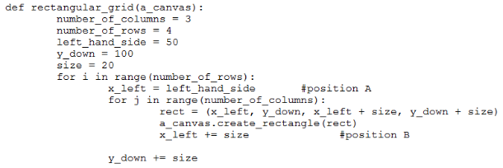
Quizzes
Consider the following code fragment:

Slide 18
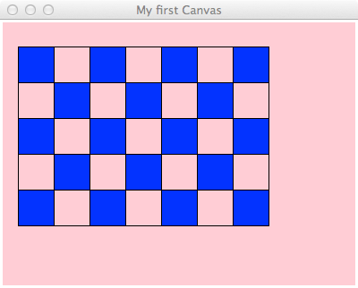
Example 4
What should we do in order to draw the following shapes?
First row:
Fill, draw, fill, draw…
Second row:
Draw, fill, draw, fill …
Third row
Fill, draw, fill, draw…
rect = (x_left, y_down, x_left + size, y_down + size)
a_canvas.create_rectangle(rect, fill="blue")
Command to create the filled square
rect = (x_left, y_down, x_left + size, y_down + size)
a_canvas.create_rectangle(rect)

Slide 19
4) Drawing … on a Canvas
Using a Boolean variable
First row:
True, False, True, False…
Second row:
False, True, False, True…
Third row
True, False, True, False…
False
False
False
True
True
True
True
False
False
False
False
True
True
True
False
False
False
True
True
True
True

Slide 20
4) Drawing … on a Canvas
What is the output of the following code fragment?
is_filled = True
for i in range(5):
print(is_filled, end=" ")
is_filled = not is_filled
i | is_filled
 | True
0 | False
1 | True
2 | False
3 | True
4 | False
True False True False True

Slide 21
Drawing … on a Canvas
We put them together:
x-margin, y-margin, width, height, first_in_row_filled=True
Set up all the variables needed for the nested loop
set up y-position
for … in loop which dictates how many rows:
Set everything up ready for drawing the row
set up x-positon, is_filled
for … in loop which handles one single row:
draw a single shape
change the x value to move along the row
modify the is_filled boolean
change the y value ready for the next row down
modify the first_in_row_filled boolean
Outer loop:
Inner loop

Slide 22
Drawing … on a Canvas
Example04.py
DEMO
Nested Loops:
first_in_row_filled = True
for i in range(number_of_rows):
x_left = left_hand_side
is_filled = first_in_row_filled
for j in range(number_in_row):
rect = (x_left, y_down, x_left + size, y_down + size)
if is_filled:
a_canvas.create_rectangle(rect, fill="blue")
else:
a_canvas.create_rectangle(rect)
x_left = x_left + size
is_filled = not is_filled
y_down = y_down + size
first_in_row_filled = not first_in_row_filled

Slide 23
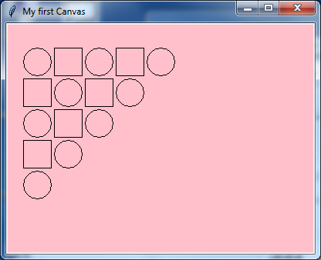
Example 5
Steps:
1st iteration of outer loop -> repeat 5 iterations in the inner loop
2nd iteration of outer loop -> repeat 4 iterations in the inner loop
3rd iteration of outer loop -> repeat 3 iterations in the inner loop
4th iteration of outer loop -> repeat 2 iterations in the inner loop
5th iteration of outer loop -> repeat 1 iteration in the inner loop

Slide 24
is_circle boolean
first_is_circle | is_circle
True | True | False | True | False | True
False | False | True | False | True
True | True | False | True
False | False | True
True | True

Slide 25
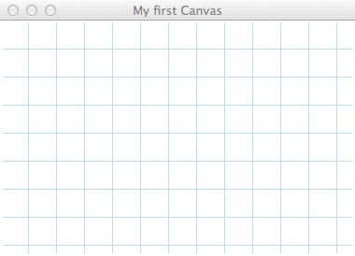
Exercise 2
Draw the canvas
def draw_shapes(a_canvas):
number_of_rows = 6
size = 30
y_down = 0
left_hand_side = size
for number_along_row in range(1, number_of_rows + 1):
x_left = left_hand_side
for j in range(number_along_row):
rect = (x_left + 2, y_down + 2, x_left + size - 2, y_down
+ size - 2)
a_canvas.create_oval(rect, fill="blue")
x_left = x_left + size * 2
y_down = y_down + size
gridlines are of size 30 pixels

Slide 26
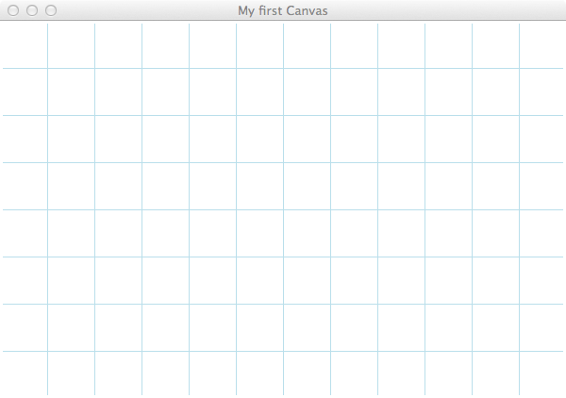
def draw_shapes(a_canvas):
number_of_rows = 5
left_hand_side = 0
y_down = 0
size = 50
first_is_circle = True
for number_to_do in range(1, number_of_rows + 1):
x_left = left_hand_side
is_circle = first_is_circle
for j in range(number_to_do):
rect = (x_left + 3, y_down + 3, x_left + size - 3, y_down +
size - 3)
if is_circle:
a_canvas.create_oval(rect, fill="blue")
else:
a_canvas.create_rectangle(rect)
x_left = x_left + size * 2
is_circle = not is_circle
y_down = y_down + size
first_is_circle = not first_is_circle
gridlines are of size 50 pixels

Slide 27
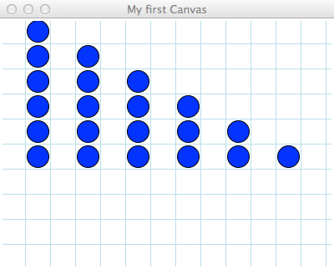
Ex01

Slide 28
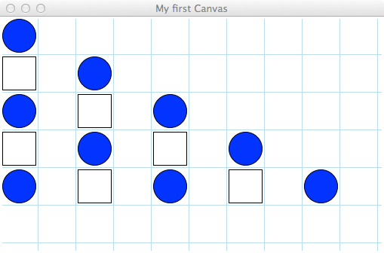
Ex02

Slide 29
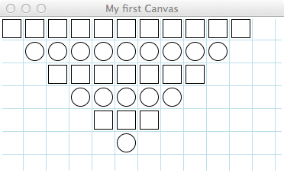
Ex03

