Slide 1

COMPSCI 1 1 Principles of Programming
Lecture 3 – Evaluating expressions, modulus and integer division operators, docstring and comments, the math module, developing a program in steps

Slide 2
Learning outcomes
At the end of this lecture, students should be able to:
import modules and use the functions defined in the module
use integer division and modulus operators
include a docstring at the top of a program and use comments
use self-documenting code to make the program easy to read and understand
understand that an expression evaluates to one value
understand the order of operations when an algebraic expression is evaluated
understand how to develop a program in steps

Slide 3
Recap
From lecture 2
perform calculations using standard arithmetic operators
use variables to store values
describe differences between int and float types
print numbers and strings to standard output
amount_to_convert = 500
nz_to_aus_rate = 0.95
nz_dollars = amount_to_convert
aus_from_nz = nz_dollars * nz_to_aus_rate
print("NZ $", nz_dollars, " = ", "AUS $", aus_from_nz, sep = "")
aus_dollars = amount_to_convert
aus_to_nz_rate = 1 / nz_to_aus_rate
nz_from_aus = aus_dollars * aus_to_nz_rate
print("AUS $", aus_dollars, " = ", "NZ $", nz_from_aus, sep = "")
NZ $500 = AUS $475.0
AUS $500 = NZ $526.3157894736842
Notes:
Formal languages are languages that are designed by people for specific applications. For example,
the notation that mathematicians use is a formal language that is particularly good at denoting relationships
among numbers and symbols. Chemists use a formal language to represent the chemical
structure of molecules. And most importantly:
Programming languages are formal languages that have been designed to express
computations.

Slide 4
Literals, variables and expressions
Literals are the actual values which can be stored in the program memory, e.g.,
34
-67.5
"a particular string"
Variables can be assigned any literal value (or an expression). Variables are used to refer to (point to) a single piece of information, e.g.,
result = 567
final_result = result + 45
phrase = "a particular string"
phrase = 'Please tell me more'
first_name = "Izzy"
Expressions are made up of literal values and variables. Expressions always evaluate to a single value. The right hand side of the assignment operator is an expression, e.g.,
number = 3
final_result = 567 + 16 ** number
final_result = final_result + number * 5 / 7

Slide 5
Docstrings
A docstring is a special kind of string (text) used to provide documentation. A docstring:
appears at the top of every CompSci 101 program,
three double-quotes are used to surround the docstring,
all programs should include a docstring at the top of the program,
the docstring contains the author and a description of what the program does.
"""
Program which calculates the area of a circle.
Author: Adriana Ferraro
"""
radius = 10
area = 3.14159265359 * radius ** 2
print("Area of circle", area)
Notes:
Leave out the docstring because I don't have room on the slides

Slide 6
Skeleton of a Python program
In general the format of a Python program is:
"""
Calculates the area of a rectangle.
Author: Adriana Ferraro
"""
width = 3.56
height = 8.4
area = width * height
print("Area of rectangle", area)
docstring
initialisation
calculation
output
Area of rectangle 29.904
Every Python program is stored in a file which has .py at the end of the file name (the file extension), e.g., CalculateArea.py, CompoundInterest.py
Notes:
sys.maxint, which is either 231 - 1 or 263 - 1

Slide 7
Comments
As well as the docstring describing the purpose of the program at the top of ALL our programs, comments can be added to the program code. A programming comment is a note to other programmers who need to understand the code.
Anything between a # (hash) and the end of the line is a comment and is ignored by the interpreter
"""
Converts a length in inches to a length in centimetres.
Author: Adriana Ferraro
"""
cm_per_inch = 2.54
length_in_inches = 100 #Change the value of length_in_inches here
length_in_cm = length_in_inches * cm_per_inch
print("Length", length_in_cm)
Length 254.0
Notes:
A programming comment is a note to other programmers

Slide 8
Use self documenting code
Add comments sparingly to explain code that is difficult, or to tell other programmers something they need to know about the code.
It is always important to use good descriptive variable names.
The program below does the same job as the program on the previous slide but it uses very poor variable names which makes the program difficult to read and difficult to understand.
"""
Author: Adriana Ferraro
"""
a = 2.54
b = 100
c = b * a
print("Length", c)
Length 254.0

Slide 9
Python libraries
Python has libraries of code which contain definitions and functions which perform useful tasks and calculations. The files in these libraries are called modules. The name of a module is the name of the file without the .py extension.
The math module contains many useful math functions and constants, e.g., math.sin(), math.cos(), math.pow(), math.sqrt(), math.floor(), …
In order to be able to use the functions of a module, we need to import the module. Importing a module means that we can then use all the functions defined inside that module, e.g.,
"""Calculates the radius of a circle, given the area.
Author: Adriana Ferraro
"""
import math
area = 221.67
radius = math.sqrt(area / math.pi)
print("Radius of circle", radius)
Radius of circle 8.399985266079987
Notes:
Any Python file is a module, its name being the file's base name without the .py extension. A package is a collection of Python modules: while a module is a single Python file, a package is a directory of Python modules containing an additional __init__.py file, to distinguish a package from a directory that just happens to contain a bunch of Python scripts. Packages can be nested at any deep, providing that the corresponding directories contain their own __init__.py file

Slide 10
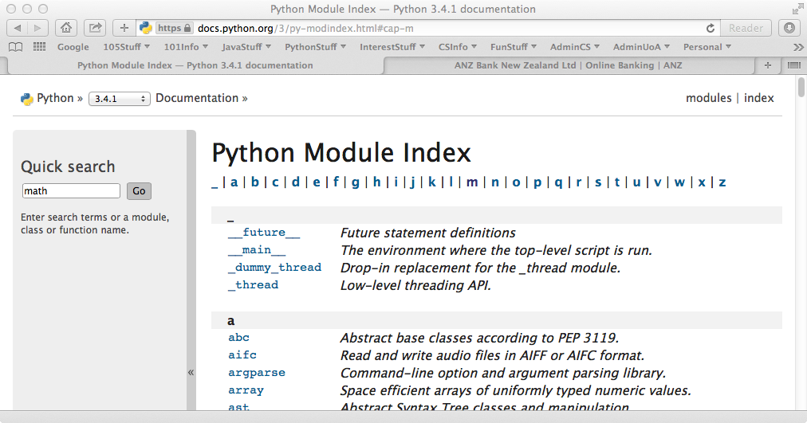
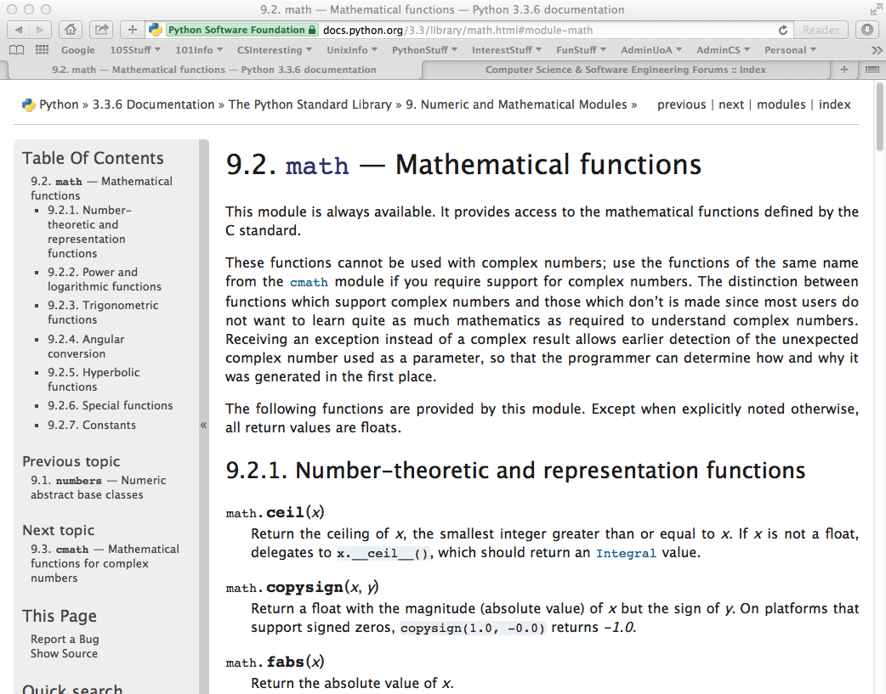
www.python.org
The following website contains documentation about all the Python modules.
https://docs.python.org/3.3/py-modindex.html
Notes:
Any Python file is a module, its name being the file's base name without the .py extension. A package is a collection of Python modules: while a module is a single Python file, a package is a directory of Python modules containing an additional __init__.py file, to distinguish a package from a directory that just happens to contain a bunch of Python scripts. Packages can be nested at any deep, providing that the corresponding directories contain their own __init__.py file

Slide 11
Expressions – order of operations
Expressions containing numbers are evaluated in the same way as in mathematical expressions, i.e., BEDMAS applies:
Note that the / operator always results in a float, e.g., 8 / 4 is 2.0.
Give the output.
Brackets
Exponents
Division, Multiplication
Addition, Subtraction
result1 = (25 - 7) * 3 + 12 / 3
result2 = 17 - 3 * 2 - 12 / 4 + 15
result3 = 32 / 4 ** (3 + 2 * 3 - 7) / 5
print(result1, result2, result3)
Remember to work from left to right when evaluating operators with the same priority.
Notes:
58.0 23.0 0.4

Slide 12
More arithmetic operators
So far, we have seen these mathematical operators: +, -, *, /, **
Two more mathematical operators:
Floor division (integer division) //
Modulus (remainder) %
Floor division (integer division) performs the division and ignores the part after the decimal point, e.g.,
16 // 5 gives 3
17 // 5 gives 3
34 // 5 gives 6
Modulus performs the division and gives the remainder, e.g.,
16 % 5 gives 1
17 % 5 gives 2
34 % 5 gives 4
16 % 30 gives 16

Slide 13
Arithmetic operators with different numeric types
These are the mathematical operators we will be using:
+, -, *, /, **, //, %
When an arithmetic operator has operands of different numeric types, the operand with the "narrower" type is widened to that of the other operand (integer is narrower than floating point), e.g.,
3 % 5.0 evaluates to 3.0
16.0 / 8 evaluates to 2.0
17 // 5.0 evaluates to 3.0
34.0 // 5 evaluates to 6.0
16.0 % 5 evaluates to 1.0
17 % 5.0 evaluates to 2.0

Slide 14
Exercise
Give the output
result1 = 25 % 3
result2 = 20 % 34
result3 = 20 // 3.0
result4 = 5 // 7
result5 = (26.7 // 1) % 3
print(result1, result2, result3, result4, result5)
Notes:
1 20 6 0 0

Slide 15
Exercise
Brackets
Exponents (**)
Multiplication, Division, Modulus, Floor division
Addition, Subtraction
Order of
operations
Give the output
result1 = 25 / 4 // 3 + 4 * 10 % 3
result2 = 10 - 7 // 3 * 3 + 13 % 5 / 5 * 2
result3 = 17 % 3 * 2 - 3 ** 2 * 3 + 19 // 2
print(result1, result2, result3)
Notes:
3.0 5.2 -1
This uses the ‘haversine’ formula to calculate the great-circle distance between two points – that is, the shortest distance over the earth’s surface – giving an ‘as-the-crow-flies’ distance between the points (ignoring any hills they fly over, of course!).

Slide 16


a
b
a
c
Heron's formula states that the
area of a triangle whose sides
have lengths a, b, and c is:
b
a
c
b
c

Slide 17
a
Write a program which uses Heron's formula to
calculate and print the area of a triangle given
the length of the three sides.
a
b
b
c
a
c
b
c
Length of sides: 4, 7 and 9
Area: 13.416407864998739
import math
side1 = 4
side2 = 7
side3 = 9
#Complete the code
print("Length of sides: ", side1, ', ', side2, ' and ',
side3, sep = "")
print("Area:", area)

Slide 18
Exercise
An inheritance is apportioned as follows:
Firstly, the administrator gets a quarter of one percent of the inheritance plus whatever is left over (nobody receives fractions of dollars, just whole dollars).
Each non-child, non-parent relative gets one portion
Each child get 100 times the amount of each relative
Each parent get twice as much as each child
total_inheritance = 1587654
administrator_percent = 0.0025
num_children = 3
num_parents = 2
num_relatives = 10
#Complete the code
Of the $1587654:
Children get $223054.0 each
Parents get $446108.0 each
Relatives get $2230.0 each
Administrator gets $3976.0
Notes:
Alternatively
Of the $1587654
Children get $223000.0 each
Parents get $446000.0 each
Relatives get $2230.0 each
Administrator gets $4354.0

Slide 19
Summary
In a Python program we can:
import modules and use the functions defined in the imported module
use integer division and modulus operators
use comments. Every program contains a docstring at the top of the program
use self-documenting code to make the program easy to understand
understand that an expression evaluates to one value
understand the order of operations when an expression is evaluated
understand how to develop a program in steps

Slide 20
Examples of Python features used in this lecture
import modules and use the functions defined in the module
import math
result = math.sqrt(345)
use integer division and modulus operators
whole_number = 456 // 3
left_overs = 456 % 12
understand the order of operations when an expression is evaluated
result = 32 / 4 ** (1 + 2 * 3 – 7 % 4) / 5

