Slide 1

COMPSCI 1 1 Principles of Programming
Lecture 22 – Python dictionaries 1

Slide 2
Learning outcomes
At the end of this lecture, students should be able to:
understand what a dictionary is
create a dictionary object
add items to a dictionary
retrieve items from a dictionary
traverse the pairs in a dictionary

Slide 3
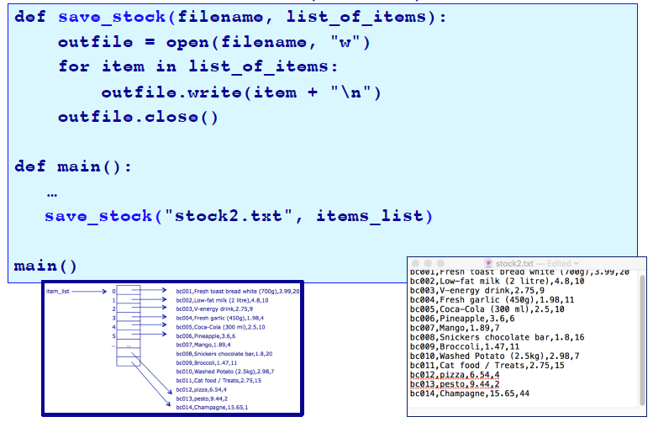
Recap
Exercise from lecture 21 on input and output:

Slide 4
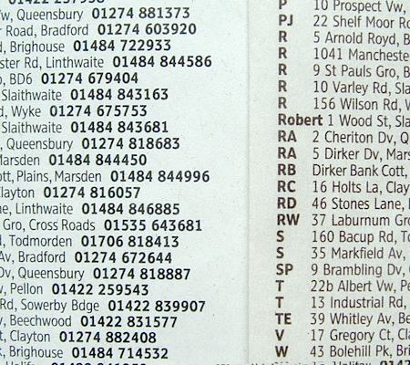
Python dictionaries
A dictionary is a mapping from a key to its associated data value.
Each key maps to a value.
The key has to be unique and an immutable object.
A phone book is an example of a mapping: the key is the person's name (plus address) and the associated value is their phone number.
The key and its associated value is called a
key-value pair or it can be called an item.
You can think of a dictionary as a list of pairs, where the first element of the pair, the key, is used to retrieve the second element, the corresponding value.

Slide 5
Creating an object of type dict
Curly braces are used for dictionaries and {} is a dictionary which contains no key-value pairs, i.e., an empty dictionary:
Another way to create an empty dictionary object is (does exactly the same thing as the code above):
def main():
english_italian = {}
print(english_italian)
print(type(english_italian))
main()
{}
<class 'dict'>
def main():
english_italian = dict()
print(english_italian)
print(type(english_italian))
main()
{}
<class 'dict'>

Slide 6
dict is a Python type
Note that the name, dict, is a Python type and should not be used as a variable name.
def main():
english_italian = dict()
main()

Slide 7
Creating a dictionary which contains pairs
A dictionary object can be initialised with key-value pairs:
Each associated pair is separated by ':' and the pairs are separated by commas.
def main():
english_italian = {"yes":"si", "bye":"ciao", "no":"no", "maybe":"forse", "thank you":"grazie"}
print(english_italian)
contacts = {"Jill": 3456, "James": 3456, "Yi": 7654,
"Syed": 6754}
print(contacts)
main()
{'maybe': 'forse', 'bye': 'ciao', 'yes': 'si', 'no': 'no', 'thank you': 'grazie'}
{'Yi': 7654, 'Jill': 3456, 'Syed': 6754, 'James': 3456}
Note: the keys have to be unique but the associated values do not.

Slide 8
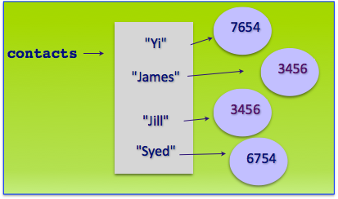
Visualising the dictionary
def main():
contacts = {"Jill": 3456, "James": 3456, "Yi": 7654, "Syed": 6754}
print(contacts)
main()
{'Jill': 3456, 'Syed': 6754, 'James': 3456, 'Yi': 7654}
Note: when the key-value pairs are printed, the order is not
predictable.

Slide 9
The keys of the dictionary must be immutable
The keys of a dictionary must be of a type which is immutable such as: string, int, tuple.
The keys of a dictionary must be unique.
The values can be of any type and they do not need to be unique.
Remember that lists are mutable and therefore dictionary keys cannot be of type list.

Slide 10
Dictionaries are not ordered structures
Dictionary elements cannot be accessed using the index value. A dictionary is a collection of key:value pairs.
There is no predictable order to the key:value pairs in a dictionary (the order may change as new pairs are added and removed).

Slide 11
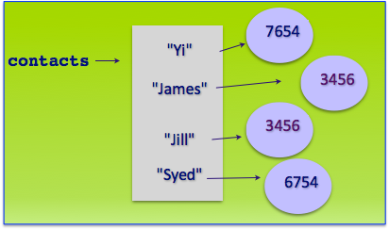
Access the value associated with a key
The value associated with a certain key can be accessed using square brackets (enclosing the key):
def main():
contacts = {"Jill": 3456, "James": 3456, "Yi": 7654,
"Syed": 6754}
name1 = "Jill"
name2 = "James"
print(name1, "is at extension:", contacts[name1])
if contacts[name1] == contacts[name2]:
print(name2, "has the same extension")
main()
Jill is at extension: 3456
James has the same extension

Slide 12
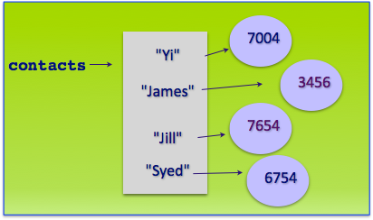
Changing the associated value in a dictionary
The associated value of a pair can be changed by assigning a different value to the dictionary key. This replaces the old value.
def main():
contacts = {"Jill": 3456, "James": 3456, "Yi": 7654, "Syed": 6754}
contacts["Jill"] = 7654
contacts["Yi"] = 7004
print(contacts)
main()
{'Syed': 6754, 'Yi': 7004, 'James': 3456, 'Jill': 7654}

Slide 13
Adding a pair to the dictionary
Key-value pairs can be added to the dictionary using assignment statements:
.
def main():
contacts = {"Jill": 3456, "James": 3456, "Yi": 7654, "Syed": 6754}
contacts["Mark"] = 7654
contacts["Jerry"] = 7004
print(contacts)
main()
{'Jerry': 7004, 'Syed': 6754, 'Yi': 7654, 'Mark': 7654, 'Jill': 3456, 'James': 3456}
Note: when the key-value pairs are printed, the order is not
predictable.

Slide 14
The number of key-value pairs in a dictionary
The len() function can be used with a dictionary object to find out how many key-value pairs are currently in the dictionary:
def main():
contacts = {"Jill": 3456, "James": 3456, "Yi": 7654, "Syed": 6754}
print(len(contacts), "in dictionary")
contacts["Yi"] = 7654
contacts["Jerry"] = 7004
print(len(contacts), "in dictionary")
main()
4 in dictionary
5 in dictionary

Slide 15
Check if a key is in the dictionary
The 'in' operator can be used to check if a key is in the dictionary:
def main():
contacts = {"Jill": 3456, "James": 3456, "Yi": 7654,
"Syed": 6754}
name = "Jack"
if name in contacts:
print(name, "is at extension:", contacts[name])
else:
contacts[name] = 0
if name in contacts:
print(name, "is at extension:", contacts[name])
print(contacts)
main()
Jack is at extension: 0
{'Jill': 3456, 'James': 3456, 'Yi': 7654, 'Syed': 6754, 'Jack': 0}

Slide 16
The in operator with dictionaries
An error is raised when accessing a key which is not in the dictionary. Usually you test before accessing a key-value pair.
1
2
3
4
5
6
def main():
contacts = {"Jill": 3456, "James": 3456, "Yi": 7654, "Syed": 6754}
if "Jill" in contacts: #Test first
print("Jill", "-", contacts["Jill"])
print(contacts["Izzy"])
main()
Jill - 3456
Traceback (most recent call last):
File "LectureCode.py", line 5, in <module>
print(contacts["Izzy"])
KeyError: 'Izzy'

Slide 17
Traversing the pairs in the dictionaries
Use a for … in loop to traverse (visit) each key in the dictionary:
def main():
contacts = {"Jill": 3456, "James": 3456, "Yi": 7654,
"Syed": 6754}
for name in contacts:
print(name , "-", contacts[name])
main()
Yi - 7654
Jill - 3456
Syed - 6754
James - 345
Same code
def main():
contacts = {"Jill": 3456, "James": 3456, "Yi": 7654, "Syed": 6754}
for key in contacts:
print(key, "-", contacts[key])
main()

Slide 18
Exercise
"Story.txt" is a text file. The following program reads the text from the file, converts it to lower case, and creates a dictionary of all the unique words which start with a vowel ("a", "e", "i","o", "u"). Note: the key is the vowel and each word is added to an associated list (the list grows as the text is processed).
def main():
vowel_words_dict = get_dictionary_from_file_words("Story.txt")
display_results(vowel_words_dict)
def get_dictionary_from_file_words(filename): #complete the code
def display_results(vowel_words): #complete the code
main()
o - ['on', 'one', 'old', 'only', 'of', 'opportunity', 'official', 'out']
e - ['elder', 'excited', "elder's"]
u - []
i - ['indian', 'in', 'if']
a - ['apollo', 'astronaut', 'a', 'and', 'across', 'asked', 'are', 'astronauts', 'after', 'an']

Slide 19
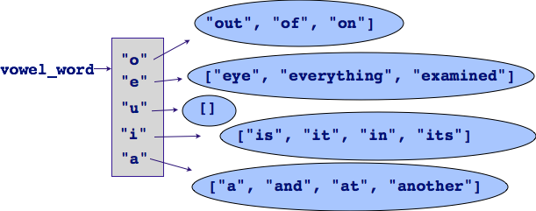
Exercise
Story.txt
A small trouble is like a pebble. Hold it too close to your eye, and it fills the whole world and puts everything out of focus.
Hold it at the proper distance, and it can be examined and properly classified. Throw it at your feet and it can be seen in its true setting, just another tiny bump on the pathway of life.

Slide 20

Exercise
def get_dictionary_from_file_words(file_name):
Notes:
Jing does a read(), a split() and process each token

Slide 21
Exercise
def display_results(vowel_words_dict):
o - ['on', 'one', 'old', 'only', 'of', 'opportunity', 'official', 'out']
e - ['elder', 'excited', "elder's"]
u - []
i - ['indian', 'in', 'if']
a - ['apollo', 'astronaut', 'a', 'and', 'across', 'asked', 'are', 'astronauts', 'after', 'an']

Slide 22
Summary
In Python:
dictionaries are used to store key:value pairs (items)
a dictionary object can be created in two ways
items can be added to a dictionary
Items can be retrieved from the dictionary
the pairs in a dictionary can be traversed using for … in

Slide 23
Python features used in this lecture
english_italian = {"yes":"si", "bye":"ciao", "no":"no", "maybe":"forse",
"thank you":"grazie"}
english_italian["never"] = "mai"
print(english_italian["bye"] )
for word in english_italian:
print(english_italian[word])
print(len(english_italian))
Notes:
ciao
mai
no
forse
ciao
si
grazie
6

Slide 24
Summary
How to create a dictionary
How to retrieve things from a dictionary
How to create a larger piece of code with many functions

Slide 25
Summary
Tests are important to know whether the code works!
Doctest is a simple way to automate the tests
Anywhere in the docstring, include tests
Tests are simply lines that start with >>>
Results of the test are compared with the following line(s)

Slide 26
A text file 2
When NASA was preparing for the Apollo project, they did some astronaut training on a Navajo Indian reservation. One day, a Navajo elder and his son were herding sheep and came across the space crew. The old man, who only spoke Navajo, asked a question, which his son translated. What are the guys in the big suits doing? A member of the crew said they were practicing for their trip to the moon. The old man got really excited and asked if he could send a message to the moon with the astronauts. Recognizing a promotional opportunity for the spin-doctors, the NASA folks found a tape recorder. After the old man recorded his message, they asked the son to translate. He refused. So the NASA reps brought the tape to the reservation, where the rest of the tribe listened and laughed, but refused to translate the elder's message to the moon. Finally, NASA called in an official government translator. He reported that the moon message said, Watch out for these guys; they've come to steal your land.

