Slide 1
COMPSCI 101 Principles of Programming
Lecture 24 Graphical User Interface (GUI)

Slide 2
Learning outcomes
At the end of this lecture, students should be able to:
understand what a GUI is
start using TkInter in Python
use a Canvas object to draw ovals, rectangles, lines, text, polygons and arcs.

Slide 3
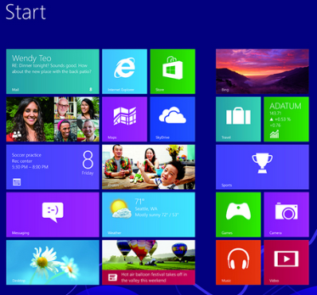
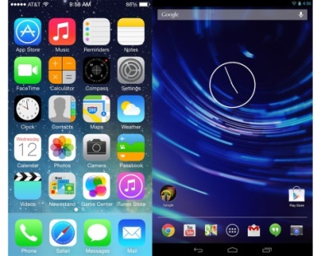
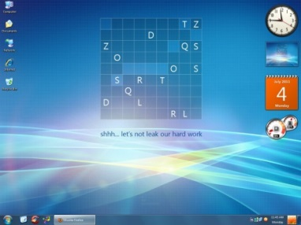
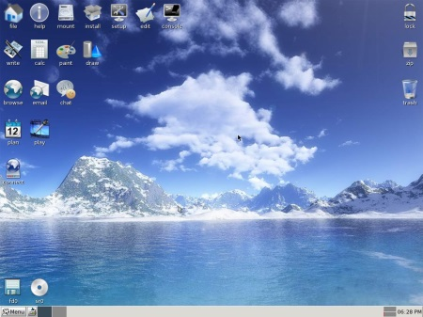
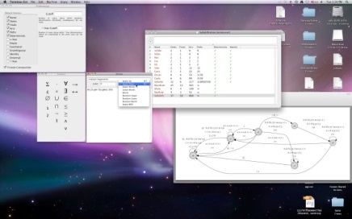
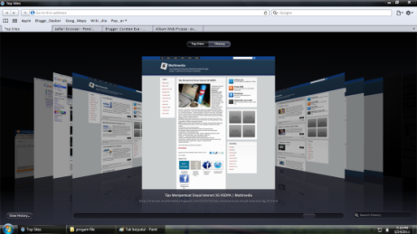
What is a GUI?
A Graphical User Interface (GUI) is a type of interface which allows users to interact with electronic devices through graphical icons and visual indicators, i.e., the visual components of an application or website which aid usability through (hopefully) easily understood graphics and icons.
GUI as opposed to text-based interfaces (which require commands to be typed at the keyboard).
Gui's, gui's everywhere gui's
Notes:
In design, a secondary notation is defined as "visual cues which are not part of formal notation". Properties like position, indentation, color, symmetry, when used to convey information, are secondary notation.
A typical example of secondary notation is syntax highlighting of programming code; the colors are not part of the code semantics, but help the programmer to visualize its meaning.

Slide 4
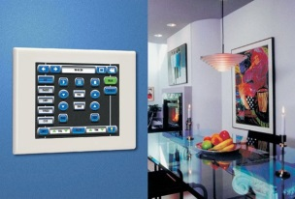
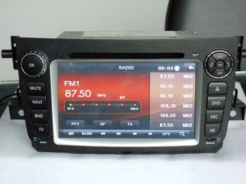
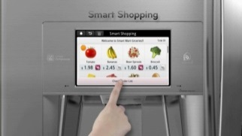
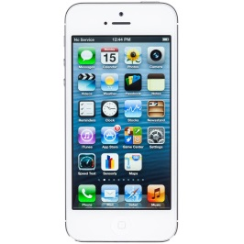
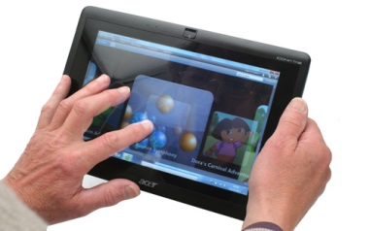
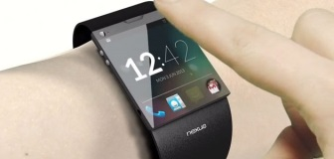
The Behaviour of Terminal-Based Programs and GUI-Based Programs
Two different versions of a program from a user’s point of view:
Terminal-based user interface
Display a menu
Get the choice
Perform the required task
Graphical user interface
Both programs perform exactly the same function
However, their behaviour, or look and feel, from a user’s perspective are quite different
Smart Home
Smart "Things"
Smart Car
Smart Refrigerator
Touchscreens
Wearable Devices

Slide 5
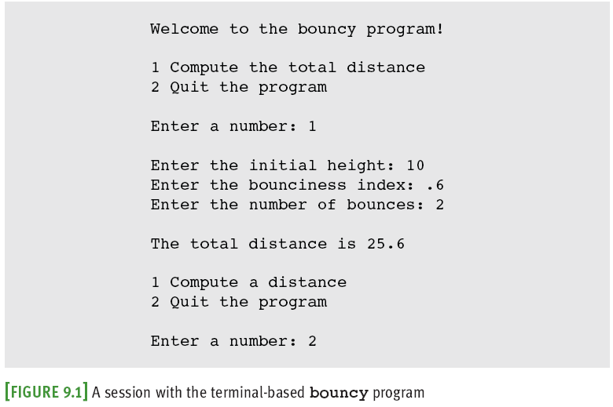
Terminal-Based
Problems:
User is constrained to reply to a definite sequence of prompts for inputs
Once an input is entered, there is no way to change it
To obtain results for a different set of input data, user must wait for the command menu to be displayed again
At that point, the same command and all of the other inputs must be re-entered
User can enter an unrecognized command

Slide 6

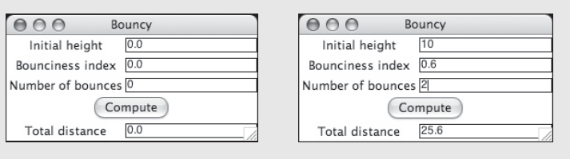
GUI-Based
Wearable Devices
Uses a window that contains various components
Called window objects or widgets
Solves problems of terminal-based version
An entry field
labels
Can be dragged to resize window
A command button

Slide 7
Python – tkinter
Most programs include a GUI and all major programming languages support one or more packages to develop GUIs.
There are many libraries and toolkits of GUI components available to the Python programmer
tkinter is not the only GUI-programming toolkit for Python but it is the most commonly used one.
tkinter includes classes for windows and numerous types of window objects
tkinter gives you the ability to create windows with widgets in them
A widget is a graphical component on the screen (button, text label, drop-down menu, scroll bar, picture, etc…)
GUIs are built by arranging and combining different widgets on the screen
Notes:
Tk provides a robust and platform independent windowing toolkit, and it is available to Python programmers through the tkinter package. Tk provides lots of widget (labels, buttons, text boxes, menus) definitions.
The tkinter package is the interface for Tk. tkinter is a set of wrappers that implement the Tk widgets as Python classes

Slide 8
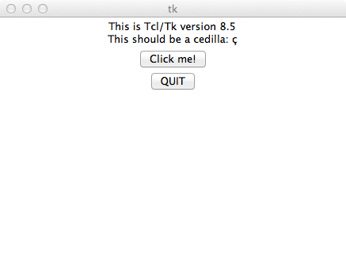
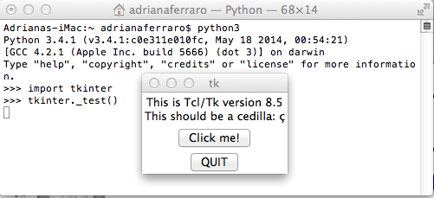
Check that tkinter is installed
Before starting, check that tkinter is properly installed on your system by typing the following in the command line window:
python -m tkinter
This command should open a window demonstrating a simple tkinter interface.
Testing for tkinter on the MAC Terminal window (usually no problem)

Slide 9
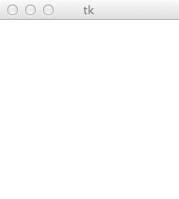
A first tkinter program
A first program using tkinter.
Note:
This window is the top level window to which we will add other components (widgets).
In this program, the variable, root, represents the top level window.
from tkinter import * #import the tkinter module
def main():
root = Tk() #Create an empty window
root.mainloop() #Pause the code and do nothing
#until the window is closed
main()

Slide 10
What is Tk?
Tk is a robust and platform independent windowing toolkit, and it is available to Python programmers through the tkinter package.
Tk provides the definitions of many widgets (labels, buttons, text boxes, menus – the components of a GUI).
In Python, the tkinter package is the interface for Tk.
tkinter is a set of wrappers which 'talk' to the Tk widgets and wrap them up as Python objects.
from tkinter import * #import the tkinter module
def main():
root = Tk() #Create an empty window
root.mainloop() #Pause the code and do nothing
#until the window is closed
main()

Slide 11
Steps to create the tkinter program
Create the parent window
All applications have a “root” window. This is the parent of all other widgets. You should create only one!
Start the event loop ( root.mainloop() )
Windows go into an “event loop” where they wait for things to happen (buttons pushed, etc…). You must tell the root window to enter its event loop or the window won’t be displayed!
root = Tk()
root.mainloop()
Notes:
To display one or more lines of text in a label widget

Slide 12
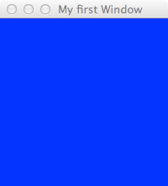
Background Colour & Title
Example01.py
DEMO
A background colour for the window can be defined:
a title for the window can be defined:
The 'config' method is used to set a variety of different window features, such as the background colour.
from tkinter import *
def main():
root = Tk()
root.title("My first Window") root.config(background='blue')
root.mainloop()
main()
Notes:
light slate gray - gray - light grey - midnight blue - navy - cornflower blue - dark slate blue - slate blue - medium slate blue - light slate blue - medium blue - royal blue – blue - dodger blue - deep sky blue - sky blue - light sky blue - steel blue - light steel blue - light blue - powder blue - pale turquoise - dark turquoise - medium turquoise – turquoise …

Slide 13
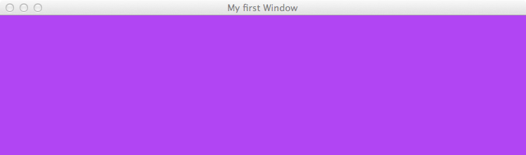
The size and position of the window
We would like to control the width, height and position of the top level window.
The geometry() method sets a size for the window and positions it on the screen.
The first two arguments are the width and the height of the window. The last two arguments are the x and y screen position coordinates of the top left hand corner of the window.
from tkinter import *
def main():
root = Tk()
root.geometry("750x200+10+30")
root.title("My first Window") root.config(background='purple')
root.mainloop()
main()
Notes:
A geometry string is a standard way of describing the size and location of a top-level window on a desktop.
The w and h parts give the window width and height in pixels. They are separated by the character 'x'.
If the next part has the form +x, it specifies that the left side of the window should be x pixels from the left side of the desktop and if it has the form -x, the right side of the window is x pixels from the right side of the desktop.
If the next part has the form +y, it specifies that the top of the window should be y pixels below the top of the desktop. If it has the form -y, the bottom of the window will be y pixels above the bottom edge of the desktop.

Slide 14
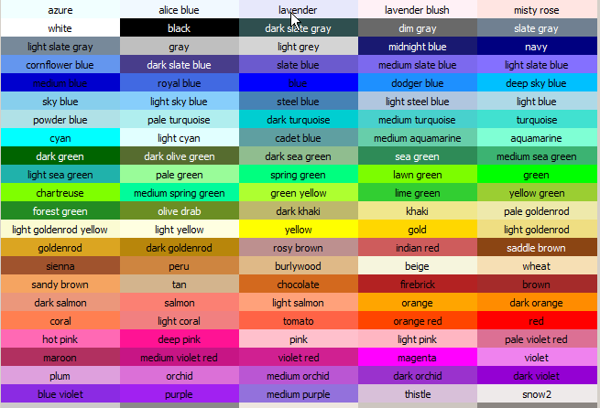
Named colours
There are lots of 'named colours' which can be used.
Look at the website, http://wiki.tcl.tk/37701
Some examples
light slate gray - gray - light grey - midnight blue - navy - cornflower blue - dark slate blue - slate blue - medium slate blue - light slate blue - medium blue - royal blue – blue - dodger blue - deep sky blue - sky blue - light sky blue - steel blue - light steel blue - light blue - powder blue
from tkinter import *
def main():
root = Tk()
root.title("My first Window") root.config(background='powder blue') root.geometry("750x200+10+30")
root.mainloop()
main()

Slide 15
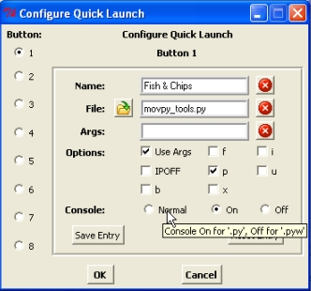
Widgets
GUIs are built by arranging and combining different widgets in the window.
Widgets are objects which can be added to our top level window. These will allow the user to interact with the program. Some widget examples:
With tkinter we are able to create windows with widgets inside them
Buttons, Checkbuttons, Radiobuttons, Menubuttons,
Entry (for text field entries)
Message (for displaying text messages to the user)
Labels (text captions, images)
Frames (a container for other widgets)
Scale, Scrollbar
Canvas (for drawing shapes, …)
Text (for displaying and editing text) and others..
In CompSci 101 we will quickly look at the Label widget and then use a Canvas widget to draw some shapes.

Slide 16

Adding a Label widget
root = Tk()
hello = Label(root,text="Hello world!")
hello.pack()
root.mainloop()
A Label widget display text.
Steps:
Create the parent window (root)
Widgets are placed inside parent windows. In our case the parent of all our widgets is the top level window.
Create a label
When creating the Label widget we need to pass the top level windows, root, (in which the label will be placed) as the first argument.
We also need to pass the text which is to be displayed inside the Label.
Define the position of the label ( hello.pack() )
Tell the label to place itself into the root window and display.
Start the event loop ( root.mainloop() )

Slide 17
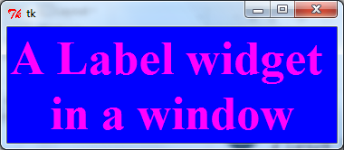
Some Label properties
Example02_2.py
DEMO
Label objects can be configured (background colour, foreground colour, font).
Properties:
bg: The normal background colour displayed
fg: specifies the colour of the text
font: specifies in what font that text will be displayed
a_label = Label(root, text = "A Label widget \nin a window")
a_label.config(bg="blue", fg="magenta")
a_font = ("Times", 40, "bold")
a_label.config(font=a_font)
Notes:
The place Geometry Manager is the simplest of the three to use. It places the widget either in absolute or relative terms. However, it is a pain to use for general placement of widgets, though can be useful in special cases

Slide 18
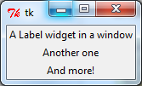
Layout Management
Example02_3.py
DEMO
Most windowing toolkits (such as tkinter) have layout management systems which have the job of arranging the widgets in the window!
When we pack widgets into the window they always go under the previous widget
root = Tk()
a_label1 = Label(root, text = "A Label widget in a window")
a_label2 = Label(root, text = "Another one")
a_label3 = Label(root, text = "And more!")
a_label1.pack()
a_label2.pack()
a_label3.pack()
Place label widgets on top of each other and centre them

Slide 19

Grid Layout Manager
Python has other geometry managers (instead of pack) to create any GUI layout you want
Grid – lets you specify a row, column grid location and how many rows and columns each widget should span
Example:
WARNING: Never use multiple geometry managers in one window! They are not compatible with each other and may cause infinite loops in your program!!
root = Tk()
go_label = Label(root, text='Go')
go_label.grid(row=0, column=0)
stop_label = Label(root, text='Stop')
stop_label.grid(row=1, column=0)
root.mainloop()

Slide 20
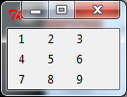
Exercise 1 Creating a number pad
Task:
Complete the following program which creates 9 labels as shown in the above picture
Code:
root = Tk()
labels = ['1', '2', '3', '4', '5', '6', '7', '8', '9']
for i in range(len(labels)):
#create and add a label each time
root.mainloop()
Notes:
label = Label(root, padx=10, text=labels[i])
label.grid(row=i//3, column=i%3)

Slide 21
Grid Layout Manager
Algorithm
1st label: row = 0, col = 0
2nd label: row = 0, col = 1
3rd label: row = 0, col = 2
4th label: row = 1, col = 0
5th label: row = 1, col = 1
6th label: row = 1, col = 2
…
labels = ['1', '2', '3', '4', '5', '6', '7', '8', '9']
Row=0, column = 2
Row=0, column = 0
Notes:
label = Label(root, padx=10, text=labels[i])
label.grid(row=i//3, column=i%3)

Slide 22
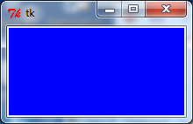
Creating a Canvas widget
Example03.2.py
DEMO
A Canvas widget provides a rectangular area in which shapes (lines, ovals, polygons, rectangles, arcs, text) can be drawn.
(The Canvas object can also contain images or bitmaps.)
As well as drawing shapes in the Canvas area, the Canvas object can contain other widgets and frames.
When creating a Canvas widget we need to pass the top level widget, root, (in which the canvas will be placed) as the first argument
root = Tk()
a_canvas = Canvas(root)
a_canvas.config(background="blue", width=200, height=100)
a_canvas.pack()
root.mainloop()
Notes:
The place Geometry Manager is the simplest of the three to use. It places the widget either in absolute or relative terms. However, it is a pain to use for general placement of widgets, though can be useful in special cases
• .create_arc(): A slice out of an ellipse. See Section 8.7, "Canvas arc objects" (p. 28).
• .create_bitmap(): An image as a bitmap. See Section 8.8, "Canvas bitmap objects" (p. 29).
• .create_image(): A graphic image. See Section 8.9, "Canvas image objects" (p. 30).
• .create_line(): One or more line segments. See Section 8.10, "Canvas line objects" (p. 30).
• .create_oval(): An ellipse; use this also for drawing circles, which are a special case of an ellipse. See Section 8.11, "Canvas oval objects" (p. 32).
.create_polygon(): A polygon. See Section 8.12, "Canvas polygon objects" (p. 33).
.create_rectangle(): A rectangle. See Section 8.13, "Canvas rectangle objects" (p. 35).
.create_text(): Text annotation. See Section 8.14, "Canvas text objects" (p. 37).
.create_window(): A rectangular window. See Section 8.15, "Canvas window objects" (p. 38).

Slide 23
Expand and Fill
Sometimes it is useful to make a widget as big as the parent window and to make the widget resizable when the parent window is resized.
The pack() method has optional parameters which control this.
expand:
When set to True, the widget expands to fill any space not otherwise used in the widget's parent.
fill:
Determines whether the widget fills any extra space allocated to it by the packer, or keeps its own minimal dimensions: NONE (default), X (fill only horizontally), Y (fill only vertically), or BOTH (fill both horizontally and vertically).
Notes:
The place Geometry Manager is the simplest of the three to use. It places the widget either in absolute or relative terms. However, it is a pain to use for general placement of widgets, though can be useful in special cases

Slide 24
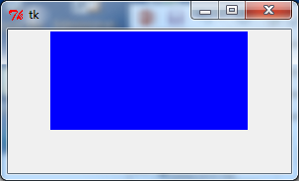

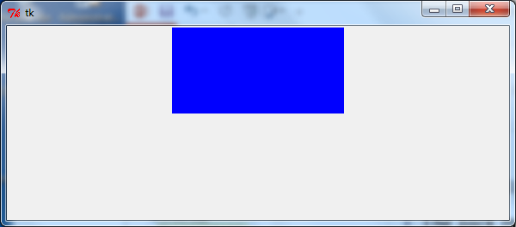
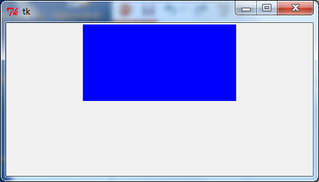
Examples
resize
Case 1:
The pack method tells Tk to fit the size of the window to the given canvas. The canvas remains unchanged (top, centre) after resizing.
Case 2:
Set the size of the window to 400x200
Canvas: centred and aligned to the top
root = Tk()
a_canvas = Canvas(root)
a_canvas.config(background="blue", width=200, height=100)
a_canvas.pack()
root = Tk()
root.geometry("400x200+10+30")
a_canvas = Canvas(root)
a_canvas.config(background="blue", width=200, height=100)
a_canvas.pack()
resize

Slide 25
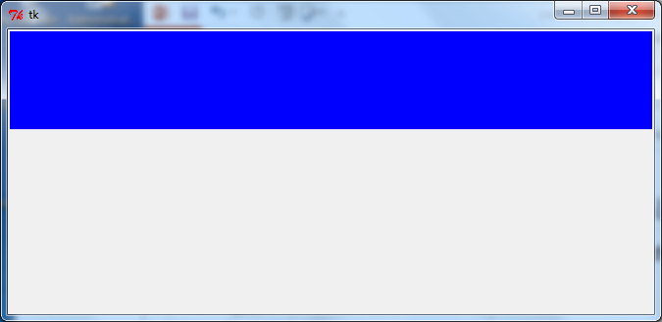
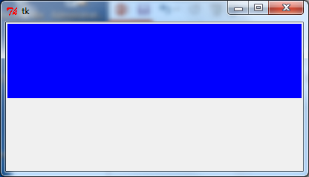
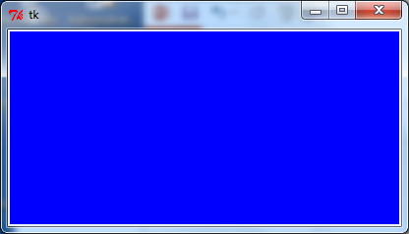
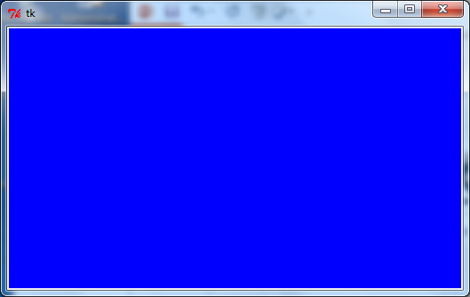
Examples
resize
Case 3:
Make the canvas as wide as the window, use Fill=X
Case 4:
make the Canvas object as big as the parent window and make the widget resizable when the parent window is resized.
...
a_canvas.pack(fill=X)
resize
...
a_canvas.pack(fill=BOTH,expand=True)

Slide 26
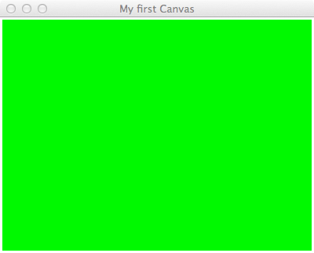
Canvas coordinate system
Each pixel in the Canvas area has an x position (across the canvas) and a y position (down the canvas).
Position (0, 0) is the top left corner of the canvas.
(0, 0)
X value increases (going right)
Y value increases (going down)
Notes:
The place Geometry Manager is the simplest of the three to use. It places the widget either in absolute or relative terms. However, it is a pain to use for general placement of widgets, though can be useful in special cases

Slide 27
Drawing
What can be done with a Canvas object?
Drawing shapes
Lines
Rectangles
Ovals
Polygons
Drawing text
Drawing Arcs

Slide 28
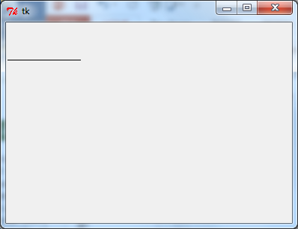
Drawing Lines
Example04.py
DEMO
The method create_line(coords, options) is used to draw a straight line.
The coordinates "coords" are given as four integer numbers: x1, y1, x2, y2. This means that the line goes from the point (x1, y1) to the point (x2, y2).
Note that the line object does not include the end pixel, e.g., the line defined by the coordinates: (0,2,5,2) only includes the 5 pixels:
(0,2), (1,2), (2,2), (3,2), (4,2)
(0, 0)
a_canvas.create_line(0, 50, 100, 50)
Notes:
The place Geometry Manager is the simplest of the three to use. It places the widget either in absolute or relative terms. However, it is a pain to use for general placement of widgets, though can be useful in special cases
Each rectangle is specified as two points: (x0, y0) is the top left corner, and (x1, y1) is the location of
the pixel just outside of the bottom right corner. For example, the rectangle specified by top left corner (100,100) and bottom right corner (102,102) is a square two pixels by two pixels, including pixel (101,101) but not including (102,102).
Rectangles are drawn in two parts:
The outline lies inside the rectangle on its top and left sides, but outside the rectangle on its bottom and right side. The default appearance is a one-pixel-wide black border.
For example, consider a rectangle with top left corner (10,10) and bottom right corner (11,11). If you request no border (width=0) and green fill (fill='green'), you will get one green pixel at (10,10). However, if you request the same options with a black border (width=1), you will get four black pixels at (10,10), (10,11), (11,10), and (11,11).
The fill is the area inside the outline. Its default appearance is transparent.

Slide 29
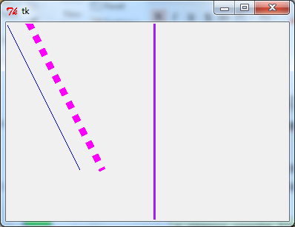
Line Options
Some line options
fill (line colour, default is black)
width (line width, default is 1.0)
dash e.g., dash = (4, 8) 4 pixels drawn followed by 8 pixels blank
a_canvas.create_line(0, 0, 100, 200, fill="blue")
a_canvas.create_line(200, 0, 200, 300, fill="purple", width="3.0")
a_canvas.create_line(30, 0, 130, 200, fill="magenta", width="10.0", dash = (4, 8))
(0, 0)
Notes:
http://www.python-course.eu/tkinter_canvas.php
http://www.tutorialspoint.com/python/tk_pack.htm

Slide 30
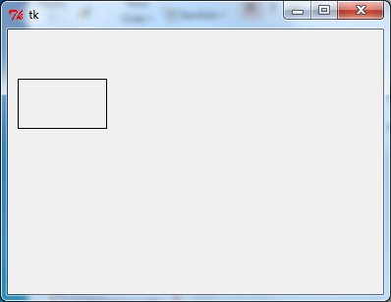
Drawing Rectangles
Example04_2.py
DEMO
The method create_rectangle(x0,y0,x1,y1, options) is used to draw a rectangle.
The rectangle is defined by two points: (x0, y0) the top left position and (x1, y1) the bottom right position.
Note that the rectangle object does not include the right hand border or the bottom border,
e.g., the rectangle with coordinates: (100,100,102,103,…) is 2 pixels by 3 pixels including the 6 pixels:
(0, 0)
a_canvas.create_rectangle(10, 50, 100, 100)
(100, 100), (101, 100),
(100, 101), (101, 101),
(100, 102), (101, 102),
Notes:
The place Geometry Manager is the simplest of the three to use. It places the widget either in absolute or relative terms. However, it is a pain to use for general placement of widgets, though can be useful in special cases
Each rectangle is specified as two points: (x0, y0) is the top left corner, and (x1, y1) is the location of
the pixel just outside of the bottom right corner. For example, the rectangle specified by top left corner (100,100) and bottom right corner (102,102) is a square two pixels by two pixels, including pixel (101,101) but not including (102,102).
Rectangles are drawn in two parts:
The outline lies inside the rectangle on its top and left sides, but outside the rectangle on its bottom and right side. The default appearance is a one-pixel-wide black border.
For example, consider a rectangle with top left corner (10,10) and bottom right corner (11,11). If you request no border (width=0) and green fill (fill='green'), you will get one green pixel at (10,10). However, if you request the same options with a black border (width=1), you will get four black pixels at (10,10), (10,11), (11,10), and (11,11).
The fill is the area inside the outline. Its default appearance is transparent.

Slide 31
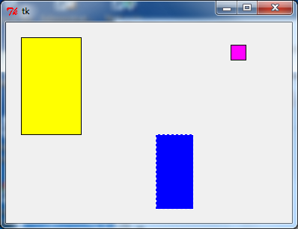
Rectangle Options
Some rectangle options
fill (colour, default is no fill)
outline (The colour of the border), default is outline='black’)
dash (dashed border)
…
a_canvas.create_rectangle(20, 20, 100, 150, fill="yellow")
a_canvas.create_rectangle(200, 150, 250, 250, fill="blue", dash = (4, 8), outline="white")
a_rect = (300, 30, 320, 50)
a_canvas.create_rectangle(a_rect, fill="magenta")

Slide 32
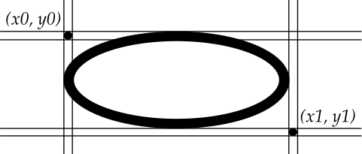
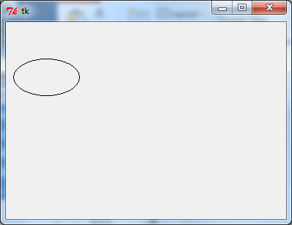
Drawing Ovals
Example04_3.py
DEMO
The method create_oval(x0,y0,x1,y1, options) is used to draw a circle or an oval(ellipse).
The oval drawn fits into a rectangle defined by the coordinates: (x0, y0) of the top left corner and (x1, y1) of a point just outside of the bottom right corner.
a_canvas.create_oval(10, 50, 100, 100)
Notes:
The place Geometry Manager is the simplest of the three to use. It places the widget either in absolute or relative terms. However, it is a pain to use for general placement of widgets, though can be useful in special cases
Each rectangle is specified as two points: (x0, y0) is the top left corner, and (x1, y1) is the location of
the pixel just outside of the bottom right corner. For example, the rectangle specified by top left corner (100,100) and bottom right corner (102,102) is a square two pixels by two pixels, including pixel (101,101) but not including (102,102).
Rectangles are drawn in two parts:
The outline lies inside the rectangle on its top and left sides, but outside the rectangle on its bottom and right side. The default appearance is a one-pixel-wide black border.
For example, consider a rectangle with top left corner (10,10) and bottom right corner (11,11). If you request no border (width=0) and green fill (fill='green'), you will get one green pixel at (10,10). However, if you request the same options with a black border (width=1), you will get four black pixels at (10,10), (10,11), (11,10), and (11,11).
The fill is the area inside the outline. Its default appearance is transparent.

Slide 33
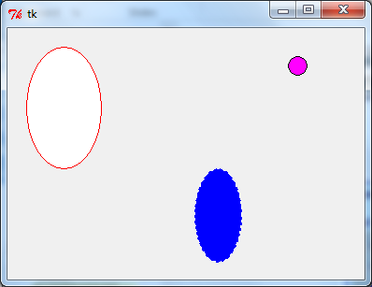
Oval Options
Some oval options:
fill (colour, default is no fill)
outline (The colour of the border. Default is outline='black’)
dash (dashed border)
a_canvas.create_oval(20, 20, 100, 150, fill="white", outline="red")
a_canvas.create_oval(200, 150, 250, 250, fill="blue", dash = (4, 8), outline="white")
a_box = (300, 30, 320, 50)
a_canvas.create_oval(a_box, fill="magenta")

Slide 34
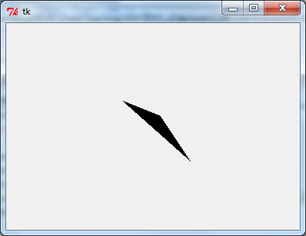
Drawing Polygons
Example04_4.py
DEMO
The method create_polygon(coords, options) is used to draw a polygon where the parameter, coords, is a series of points.
Note:
The createPolygon method requires at least three (x, y) coordinate pairs
The createPolygon method connects the first point to the last point to enclose the area.
p1
p2
p3
points = [10,10,100,20,70,40,90,50,80,80,180,270…]
points = [150, 100, 200, 120, 240, 180] a_canvas.create_polygon(points)
(150, 100)
(200, 100)
(240, 180)
Notes:
The place Geometry Manager is the simplest of the three to use. It places the widget either in absolute or relative terms. However, it is a pain to use for general placement of widgets, though can be useful in special cases
Each rectangle is specified as two points: (x0, y0) is the top left corner, and (x1, y1) is the location of
the pixel just outside of the bottom right corner. For example, the rectangle specified by top left corner (100,100) and bottom right corner (102,102) is a square two pixels by two pixels, including pixel (101,101) but not including (102,102).
Rectangles are drawn in two parts:
The outline lies inside the rectangle on its top and left sides, but outside the rectangle on its bottom and right side. The default appearance is a one-pixel-wide black border.
For example, consider a rectangle with top left corner (10,10) and bottom right corner (11,11). If you request no border (width=0) and green fill (fill='green'), you will get one green pixel at (10,10). However, if you request the same options with a black border (width=1), you will get four black pixels at (10,10), (10,11), (11,10), and (11,11).
The fill is the area inside the outline. Its default appearance is transparent.

Slide 35
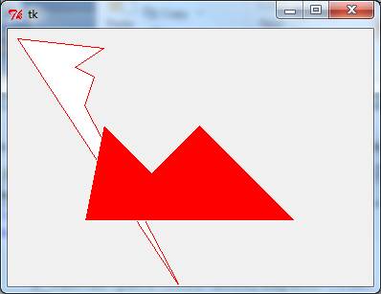
Polygon Options
Some Polygon Options:
fill (colour.The default value is black)
outline (The colour of the border. Default is outline='black’)
dash (dashed border)
points = [10, 10, 100, 20, 70, 40, 90, 50, 80, 80, 180, 270]
a_canvas.create_polygon(points, fill="white", outline="red")
coords = [80,200, 100, 100, 150, 150, 200, 100, 250, 150, 300, 200]
a_canvas.create_polygon(coords, fill="red", outline="white")

Slide 36
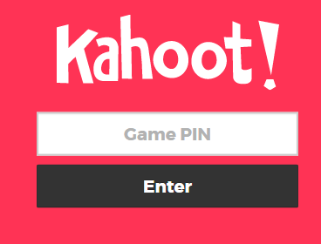
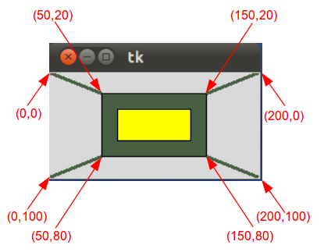
Exercise 2
Complete the following code to draw the following shapes on a canvas:
from tkinter import *
def main():
root = Tk()
a_canvas = Canvas(root, width=200, height=100)
a_canvas.pack(fill=BOTH, expand=True)
root.mainloop()
main()

Slide 37
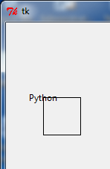
Drawing Text
Example04_5.py
DEMO
The method create_text(x, y, text="…", options) is used to print text on a canvas.
The first two parameters are the x and the y positions of the text object.
Note:
By default, the text is centred on this position.
a_canvas.create_text(50, 100, text="Python")
a_canvas.create_rectangle(50, 100, 100, 150)
(50, 100)

Slide 38
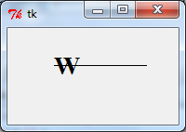
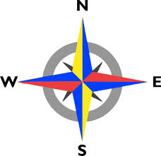
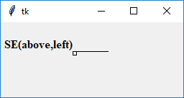
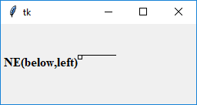
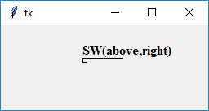

Text Options
Some other Text Options
fill (colour, default is black)
font (The font used to display the text)
anchor (controls where the text is displayed with respect to x, y)
By default, the text is centred on this position. You can override this with the anchor option.
a_canvas.create_line(100, 40, 150, 40)
a_canvas.create_rectangle(100, 40, 105, 45)
a_canvas.create_text(100, 40, text="NW(…)", anchor=NW, font=a_font)
Note: north – below the line; south above the line
east: before the point, west: after the point
For example: SW: the text will be positioned so its lower left corner is at point (x, y).
Notes:
North – below the line; South above the line
E: before the point, W: after the point
For example, if you specify anchor=tk.SW, the text will be positioned so its lower left corner is at point (x, y).

Slide 39

Drawing Arcs
Example04_6.py
DEMO
The method create_arc(x0, x1, y0, y1, start=…, extent=…, options) is used to draw an arc on a canvas.
An arc object is a wedge-shaped slice taken out of an ellipse.
This includes whole ellipses and circles as special cases
Point (x0, y0) is the top left corner and (x1, y1) the lower right corner of the bounding rectangle
start : Starting angle for the slice,
extent : Width of the slice in degrees. (extends counterclockwise)
a_canvas.create_rectangle(50,50,150,200) a_canvas.create_arc(50,50,150,200,start=225,extent=90))
(50, 50)
the arc starts at an angle 225 degrees counterclockwise from the positive x-­direction, and extends counterclockwise for 90 degrees.
90
(150, 200)

Slide 40




Arc Options
start: 0 degree
Some arc options
fill (colour, default is no fill)
outline (The colour of the border. Default is outline='black’)
dash (dashed border)
start: 0
extend: 90
start: 0
extend: 45
start: 120
extend: 90
start: 120
extend: 45
90
120
90

Slide 41

Example:
Example04_7.py
DEMO
create_arc(x0, y0, x1, y1, start=…, extent=…, **other_options)
start1_degrees = 45
extent_degrees = 100
enclosing_oval = (10, 20, 220, 150)
a_canvas.create_oval(enclosing_oval, fill="white")
a_canvas.create_arc(enclosing_oval, start=start1_degrees, extent=extent_degrees, fill="red")
start2_degrees = start1_degrees + extent_degrees + 10
a_canvas.create_arc(enclosing_oval, start=start2_degrees, extent=extent_degrees, fill="blue")
...

Slide 42
Summary
tkinter module includes classes, functions, and constants used in GUI programming
A GUI-based program is structured as a main window class
A Canvas object can be used to draw simple shapes.
Line
Circle
Rectangle
Polygon
Arc
Text

Slide 43


