Slide 1
COMPSCI 101 Principles of Programming
Lecture 27 - Using the Python interpreter, Python sequences

Slide 2
Learning outcomes
At the end of this lecture, students should be able to:
recognise sequences and the common features of sequences
use the interactive Python interpreter to check python statements and functions
use the interactive Python interpreter to look up Python help

Slide 3
Sequences: strings, lists and tuples
Sequence types
There are five types of sequences in Python. In CompSci 101 we use three of these: strings, lists and tuples.
Sequences allow you to store multiple values in an organized and efficient fashion.
The indices of the elements of a sequence start at 0. The indices can be negative (to access elements from the end of the sequence).
The order of the elements in a sequence is important.
Each element of a sequence can be accessed using square brackets and the index number, e.g.,
a_tuple = (3, 4, 8)
a_list = [3, 4, 8]
a_string = "348"
a_tuple = (3, 4, 8)
print(a_tuple[2])
middle = a_list[1]
last = a_string[-1]

Slide 4
Sequences continued
Sequences can be sliced:
The len(), min(), max() functions can be applied to sequences (sum() can be used with tuples and lists).
a_tuple = (3, 4, 8, 7, 2)
a_list = [3, 4, 8, 0, 1]
a_string = "3and 4"
a_tuple2 = a_tuple[0:3:2]
a_list2 = a_list[1:3]
print(a_tuple2, a_list2, a_string[5:1:-2])
(3, 8) [4, 8] 4d
5
6
8
n
3
(9, 'a')
a_tuple_list = [(3, 'c'), (9,'a'), (1, 'z')]
print(len(a_tuple))
print(len(a_string))
print(max(a_tuple))
print(max(a_string))
print(len(a_tuple_list))
print(max(a_tuple_list))
Notes:
First item by default

Slide 5
Sequences continued
The +, *, and 'in' operators can all be used with sequences
a_tuple = (3, 4) * 3 + (2, 1)
a_list = [3, 0, 1] + [6, 2] * 2
a_string = "3 & 4" * 2 + "end"
print(a_tuple)
print(a_list)
print(a_string)
print(4 not in a_tuple, 24 in a_list, "23" in a_string)
(3, 4, 3, 4, 3, 4, 2, 1)
[3, 0, 1, 6, 2, 6, 2]]
3 & 43 & 4end
False False False

Slide 6
Iterating through the elements of sequences
A for … in … loop can be used to visit each element of a sequence, e.g.,
a_tuple = (3, 4, 8, 7, 2)
a_list = [3, 4, 8, 24, 1]
total = 0
for number in a_tuple:
total += number
print("1.", total)
total = 0
for number in a_list:
total += number
print("2.", total )
1. 24
2. 40
Notes:
for number in a_list:
number += 1
print(a_list)
#Correct solution
for i in range(len(a_list)):
a_list[i] += 1
print(a_list)

Slide 7
Iterating through the elements of strings
A for … in … loop is used to visit each character in a string sequence. The elements of a string sequence are the characters making up the string.
word = "wonderful"
number = 0
for letter in word:
if letter in "aeiou":
number += 1
print(number)
3

Slide 8
Iterating through the characters of a sequence – Exercise 1
Complete the get_num_uniques() function which returns the number of unique elements in the sequence (including non alphabetic characters).
def get_num_uniques(a_sequence):
uniques = []
for
if
uniques.
return len(uniques)
def use_get_num_uniques():
words = "Number of unique elements:"
print(words, get_num_uniques("green apple"))
print(words, get_num_uniques("abcdefg") )
print(words, get_num_uniques("abbbbbb") )
print(words, get_num_uniques((3, 4, 3, 3, 4, 6, 3, 7, 8, 4)) )
print(words, get_num_uniques([3, 4, 3, 3, 4, 6, 3, 7, 8, 4]) )
main()
Number of unique elements: 8
Number of unique elements: 7
Number of unique elements: 2
Number of unique elements: 5
Number of unique elements: 5

Slide 9
Iterating through the characters of a string – Exercise 2
Complete the count_longer_words() function to find the count of words that are longer than the parameter word from a given list of words.
def count_longer_words(a_list, word):
count = 0
for
if
return count
def main():
print(count_longer_words(['Double', 'letters', 'in', 'green', 'apple'], 'go'))
print(count_longer_words(['Number', 'of', 'unique', 'elements'], 'go'))
main()
4
3

Slide 10
Iterating through the characters of a string – Exercise 3
Complete the count_doubles() function which returns the number of double letters (a letter followed by the same letter) excluding double spaces, in the string passed as a parameter.
def count_doubles(text):
count = 0
...
def main():
print("Double letters in green apple", count_doubles("green apple"))
print("Double letters in abcdefg", count_doubles("abcdefg"))
print("Double letters in abbbbbb", count_doubles("abbbbbb"))"
main()
Double letters in green apple 2
Double letters in abcdefg 0
Double letters in abbbbbb 3

Slide 11
Compilers and interpreters
Compilers
Compilers convert source code into machine code and store the machine code in a file. The machine code can then be run directly by the operating system as an executable program (… .exe file).
Interpreters
Interpreters bypass the compilation process and convert and execute the code directly statement by statement.
Python is an interpreted language, i.e., the Python interpreter reads and executes each statement of the Python source program statement by statement:
this is why even if you can have an error in the program further down, the program executes until it hits that error.

Slide 12
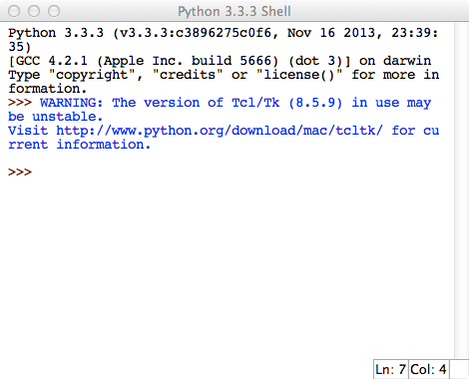
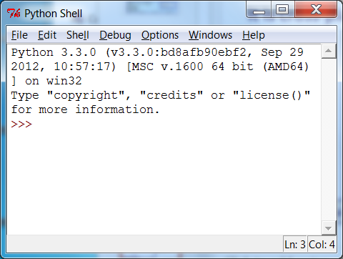
Python IDLE
IDLE (Integrated DeveLopment Environment) is an integrated development environment for Python. This is the development environment provided when you download Python.
WIKIPEDIA states "IDLE is intended to be a simple IDE and suitable for beginners, especially in an educational environment. To that end, it is cross-platform, and avoids feature clutter."
IDLE provides an interactive environment for checking Python code and for running Python programs.
IDLE window on a MAC
IDLE window on a PC

Slide 13
The Python interactive interpreter (Python shell)
The interactive Python interpreter
The Python interactive interpreter makes it easy to check Python commands.
Open the interactive interpreter
We will use IDLE which opens a window with the interpreter prompt: >>>
Once the Python interpreter has started any Python command can be executed (at the prompt >>>)
>>> word = "amazing"
>>> len(word)
7
>>> word = word * 3
>>> word
'amazingamazingamazing'
>>> another_word = word[2::3]
>>> another_word
'anmiazg'
>>> word[:0:-4]
'ganmi'
Notice that the interpreter displays the result of each statement even though there is no print() in the statement.

Slide 14
The Python interactive interpreter cont.
The interactive Python interpreter can also be used to test functions
The Python interactive interpreter makes it easy to check Python code.
>>> def get_result(command, what_to_do, where):
return command + " " + what_to_do + " in the " + where
>>> get_result("a", "b", "c")
'a b in the c'
>>> get_result("come", "sing", "hall")
'come sing in the hall'
>>> get_result("go", "jump", "pond")
'go jump in the pond
Notice that it is necessary to insert a blank line to end the function definition.
See the results of calling the function three times with different arguments.

Slide 15
The Python interactive interpreter help
The interactive Python interpreter can also be used to get help:
>>> help(str.rfind)
rfind(...)
S.rfind(sub[, start[, end]]) -> int
Return the highest index in S where substring sub is found,
such that sub is contained within S[start:end]. Optional
arguments start and end are interpreted as in slice
notation.
Return -1 on failure.
>>> help(sum)
sum(...)
sum(iterable[, start]) -> value
Return the sum of an iterable of numbers (NOT strings) plus
the value of parameter 'start' (which defaults to 0). When
the iterable is empty, return start.

Slide 16
None
print statements (in the interpreter window) just print to the interpreter window.
A function which does not explicitly return a value, always returns None.
>>> def do_little(n1, n2):
print("Sum:", n1 + n2)
>>> do_little(3, 5)
Sum: 8
>>> print(do_little(3, 5))
Sum: 8
None
Notice that it is necessary to insert a blank line to end the function definition.
The code in the function executes.
The result of calling the function is printed.

Slide 17
Summary
strings, lists and tuples are sequences
The operators: +, * and in can be used with sequences
We use a for … in … to iterate through each element of a sequence
len(), min(), max() can be used with sequences
sum() can be used with tuples and lists
Each element of a sequence can be accessed using the index operator. The index can be negative (starting from the end of the sequence)
Sequences can be sliced using [slice_start: slice_end: step]
The Python interactive interpreter (IDLE)
use the interactive Python interpreter to check python statements and functions
use the interactive Python interpreter to look up Python help

Slide 18
Python features used in this lecture
sequence1 = (5, 7, 2, 6, 4, 3, 9)
sequence2 = [5, 7, 2, 6, 4, 3, 9]
sequence3 = "This is a sequence of characters"
for element in sequence3:
…
min_value = min(sequence1)
max_value = max(sequence2)
total = sum(sequence1)
element_from_end1 = sequence1[-2]
element_from_end3 = sequence3[-2]
element_from_end1 = sequence1.index(4)
position3 = sequence3.index("uen")
part1 = sequence1[2: 5: 3]
part2 = sequence2[2: 7: 2]
part3 = sequence3[1: 5: 2]

Slide 19
The count_doubles() function
Parameter: a string (e.g. ‘green apple’)
Returns: the number of double letters (a letter followed by the same letter)
excluding double spaces
def count_doubles(text):
count = 0
next = 1
letter1 = text[0]
while next < len( __________):
letter2 = text[ ______]
if __________ == _________ and letter1 != " ":
count += 1
letter1 = ______
else:
letter1 = ______
next += 1
return count

