Slide 1
MapReduce Implementation of Needleman-Wunsch using Spark
Abbas Furniturewalla, Fahad Mohammad, Harshil Patel

Slide 2
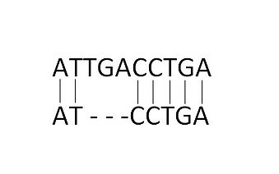
Sequence Alignment
Concept of Bioinformatics
Arrange sequences to identify regions of similarity
Used to find functional, structural, evolutionary relationships
Also used for non-biological sequences
Global vs. Local
Unaligned:
ATTGACCTGA
ATCCTGA
Aligned

Slide 3
Related Works
Smith-Waterman algorithm
Local sequence alignment
Finds local regions with high similarity
Parallelized spark implementation exists

Slide 4
Needleman-Wunsch Algorithm
Traditional global alignment algorithm
Creates score matrix for sequences
Fills in matrix
Traces back from the last value

Slide 5
Needleman-Wunsch: Scoring Matrix
C | -6
A | -5
A | -4
G | -3
T | -2
A | -1
_ | 0 | -1 | -2 | -3 | -4 | -5 | -6
 | _ | A | C | C | A | G | C
Create scores
Match = +1
Miss = -1
Gap= -1
Initialize Matrix

Slide 6
Needleman-Wunsch: Filling the Matrix
C | -6
A | -5
A | -4
G | -3
T | -2
A | -1 | 1
_ | 0 | -1 | -2 | -3 | -4 | -5 | -6
 | _ | A | C | C | A | G | C
Next element value
Check side(add gap)
Check bottom(add gap)
Check diagonal(add match/miss)
Insert Largest Value
Keep track of source
-2
1
-2

Slide 7
Needleman-Wunsch: Filling the Matrix
C | -6
A | -5
A | -4
G | -3
T | -2 | 0 | 0
A | -1 | 1 | 0
_ | 0 | -1 | -2 | -3 | -4 | -5 | -6
 | _ | A | C | T | A | G | C

Slide 8
Needleman-Wunsch: Filling the Matrix
C | -6 | -4 | -2 | -3 | -1 | -1 | 1
A | -5 | -3 | -3 | -2 | 0 | 0 | -1
A | -4 | -2 | -2 | -1 | 1 | 0 | 0
G | -3 | -1 | -1 | 0 | 0 | 1 | 0
T | -2 | 0 | 0 | 1 | 0 | -1 | 2
A | -1 | 1 | 0 | -1 | -2 | -3 | -4
_ | 0 | -1 | -2 | -3 | -4 | -5 | -6
 | _ | A | C | T | A | G | C

Slide 9
Needleman-Wunsch: Traceback
C | -6 | -4 | -2 | -3 | -1 | -1 | 1
A | -5 | -3 | -3 | -2 | 0 | 0 | -1
A | -4 | -2 | -2 | -1 | 1 | 0 | 0
G | -3 | -1 | -1 | 0 | 0 | 1 | 0
T | -2 | 0 | 0 | 1 | 0 | -1 | -2
A | -1 | 1 | 0 | -1 | -2 | -3 | -4
_ | 0 | -1 | -2 | -3 | -4 | -5 | -6
 | _ | A | C | T | A | G | C
Trace values back starting from top
Use Traceback to find best alignment
Diagonal -> write both characters
Adjacent -> write only row character and leave gap for column
Bottom -> write only column character and leave gap for row
Seq A = A _ T G A A C
Seq B = A A T _ A G C

Slide 10
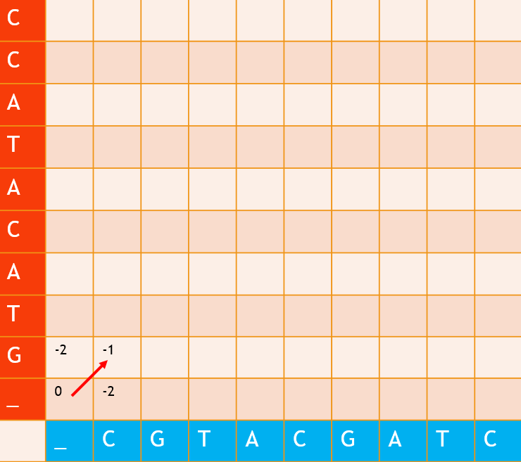
Parallelizing The Algorithm
Matrix representation: <key, value> pairs, key is [i,j] position, value is [score, origin_of_score]. 0,0 is lower-left corner. For initial scores, origin_of_score would be null
K V
<[0,0] , [ 0 , null] >
<[1,0] , [-2, null] >
<[0,1] , [-2, null] >
<[1,1] , [-1, [0,0]] >
Notes:
We will be representing the matrix using key value pairs. The key is the index of the matrix, and the value is the score, and where the score came from. I wrote out all of the values in this matrix in key value pair.

Slide 11
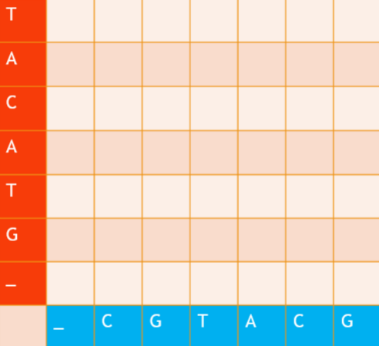
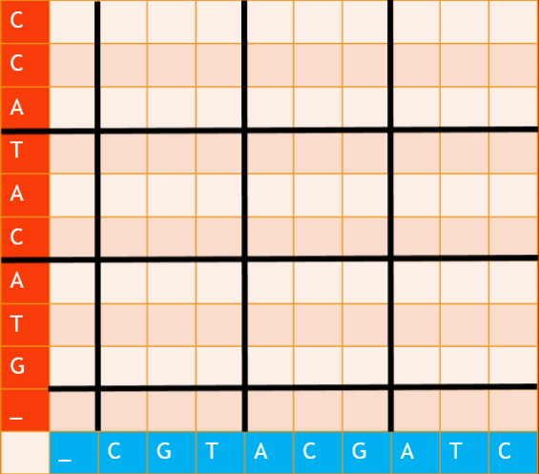
Parallelizing The Algorithm
Step 1) Partition Matrix based on number of available nodes. So, we will be calculating each partition serially
3 Nodes
Notes:
We will be parallelizing the algorithm by partitioning the matrix, into submatrix. Each submatrix is calculated by one node using serial means.

Slide 12
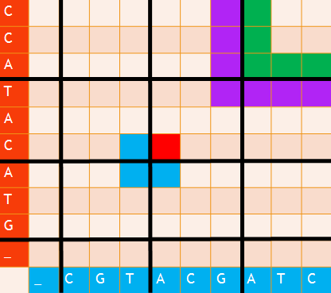
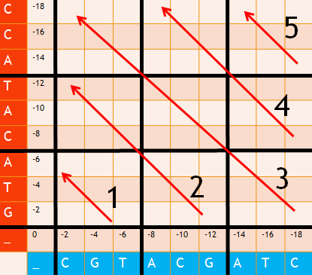
Parallelizing The Algorithm
Catch is that each partition is dependent on partitions to left, below, and diagonal from it. So, you can only run diagonal partitions at the same time.
Notes:
The catch is that each node is dependent on the lower partition, the left partition, and the diagonal partition from it. For example, if you want to calculate the value for the red cell, you need all the values in the blue cells. If you want to calculate the value for the green cells, you need all the purple cells. So, you can’t solve all the partitions at once. Instead, we are choosing to solve the matrix in the steps 1-5 shown in the figure to the right. After you solve one partition, then you can run two partitions in parallel. After you solve 2, then you can solve 3 partitions in parallel. Then, on the upper triangle of the matrix, you can solve two partitions, then one partition.

Slide 13
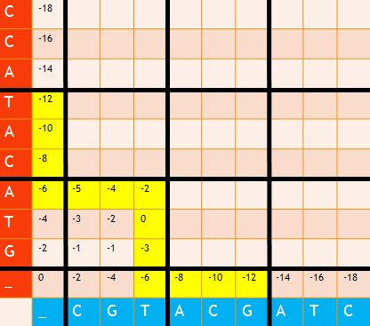
Parallelizing The Algorithm
Step 2) Initialize. Fill in initial edges and first matrix serially, as well and initialize outgoing_edge, another KV pair vector with all the values that are needed for the next diagonal to be calculated
Notes:
Step 2 was shown in the last graph, but you can fill in the initial edges serially, and calculate the first matrix.

Slide 14


Parallelizing The Algorithm
Step 3) Map algorithm Inputs: ougoing_edge, partition_size Outputs: incoming_edge
outgoing_edge
<[6,0],[-12, null]>
<[5,0],[-10, null]>
<[4,0],[-8, null]>
<[3,0],[-6, null]>
<[3,1],[-5, [2,0]]>
<[3,2],[-4, [2,1]]>
<[3,3],[-2, [2,3]]>
<[2,3], [0, [1,2]]>
<[1,3],[-3, [1,2]]>
<[0,3],[-6, null]>
<[0,4],[-8, null]>
<[0,5],[-10, null]>
<[0,6],[-12, null]>
incoming_edge
Node 1:
<[6,0],[-12, null]>
<[5,0],[-10, null]>
<[4,0],[-8, null]>
<[3,0],[-6, null]>
<[3,1],[-5, [2,0]]>
<[3,2],[-4, [2,1]]>
<[3,3],[-2, [2,3]]>
Node 2:
<[3,3],[-2, [2,3]]>
<[2,3], [0, [1,2]]>
<[1,3],[-3, [1,2]]>
<[0,3],[-6, null]>
<[0,4],[-8, null]>
<[0,5],[-10, null]>
<[0,6],[-12, null]>
Map
Notes:
Step 3 will be to map the outgoing edge vector, to the incoming_edge vector that each node will use to calculate the matrix. So, everything shown in yellow is the outgoing_edge vector, and it splits it into the incoming_edge vector that each node will use.

Slide 15
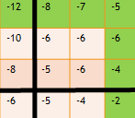
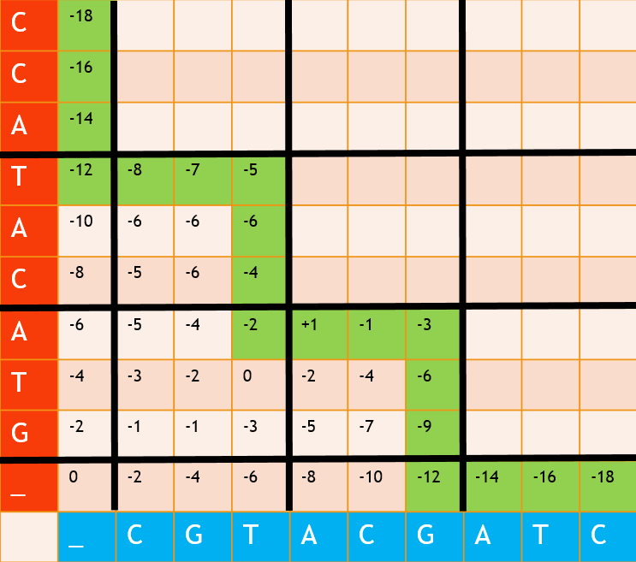
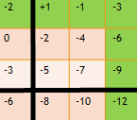
Parallelizing The Algorithm
Step 4) Reduce Algorithm inputs: incoming_edge outputs: matrix, outgoing_edge
Calculates the matrix for each node, reduces all values back into original matrix vector, also reduces all of the new outgoing_edge values for each node into a single outgoing edge vector
Notes:
Step 4 is to use the reduce algorithm. So the reduce algorithm in our case would do 3 things. First, it would fill in the matrix for each partition using a normal loop. It would reduce all these values back into the original matrix, because each value is a <key, value>, so it just has to reduce all the <key, value> pairs back into one long matrix vector. Lastly, it would also reduce all the outgoing_edge vectors for each node into a single outgoing_edge vector, shown in the green squares.

Slide 16
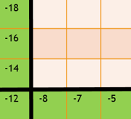
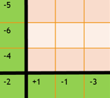
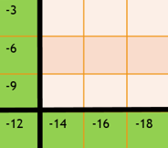
Parallelizing The Algorithm
Step 5) Loop it over and over again. Here, it maps the outgoing_edge into incoming_edges
Notes:
Then, now that we have a new outgoing edge vector, we can loop the map and reduce algorithms until the entire matrix is filled in. So, I will just run through the slides so you can see that.

Slide 17
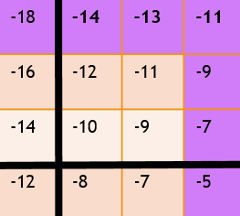
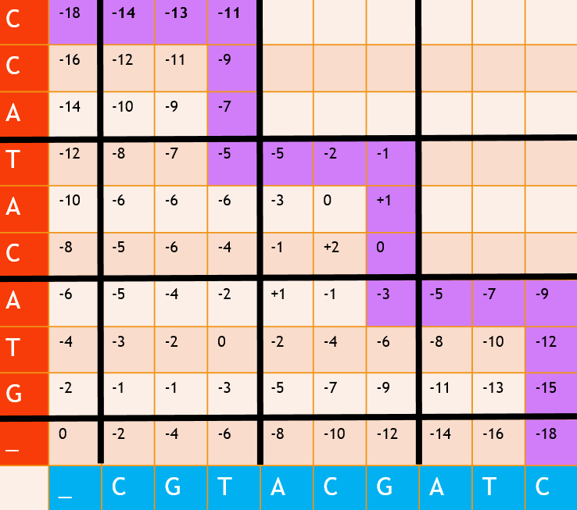
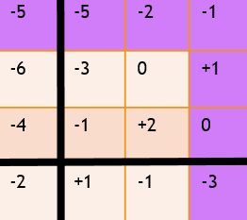
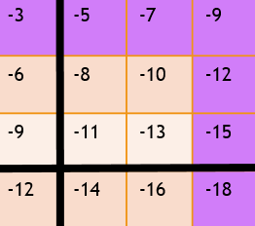
Parallelizing The Algorithm
Reduce
Notes:
So once again, fills in each sub matrix, reduces it back into one matrix, and also reduces all the outgoing edges in purple back into one long outgoing edge

Slide 18
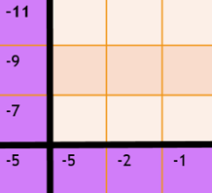
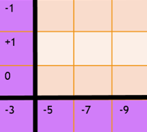
Parallelizing The Algorithm
Map
Notes:
Then Map to each node again

Slide 19
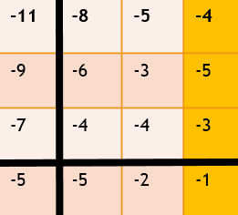
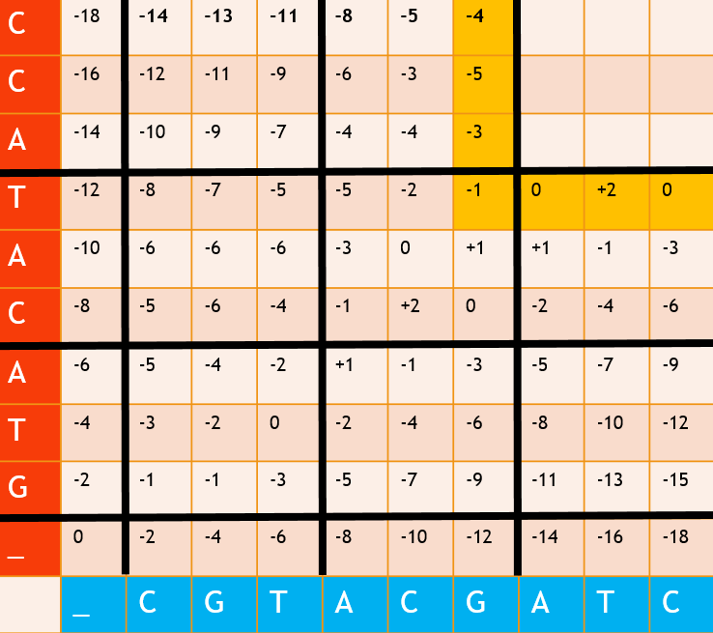
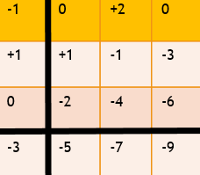
Parallelizing The Algorithm
Reduce
Notes:
Then reduce again

Slide 20
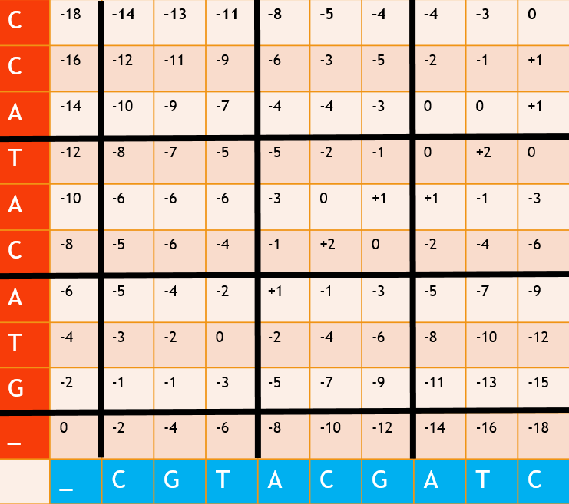
Parallelizing The Algorithm
One more map/reduce or just use serial method for last matrix
Notes:
Then you can do map/reduce one more time for the last node or just use a serial loop since it’s only one matrix

Slide 21
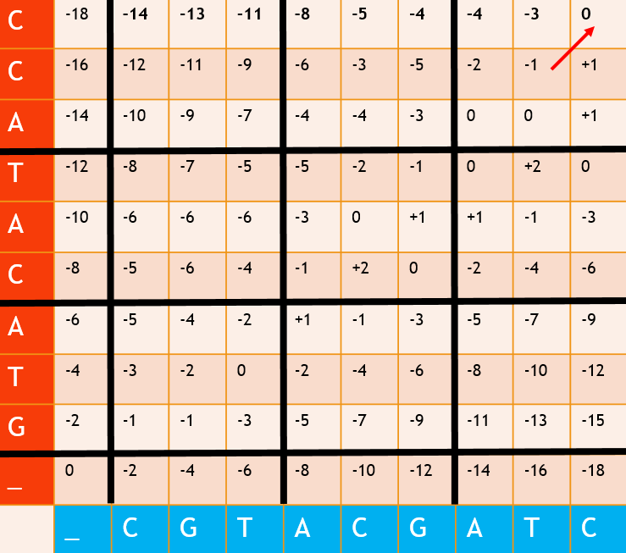
Parallelizing The Algorithm
Traceback: Look at the last element, use its origin_of_score
For example, the last element’s key value pair is:
Then you look at index [8,8], and see where that came from, and repeat, and align
K V
<[9,9] , [ 0 , [8,8]] >
Notes:
For traceback, you look at the last element you have, and use its origin_of_score in the key value pair. For example, in the matrix we just calculated, the score is 0, and it came from cell 8,8. So then you look at cell 8,8, do the alignment procedure that Fahad explained, and repeat until yoyu have both sequences aligned, which I won’t show here.

Slide 22


Remaining Steps
Implement newly parallelized algorithm in Spark
The map() function
Splits outward edge to inward edges
Maps inward edges to respective nodes
using vector of <key,value> pairs
The reduce() function
Combines outward edges
Forms vector of<key,value> pairs
The idea is to use the indexes(keys) to split and combine the outward and inward edges

Slide 23

Remaining Steps
Evaluation
Environment -> Spark and Hadoop setup on Windows 10(completed)
Deploy Spark application on Amazon EC2
spark-ec2 script, spark-submit
# of instances based on diagonal of matrix
Compare performance against:
Serial implementation
1
2
3

