Slide 1
聲音節奏遊戲
資工四 王 凡
資工四 黃冠豪
資工四 江建德

Slide 2
Outline
Introduction
System
Technique
Problem
Future Work
Demo

Slide 3
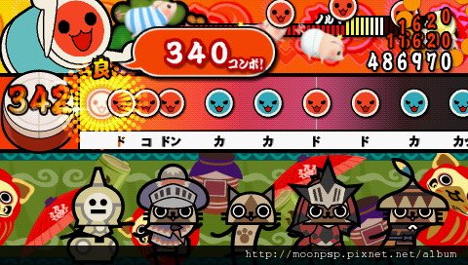
Introduction
音樂節奏遊戲
自訂敲擊聲音
身歷其境的使用者經驗

Slide 4
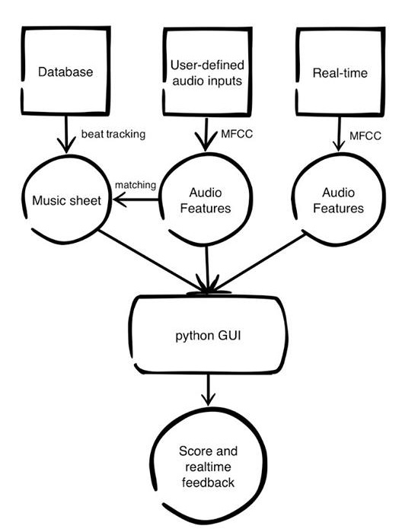
System

Slide 5
Technique
Audio Recognition
Beat Tracking
Audio Matching
Handle Input Stream

Slide 6
Technique Audio Recognition
Recording
End Point Detection
MFCC Feature Extraction

Slide 7
Technique Beat Tracking
For preparing database
Use Library from professor Roger

Slide 8
Technique Audio Matching
For preparing database
MFCC Feature Distance

Slide 9
Technique Handle Input Stream
Get input stream around beat

Slide 10
Demo Audio Recognition

Slide 11
Demo Game

Slide 12
Problem
邊放歌邊玩會影響判斷
無法偵測同時敲擊
遊戲畫面更新速度與聲音會有差異
聲音準確度

Slide 13
Future Work
Battle System
Higher accuracy
Detect different sounds at same time
Noisy removed

