Slide 1
Browser Test: Hamster & Antibody Screenshot PPT Report
2026-04-11

Slide 2
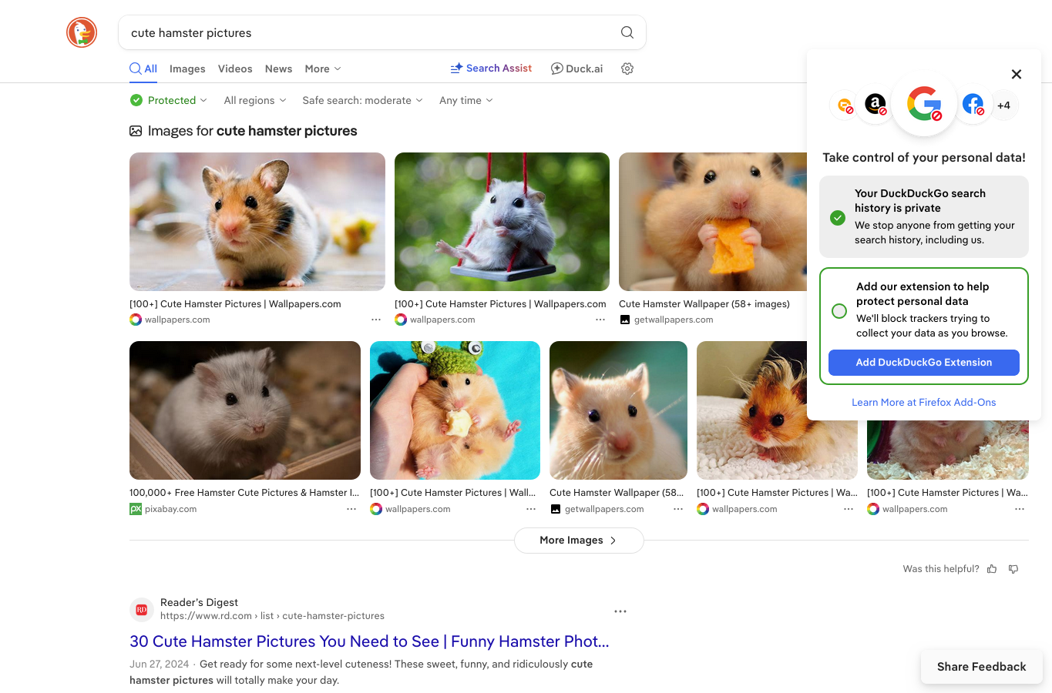
DuckDuckGo: cute hamster pictures

Slide 3
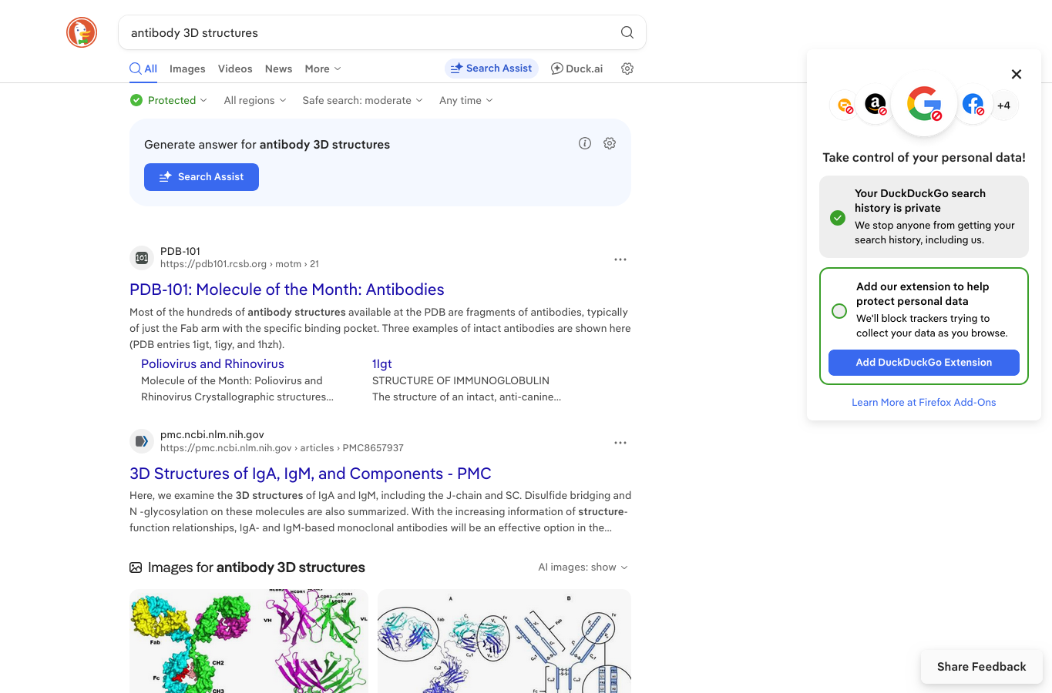
DuckDuckGo: antibody 3D structures

