Slide 1
Transposition Ciphers in Historical Context
William Ricker
© 2016
CC-BY-SA

Slide 2
Agenda
1. Crypto News Review
2. History: Transposition Ciphers in Historic Context
3. How To Reminder for GPG/PGP Key-signing
4. GPG/PGP Key-signing

Slide 3
Crypto News review: from 2014-09
2014-fall
  SHELLSHOCK wasn't crypto
  POODLE - “Padding Oracle on Downgraded Legacy Encryption” - Yet another side-jack exploit – HTTPS in Starbucks not safe if SSLv3 downgrade allowed !
  SSLsplit - tool for MITM intercept
  "Let's Encrypt" announced for 2015
  Whatsapp adds E2E
2015
  FREAK (downgrading session to export ciphers)
  RowHammer (DRAM abuse)
  TrueCrypt Audit
  LogJam “ Imperfect Forward Secrecy” (per Sggrc) – export-grade TLS
2016
  CacheBleed: A Timing Attack on OpenSSL Constant Time RSA
  Drown – riffing SSLv2 to compromise TLS (turn off old ciphers!)
  BadLock – overblown!
  CA follies continue
    many more named exploits, mostly over-sold
  CVE-2016-6313 Random Number prediction
    4640 bits from the RNG needed yawn
  The Million-Key Question—Investigating the Origins of RSA Public Keys
  weaponizing of Rowhammer with “Flip Feng Shui,”

Slide 4
2. Transposition Ciphers in Historic Context
Using Codes and Ciphers !

Slide 5
Cryptographic Taxonomy
Steganography
Codes
Ciphers
Composite

Slide 6
Taxonomy: Steganography
message, what message ?
e.g, Acme::Bleach or lemon juice
Example, “Attack at Dawn” becomes:

Slide 7
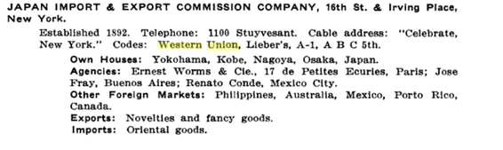
Taxonomy: Codes
Semantic level substitution
  One Part vs Two Part
  Complete or partial
Nomenclator – one-part, partial
  “Attack At Dawn”
  to “GrapeJelly At Dawn”
Commercial Codebooks – one-part.
  Mostly for brevity;
  registration required.
Trench Codes
Military & Diplomatic Codebooks
  Normally two part (plus additive)
  Washington Naval Conference of 1922
  Gray
  Midway (JN-25b)
  “GrapeJelly Textbook”
BOHORDER PESTANEABA
04206 114976
(inserted ATTACK in 1st custom space after Attach; used 5am Thursday for DAWN)

Slide 8
Taxonomy: Ciphers
Orthographic level
Substitution –
  from Caesar, ROT13 to Enigma to Vernam to Solitaire
  (Hebrew Atbaš was before Caesar.)
  Digital stream ciphers
Transposition
  Rearrange the deckchairs
Hybrid
  Digital Block ciphers Feistel rounds of S&P(DES, AES)
  Tunny (Baudot TTY bits toggled and swapped);

Slide 9
All of the above
  Diplomatic (or commercial) codebooks with Additives and/or Transposition super-encipherment
  Substitution Cipher with Jargon phrasebook to avoid probable words
  KGB/VIC ciphers: straddle or Vigenère, proper-noun inclusions, hidden OTP, double transposition with voids, microdot or secret ink, hollow-nickel.

Slide 10
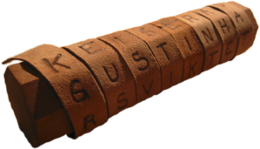
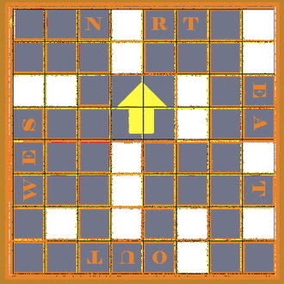
Transposition Ciphers
Scytale (Wikipedia image)
Grilles (primitive)
Rail fence (combines with bifid substitution naturally)
Columnar
Double
Variations
  Disrupted ( Voids )
  Myszkowski (POTATO, TOMATO)
  Unpadded / Ragged
u

Slide 11
Transposition -
Disadvantages
  limited key-space
  Shape choices of key are tied to size of message trivially
  Error prone by hand
    And the More-secure variations are more error prone (and may be complication illusoire)
  Frequency analysis matches input
    Discloses transposition in use
    And/or discloses input language or prior substitution's frequencey
Advantages
  Cryptanalysis requires either probable word or 'depth' on a key
    Simplest substitution does not; yields to entropy
  But 'the' may be enough of a probable word

Slide 12
Historic Example 1. USMTC (Y-150)
Smithsonian/Zooniverse/ Huntington Library Citizen-science initiative to transcribe Lincoln's war telegrams “Decoding the Civil War”
  http://www.smithsonianmag.com/smart-news/you-can-help-decode-thousands-top-secret-civil-war-telegrams-180959561/
  https://www.zooniverse.org/projects/zooniverse/decoding-the-civil-war
  https://www.zooniverse.org/projects/zooniverse/decoding-the-civil-war/about/education
  https://blog.decodingthecivilwar.org/
  https://web.archive.org/web/20160628222057/http://www.c3teachers.org/wp-content/uploads/2016/01/Anatomy-of-a-Cipher.pdf
  Really looking for transcribers
  See also William Rattle Plum, The Military Telegraph during the Civil War in the United States v1 & v2
    https://archive.org/search.php?query=Plum%2C%20William%20Rattle

Slide 13
Lincoln's War Dept Code
Nomenclator code
  With multiple replacements
  Single-part
  Does not include small /common words
    But recommends punning homophony
      Anna Police = Anapolis (will fractionate)
      Tooth = To The, Toby = to be (won't help anagramming)
Superencrypted by Transposition
  Route encryption by words
    Words are easier in manual telegraphy
    Columnar variant with reversed columns (typically alternately but 2^N choices)
    Prefix of 3 blind (commencement) words to indicate the columns & Route and lines.
    Suffix of a blind word after each column as a buffer, ?indicating which it was?
U.S. MILITARY TELEGRAPH.
Apr 12 1865
By Telegraph from War Dept
To J. H. Emerick
Whats next news I the prayers I to while coming star
what you you mean dispatch zebra I you spirit there
understanding any if the piloted your offer there such of
any and have was I to Emma never seen of of no toby
Zodiac on there is with what remains yoke as sign my
sign temper acted in to paradise flood over weitzel abe
remember pekin that my walnut to form such why not
say may it if together there you have spoken matter have senses shelter bardie not galway in manifested torch letter in no bologne plenty dont sign me you legislature me appeared but bearing out unity in your prayers while doubt the is the is pedlar draw you down
T. T. Eckert
123
From “Anatomy of a Cipher” Daniel W. Stowell https://web.archive.org/web/20160628222057/http://www.c3teachers.org/wp-content/uploads/2016/01/Anatomy-of-a-Cipher.pdf

Slide 14
Decryption
Note check 123 is 2 less than body count 125. It's the original's count ! !
To Emerick, From Eckert – those are the Operators. Routing to operator with inner addressee.
“Whats next news I the prayers I to”
  Blinds. In current code,
    “Whats” is 10 columns and below Route (negative = up)
    Next:2 + News:9 = 11 Lines
    ROUTE: 6 10 -1 8 -2 4 -7 3 -5 9
    count: 1 2 3 4 5 6 7 8 9 10
    unROUTE: 3 5 8 6 9 1 7 4 10 2

Slide 15
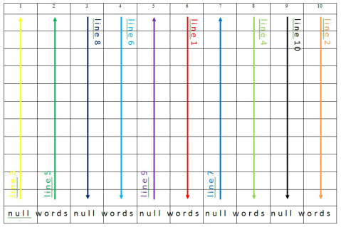
Sample Route WHATS

Slide 16

Decryption... break to columns
C 6( 1):I the prayers I to while coming star what you you mean
C 10( 2):dispatch zebra I you spirit there understanding any if the piloted your
C -1( 3):offer there such of any and have was I to Emma never
C 8( 4):seen of of no toby Zodiac on there is with what remains
C -2( 5):yoke as sign my sign temper acted in to paradise flood over
C 4( 6):weitzel abe remember pekin that my walnut to form such why not
C -7( 7):say may it if together there you have spoken matter have senses
C 3( 8):shelter bardie not galway in manifested torch letter in no bologne plenty
C -5( 9):dont sign me you legislature me appeared but bearing out unity in
C 9(10):your prayers while doubt the is the is pedlar draw you down
This is output of a Perl program,
  using Perl 5.24 features that were experimentally introduced in 5.20
  Come to Boston Perl Mongers to see it !

Slide 17
Decryption: column check blinds
C 6( 1):I the prayers I to while coming star what you you
C 10( 2):dispatch zebra I you spirit there understanding any if the piloted
C -1( 3):offer there such of any and have was I to Emma
C 8( 4):seen of of no toby Zodiac on there is with what
C -2( 5):yoke as sign my sign temper acted in to paradise flood
C 4( 6):weitzel abe remember pekin that my walnut to form such why
C -7( 7):say may it if together there you have spoken matter have
C 3( 8):shelter bardie not galway in manifested torch letter in no bologne
C -5( 9):dont sign me you legislature me appeared but bearing out unity
C 9(10):your prayers while doubt the is the is pedlar draw you
col checks MEAN YOUR NEVER REMAINS OVER NOT SENSES PLENTY IN DOWN

Slide 18
Decryption... unreverse
C 6( 1):I the prayers I to while coming star what you you
C 10( 2):dispatch zebra I you spirit there understanding any if the piloted
C 10( 2):dispatch zebra I you spirit there understanding any if the piloted
C 1( 3):Emma to I was have and any of such there offer
C 8( 4):seen of of no toby Zodiac on there is with what
C 2( 5):flood paradise to in acted temper sign my sign as yoke
C 4( 6):weitzel abe remember pekin that my walnut to form such why
C 7( 7):have matter spoken have you there together if it may say
C 3( 8):shelter bardie not galway in manifested torch letter in no bologne
C 5( 9):unity out bearing but appeared me legislature you me sign dont
C 9(10):your prayers while doubt the is the is pedlar draw you

Slide 19
Decryption... unscramble to lines
L ( 1):Emma flood shelter weitzel unity I have seen your dispatch
L ( 2):to paradise bardie abe out the matter of prayers zebra
L ( 3):I to not remember bearing prayers spoken of while I
L ( 4):was in galway pekin but I have no doubt you
L ( 5):have acted in that appeared to you toby the spirit
L ( 6):and temper manifested my me while there Zodiac is there
L ( 7):any sign torch walnut legislature coming together on the understanding
L ( 8):of my letter to you star if there is any
L ( 9):such sign in form me what it is pedlar if
L (10):there as no such sign you may with draw the
L (11):offer yoke bologne why dont you say what you piloted

Slide 20
Decryption... Decode Arbitraries
L ( 1):/9am/ /12/ /Genl./ weitzel /./ I have seen your dispatch
L ( 2):to /Col./ bardie abe out the matter of prayers /./
L ( 3):I to not remember bearing prayers spoken of while I
L ( 4):was in /Richmond/ /,/ but I have no doubt you
L ( 5):have acted in that appeared to you /to be/ the spirit
L ( 6):and temper manifested my me while there /./ is there
L ( 7):any sign /of the/ /Rebel/ legislature coming together on the understanding
L ( 8):of my letter to you /?/ if there is any
L ( 9):such sign in form me what it is /,/ if
L (10):there as no such sign you may with draw the
L (11):offer /signed/ /Pres of U.S./
/why dont you say what you piloted/
Long-hand typos:
to for do, bearing for hearing, that for what, my for by

Slide 21
Cryptanalysis
Blog says never broken by Confederates.
  Likely true.
  Says more of Rebels than of system!
    Rebels happily used simple polyalphabetic Vigenère with single key for most of war for their General officer cipher (See previous Vicksburg talk.)
    Rebels likely didn't have crypto-intel staff to crack this
      both sides broke wig-wag simple substitiutions of the other.
        NSA Spectrum, The Gray Fox Swallowed the Bait
        https://www.nsa.gov/news-features/declassified-documents/cryptologic-spectrum/assets/files/gray_fox.pdf
      Union did much better, no reports seen of Rebels doing so
Breakable but difficult.
  Depth needed – thus volume of intercepts
    In theory, If this historic trove contained many encrypted telegrams matching one missing code book edition, it could be derived
      but that seems unnecessary given content of the archive
  Nomenclator & Codebook Codes broken before and after,
    In theory, could've been broken
    if intercepts and staff available

Slide 22
Depth needed
  To break either a transposition or a code-book requires lots of intercepted material.
  Nomenclator codes were broken in Renaisance by “Dark Chambers”
    that copied all mail in/out of capital, including “sealed” diplomatic pouches,
    so it was possible to reconstruct single-part code book by pencil and paper.
  Pre-radio: tapping telegraph lines was common by Cavalry
    but only get messages on that circuit,
    not everything as one gets with radio telegraphy in WW1

Slide 23
Aids in breaking
Kerckhoffs' principle: only the keys are secret;
  "the enemy knows the system" (Shannon's version).
  Assume we know, or guess from observing multiple messages, that route transposition of codebook words, with blind indicators added.
  We don't know the routes; nor the blind indicators; nor the Nomenclator book of Arbitraries.
Transposition
  Blind route indicators would make sorting messages into depths easier, as 1st Blind is number of columns. Many homophones, 9 per Route.
    (Did they have more than one Route for a given width during a key period? If not, Fail! )
    One-part alphabetic will suggest homophones !
  Typically small number of factors of body size for columns x lines.
    Blind route indicators will tattle that # columns is sometimes the same as another message of different length, removing all doubt as to which factors are which.
  Blind column indicators serve as error correction for proper recipient but likewise will aid a cryptanalyst with a depth to do multiple anagramming once they've been intuited
Codebook
  Nomenclator means don't have to break the little words in each version of code first, they're given free (like word-breaks in newspaper CryptoQuotes™). Oops.
  Single-part code-book's parallel ordering of sensitive and cover words helps infer meaning !
  Military Intelligence has much context to provide probable words from Order of Battle and Operational Awareness.
    E.g., if we knew addressee SHELTER Weitzel refers to a (Maj)Genl, could infer SHELTER is either /MajGenl/ or /Genl/ from context.
  Unknown Codewords can be obvious from context once known ones filled in.
    /Richmond/ … WALNUT Legislature
    Which Legislature might General in Richmond be talking to? Not likely State of Maine …
    Recently declassified, how Nazi Germany broke a US Code https://www.nsa.gov/news-features/declassified-documents/tech-journals/
Blinds acting as nulls in last line are operator chat !

Slide 24
Historic Examle 2. ADFGVX (Y-100)
Well, Y-98.
  WW1 centenary is well underway (1914-1918)
    Centenaries of Battles of the Somme (1916 Jul01 to Nov18 ) and Verdun (1916 Feb21 – Dec18) extends before I write this to after I present. Ouch!
  but this cipher is March to July 1918 * .
German near-front Army/Corps/Division cipher, Western Front.
  Trying to break out of trenches into decisive movement before attrition; Tanks & Gas.

Slide 25
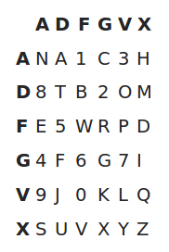
ADFG(v)x
Polybius Substitution
  Fractionated Bifid Substitution
  Thoroughly mixed alphabet
  Labels ADFG(V)X
    Optimized for Morse Code Wireless Telegraphy speed & accuracy
    ·- --· ··-· --· ···- -··-
  Expanded from 5x5 to 6x6 to include numerals in June
    Avoids spelling
      numerals become probable words!
        eins zwei drei vier fünf sechs sieben acht neun zehn
      or shifts to digits modes in other systems.
    Shorter messages. less mistakes.
  (Image from Wikipedia)
Single Columnar Transposition
  Ragged last row hence ragged columns
Irregular splitting / blocking of long messages
  To avoid multiple anagramming

Slide 26
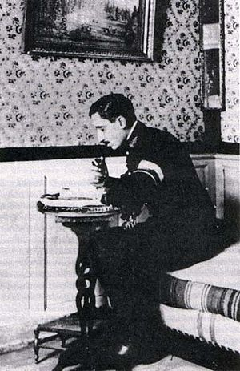
Cryptanalysis of ADFGX
Mostly one Analyst: Lt Georges Painvan
(picture via Wikipedia)
Irregular message sizes:
  Ragged row prevents factoring for size
  But eventually actually harmed security
Frequency analysis says little at start
  Only 5 (later 6) letters discloses it's a Bifid
  Freq distribution varied day to day disclosed that Polybius is keyed daily
    And thus likely the transposition key too

Slide 27
Cryptanalysis … Depth
Transposition requires Depth to break
  Regular blocks in one message can provide that, but avoided here
Required depth of messages needed in same day key and similar or same size to crack
  Initially too few messages
  Flurry of messages prior to attack!
  Only 10 days broken, but 50% of all traffic

Slide 28
Cryptanalysis … Entry
Find Column width, lengths
  Stereotyped military message prologue results in common pattern even after transposition
    similar to “cribs”, but only need the pattern not the text !
      (the text crib will help later)
  Divide columns into long and short using prologue pattern
    limits anagramming choices to subsets
    Undoes the complication of where to break the columns
Two messages with same length: Multiple Anagramming
Different but close: Pattern similarity discloses width and length.

Slide 29
Cryptanalysis – matching columns
Frequency analysis
  Dividing columns into even/odd.
    (Also can detect Even vs Odd number of columns if not determined otherwise)
  Candidate pair [odd:even] columns as Polybius bifid letters
    Bifid means only 36 not 26*26 kinds in each pairing so easier to have enough data to be meaningful

Slide 30
Cryptanalysis … finishing
Once anagrammed, bifid coordinate pairs can be treated as simple mono-alphabetic substitution; routine.
  Re-use the crib to start.
Having recovered transposition (# columns and permutation) and substitution (mixed alphabet) keys of the day, all messages of the day are readable.
  SIGINT Metadata will likely indicate priority of which to read first.
General solution in between-war (de)classified text http://www.nsa.gov/public_info/declass/military_cryptanalysis.shtml later; only special case depth solutions during war.

Slide 31
Critique
At a post-wars history conference, cryptanalyst Maj.(then Lt.)Painvin and cryptographer Col.(then Lt.)Nebel met.
  Double Transposition would have been too hard to get right in transmission,
  but would have blocked timely breaks if used properly.
  Using it wrong would have transmitted errors more useful to breaker than recipient
  and many retransmissions, likewise !
Illusory Complications
  Same chars in row & column labels – but can tell 'Ax' from 'xA'
  Lack of 'Russian copulation' (nor free re-wording) to hide stereotyped beginning flagged width and column size in common patterns
  Varying column lengths leaked by stereotype leaking patterns through transpostion
  Sorting into long / short columns reduced anagramming
  Fractionated letters actually makes frequency testing candidate column pairs more useful

Slide 32
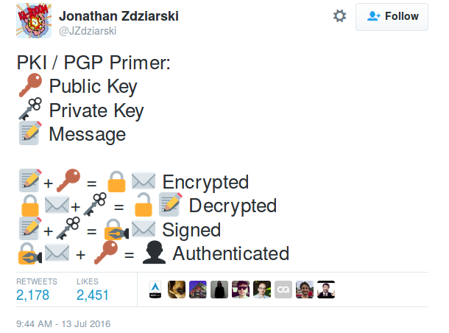
3. GPG/PGP Key Signing
A quick HOW TO

