Slide 1
What is static analysis?
Covers anything that looks at code without executing it
Less to be learned than with unit tests but much easier to implement
Why doesn't a bad script just fail to compile?

Slide 2
Why do static analysis?
Find certain classes of bugs
Good bang for buck
Enforce a coding standard in a team
Frequently incorporated in IDEs
Use with a build server for best results

Slide 3
Code style checking
Descriptive variable names
Small modular functions
Tabs vs spaces
Forbidden features (eval)
PEP8

Slide 4
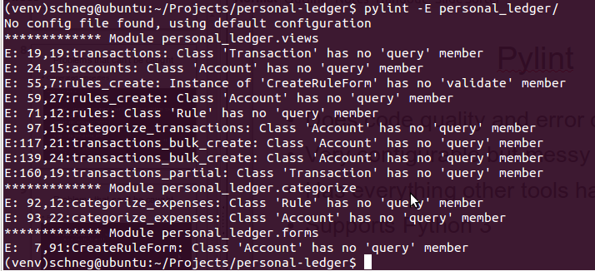
False positives

Slide 5
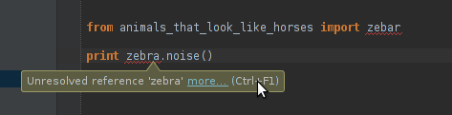
Problems that can be caught
Invalid imports

Slide 6
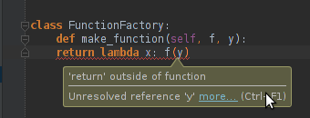
Problems that can be caught
Keywords where they don't belong

Slide 7
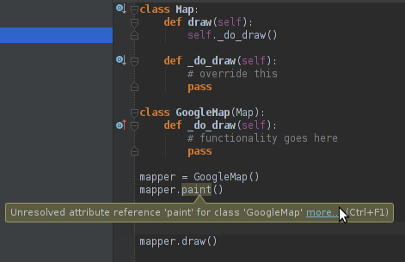
Problems that can be caught
Missing methods where types can be easily inferred

Slide 8
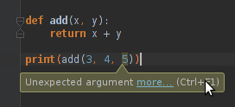
Problems that can be caught
Too many/few arguments

Slide 9
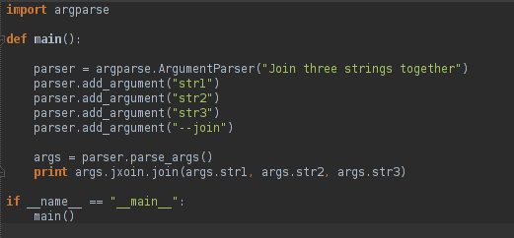
Problems that can't be caught
Generated properties

Slide 10
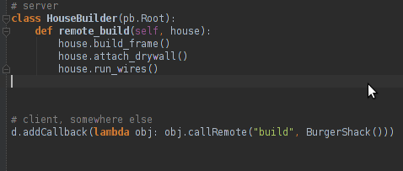
Problems that can't be caught
Remote IPC

Slide 11
Pylint
Does code quality and error checking
Very configurable but messy default values
Has everything other tools have
Supports Python 3

Slide 12
Pychecker
Looks for code smells and syntax errors
Less strict than Pylint
Imports modules to check them, which may produce unwanted side effects
Slow release cycle

Slide 13
Pyflakes
Checks for syntax errors
Lightweight
Fewer false positives than pylint

Slide 14
astroid (formerly libastng)
Syntax tree library used by pylint, pychecker
Adds type inference over default python AST
Write your own static analysis tool!

Slide 15
Related topics
Dead code removal
Complexity analysis
Refactoring tools
Cython
Duplicate code identification
Function annotations (Python 3)

