Slide 1

University of Massachusetts
Boston
Computer Graphics CS460
Professor : Daniel Haehn
December 09/2020
By: Anees
: Jesh Amera
: Thuc
https://www.umb.edu/creative_services/brand_manual/files

Slide 2
Shadow mapping in a 3D WebGL model

Slide 3
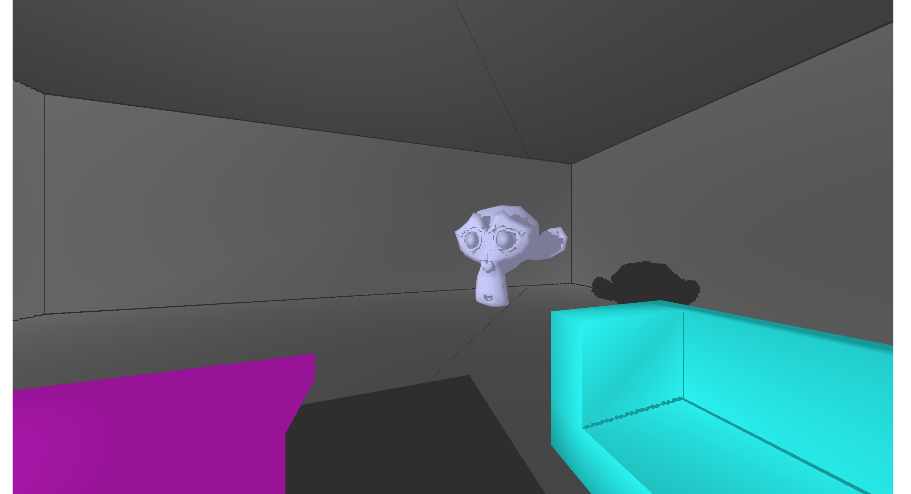

Slide 4
https://aneesurrehman001.github.io/cs460_final
Build in progress…

Slide 5

https://www.123rf.com/stock-photo/thank_you_button.html?sti=nzpkqn3px1e9s36l76|

