Slide 1





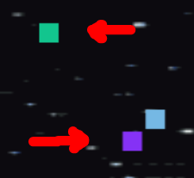

INSTRUCTION
Shoot laser beams
Use arrow button for moving
Get star to upgrade the laser
The meteors change direction!!!
Avoid colored obstacles (meteorites)
Press Enter for pause and get help!
➔ Enter again to continue!!!
GOOD LUCK!!!

