Slide 1
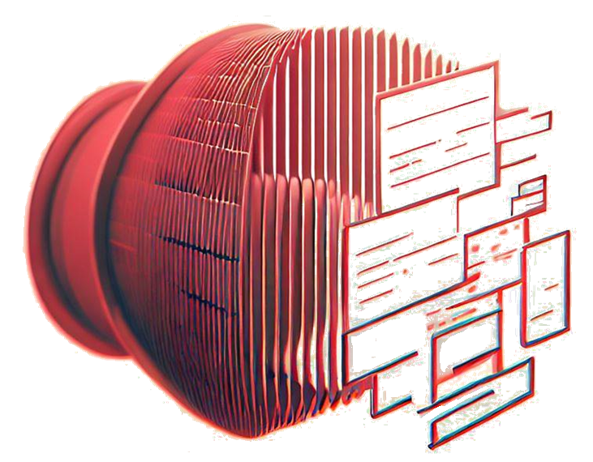







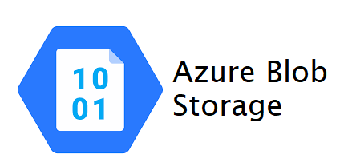

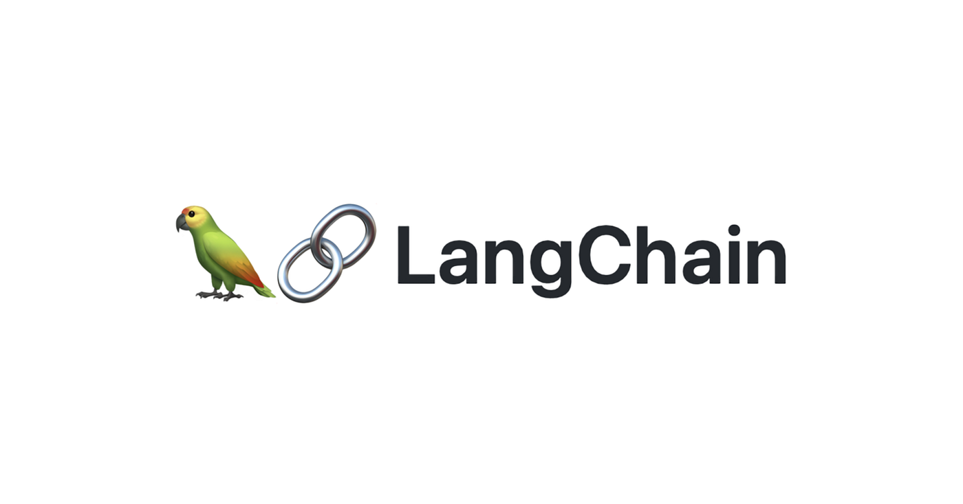
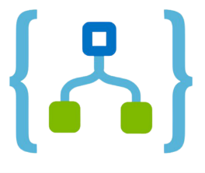


KITN
Know It Now
GPT Assisted Data Sourcing
VPN Restricted
OR
STORAGE
Every webapp is configured to one collection to restrict access
Sharepoint
Teams
5 Response is given
Web-app backend
LOGIC
Collection Name
1 Question is handed over for processing along with the collection restriction
4 The sources and question are provided to the AI model for summarising
New or removed PDF files trigger an Azure function
Azure Logic Apps
Every Sharepoint folder is linked to 1 Blob container
Removed/New files are removed or added to Azure Blob Storage
3 The transformed question is handed to the vectorstore which identies relevant documents.
The sources are than sent back to LangChain.
ChromaDB
Vectorstore
2 Question is transformed by the model to look for relevant documents in the vectorstore
Azure OpenAI
New or Removed files are added / removed from the index
GPT3.5 Turbo
Notes:
Add cloud indications → Show where the difference sits if you use/do not use cloud

