Slide 1

Bota Duisenbay
1849680
MSc AI and Robotics

Slide 2
Agenda
Dataset
Preprocessing
Feature extraction
Temporal info stream
Spatial info stream
Fusion strategy
Experimental results

Slide 3
Dataset
Datasets (EEG international 10 − 20 system):
Emotion Recognition (SEED)
three emotion classification tasks (positive, neutral, and negative)
15 subjects, 2 experiment runs, 15 sessions in each run
In each session four stages: 5 seconds notice before the movie starts, around 4 minutes of movie watching, 45 seconds of self-assessment, and 15 seconds of rest.
62 EEG channels were recorded at a sampling frequency of 1000Hz
Vigilance Estimation (SEED-VIG)
asked to drive the simulated car in virtual environment with eye-tracking glasses on (PERCLOS)
23 subjects, 2 hours duration of each experiment - 885 EEG trials
17 channels with frequency 1000HZ
EEG Motor Imagery Classification (BCICIV 2a and BCICIV 2b)

Slide 4
Dataset
Datasets (EEG international 10 − 20 system) used:
Emotion Recognition (SEED)
Vigilance Estimation (SEED-VIG)
EEG Motor Imagery Classification BCICIV 2a (four class)
classify 4 MI tasks (left hand, right hand, tongue, both feet)
9 subjects each 2 sessions: each session 72 trials for each class => 288 trials per session
Duration 7.5 sec: fixation, visual cue, MI period and rest. => we use [2.0 - 6.0 s]
22 EEG channels sampling frequency 250Hz
EEG Motor Imagery Classification BCICIV 2b (2 class)
classify 2 MI tasks (left hand or right hand)
9 subjects each 5 sessions: first 2 - 120 trials with feedback, last 3 - 160 trials without feedback
Duration 8 sec: fixation, visual cue, MI period and rest. => we use [3.4 - 7.4 s]
3 EEG channels sampling frequency 250Hz

Slide 5
2. Preprocessing
Conversion from .gdf -> .mat (BCICIV 2a/2b)
Downsampling: 1000Hz -> 200Hz (SEED/ SEED-VIG)
Cut relevant interval
Artifact removal:
Bandpass filter: 5th order Butterworth 0.5 - 70Hz (H subbands)
Power noise removal:
Notch filter at 50Hz
Normalization [-1,1]
Dataset | Range | H sub bands | Interval | T
Seed | 1 - 50 Hz | 5 |  | 8 s
Seed vig | 0.5 - 50 Hz | 25 |  | 8 s
Bciciv 2a | 0.5 - 50 Hz | 25 | 2.0 - 6.0 s | 4 s
Bciciv 2b | 0.5 - 50 Hz | 25 | 3.4 - 7.4 s | 4 s

Slide 6
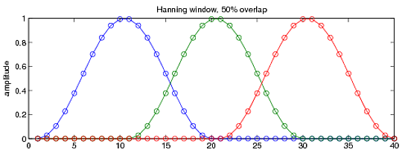
3. Feature Extraction
L 50% overlapping Hanning windows
Power Spectrum Density (PSD) and DE using periodogram method
reshape matrices to in form: (Trials, H, L, 2*H*N)
Dataset | Trials | H sub bands | T duration | L windows | N channels | Features No (2*H x N)
Seed | 248/170 | 5 | 8 s | 15 | 62 | 10x62
Seed vig | 885 | 25 | 8 s | 15 | 17 | 50x17
Bciciv 2a | 288 | 25 | 4 s | 7 | 22 | 50x22
Bciciv 2b | 400/320 | 25 | 4 s | 7 | 3 | 50x3

Slide 7
4. Temporal Information
K fold train data
reshape into 2d array and MinMax normalization [-1,1]
Train the model
Evaluate with accuracy and Cohen Kappa scores
Seed | LSTM 256 | BatchNorm LeakyReLu | LSTM 256 | BatchNorm LeakyReLu | LSTM 256 | BatchNorm LeakyReLu | FC 64 | CategoricalCrossentropy
Seed vig |  |  |  |  |  |  |  | MeanSquaredError
Bciciv 2a |  | Dropout 0.2 |  | Dropout 0.1 |  | Dropout 0.1 |  | CategoricalCrossentropy
Bciciv 2b |  | BatchNorm LeakyReLu |  | BatchNorm LeakyReLu |  | BatchNorm LeakyReLu |  | BinaryCrossentropy

Slide 8
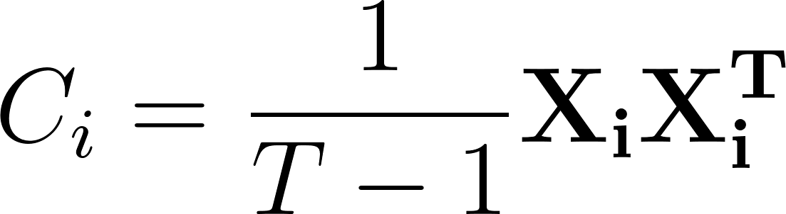

5. Spatial information
Spatial Covariance Matrices (SCMs) for each EEG X
Dimensionality Reduction using PCA
Affine-Invariant Distance (Riemannian distance between C)
Choice of Reference - approx Riemannian mean using GD to get C ref
Tangent Space Learning - mapping from Riemannian to Euclidean
Vectorization - Upper(S) and sqrt(2) on non diag s
2 FC (512, 64) with dropout (0.5)
Dataset | Sub bands H | Channels N | Best rank R | Features No HxRx(R+1)/2
Seed | 5 | 62 | 48 | 5x48x24
Seed vig | 25 | 17 | 11 | 25x11x6
Bciciv 2a | 25 | 22 | 18 | 25x18x9
Bciciv 2b | 25 | 3 | 3 | 25x3x2

Slide 9
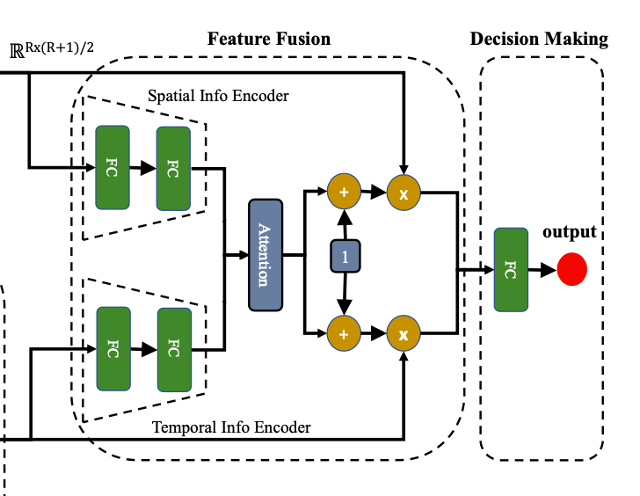
6. Fusion
Encoders to learn embedding specific features:
Spatial - 2 FC (32, 1)
Temporal - 2 FC(32, 1)
Soft attention to learn weight (alpha) for each embedding-specific feature
(1+alpha) new weighted embedding
Decision Making - FC (128)

Slide 10
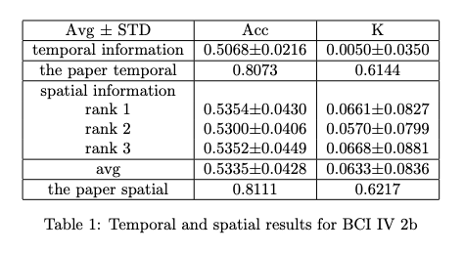
7. Results

Slide 11
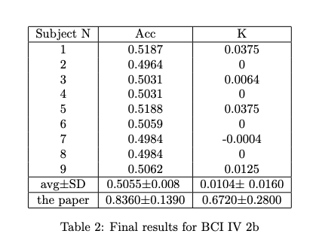
7. Results

