Slide 1
Sprint 1 – Capstone
Lending Club : Loans Data Analysis
- Vidya B

Slide 2

Introduction
396030
396030
Lending was the largest P2P lender in the world by 2015
Data from 2007 to 2018 with 27 cols and 396030 rows
Key Data – Loan Amount, Term, Int rate, Annual Income, Loan Status, purpose,

Slide 3
Null Values in Percentage
emp_title | 5.8
emp_length | 4.6
title | 0.4
revol_util | 0.1
mort_acc | 9.5
pub_rec_bankruptcies | 0.1

Slide 4
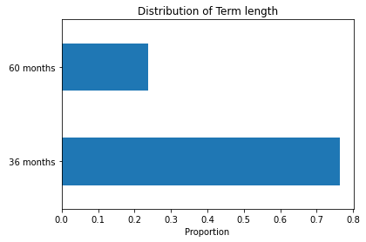
Distribution of loans by Term

Slide 5
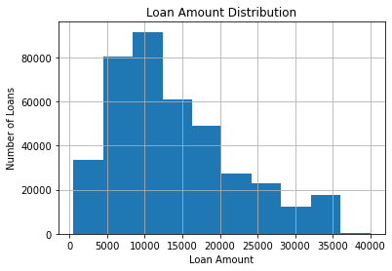
Distribution of loans by Loan Amount

Slide 6
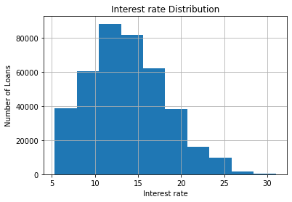
Distribution of Loans by Interest rate

Slide 7
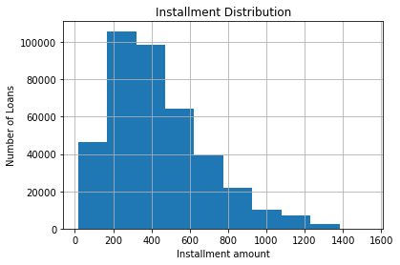
Distribution by Installment size

Slide 8
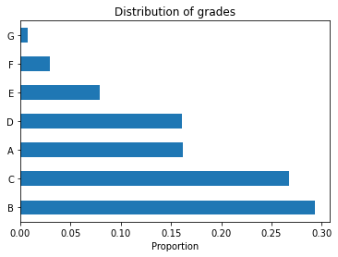
Normalized Comparison of grades in the dataset

Slide 9
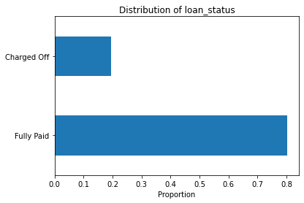
Comparison of loan status (normalized)

Slide 10
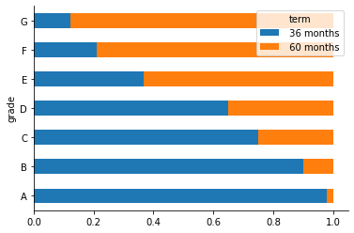
Relationship between Grades and Term

