Slide 1

Sprint 1 – Capstone
Lending Club : Loans Data Analysis
- Vidya B
BrainStation

Slide 2
Area of Capstone
Domain – Lending in Financial Services
Typical Business Problems:
Low throughput in approvals in a given time.
High Loan processing time
Inefficient Sourcing Strategies and
Segmenting customers

Slide 4
Solutions through Data Science
Identify patterns driving successful outcomes
Answer questions such as whether there is a statistical significance difference successful outcomes when the term of loan is 3 years or 5 years and when the interest rate is, for instance, 13% or 15%
Which features played a major role in successful outcomes and which features are irrelevant

Slide 5
Impact of Solutions
Employee Productivity
Risk Mitigation
Increase in Profitability

Slide 6

Dataset
Lending Club released loan performance data from 2007 to 2018
300k row and 27 columns
Key Data – Loan amount, interest rate, tenor, purpose of loan.

Slide 7
Null Values in Percentage
emp_title | 5.8
emp_length | 4.6
title | 0.4
revol_util | 0.1
mort_acc | 9.5
pub_rec_bankruptcies | 0.1

Slide 8
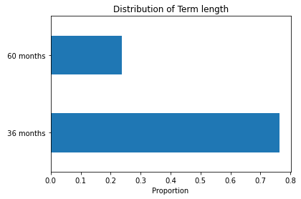
Distribution of loans by Term

Slide 9
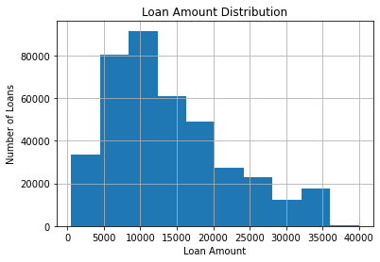
Distribution of loans by Loan Amount

Slide 10
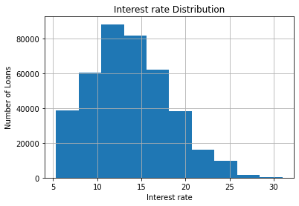
Distribution of Loans by Interest rate

Slide 11
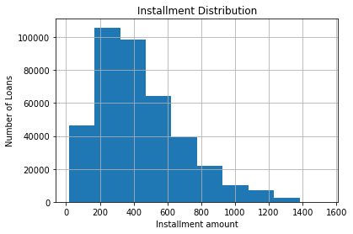
Distribution by Installment size

Slide 12
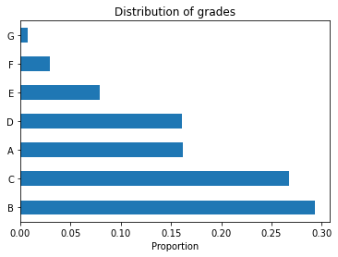
Normalized Comparison of grades in the dataset

Slide 13
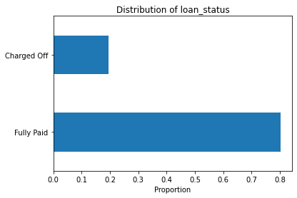
Comparison of loan status (normalized)

Slide 14
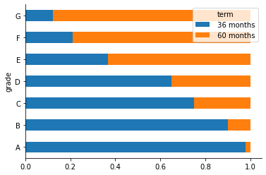
Relationship between Grades and Term

Slide 15
Next Steps
Handling the null values
Dropping more columns with very high categories
Encoding the categorical columns
Come up with questions for solving with Hypothesis testing
Baseline Modeling: Identify similar types of customers using KNN Algorithm

