Slide 1
From Urns to Coupons
“Coupon Collecting” is classic probability problem
  There exist N different types of coupons
  Each is collected with some probability p_{i} (1 ≤ i ≤ N)
Ask questions like:
  After you collect m coupons, what is probability you have k different kinds?
  What is probability that you have ≥ 1 of each N coupon types after you collect m coupons?
You’ve seen concept (in a more practical way)
  N coupon types = N buckets in hash table
  collecting a coupon = hashing a string to a bucket

Slide 2
Digging Deeper on Independence
Recall, two events E and F are called independent if
P(EF) = P(E) P(F)
If E and F are independent, does that tell us whether the following is true or not:
P(EF | G) = P(E | G) P(F | G),
where G is an arbitrary event?
In general, No!

Slide 3
Not-so Independent Dice
Roll two 6-sided dice, yielding values D₁ and D₂
  Let E be event: D₁ = 1
  Let F be event: D₂ = 6
  Let G be event: D₁ + D₂ = 7
E and F are independent
  P(E) = 1/6, P(F) = 1/6, P(EF) = 1/36
Now condition both E and F on G:
  P(E|G) = 1/6, P(F|G) = 1/6, P(EF|G) = 1/6
  P(EF|G) ≠ P(E|G) P(F|G) → E|G and F|G dependent
Independent events can become dependent by conditioning on additional information

Slide 4
Do CS Majors Get Fewer A’s?
Say you are in a dorm with 100 students
  20 of the students are CS majors: P(CS) = 0.2
  30 of the students get straight A’s: P(A) = 0.3
  6 students are CS majors who get straight A’s
    P(CS, A) = 0.06
    P(CS, A) = P(CS)P(A), so CS and A are independent
  At faculty night, only CS majors and A students show up
    So, 44 (= 20 + 30 – 6) students arrive
    Of 44 students, 30 get A’s ⇒ P(A | faculty night) = 30/44 ≈ 0.68
    But, P(A | faculty night, CS) = 6/20 = 0.3
    Appears that being CS major lowers probability of straight A’s
    But, weren’t they supposed to be independent?
  In fact, CS and A conditionally dependent at faculty night

Slide 5
Explaining Away
Say you have a lawn
  It gets watered by rain or sprinklers
  P(rain) and P(sprinklers were on) are independent
  Now, you come outside and see the grass is wet
    You know that the sprinklers were on
    Does that lower probability that rain was cause of wet grass?
  This phenomena is called “explaining away”
    One cause of an observation makes other causes less likely
  Only CS majors and A students come to faculty night
    Knowing you came because you’re a CS major makes it less likely you came because you get straight A’s

Slide 6
Conditioning Can Break Dependence
Consider a randomly chosen day of the week
  Let A be event: It is not Monday
  Let B be event: It is Saturday
  Let C be event: It is the weekend
A and B are dependent
  P(A) = 6/7, P(B) = 1/7, P(AB) = 1/7 ≠ (6/7)(1/7)
Now condition both A and B on C:
  P(A|C) = 1, P(B|C) = 1/2, P(AB|C) = 1/2
  P(AB|C) = P(A|C) P(B|C) → A|C and B|C independent
Dependent events can become independent by conditioning on additional information

Slide 7
Conditional Independence
Two events E and F are called conditionally independent given G, if
P(E F | G) = P(E | G) P(F | G)
Or, equivalently: P(E | F G) = P(E | G)
Exploiting conditional independence to generate fast probabilistic computations is one of the main contributions CS has made to probability theory
  Judea Pearl wins 2011 Turing Award
  “For fundamental contributions to artificial intelligence through the development of a calculus for probabilistic and causal reasoning”

Slide 8
Random Variable
A Random Variable is a real-valued function defined on a sample space
Example:
  3 fair coins are flipped.
  Y = number of “heads” on 3 coins
  Y is a random variable
  P(Y = 0) = 1/8 (T, T, T)
  P(Y = 1) = 3/8 (H, T, T), (T, H, T), (T, T, H)
  P(Y = 2) = 3/8 (H, H, T), (H, T, H), (T, H, H)
  P(Y = 3) = 1/8 (H, H, H)
  P(Y ≥ 4) = 0

Slide 9
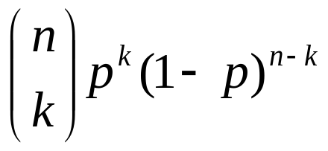
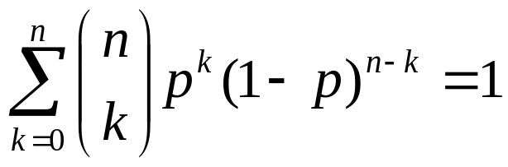
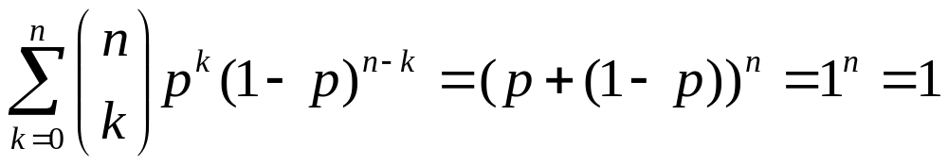
Binary Random Variables
A binary random variable is a random variable with 2 possible outcomes (e.g., coin flip)
  Now consider n coin flips, each which independently come up heads with probability p
  Y = number of “heads” on n flips
  P(Y = k) = , where k = 0, 1, 2, ..., n
  So,
  Proof:

Slide 10
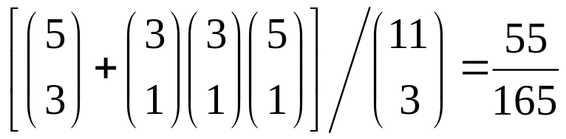
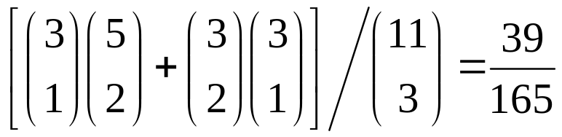
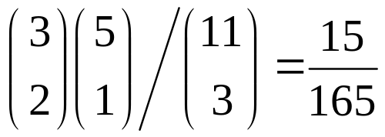
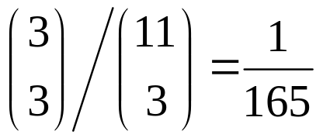
Simple Game
Urn has 11 balls (3 blue, 3 red, 5 black)
  3 balls drawn. +$1 for blue, -$1 for red, $0 for black
  Y = total winnings
  P(Y = 0) =
  P(Y = 1) = = P(Y = -1)
  P(Y = 2) = = P(Y = -2)
  P(Y = 3) = = P(Y = -3)

Slide 11

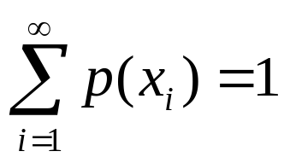
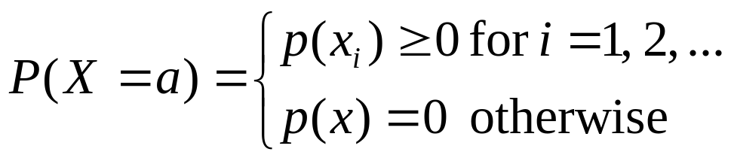
Probability Mass Functions
A random variable X is discrete if it has countably many values (e.g., x₁, x₂, x₃, ...)
Probability Mass Function (PMF) of a discrete random variable is:
Since , it follows that:
where X can assume values x₁, x₂, x₃, ...

Slide 12
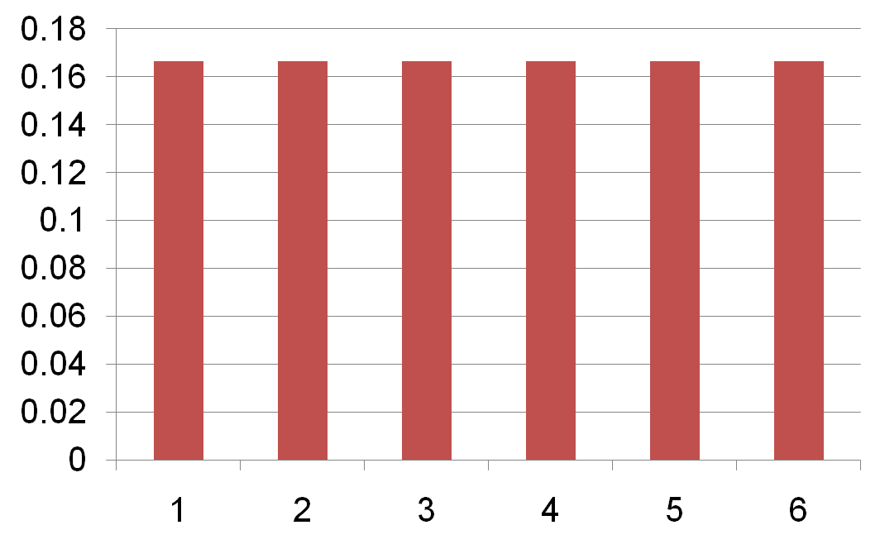
PMF For a Single 6-Sided Die
1/6
p(x)
X = outcome of roll

Slide 13
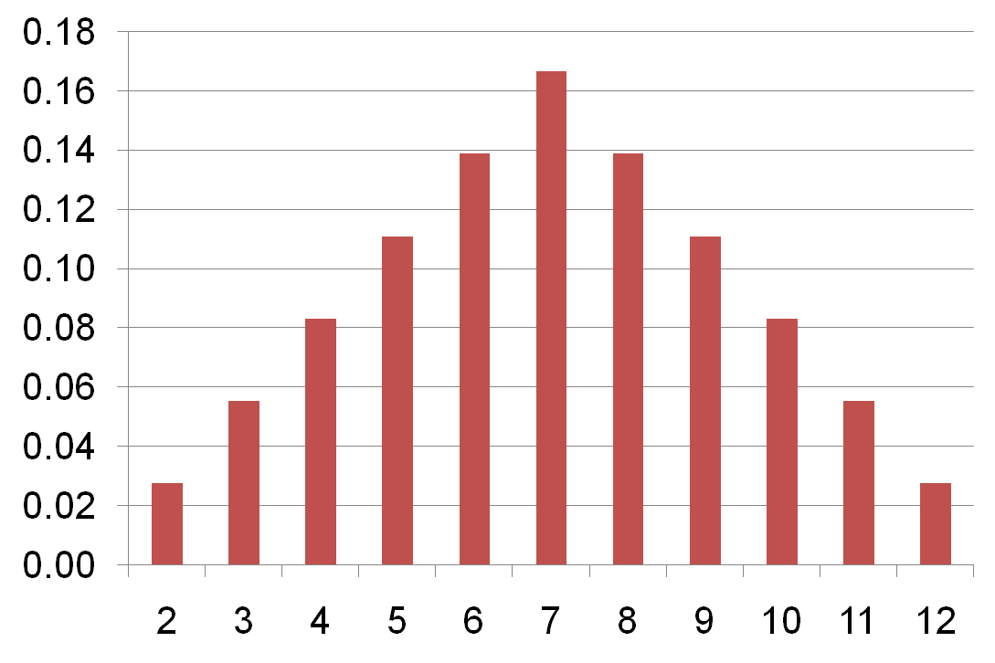
PMF For a Roll of Two 6-Sided Dice
6/36
5/36
4/36
p(x)
3/36
2/36
1/36
X = total rolled

Slide 14
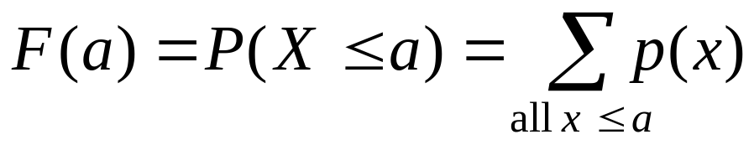
Cumulative Distribution Functions
For a random variable X, the Cumulative Distribution Function (CDF) is defined as:
The CDF of a discrete random variable is:

Slide 15
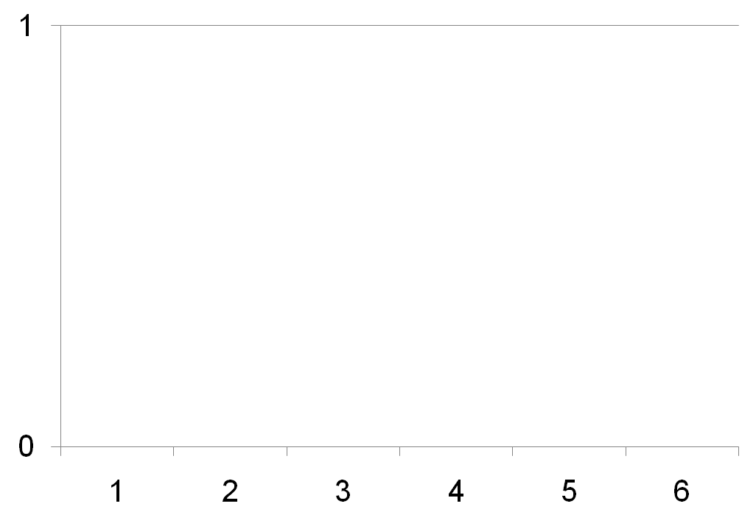
CDF For a Single 6-Sided Die
5/6
4/6
3/6
F(x)
2/6
1/6
X = outcome of roll

Slide 16
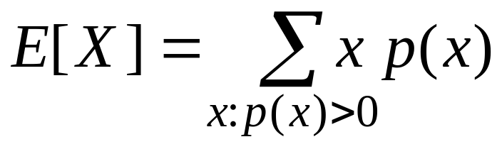
Expected Value
The Expected Values for a discrete random variable X is defined as:
Note: sum over all values of x that have p(x) > 0.
Expected value also called: Mean, Expectation, Weighted Average, Center of Mass, 1st Moment

Slide 17
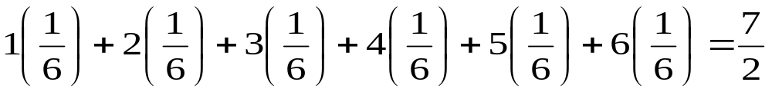
Expected Value Examples
Roll a 6-Sided Die. X is outcome of roll
  p(1) = p(2) = p(3) = p(4) = p(5) = p(6) = 1/6
E[X] =
Y is random variable
  P(Y = 1) = 1/3, P(Y = 2) = 1/6, P(Y = 3) = 1/2
E[Y] = 1 (1/3) + 2 (1/6) + 3 (1/2) = 13/6

Slide 18
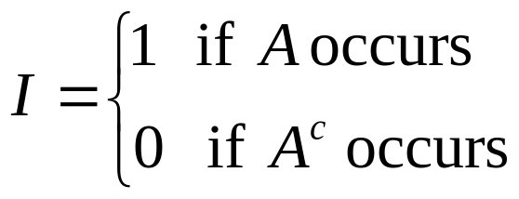
Indicator Variables
A variable I is called an indicator variable for event A if
What is E[I ]?
  p(I =1) = P(A), p(I = 0) = 1 – P(A)
  E[I ] = 1 P(A) + 0 (1 – P(A)) = P(A)
  We’ll use this property frequently!

Slide 19
Lying With Statistics
“There are three kinds of lies:
lies, damned lies, and statistics”
– Mark Twain
School has 3 classes with 5, 10 and 150 students
Randomly choose a class with equal probability
X = size of chosen class
What is E[X]?
  E[X] = 5 (1/3) + 10 (1/3) + 150 (1/3)
  = 165/3 = 55

Slide 20
Lying With Statistics
“There are three kinds of lies:
lies, damned lies, and statistics”
– Mark Twain
School has 3 classes with 5, 10 and 150 students
Randomly choose a student with equal probability
Y = size of class that student is in
What is E[Y]?
  E[Y] = 5 (5/165) + 10 (10/165) + 150 (150/165)
  = 22635/165 ≈ 137
Note: E[Y] is students’ perception of class size
  But E[X] is what is usually reported by schools!

Slide 21
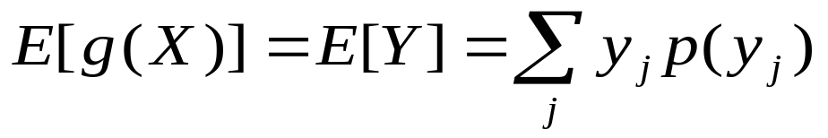
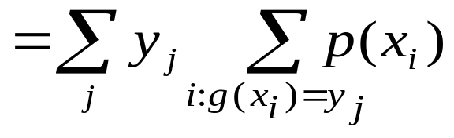
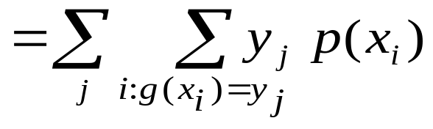
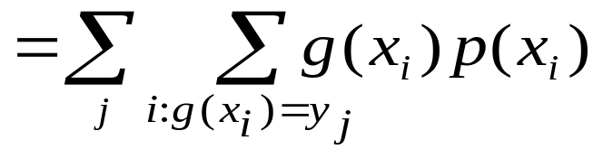
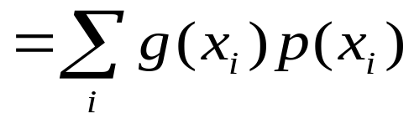
Expectation of a Random Variable
Let Y = g(X), where g is real-valued function

Slide 22
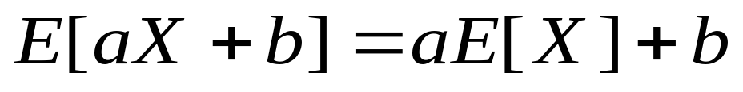
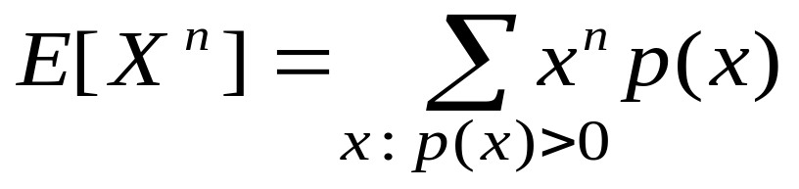
Other Properties of Expectations
Linearity:
  Consider X = 6-sided die roll, Y = 2X – 1.
  E[X] = 3.5 E[Y] = 6
N-th Moment of X:
  We’ll see the 2nd moment soon...

