Slide 1
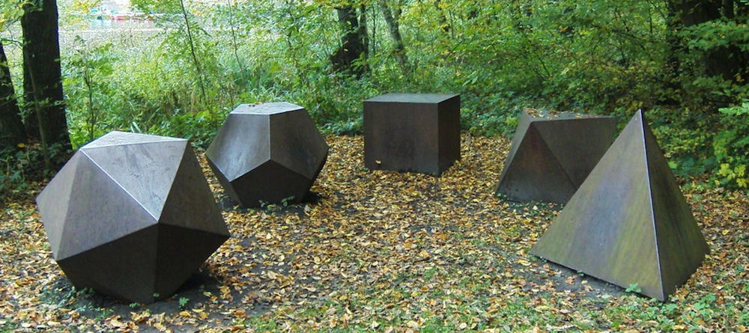
Combinatorics
CS 109
Lecture 2
March 30th, 2016

Slide 2
Today’s Topics
Last time:
Syllabus
Sum Rule of Counting (for non-overlapping spaces)
Inclusion-Exclusion principle (for overlapping spaces)
Product Rule of Counting (for multi-part experiments)
Pigeon Hole Principle
TODAY: Counting, continued:
Combinations
Permutations
Next lecture:
Axioms of Probability
Sample Spaces

Slide 3
Review: Counting Rules
Definition: Sum Rule of Counting
if outcome of experiment can be from
set A, where |A| = m, or
set B, where and |B| = n, and
A ∩ B = ∅, // this line here is the kicker
then the number of outcomes of the experiment is |A| + |B| = m + n.
Definition: Inclusion-Exclusion Principle
if outcome of experiment can be from
set A or set B,
where A and B may overlap, //Accounts for “kicker” restriction of Sum Rule
then the number of outcomes is: |A ∪ B| = |A| + |B| - |A ∩ B|
Definition: Product Rule of Counting:
if an experiment has two parts,
outcome from set A in 1st part, where |A| = m, and
outcome from set B in 2nd part (regardless of the first part), where |B| = n,
then the total number of outcomes is |A| |B| = mn.

Slide 4
Counting: Permutations
Ordered Sequences

Slide 5
Binary Search Tree
A binary search tree (BST), is a binary tree where for every node n in the tree:
n's value is greater than all the values in its left subtree.
n's value is less than all the values in its right subtree.
both n's left and right subtrees are binary search trees.
2
1
4
3
5

Slide 6
Binary Search Tree
Problem: How many possible BSTs containing values 1, 2, and 3 have degenerate structure (i.e., each node in the BST has at most one child)?
Solution: 3! ways to order 1, 2, and 3 for insertion
1, 2, 3 1, 3, 2 2, 1, 3 2, 3, 1 3, 1, 2 3, 2, 1
There are 4 degenerate BSTs possible.
1
1
2
2
3
3
2
3
1
3
1
3
1
2
3
2
2
1

Slide 7
Generalizing the BST example
Example says:
with 3 nodes,
there are 3! permutations of key insertion order, and, of those
4 are degenerate trees
Can we make a general solution?
with n nodes,
there are n! permutations of key insertion order, and, of those
____ are degenerate trees

Slide 9
Counting: Combinations
Unordered Subset Collections

Slide 10
Recursive Code for Combinations
I know what you’re thinking right now: “I so miss writing recursive functions right now!”
It’s your lucky day!

Slide 11
Recursive definition of
Let’s write a function C(n, k)
The number of ways to select k objects from a set of n objects.

Slide 12
C(n,k)

Slide 13
C(n,k)
Select any one of the n points in the group

Slide 14
C(n,k)
Separate this point from the rest

Slide 15
C(n,4)
Let’s consider specific problem C(n, 4)

Slide 16
C(n,4)
This point can be included in the 4 points we choose

Slide 17
C(n,4)
Or, it can be excluded from the 4 points we choose

Slide 18
C(n,k)
Total number of solutions is
number of solutions including
+
number of solutions not including

Slide 19
C(n,k)
1
n - 1
Total number of solutions is
number of solutions including
+
number of solutions not including

Slide 20
C(n,k)
1
n - 1
number of solutions including
C(n-1, k-1)

Slide 21
C(n,k)
1
n - 1
number of solutions including
C(n-1, k-1)
number of solutions not including
C(n-1, k)

Slide 22
C(n,k)
1
n - 1
Total number of solutions is
C(n-1, k-1) + C(n-1, k)

Slide 23
C(n,k)
1
n - 1
int C(int n, int k)
{
if (k == 0 || n == k) return (1);
return (C(n-1, k-1) + C(n-1, k));
}

Slide 25


Slide 26
Combinations example:
Nick Fury is going to make another movie, but he only has enough budget for 4 superheros of these 6:
Iron Man
Hulk
Ant-man
Captain America
Thor
Wonderwoman
How many ways can we make the new Avengers team?
We’ve got 6 things, and we want to choose 4 of them (or, remember, we could equivalently say we want to choose 2 of them), “6 choose 4” = = 15

Slide 27
Combinations example: Warm-up
Nick Fury is going to make another movie, but he only has enough budget for 4 superheros of these 6:
Iron Man, Hulk, Ant-man, Captain America, Thor, Wonderwoman
Except we can’t pick both Iron Man and Thor, because they fight. Now how many?
We need to analyze cases and use the Sum Rule of Counting. Which cases should we analyze?
4 cases: we include Iron Man, we don’t include Iron Man, we include Thor, we don’t include Thor
3 cases: we include neither Iron Man nor Thor, we include Iron man and not Thor, we include Thor and not Iron man
2 cases: we include Iron Man and Thor, we don’t include Iron Man or Thor
Other/none/more than one

Slide 28
Combinations example: Warm-up
Nick Fury is going to make another movie, but he only has enough budget for 4 superheros of these 6:
Iron Man, Hulk, Ant-man, Captain America, Thor, Spiderman
Except we can’t pick both Iron Man and Thor, because they fight. Now how many?
We need to analyze cases and use the Sum Rule of Counting. Which cases should we analyze?

Slide 29
